Slide 1
Basic CUDA Programming
Computer Architecture 2025 (Prof. Chih-Wei Liu)
CUDA Tutorial

Slide 2
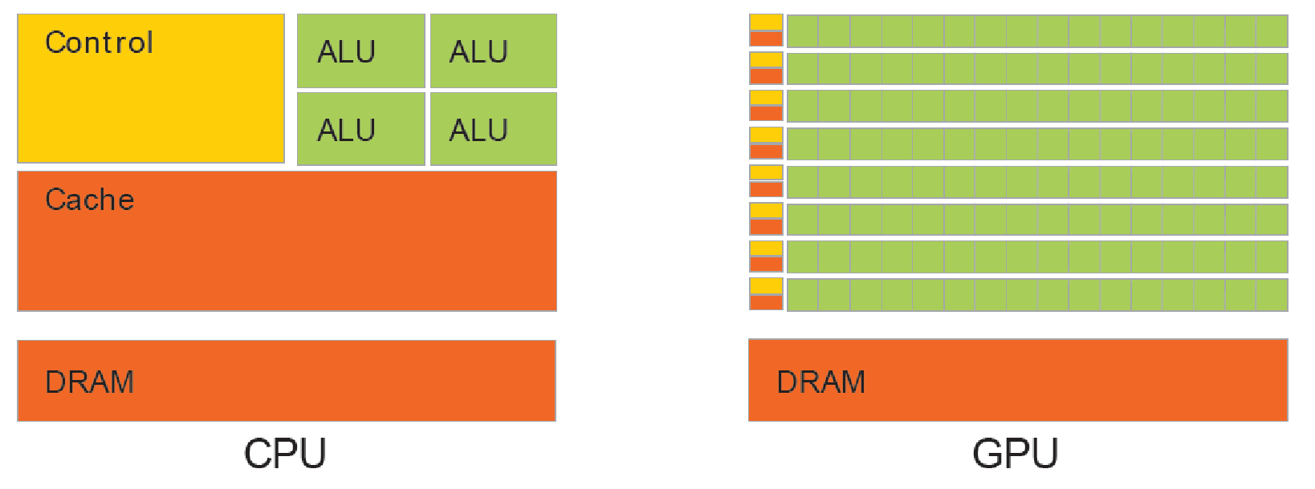
From Graphics to General Purpose Processing – CPU vs GPU
CPU：general purpose computation (SISD)
GPU：data-parallel computation (SIMD)

Slide 3
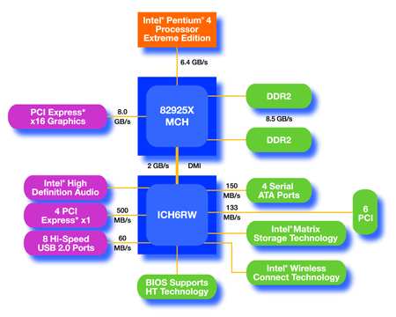
Heterogeneous computing:
CPU+GPU Cooperation
Host-Device Architecture：
CPU
(host)
GPU w/
local DRAM
(device)

Slide 4
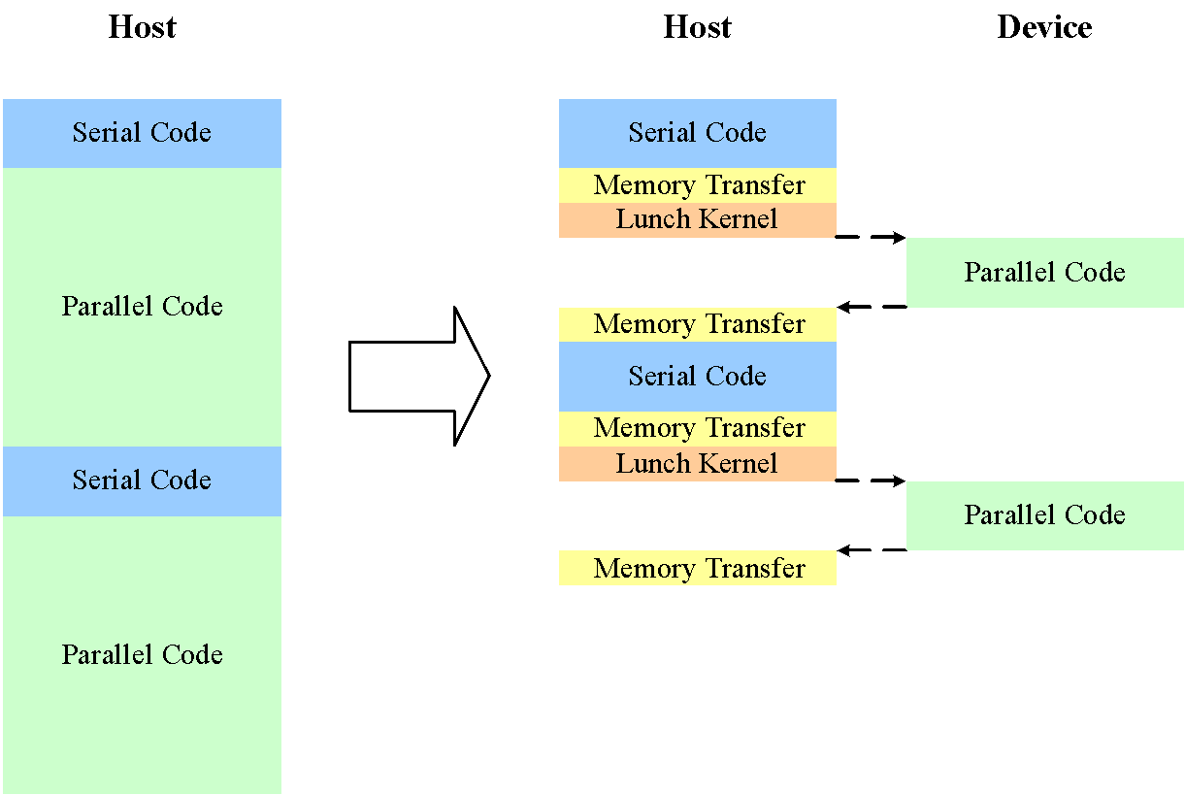
Heterogeneous computing:
CUDA Code Execution

Slide 5
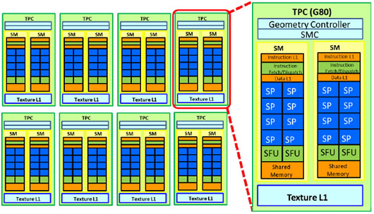
Heterogeneous computing:
NIVIDA G80 series
Streaming Multiprocessor (SM)
  Streaming Processor (SP) / CUDA core
  Shared memory
For NV GTX 1080, the number of SPs is 2560.

Slide 6
CUDA Programming Model (1/7)
Define
  Programming model
  Memory model
Help developers map the applications or algorithms onto CUDA devices more easily and clearly.
It is important to follow CUDA’s programming model to obtain higher performance of program execution.

Slide 7
CUDA Programming Model (2/7)
C/C++ for CUDA
  Subset of C with extensions
  C++ templates for GPU code
  CUDA goals:
    Scale code to 100s of cores and 1000s of parallel threads.
    Facilitate heterogeneous computing: CPU + GPU

Slide 8
CUDA Programming Model (3/7)
CUDA Kernels and Threads：
  Parallel portions of an application executed on the device are kernels. And only one kernel is executed at a time.
  All the threads execute the same kernel at a time.

Slide 9
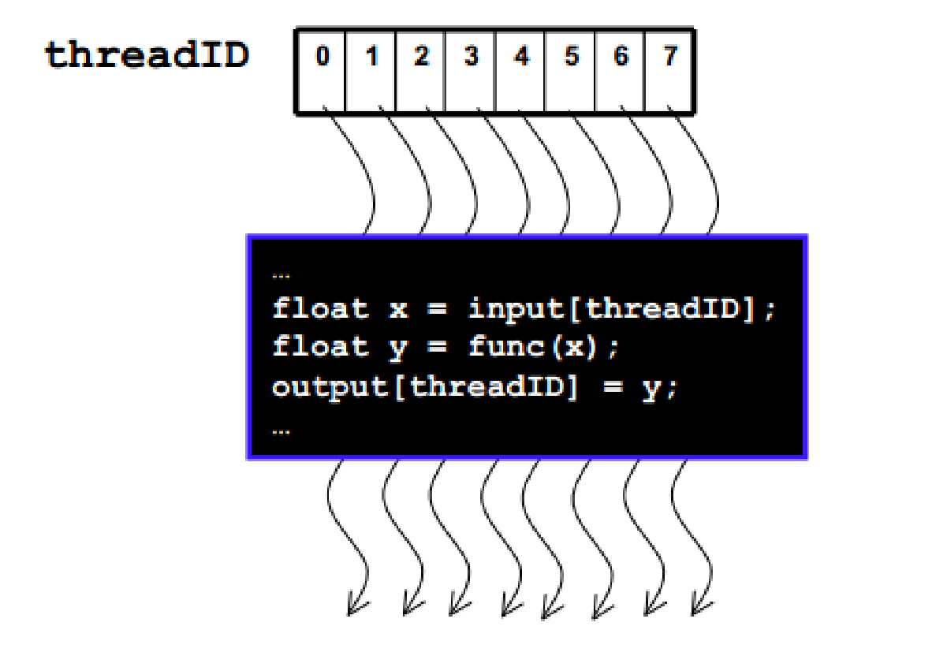
CUDA Programming Model (4/7)
Arrays of Parallel Threads：
A CUDA kernel is executed by an array of threads
  Each thread has an ID that it uses to compute memory addresses and make control decisions

Slide 10
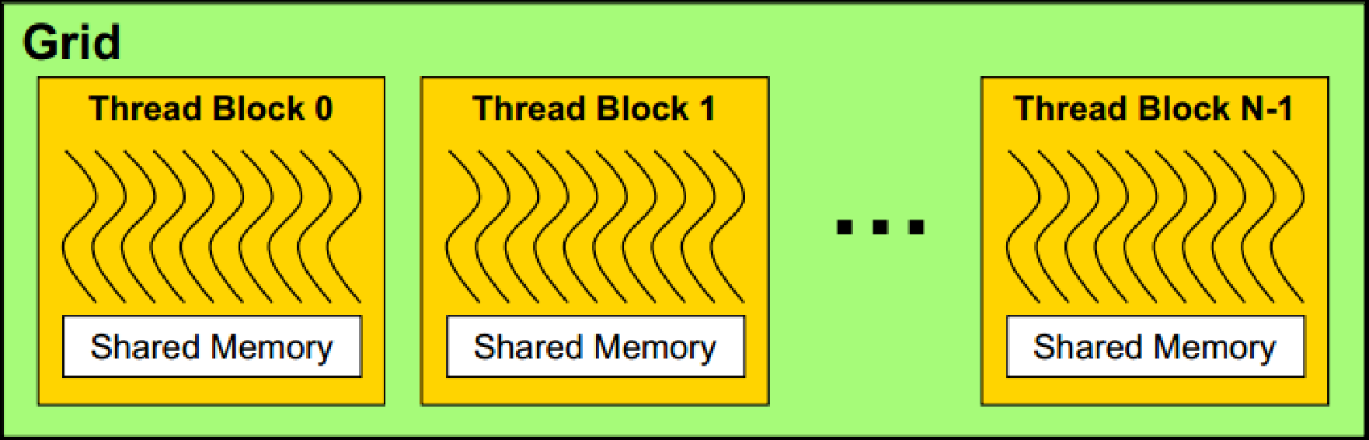
CUDA Programming Model (5/7)
Thread Batching：
Kernel launches a grid of thread blocks
  Threads within a block cooperate via shared memory
  Threads in different blocks cannot cooperate

Slide 11
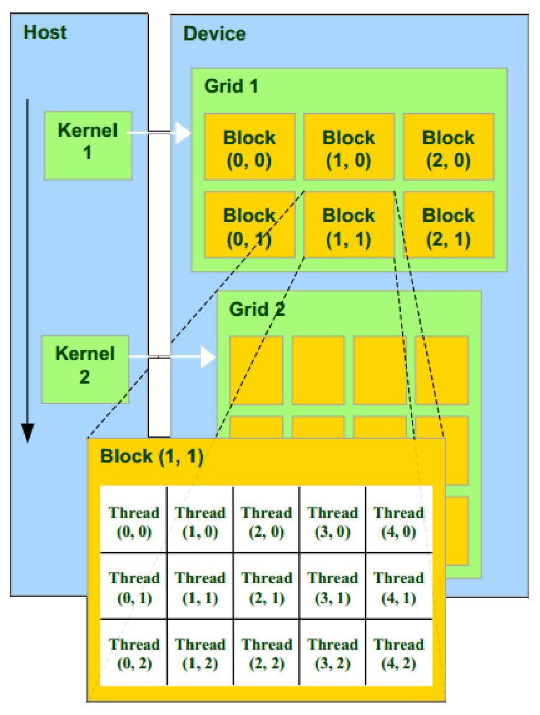
CUDA Programming Model (6/7)
CUDA Programming Model：
A kernel is executed by a grid of thread blocks
  Block can be 1D or 2D or 3D.
A thread block is a batch of threads
  Thread can be 1D or 2D or 3D.
  Data can be shared through shared memory
  Execution synchronization
  But threads from different blocks can’t cooperate.

Slide 12
CUDA Programming Model (7/7)
Memory Model：
Registers
  Per thread
  Data lifetime = thread lifetime
Shared memory
  Per thread block on-chip memory
  Data lifetime = block lifetime
Local memory
  Per thread off-chip memory (physically in device DRAM)
  Data lifetime = thread lifetime
Global (device) memory
  Accessible by all threads as well as host (CPU)
  Data lifetime = from allocation to deallocation
Host (CPU) memory
  Not directly accessible by CUDA threads

Slide 13
Heterogeneous computing:
NVIDIA CUDA Compiler (NVCC)
NVCC separates CPU and GPU source code into two parts.
  For host codes, NVCC invokes typical C compiler like GCC, Intel C compiler, or MS C compiler.
  All the device codes are compiled by NVCC.
    The extension of device source files should be “.cu”.
All executable with CUDA code requires：
  CUDA core library (cuda)
  CUDA runtime library (cudart)

Slide 14
CUDA C/C++ Basic

Slide 15
GPU Memory Allocation/Release
Memory allocation on GPU
  cudaMalloc(void **pointer, size_t nbytes)
Preset value for specific memory area
  cudaMemset(void *pointer, int value, size_t count)
Release memory allocation
  cudaFree(void *pointer)
int n = 1024;
int nbytes = 1024*sizeof(int);
int *d_a = 0;
cudaMalloc( (void**)&d_a, nbytes );
cudaMemset( d_a, 0, nbytes);
cudaFree(d_a);

Slide 16
Data Copies
cudaMemcpy(void *dst, void *src, size_t nbytes, enum cudaMemcpyKind direction);
  direction specifies locations (host or device) of src and dst
  Blocks CPU thread: returns after the copy is complete
  Doesn’t start copying until previous CUDA calls complete
enum cudaMemcpyKind
  cudaMemcpyHostToDevice
  cudaMemcpyDeviceToHost
  cudaMemcpyDeviceToDevice

Slide 17
Function Qualifiers
__global__ : invoked from within host (CPU) code, also called ‘kernel’
__device__ : called from other GPU functions, cannot be called from host (CPU) code
__host__ : can only be executed by CPU, called from host

Slide 18
Variable Qualifiers (GPU code)
__device__
  Stored in device memory (large capacity, high latency, uncached)
  Allocated with cudaMalloc (__device__ qualifier implied)
  Accessible by all threads
  Lifetime: application
__shared__
  Stored in on-chip shared memory (SRAM, low latency)
  Allocated by execution configuration or at compile time
  Accessible by all threads in the same thread block
  Lifetime: duration of thread block

Slide 19
CUDA Built-in Device Variables
All __global__ and __device__ functions have access to these automatically defined variables
dim3 gridDim;
  Dimensions of the grid in blocks
dim3 blockIdx;
  Block index within the grid
dim3 blockDim;
  Dimensions of the block in threads
dim3 threadIdx;
  Thread index within the block

Slide 20
Launching Kernels
kernel<<<dim3 grid, dim3 block>>>(…);
dim3 grid(16,16);
dim3 block(16,16);
kernel1<<<grid, block>>>(…);
kernel2<<<32, 512>>>(…);

Slide 21
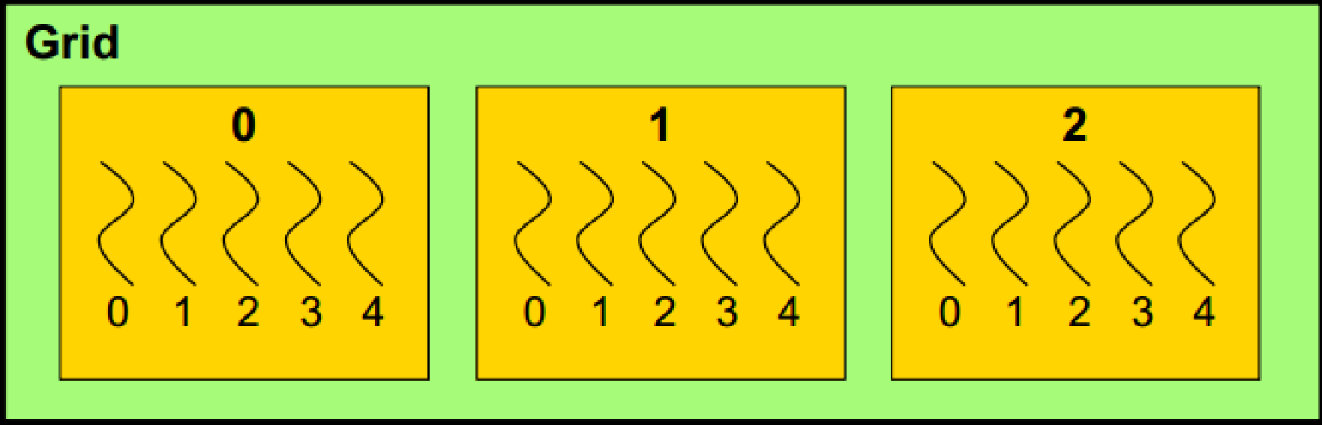
Data Decomposition
Often want each thread in kernel to access a different element of an array.
blockIdx.x
blockDim.x = 5
threadIdx.x
0 1 2 3 4 5 6 7 8 9 10 11 12 13 14
idx = blockIdx.x*blockDim.x + threadIdx.x

Slide 22
Data Decomposition Example:
Increment Array Elements (1) (1/4)
EXAMPLE-1
Number of threads ≥ N
Increment N-element vector a by scalar b
  Each thread only executes ONCE
CPU program
void increment_cpu(int a[], int b, int N)
{
for(int idx=0;idx<N;idx++)
a[idx]=a[idx]+b;
}
void main()
{
…
increment_cpu(a,b,N);
}
CUDA program
__global__ void increment_gpu(int a[], int b, int N)
{
int idx = blockIdx.x*blockDim.x+threadIdx.x;
if(idx<N)
a[idx]=a[idx]+b;
}
void main()
{
…
dim3 dimBlock(BlockSize);
dim3 dimGrid(ThreadNum);
increment_gpu<<<dimGrid,dimBlock>>>(d_a,b,N);
}
main_gpu_1.cu

Slide 23
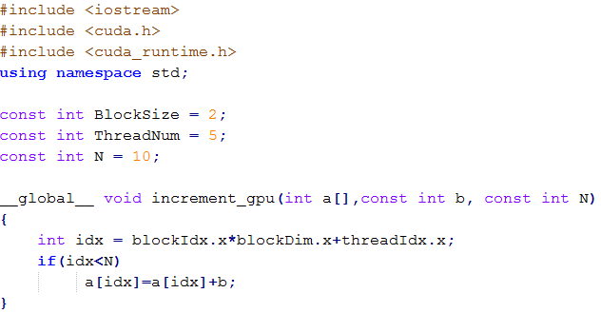
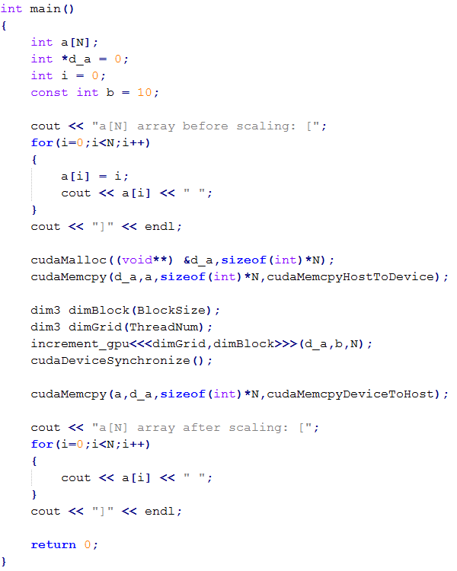
Data Decomposition Example:
Increment Array Elements (1) (2/4)
EXAMPLE-1
Number of threads ≥ N
Increment N-element vector a by scalar b
  Each thread only executes ONCE
Pointer referred to device memory space
Allocate an integer array on device’s memory
Copy the ‘a’ array’s value to ‘d_a’ (on the device)
main_gpu_1.cu

Slide 24
Data Decomposition Example:
Increment Array Elements (1) (3/4)
EXAMPLE-1
Number of threads ≥ N
Increment N-element vector a by scalar b
  Each thread only executes ONCE
Invoke CUDA kernel function
Make sure all the tasks are finished
Retrieve the results from device.
main_gpu_1.cu

Slide 25
Data Decomposition Example:
Increment Array Elements (1) (4/4)
EXAMPLE-1
Number of threads ≥ N
N = 10
BlockSize = 2
ThreadNum = 5
total tasks
total threads = 2*5
a[0] | a[1] | a[2] | a[3] | a[4] | a[5] | a[6] | a[7] | a[8] | a[9]
(0,0) | (0,1) | (0,2) | (0,3) | (0,4) | (1,0) | (1,1) | (1,2) | (1,3) | (1,4)
#1
(blockIdx.x , threadIdx.x)

Slide 26
Data Decomposition Example:
Increment Array Elements (2) (1/3)
EXAMPLE-1
Number of threads < N
N = 10
BlockSize = 1
ThreadNum = 5
total tasks
total threads = 1*5
a[0] | a[1] | a[2] | a[3] | a[4] | a[5] | a[6] | a[7] | a[8] | a[9]
(0,0) |  | (0,1) |  | (0,2) |  | (0,3) |  | (0,4)
 | (0,0) |  | (0,1) |  | (0,2) |  | (0,3) |  | (0,4)
#1
#2
stripe size
(blockIdx.x , threadIdx.x)

Slide 27
Data Decomposition Example:
Increment Array Elements (2) (2/3)
EXAMPLE-1
Number of threads < N
Increment N-element vector a by scalar b
CPU program
void increment_cpu(float *a, float *b, int N)
{
for(int idx=0;idx<N;idx++)
a[idx]=a[idx]+b;
}
void main()
{
…
increment_cpu(a,b,N);
}
CUDA program
__global__ void increment_gpu(float *a, float *b, int N)
{
int TotalThread = gridDim.x*blockDim.x;
int stripe = N / TotalThread;
int head = (blockIdx.x*blockDim.x + threadIdx.x)*stripe;
for(int i = head;i<(head+stripe);i++)
a[i]=a[i]+b;
}
void main()
{
…
dim3 dimBlock(blocksize);
dim3 dimGrid(ceil(N/(float)blocksize));
increment_gpu<<<dimGrid,dimBlock>>>(a,b,N);
}
main_gpu_2.cu

Slide 28
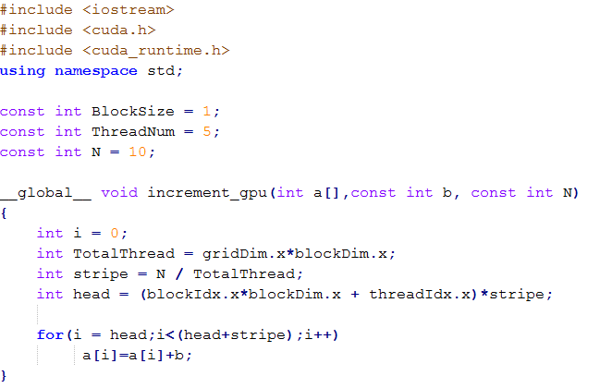
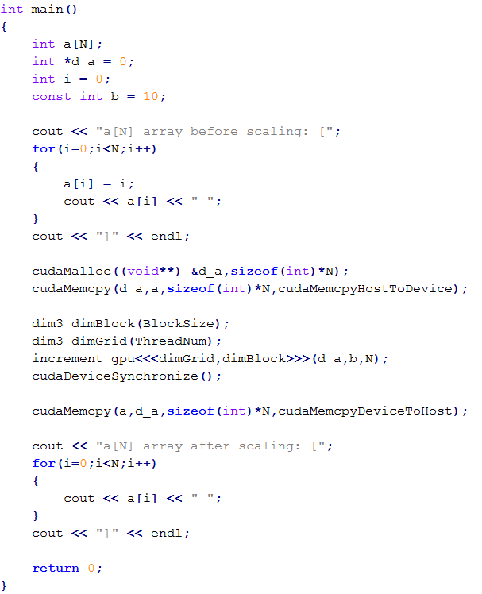
Data Decomposition Example:
Increment Array Elements (2) (3/3)
EXAMPLE-1
Number of threads < N
Increment N-element vector a by scalar b
main_gpu_2.cu

Slide 29
Reference
NVIDIA CUDA Toolkit Documentations (http://docs.nvidia.com/cuda/)
Recommended learning materials
  CUDA Programming C/C++ basic (https://www.youtube.com/watch?v=kyL2rj_Se3M )

