Slide 1
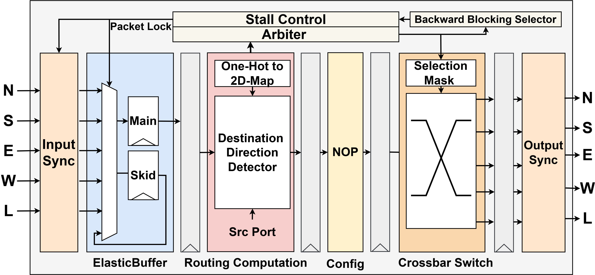
Function Block | Sync In | EB | RC | Arbiter | XB | Sync Out
Delay (ns) | 0.45 | 0.44 | 0.30 | 0.23 | 0.23 | 0.45

