Slide 1
Expedition: Beyond Tutorial
This walk-through requires no components and introduces you to the game mechanics as they would be encountered in an actual game. The rule book goes into full details and is a bit more particular with naming conventions and specific details on different components.
Overview of Steps
create a character (and then two more!)
select a quest and starting location
organize the cards for the journey
purchase some goods for the adventure
go!

Slide 2
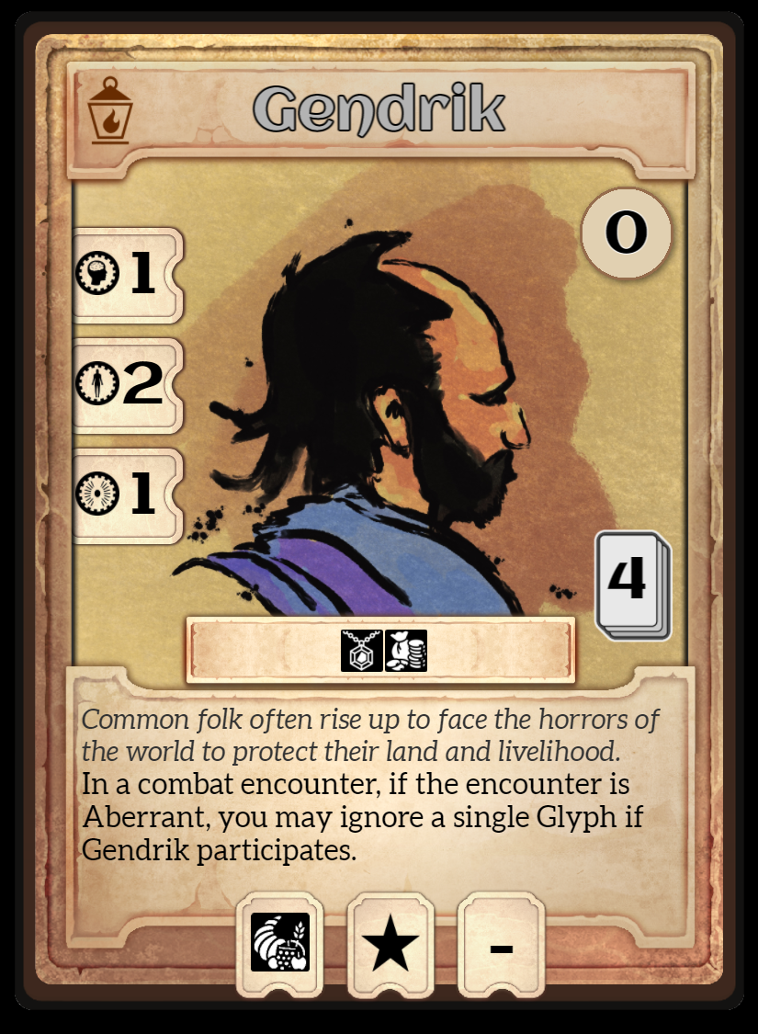
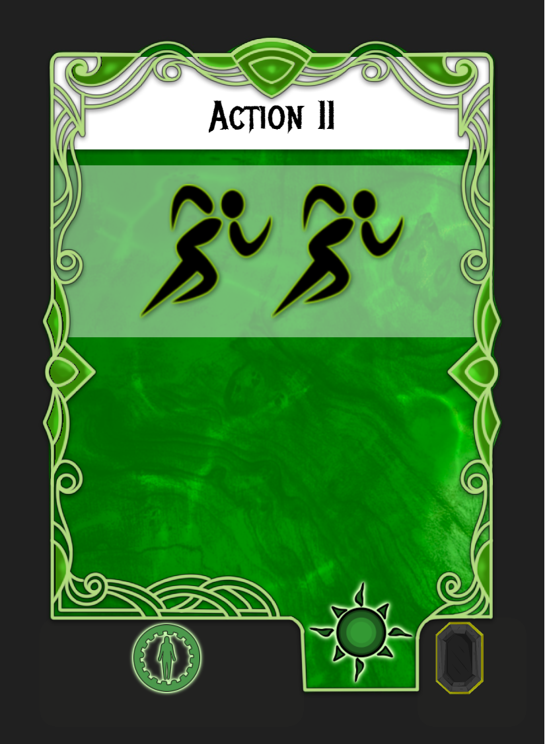
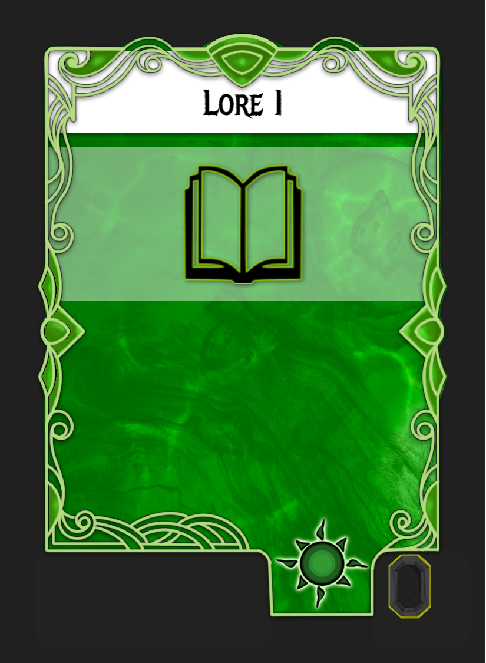
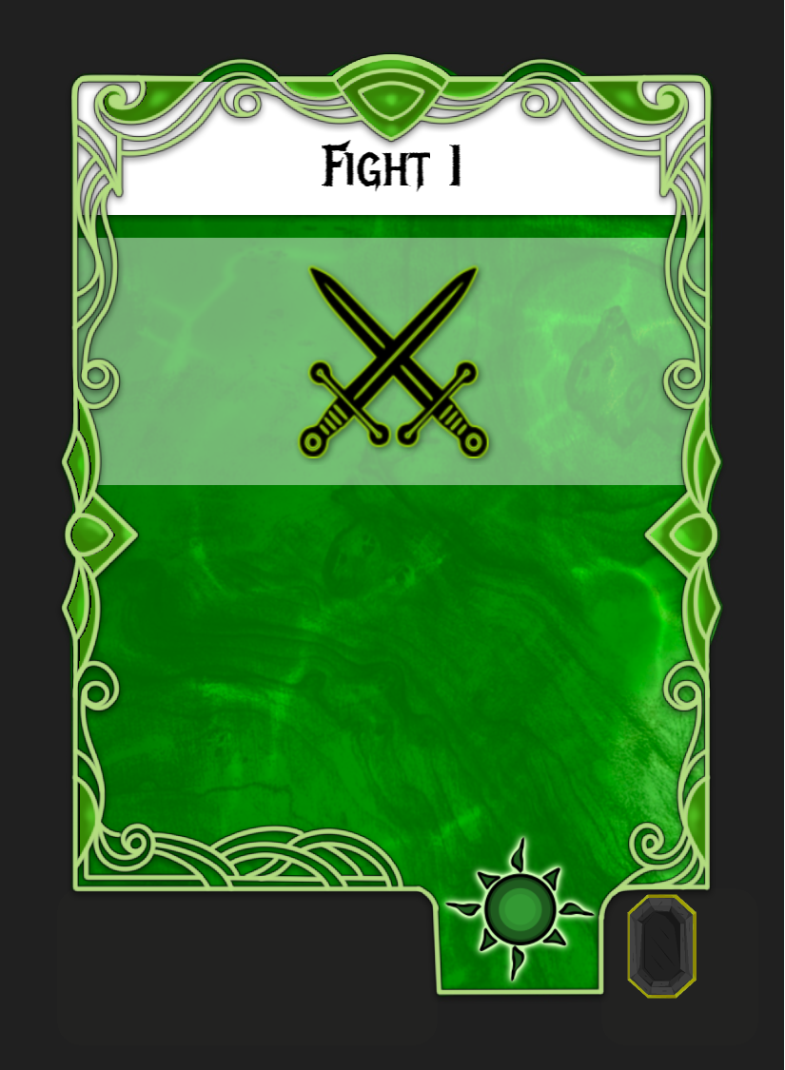
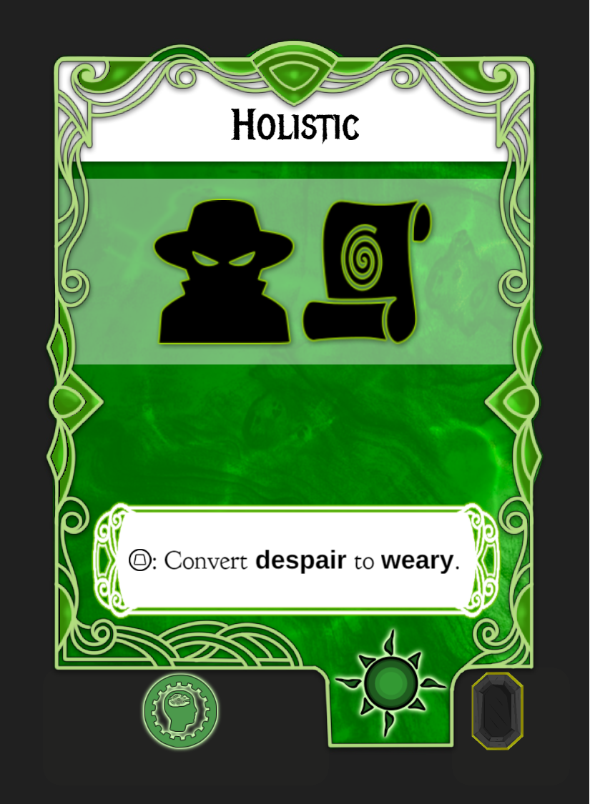
Character Creation
The characters we’ll use for this little adventure will be the three very low level characters to help amplify the rules and keep the adventure short.
Let’s start Gendrik first! The attributes on the right are his mind, body and spirit. These are important when recovering used cards.
He can hold 4 Play Cards, upgrading his level (he is currently level 0) will cost a gem and a bag of coins.
He’s got some text down there that will come into play later and some weird icons on the bottom.
These icons are Tokens that he can hold. He can hold 2 tokens, one of which can only be a food-type token, and the other can be any. The dash indicates he can’t hold a third Token.
This is what we selected for Gendrik’s Play Cards: Action II, Lore I, Fight I and Holistic. The icons shown on these cards are called Glyphs, and are how you avoid taking damage in encounters.
These Play Cards are called Aspects. Aspects show a sun in the lower right and represent the character’s core skills.

Slide 3
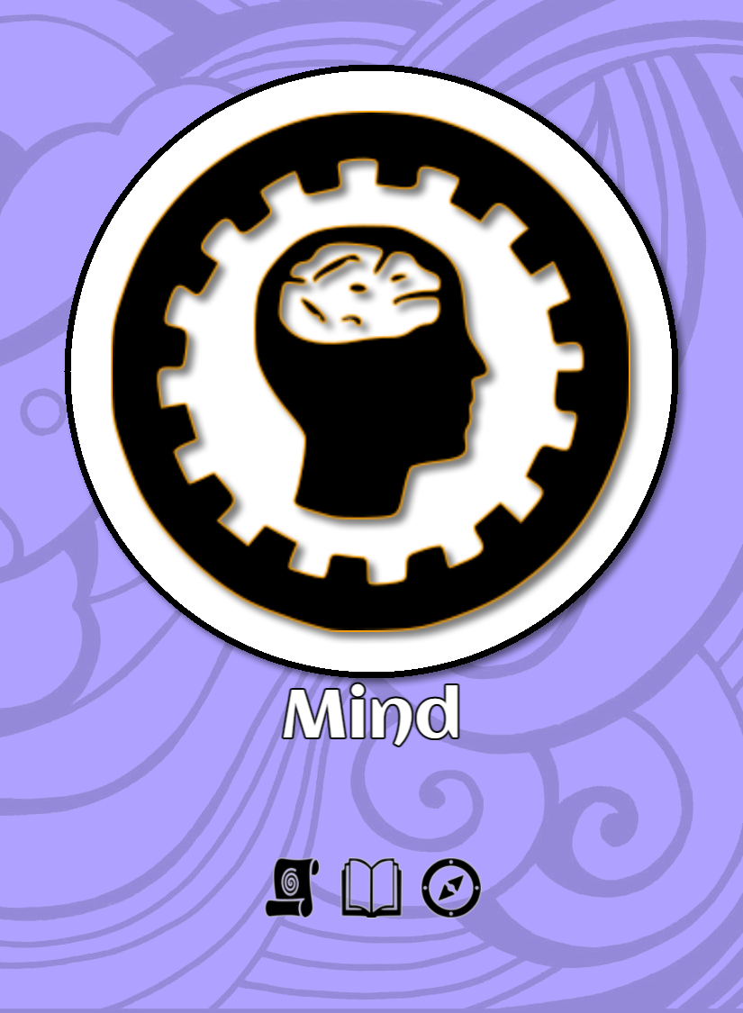
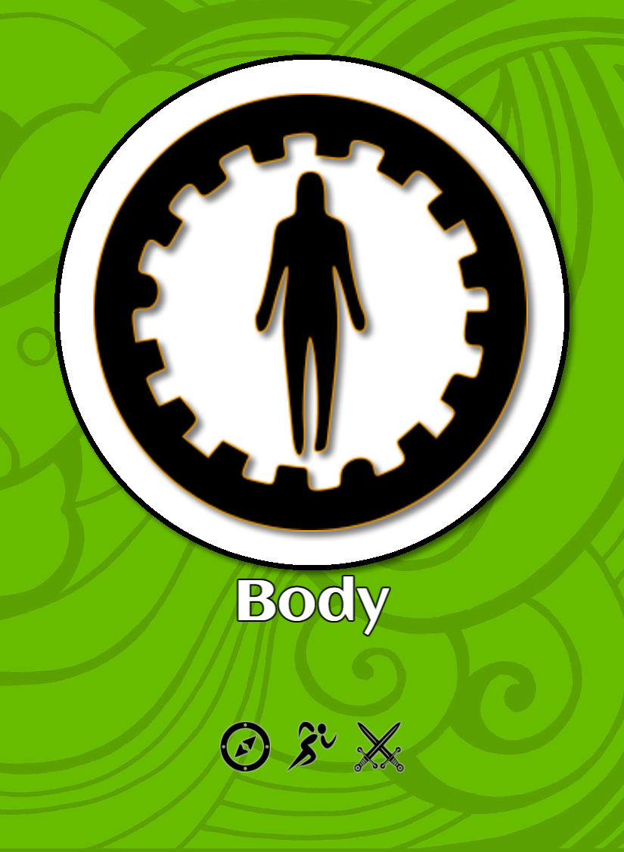
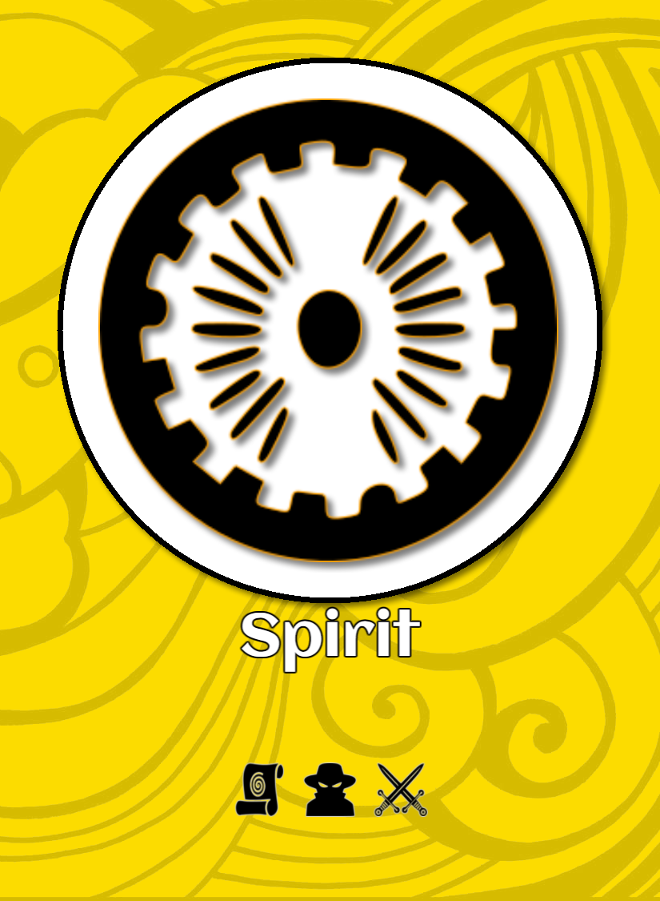
Character Creation
Attributes are Cool!
Mind, body and spirit attributes have cards associated with them to show the status of the attribute. Let’s grab Gendrik’s attribute cards! We can stack these with his Play Cards, or lay them all out for a cool looking table.
Gendrik’s “full” hand of Play Cards and Attributes:
That’s it for Gendrik for now! Making characters is fairly simple, but when you make your own, you’ll pay more attention to the symbols in the lower left on those Play Cards, because that’s the refresh cost, which we’ll get into when this adventure is underway!

Slide 4
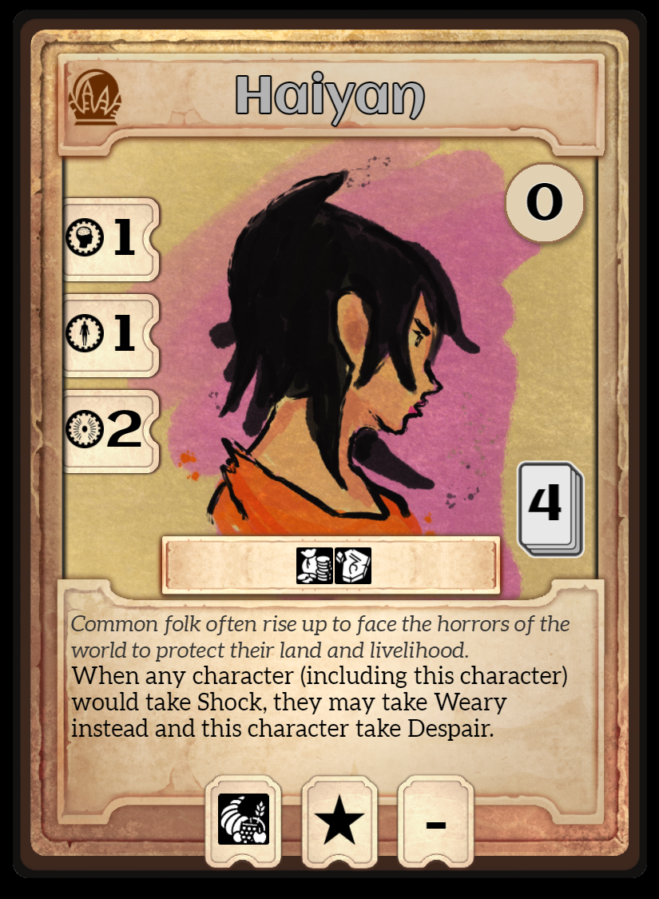
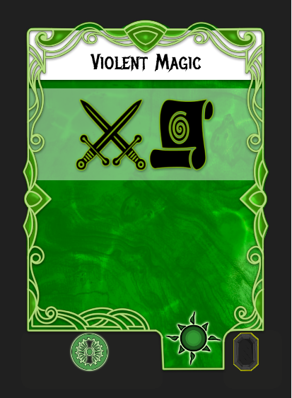
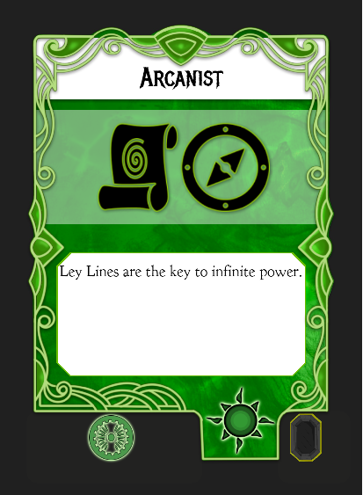
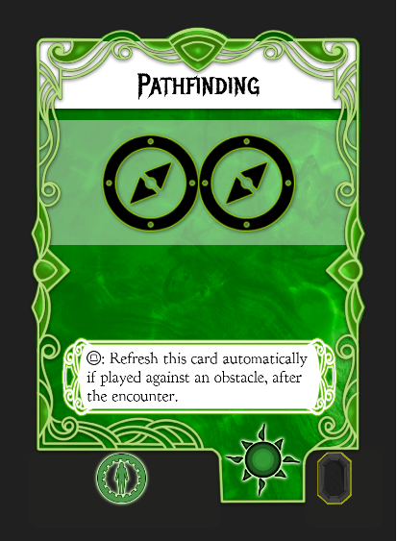
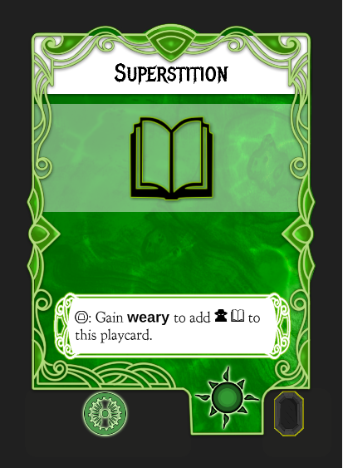
Character Creation
Let’s make Gendrik’s adventuring friends now. We’re using the two other zero level characters, Haiyan and Ortem.
When creating a team of characters, leverage some of their abilities along with their attributes. Characters can be quite unique, since any character can have any Play Card combinations.

Slide 5
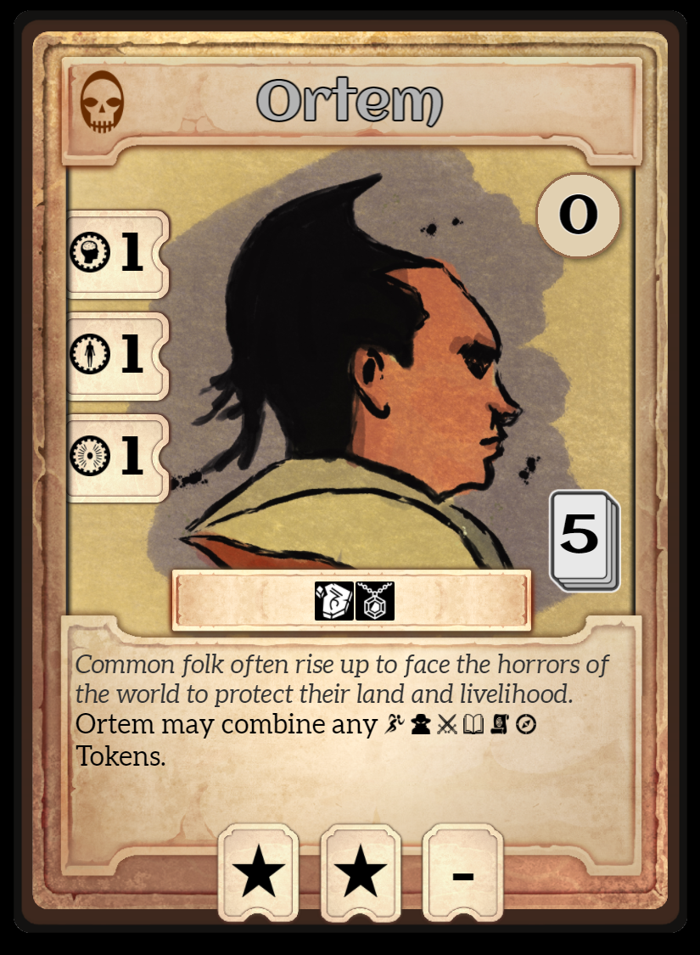
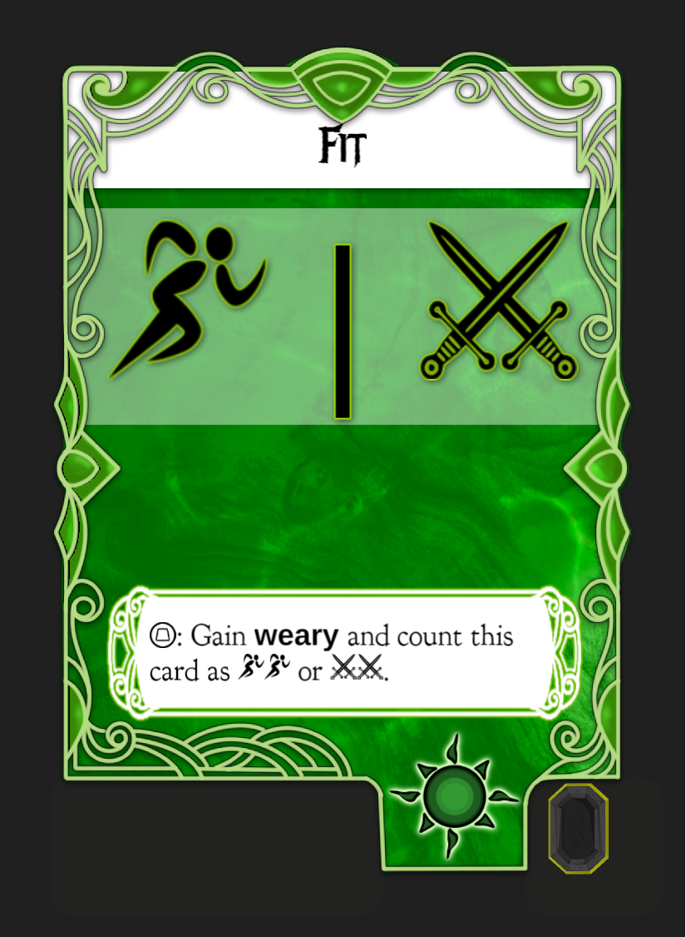
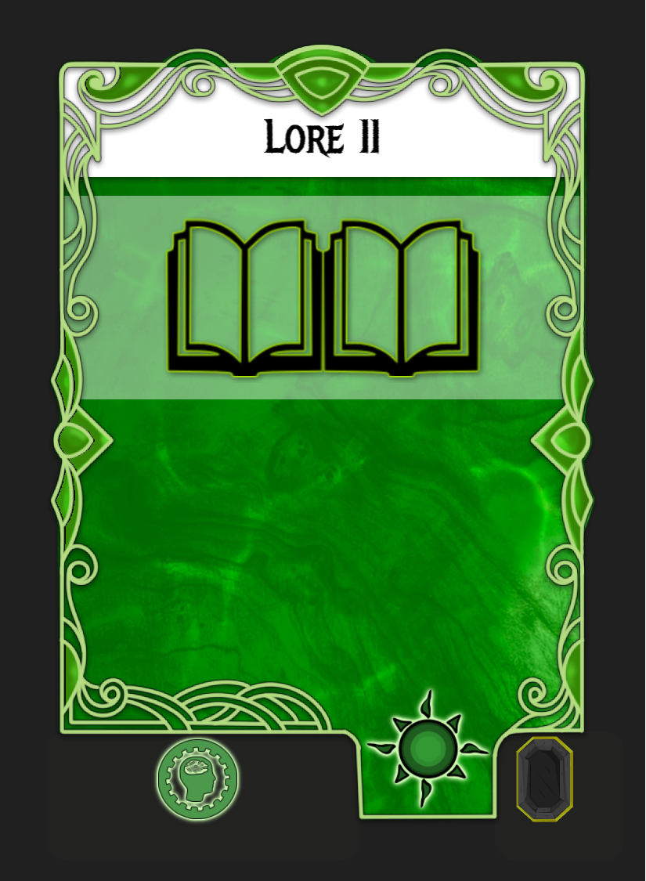
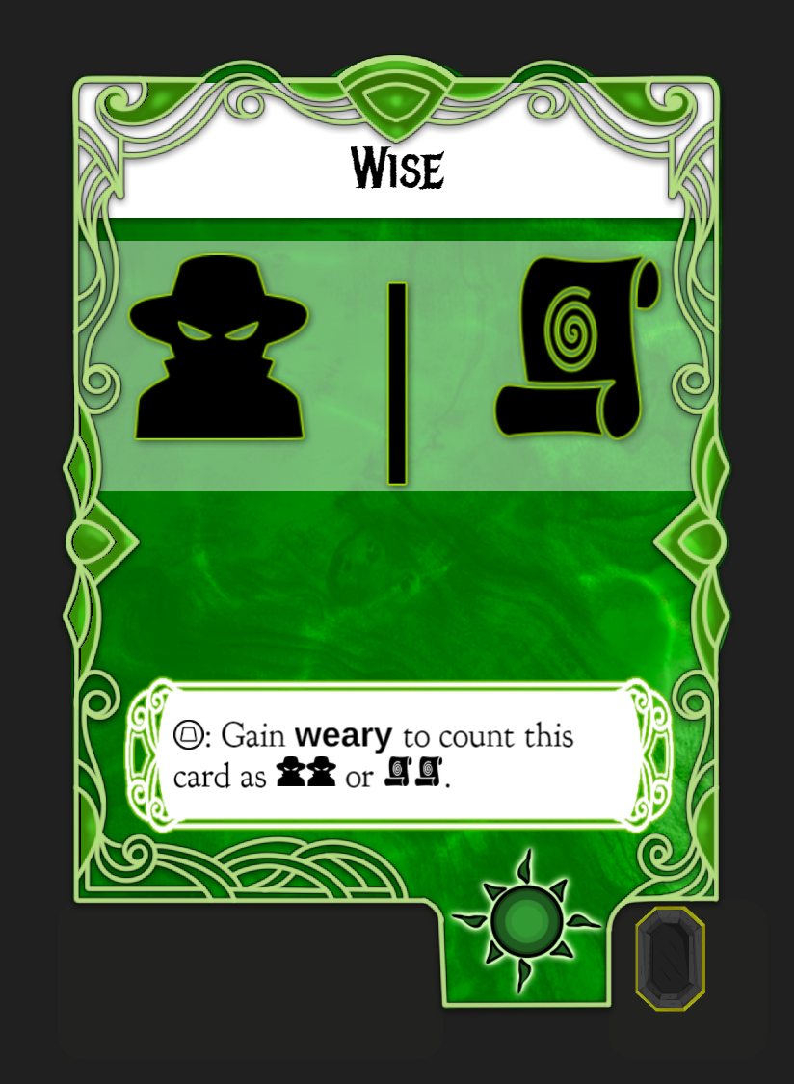
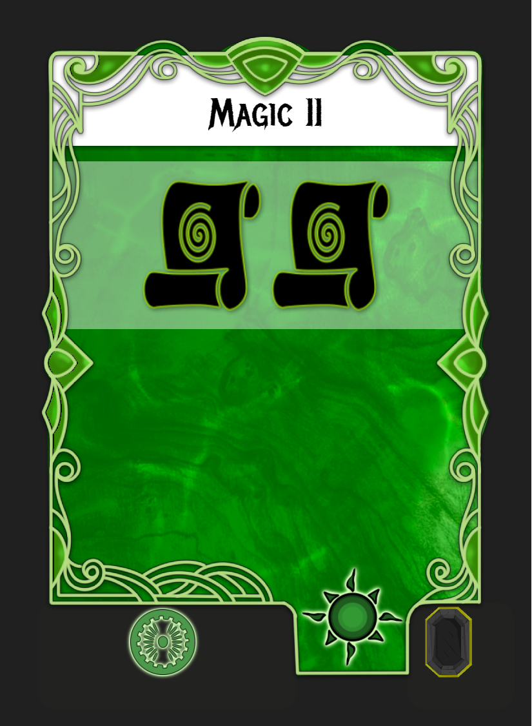
Character Creation
Here is Ortem – his attributes are all 1 (very low), so he is a bit on the fragile side, but his ability to combine any of the main Tokens should offset some of that weakness. You can only combine tokens when you receive another token that the character already holds.
With our characters built and ready, we can pick the quest that they’ll go on. The quest will determine the starting location as well as which destination setting the team will be traveling to.

Slide 6
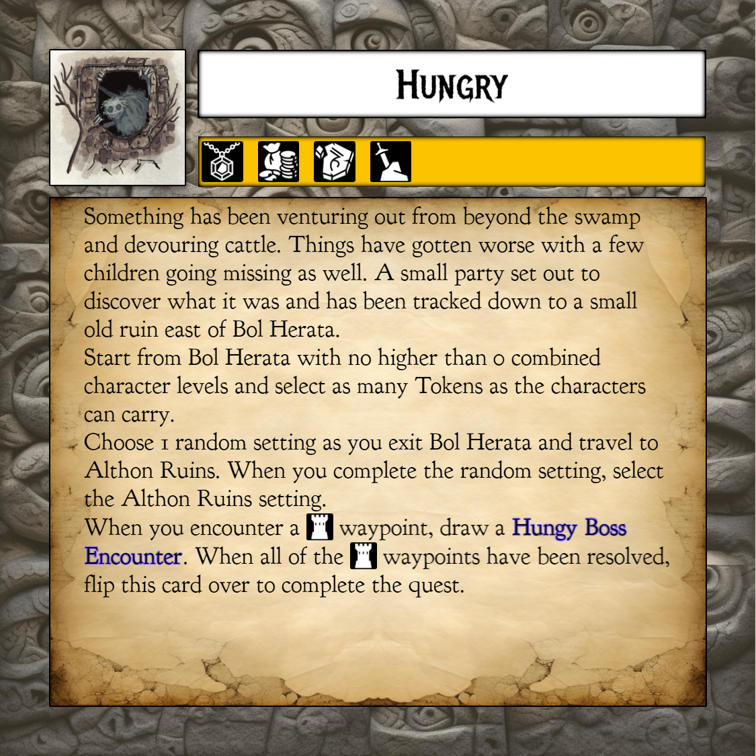
Quest!!
For this quest, we’re picking “Hungry”. The start location is Bol Herata and the destination is the setting Althon Ruins.
This quest calls for ONE random setting drawn from all other settings that do not belong to Althon Ruins.
This quest allows our character to take whichever Tokens they can hold, so we’ll grab some Tokens for each character.

Slide 7
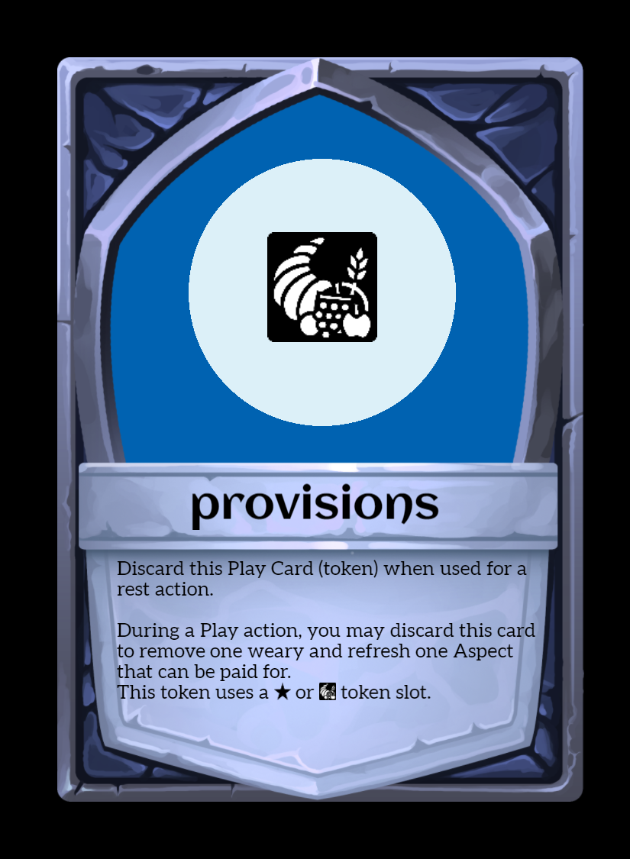
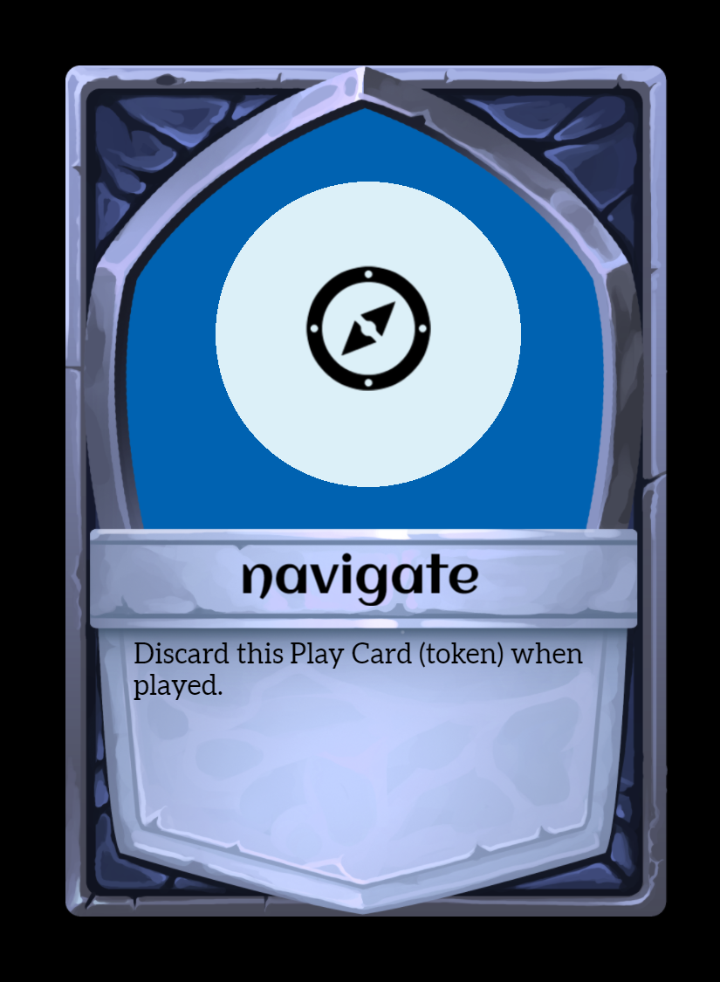
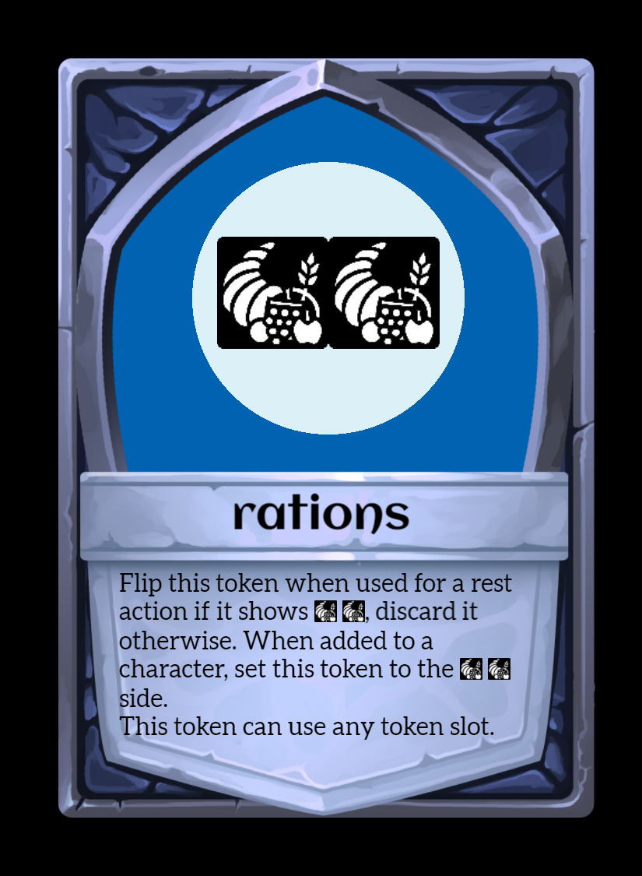
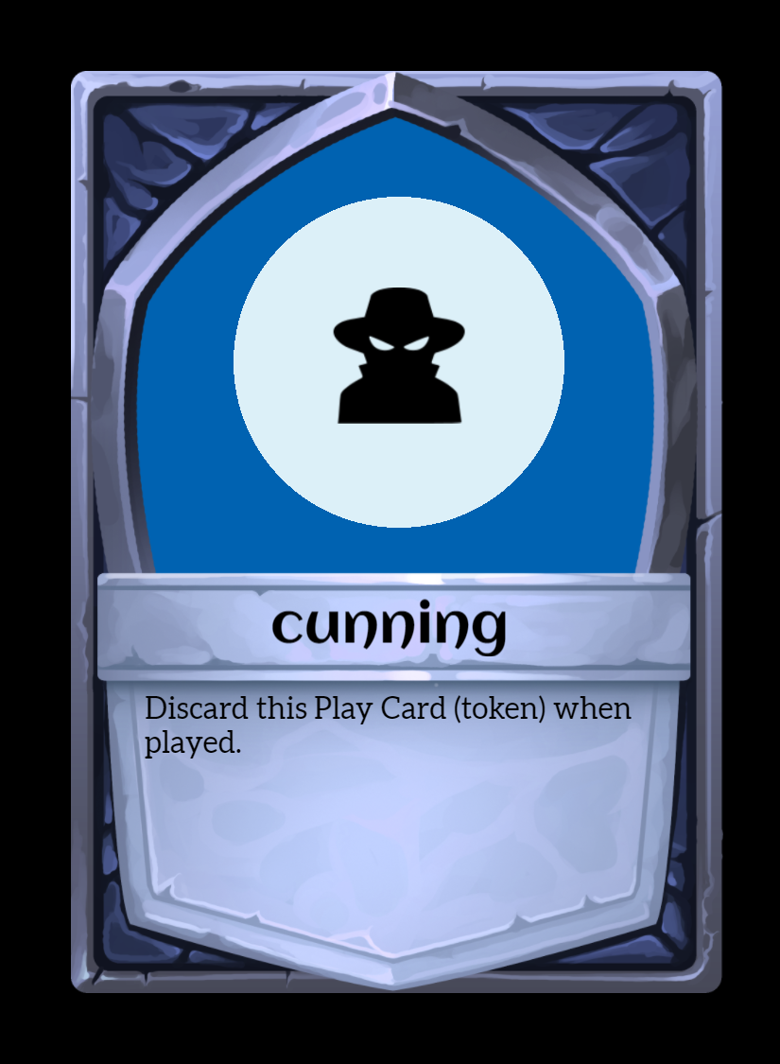
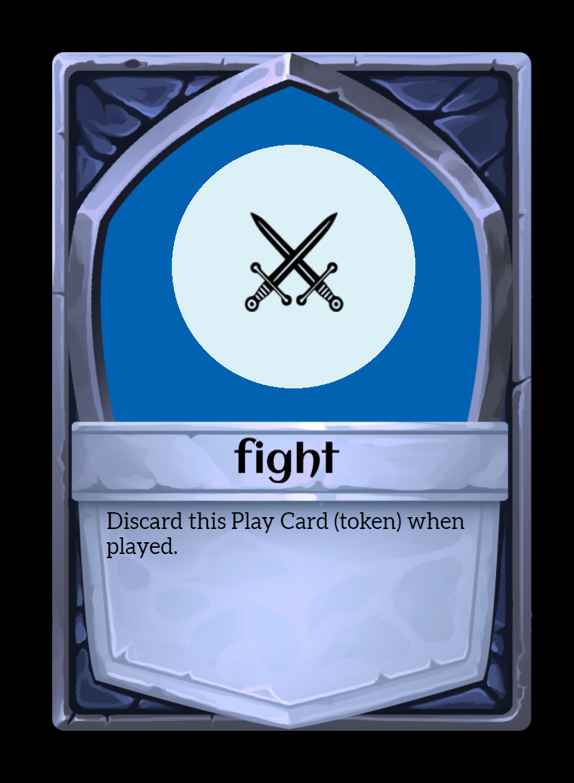
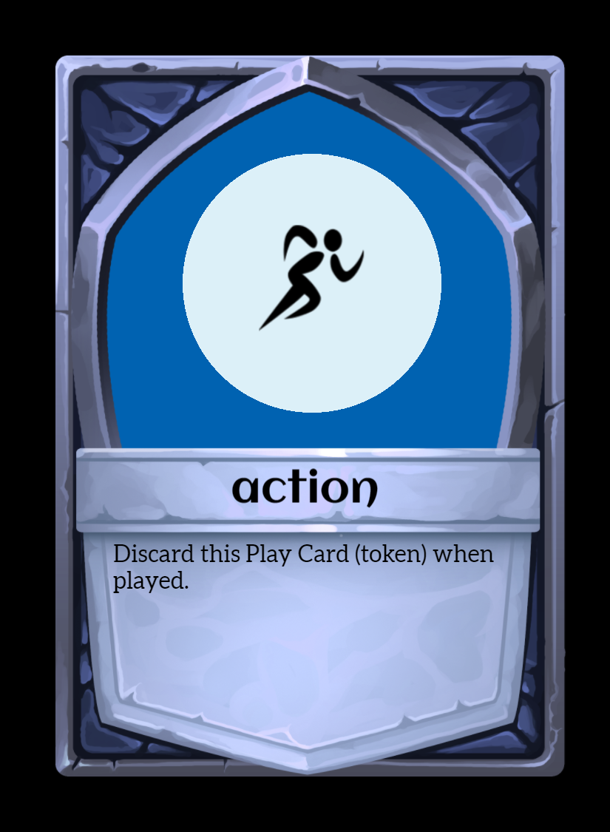
Token Selection
Since Gendrik and Haiyan are limited on their tokens, we selected two different types of food – provisions and rations. When a character picks up rations, it is automatically flipped to the two glyph side. This gives us two chances for rest with one token!
The provisions token that Gendrik has can be used for either a rest action OR during an encounter to give a character some respite and refresh a card.

Slide 8
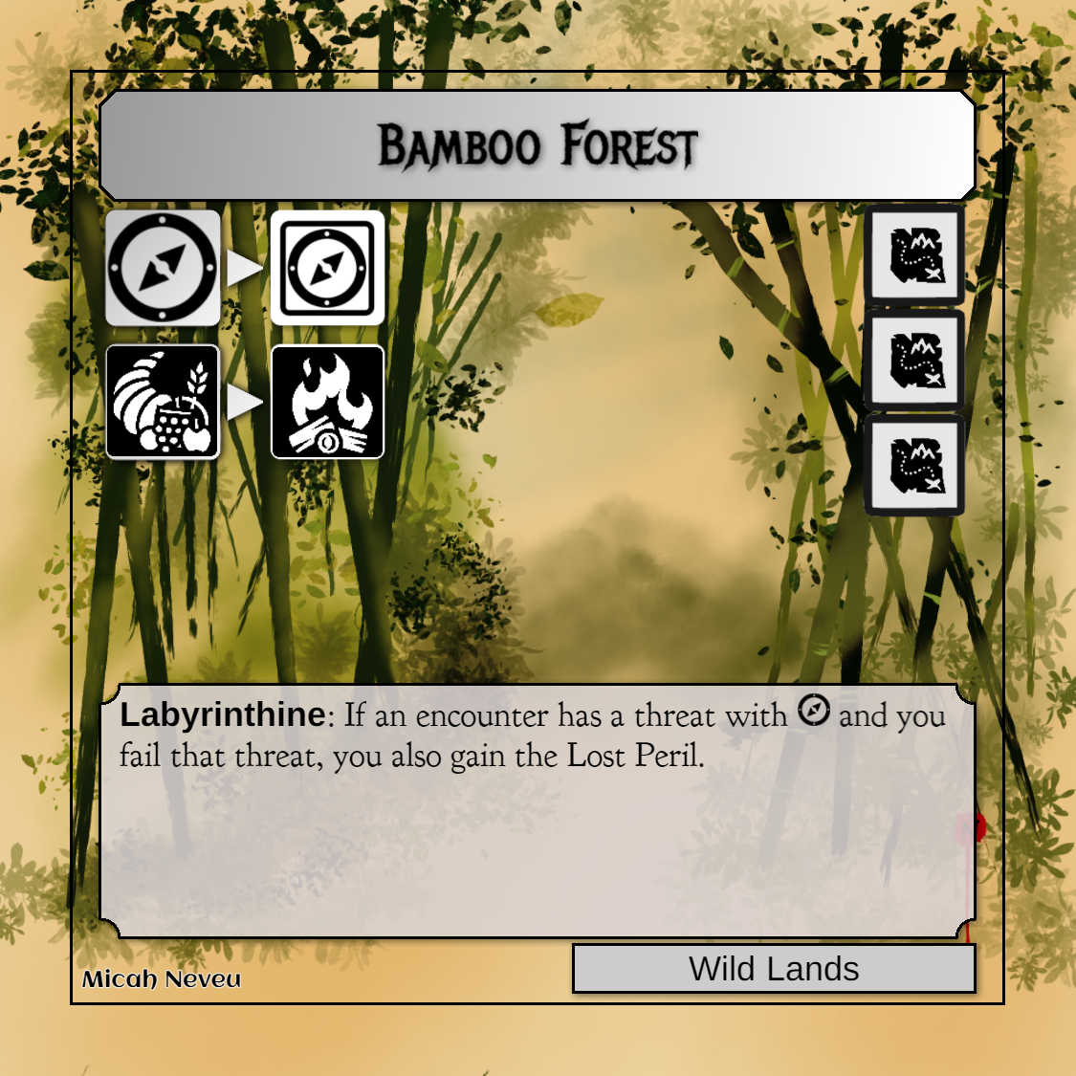
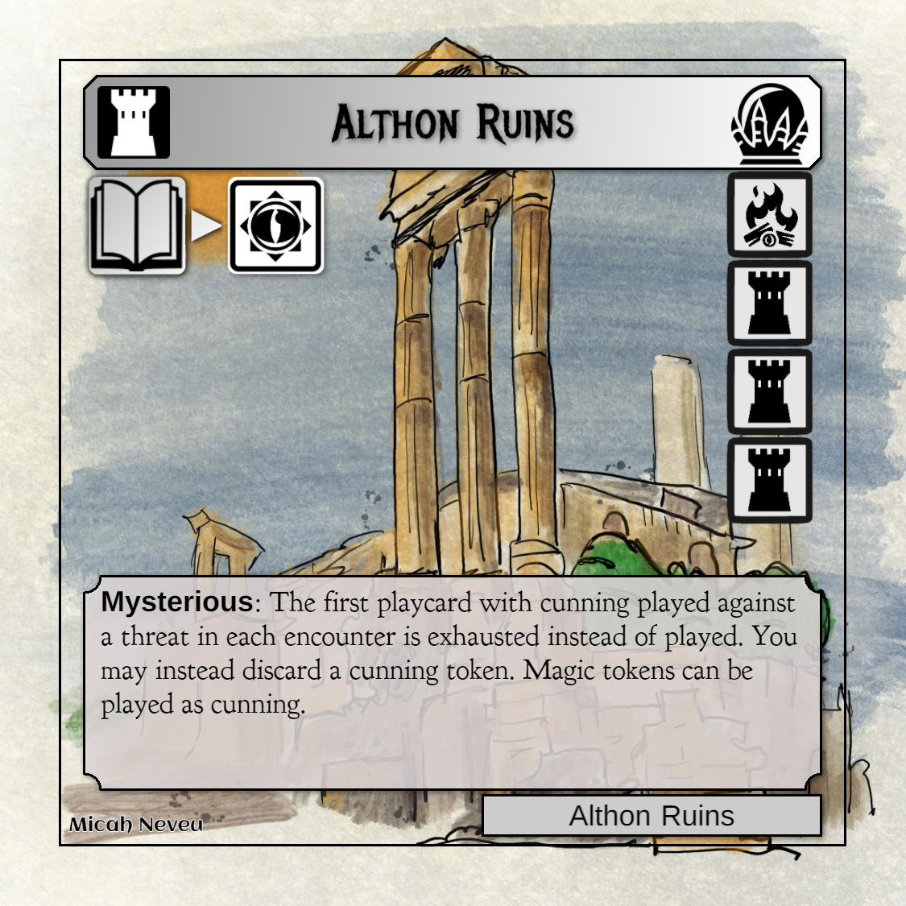
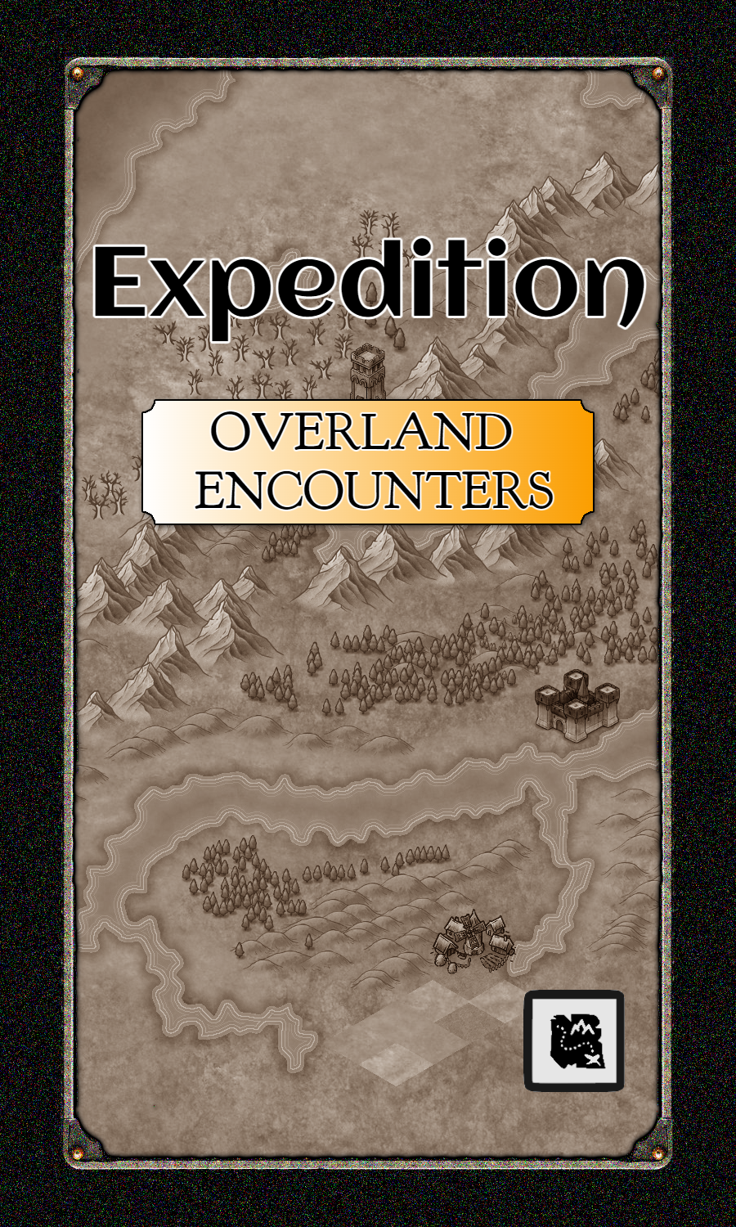
Quest!!
Let’s draw that random Setting! Bamboo Forest. The Bamboo Forest has two actions (on the left) and 3 way points (on the right). Each way point calls for a specific action. These, showing the map, mean that we draw an overland encounter. Once we get through all three way points, we’ll arrive at the Althon Ruins setting.
Keep an eye on the special text at the bottom of the setting. The Bamboo Forest is Labyrinthine, which can add an extra Peril if you fail to match the glyphs on the threat.
There are also two actions on the left:
We may play a play card that has navigate to receive a navigate token.
We may also discard a ration to perform a rest action.
We can only play one action at a time, and only after passing an encounter.
So! Let’s draw a random overland encounter and see what perils the crew faces as they venture through the forest.

Slide 9
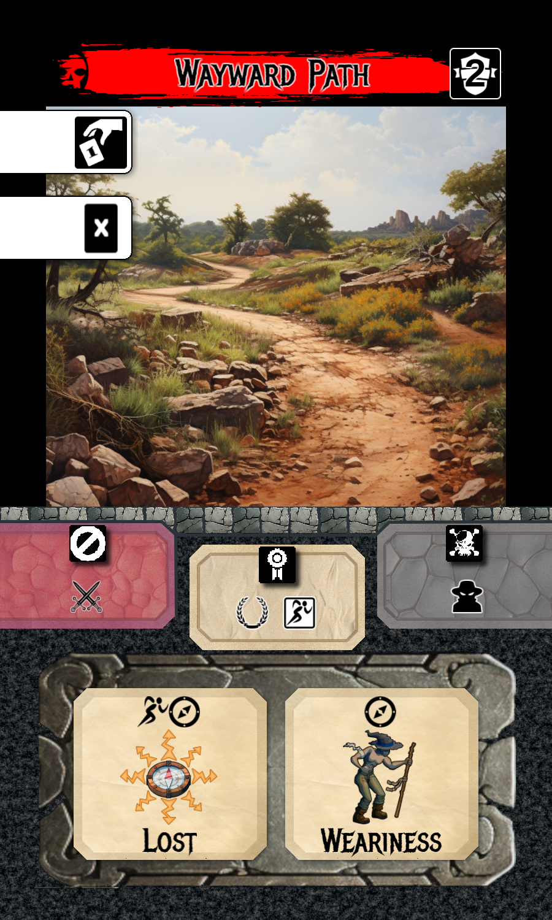



Current Setting
1st Random Encounter
This side of the card shows what actions characters can perform. A character can only pick one of these actions, and characters can all pick the same if they choose.
The first action is to play a single Play Card.
The second means a character can remove a Peril.
We draw an overland encounter on the first way point. It’s an overland encounter based on the way point icon, a map.
Taboo: Play cards with this glyph count as having NO glyphs. You could still play the card for its effects.
Rewards: If you match the number of glyphs or greater shown in the upper right (2, in this case) it counts as “passing” the encounter and you can select one reward from this section.
Extra Difficulty: Some effects can make encounters more difficult. The glyphs shown here are added to the threats in the lower section.
This encounter has two threats in the lower section. One with the Lost peril and one with the Weariness peril. To avoid the negative effects (Lost, Weariness), we need to play cards and tokens that match. A play card cannot be split between the two threats.
For instance, playing Pathfinding (with two navigate glyphs) would only be able to apply to either Lost or Weariness.
A Threat has glyphs and a peril. To avoid the peril, you need to match the glyphs. So, to avoid Lost, you’ll need to play one Action and one Navigate glyph. Playing these two glyphs would count as successfully passing the encounter, even if you do not match the Weariness Threat.

Slide 10

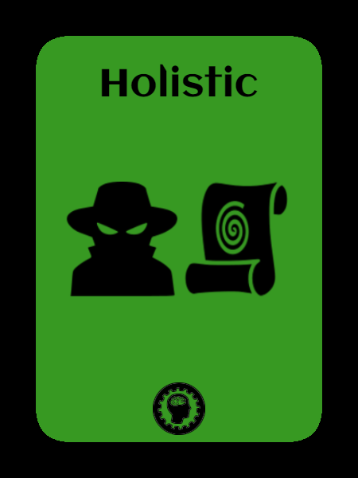
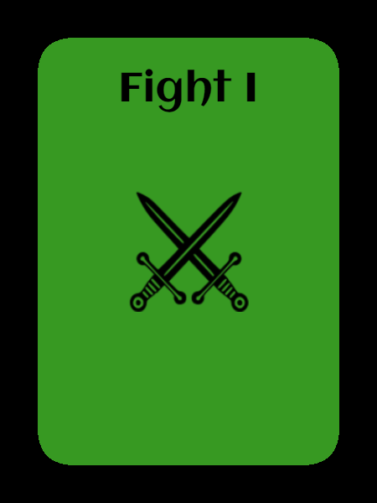
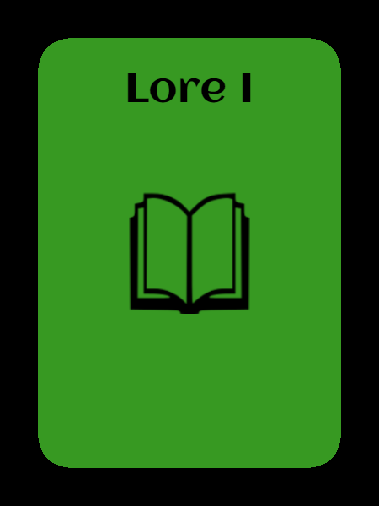


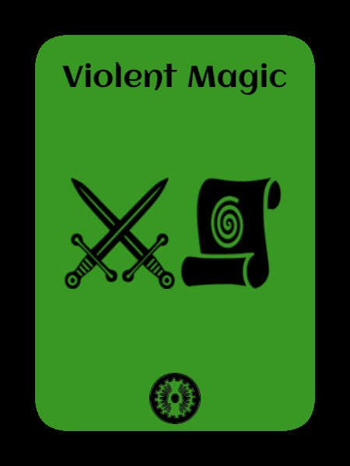

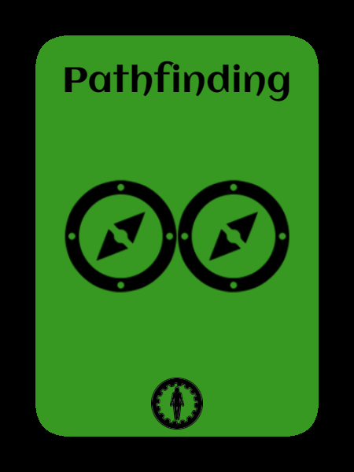



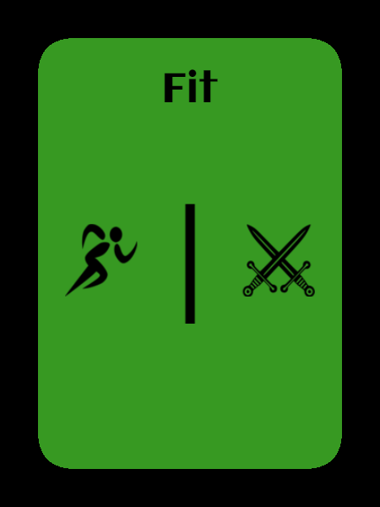
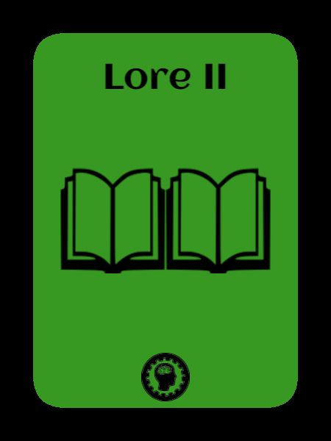
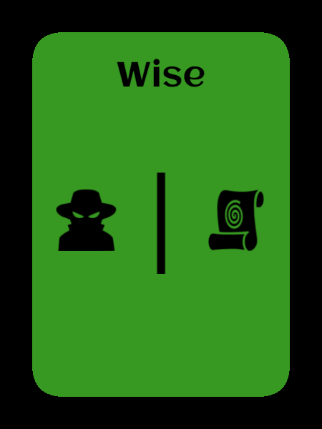
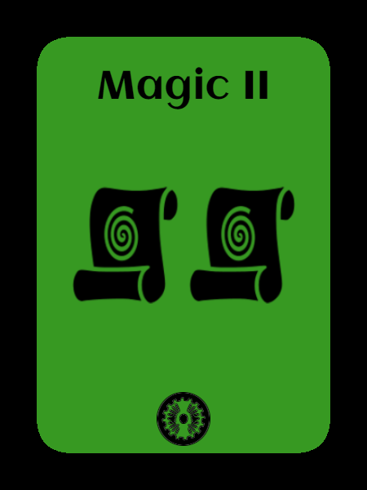


Characters

Slide 11
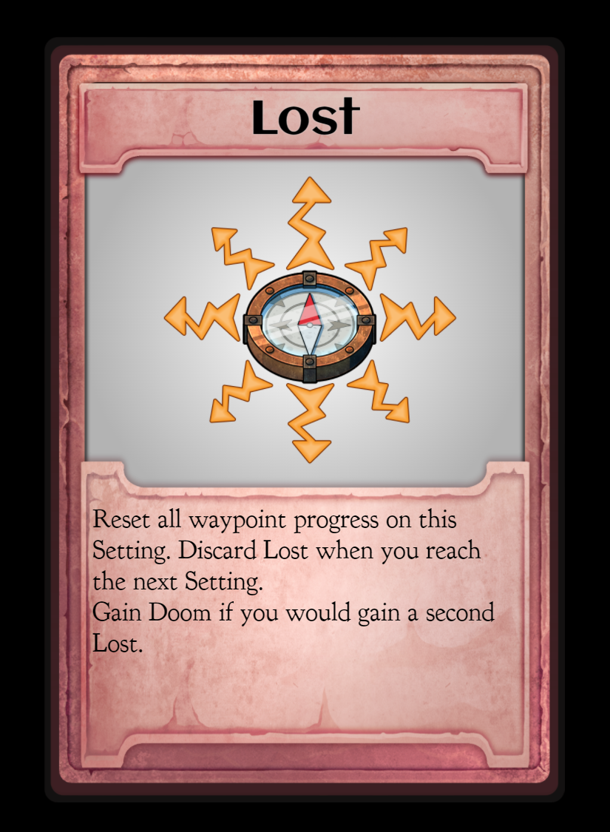
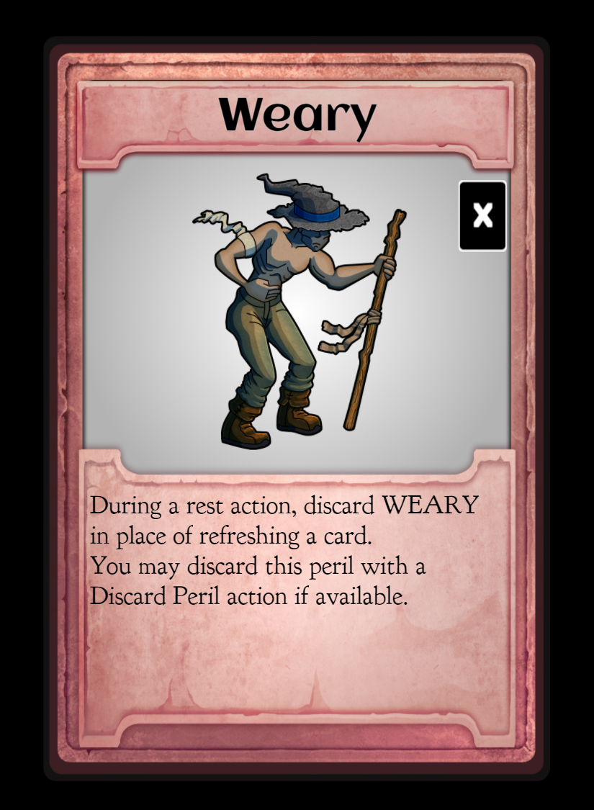
Encounter that Encounter!
Each character can choose one action from the left. Since no one has any perils to discard, each character will select the Play Card action (as shown by the hand).
Before we do that, let’s understand the perils that could occur, so we can make the best decision on which cards to play. Sometimes NOT using a play card is the best strategy.
Lost will reset our progress, which can be very difficult to deal with, especially if you’ve completed a few way points on the setting.
Weary makes it more difficult to recover used play cards.

Slide 12
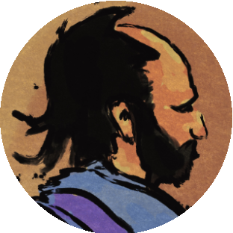
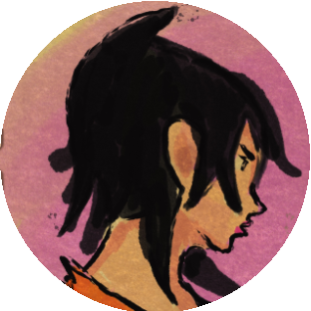
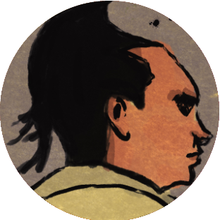
Encounter that Encounter!
Now that we have an idea of what the negative effects are on this encounter, we can select our characters’ actions.
We could simply have one character play one card with Navigate, and take the Lost Peril. Since we need to match 2 glyphs to pass this encounter, we won’t be able to collect a reward.
If we look back at the setting (Bamboo Forest) and read the text about Labyrinthine, you’ll notice any threat that has Navigate and we fail, we also gain Lost Peril. If we get a Lost while we already have one, we’ll get a Doom!
That changes things a bit on how we’ll proceed. We will have all three characters choose the Play Card action to resolve these perils.
Gendrik will play his Navigate Token on the Weariness threat. Played Tokens are discarded, while played Aspect cards are turned over to the exhausted side.
Haiyan will play the aspect card Arcanist on Lost.
Ortem will play the aspect card Fit on Lost.

Slide 13
Encounter
Since all glyphs were matched on both Threats, we don’t take any damage. Additionally, since we matched 2+ glyphs, this encounter is considered “passed”. We get to pick a reward! Since we just used one of Gendrik’s tokens, we can replace it with a new one, in this case, it is an Action token. Tokens are identified by a glyph in a square.
Character status after the first encounter:

