Slide 1
Request Tracker 3.8
Stefan Hornburg
Nordic Perl Workshop 2009
Oslo, 17th April 2009
Notes:
Introduction
Start the talk what RT is about, why to come involved with it and how do I take advantage of RT 3.8.
Request Tracker, usually abbreviated to RT is a ticket system to capturing and
managing tasks and issues belonging to projects and/or clients. It is used by small and large organizations all over the world.
I came across RT when I started to work for clients in NY. One of this clients is a webhosting company, which uses RT for communication with his clients. Mostly simple tasks like adding new domains, new email addresses and such.
After that I installed more instances of RT,
for example for my client in Vienna and one instance for my clients in general.

Slide 2
Request Tracker
Ticket System
  Tasks, Projects, Times, Teamwork
Queues
Tickets
  Transactions
  Status
  Dates
  Attachments
Users
  Groups, Rights

Slide 3
Playground
URL: http://support.linuxia.de/rt
Login: oslo/oslo
Queue: Nordic Perl Workshop
Email: npw@support.linuxia.de

Slide 4
Request Tracker 3.8
New features
Plugins
Installation, Upgrading, Configuration
Interfaces

Slide 5
RT 3.8 Features
Dashboards
Ticket Bookmarks
Richtext email
Email signatures and encryption
Charts of Ticket Relationships
Email digests
Session expiration
Plugins
Visual Style
Bug Fixes

Slide 6
Ticket Bookmarks
Add/remove bookmarks
  * at upper right corner of ticket display
List bookmarks
  RT at a Glance/Edit

Slide 7
Dashboards
Contents
  Saved Searches
  Saved Graphs
  Ticket Relationship Graphs
Location
  Tools/Dashboards

Slide 8
Dashboard Rights I
Create
  CreateDashboard, CreateGroupDashboard, CreateOwnDashboard
Delete
  DeleteDashboard, DeleteGroupDashboard, DeleteOwnDashboard
Modify
  ModifyDashboard, ModifyGroupDashboard, ModifyOwnDashboard
See
  SeeDashboard, SeeGroupDashboard, SeeOwnDashboard
Subscribe
  SubscribeDashboard
Notes:
CreateOwnDashboard pointless without ModifyOwnDashboard, SeeOwnDashboard

Slide 9
Dashboard Rights II
Saved Searches
  CreateSavedSearch
  ShowSavedSearch
  LoadSavedSearch
http://wiki.bestpractical.com/view/Rights

Slide 10
Richtext Email
WYSIWYG editor for HTML emails
FCKeditor
  Excellent cross-platform support
  Local copy in html/NoAuth/RichText
Just plain text
  Set($MessageBoxRichText, 0);
  Preferences/General (ModifySelf)
Display improvements
Notes:
RT displays HTML and multipart email messages to work more like desktop email clients.
Local copy => customizations

Slide 11
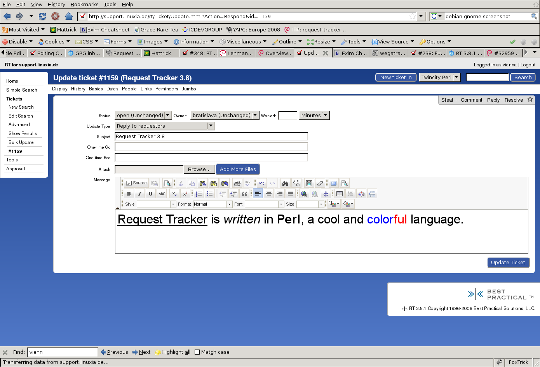
Richtext Email

Slide 12
Email Signatures and Encryption
verify PGP signatures on incoming messages
decrypt encrypted messages
sign and encrypt outgoing mail

Slide 13
Encryption: Setup
RT's GnuPG libraries couldn't successfully read your configured GnuPG home directory (/var/cache/request-tracker3.8/data/gpg). PGP support has been disabled
cd /var/cache/request-tracker3.8/
mkdir -p data/gpg
chown -R www-data data
chmod -R o-rx data
su www-data
GNUPGHOME=data/gpg gpg --gen-key

Slide 14
Encryption: Configuration
Set( %GnuPG,
Enable=>1,
OutgoingMessagesFormat=>'RFC',
AllowEncryptDataInDB=>0,
);
Set( %GnuPGOptions,
'passphrase'=>'foobar',
'no-permission-warning'=>undef,
'homedir'=>'/var/cache/request-tracker3.8/data/gpg'
);
Set(@MailPlugins, 'Auth::MailFrom', 'Auth::GnuPG',
);

Slide 15
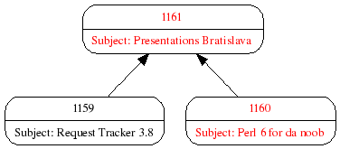
Charts of Ticket Relationships

Slide 16
Charts of Ticket Relationships
Ensure modules are installed, otherwise silent failure
./sbin/rt-test-dependencies --with-GD –with-GRAPHVIZ

Slide 17
Mail Delivery / Digests
Preferences/Mail
  Needs ModifySelf right
Delivery Options
  Individual
  Daily
  Weekly
  Suspended
Cronjob for Digests

Slide 18
Session Expiration
No expiration save by closing the browser
Now with rt-clean-sessions

Slide 19
Plugins
Extensions for RT
  Interface formalized in 3.8
Download: CPAN
Installation
  Standard module installation
  RTHOME environment variable
Configuration: RT_SiteConfig.pm
  @Plugins
  @MailPlugins

Slide 20
Plugins
RT::Authen::ExternalAuth
  External lookup of authentication and information
RTx::EmailCompletion
  Auto completion on email fields
RT::Extension::EmailByCommand
RT::Extension::ActivityReports
  Reporting tools to analyze activity

Slide 21
New Features: Conclusion
Documentation missing
Bugs in new features

Slide 22
Installation, Upgrade and Configuration
Installation
Upgrades from RT 3.6 to RT 3.8
Configuration

Slide 23
Installation: Debian vs RedHat
Debian
  Tons of packaged Perl modules
  Debian Perl Group
  Perl used for many system/packaging tools
  RT 3.8 packages missing :-(
RedHat
  notoriously breaking Perl (modules)
  Scalar::Util from CPAN
Notes:
Of course I'm biased as Debian maintainer, user and consultant, but here are some pretty good arguments to use Debian as distribution for serious Perl work.

Slide 24
Installation: Prerequisites
Perl 5.8.3
SQL database
  MySQL (4.0.13 or later with InnoDB support)
  PostgreSQL (7.2 or later)
  Oracle (9iR2 or later)
  SQLite (3.0 or later)
Webserver
  Apache 1.3.x or 2.x
    mod_perl
    FastCGI
  Other
    FastCGI
Perl modules

Slide 25
Installation
Download and unpack tarball
  http://download.bestpractical.com/pub/rt/release/rt.tar.gz
Read README
./configure
  /opt/rt3
make testdeps
make fixdeps
make install (as root)
edit configuration
  /opt/rt3/etc/RT_SiteConfig.pm
Notes:
./configure –help shows all the options

Slide 26
Edit Configuration
  # THE BASICS:
  Set($rtname, 'support.linuxia.de');
  Set($Organization, 'support.linuxia.de');
  Set($CorrespondAddress , 'rt@support.linuxia.de');
  Set($CommentAddress ,
  'rt-comment@support.linuxia.de');
  # THE WEBSERVER:
  Set($WebPath , "/rt");
  Set($WebBaseURL , "http://support.linuxia.de");

Slide 27
Database Configuration and Setup
Configuration
Set($DatabaseType, 'mysql');
Set($DatabaseHost, 'localhost');
Set($DatabaseName, 'support');
Set($DatabaseUser , 'support');
Set($DatabasePassword , 'mysecret');
Setup
make initialize-database

Slide 28
Edit Configuration: Database
Set($DatabaseType, 'mysql');
Set($DatabaseHost, 'localhost');
Set($DatabaseUser , 'support');
Set($DatabasePassword , 'mysecret');

Slide 29
Webserver Configuration
<VirtualHost 85.10.244.99:80>
ServerName support.linuxia.de
DocumentRoot /opt/rt3/share/html
AddDefaultCharset UTF-8
PerlRequire "/opt/rt3/bin/webmux.pl"
<Location /NoAuth/images>
SetHandler default
</Location>
<Location />
SetHandler perl-script
PerlResponseHandler RT::Mason
</Location>
</VirtualHost>

Slide 30
Installation: Finish
Change password for RT root user
  Default is password
Create
  Queues
  Users
  Groups
  Rights
  Mail aliases

Slide 31
Email Gateway: Aliases for Queues
  tcpw@support.linuxia.de:
  /usr/bin/rt-mailgate --queue 'Twincity Perl Workshop' --action correspond --url http://support.linuxia.de/rt
  tcpw-comment@support.linuxia.de:
  /usr/bin/rt-mailgate --queue 'Twincity Perl Workshop' --action comment --url http://support.linuxia.de/rt

Slide 32
Upgrading 3.6 => 3.8: Preparations
Take RT offline
Backup database
  mysqldump support > support.dmp

Slide 33
Upgrading 3.6 => 3.8: MySQL
Apply schema upgrade
  perl etc/upgrade/schema.mysql-4.0-4.1.pl db user pass > sql.queries
  Check queries
  mysql < sql.queries
Consequences
  Repeated logins
  Corrupted attachments

Slide 34
Upgrading 3.6 => 3.8
  Update files and binaries
    make upgrade
  Update database
    /opt/rt3/sbin/rt-setup-database --dba root --prompt-for-dba-password --action upgrade
  Clear mason cache
    rm -fr /opt/rt3/var/mason_data/obj
  Restart webserver

Slide 35
Cronjobs: Mail Digest
  /etc/cron.daily/request-tracker3.8
  # Send daily RT emails.
  /usr/sbin/rt-email-digest -m daily
  /etc/cron.weekly/request-tracker3.8
  # Send weekly RT emails
  /usr/sbin/rt-email-digest -m weekly

Slide 36
Cronjobs: Mail Dashboards
/etc/cron.hourly/request-tracker3.8
# Send RT dashboard emails
/usr/sbin/rt-email-dashboards

Slide 37
Interfaces
Web
Email
REST
CLI

Slide 38
CLI
  New Queue:
  $ rt create -t queue set name='Perl-Workshop'
  # Queue 4 created.
  New Ticket:
  $ rt create -t ticket set subject='Presentation Slides' \
  set queue='Perl-Workshop'
  # Ticket 11 created.

Slide 39
RT::Client::REST
  New Queue:
  $rt = new RT::Client::REST
  (server => 'http://support.linuxia.de/rt');
  $rt->login(username => 'racke',
  password => 'nevairbe');
  New Ticket:
  $ rt create -t ticket set subject='Presentation Slides' \
  set queue='Perl-Workshop'
  # Ticket 11 created.

Slide 40
CLI
Display ticket:
$ rt show ticket/11 -f id,subject,queue,requestors,owner
id: ticket/11
Subject: Presentation Slides
Queue: Perl-Workshop
Requestors: racke@linuxia.de
Owner: Nobody

