Slide 1
Request Tracker 3.8 & 4.0
Stefan Hornburg
YAPC::EU::2009
Lisbon, 5th August 2009
Notes:
Welcome to my presentation about “Request Tracker 3.8 & 4.0”.
My name is Stefan Hornburg and I'm self employed as programmer and system administrator.
You know, after coming back from a conference or just on a bloody Monday
Customers peppering you with requests.
No way you can handle all them at the same time.

Slide 2

Please open up a ticket in our request tracker!

Slide 3
Request Tracker
Mature project
Active community and developer team
Customizations
Interfaces
Perl

Slide 4
Request Tracker
Bugtracking System for Perl / CPAN
Trouble Ticket System
  Companies
  Organizations
Customers
  Few instances dedicated to clients and organizations
  One instance for other clients
Best Practical

Slide 5
Request Tracker
Introduction
  Basics
  Customizations
  Interfaces
Plugins
REST
  Tickets from YAPC talks with calendar dates
  and tags
RT 4
Notes:
This presentation starts with a short introduction into RT.

Slide 6
Playground
URL: http://support.linuxia.de/rt
Username: lisbon
Password: lisbon09
Queue: YAPC::EU::2009

Slide 7
Basics
Ticket System
  Tasks, Projects, Times, Teamwork
Queues
Tickets
  Transactions
  Status
  Dates
  Attachments
Users
  Groups, Permissions

Slide 8
Customizations
Custom Fields
Templates
Scripts
Callbacks
Overlay
'local' directory
Extensions (Plugins)
http://wiki.bestpractical.com/view/CleanlyCustomizeRT

Slide 9
Custom Fields
Configuration/Custom Fields
Create
Applies To
Rights
  AdminCustomFields
  ModifyCustomFields
  SeeCustomFields

Slide 10
Callback example
html/Callbacks/RTx-Calendar/User/Elements/Tabs/Default
<%init>
$tabs->{'z'} = {
title =>loc("Calendar"),
path => "Prefs/Calendar.html"
};
</%init>
<%args>
$tabs
$current_subtab => undef
$Searches => undef
</%args>

Slide 11
Interfaces
Web
  View and manipulate tickets
  Convenient but not lazy
Email
  Create, correspond, comment on tickets
  Manipulate tickets through plugins
Commandline
  View and manipulate tickets
REST
  View and manipulate tickets with Perl scripts

Slide 12
Plugins
Extensions for RT
  Interface formalized in 3.8
Download: CPAN
Installation
  Standard module installation
  RTHOME environment variable
Configuration: RT_SiteConfig.pm
  @Plugins
  @MailPlugins
Configuration: Plugin

Slide 13
Plugins
RTx::Calendar
  Calendar view for tickets
RTx::Tags
  Tag cloud for tickets
RT::Authen::ExternalAuth
  External lookup of authentication and information
RTx::EmailCompletion
  Auto completion on email fields
RT::Extension::CommandByMail
  Manipulate tickets by email

Slide 14
Plugins: Installation and Configuration
$ export RTHOME=/opt/rt3
$ perl Makefile.PL
$ make
$ make install
/opt/rt3/etc/RT_SiteConfig.pm:
Set(@MailPlugins, qw(Auth::MailFrom Filter::TakeAction));
Set(@Plugins,(qw(RT::Extension::CommandByMail)));

Slide 15
Plugins: Portlets
Set($HomepageComponents, [qw(QuickCreate Quicksearch MyCalendar MyAdminQueues MySupportQueues MyReminders RefreshHomepage TagCloud Dashboards)]);

Slide 16
RTx::Calendar
Calendar view for tickets
  Overview for homepage (MyCalendar)
  Search results
Prerequisites
  Date::ICal
  Data::ICal
  DateTime::Set

Slide 17
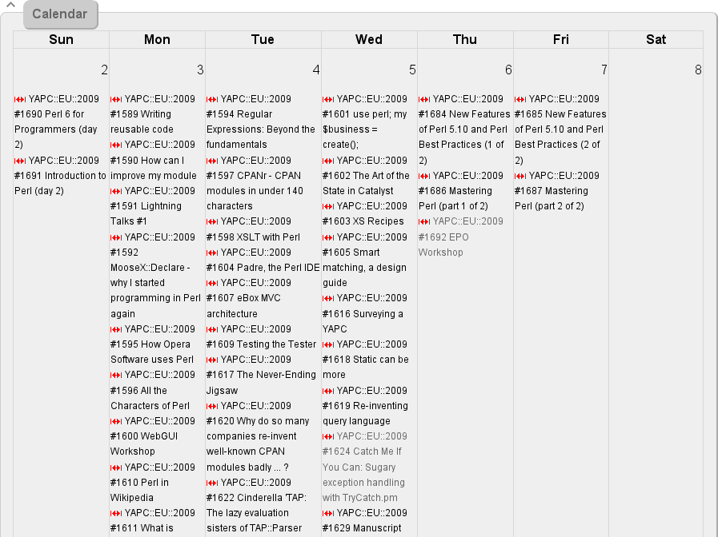
Sample Calendar

Slide 18
RTx::Tags
Tag Cloud for Tickets
  Simple search
  Homepage (TagCloud in $HomepageComponents)
Requires HTML::TagCloud
Create Custom Field 'Tags'
  Enter one value
  Applies to tickets
Current version: 0.25, released yesterday

Slide 19
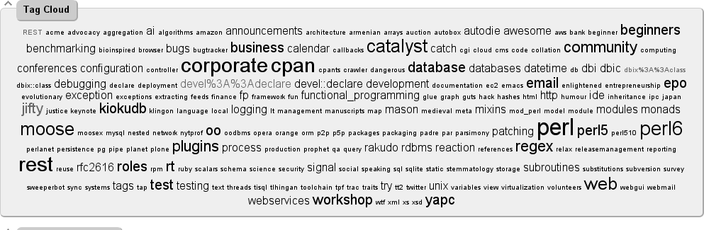
Sample Tag Cloud

Slide 20
RTx::EmailCompletion
Auto completion on email fields through Ajax
LDAP

Slide 21
RT::Authen::ExternalAuth
Authenticate RT user against external data sources
  LDAP (Active Directory)
  DBI
  SSO with external cookies

Slide 22
RT::Extension::CommandByMail
Set(@MailPlugins, qw(Auth::MailFrom Filter::TakeAction));
Set(@Plugins,(qw(RT::Extension::CommandByMail)))
Set($CommandByMailGroup, group_id);

Slide 23
RT::Extension::CommandByMail
Commands like email headers, but in the body
No HTML
No empty lines

Slide 24
RT::Extension::CommandByMail
Owner: racke
Priority: 10
CustomField.{Tags}: Plugins

Slide 25
REST
REST via HTTP
  Access with RT username and password (using same permissions)
  No RT installation required
  Multiple instances
RT CLI
Perl
  RT::Client::REST module
Ruby
  rt-client gem

Slide 26
REST: Main object and login
$rt = new RT::Client::REST(server => 'support.linuxia.de');
$rt->login(username => 'lisbon',
password =>lisbon);

Slide 27
RT::Client::REST
Modules for the RT objects
  RT::Client::REST::Object (base class)
  RT::Client::REST::Queue (queue)
  RT::Client::REST::Ticket (ticket)
  RT::Client::REST::Transaction (transaction)
  RT::Client::REST::Attachment (attachment)
  RT::Client::REST::User (user)
  RT::Client::REST::SearchResult (lists)

Slide 28
RT::Client::REST::Queue
Operations
  Retrieve
  Store (create or update)
    AdminQueue
  Tickets (except status “deleted”)

Slide 29
RT::Client::REST::Queue
# create queue
$queue = new RT::Client::REST::Queue (
rt => $rt,
name => 'YAPC::EU::2009',
description => 'Yet Another Perl Conference Europe');
$queue->store;
# get tickets for queue
$queue = new RT::Client::REST::Queue (
Rt => $rt,
Id => 'YAPC::EU::2009');
$ticket_list = $queue->tickets();

Slide 30
RT::Client::REST::SearchResult
$ticket_list = $queue->tickets();
print "Tickets found: "
. $ticket_list->count() . "\n";
$iterator = $ticket_list->get_iterator;
while (defined($obj = &$iterator)) {
print "ID: ", $obj->id, ",Subject: ", $obj->subject, "\n";
}

Slide 31
RT::Client::REST::Ticket
Operations
  Retrieve
  Store (create or update)
  Comment
  Correspond
  Attachments
  Transactions
  Take, Untake, Steal

Slide 32
Creating a Ticket
# create ticket
$ticket = new RT::Client::REST::Ticket(
rt => $rt,
queue => 'YAPC::EU::2009',
subject => 'YAPC::EU::2009'
);
# store ticket
$ticket->store(text => 'Hello Lisbon!');
# get ticket number
$id = $ticket->id();

Slide 33
REST: Custom Fields
$ticket = new RT::Client::REST::Ticket(%parms);
$ticket->cf('Tags',
        'RT REST Mason Jifty');
$ticket->store();

Slide 34
REST: Custom Fields Caveats
Permission for modifying custom fields:
  ModifyCustomField (Configuration / Custom Fields)
No failure on missing permissions

Slide 35
REST: Restrictions
Can't search users
Can't search queues

Slide 36
REST: Application
Download Calendar File
Create Ticket for each Talk
  Subject, Description
  Starts, Due, Time Estimated
  Talk URL (Custom Field)
  Extract Tags from YAPC::EU site (Custom Field)

Slide 37
Request Tracker 4
Complete overhaul of the codebase
Jifty web application platform
  Browser based setup
TicketSQL extended as tisql
  New powerful query language
Scrips replaced by Lorzy
  Lisp-like mini language
Date and Time rationalization
  DateTime suite
Status
  Different set of status for different queues

Slide 38
Running RT4
Prerequisites
  Jifty (0.90701)
  Jifty DBI (SVN)
  Lorzy (SVN)
Sources
  git clone git://github.com/bestpractical/rt.git
  git checkout 3.999-trunk
Running
  jifty server
  web based setup
Installation
  None
Layout/REST

Slide 39
Conclusion
Use RT and report bugs
Get slides
  http://www.linuxia.de/talks/yapc2009/
Contact me
  racke@linuxia.de
  IRC #rt

