Slide 1

IIT ISM Dhanbad
Movie Recommendor
Github link :https://github.com/rackson3861
By: Sumit Rai

Slide 2
Layout of Approach
Parameters Selection
Bag of Words Formation
Using CountVectorizer and Tfidfvectorizer
Using both GPU/CPU computation the COSINE SIMILARITY
Results

Slide 3
Parameter Selection
adult : people may like adult or non- adult movies so it is important parameter though less effective.
belongs_to_collection, genre, overview, original language, production company and tagline are other important parameters
Parameter selection is based on content based recommender and not collaborative recommender

Slide 4
Bag Of Words
Bag of Words is formed by concatenating the chosen features column wise and the making them as a single string of each movie.
Further concatenating back the movies corresponding to each sentence.
Bag of Words can be found in bag_of_words.csv and its corresponding python file in creating_bag_of_words.py

Slide 5
Vectorizer
Personally I frequently use CountVectorizer but for this purpose I tried both and found that CountVectorizer is working more efficiently.
Reason maybe the numerical values are more for the words appearing more frequently and so more similarity is generated based on them.

Slide 6
GPU/CPU Computing
The overall complexity of count_matrix formation ie the cosine similarity decides the overall complexity of the program.
N = No. of movies
K = Trainable parameters
For each movie we have K parameters so for each movie compuation is N*K.
Moreover there are N such movies so overall complexity is N*N*K

Slide 7
O(N*N*K) complexity leads to very large time .
For N = 45464 as in out case.
K = 50000 (in reality it is 84k something but considering feature selection.
No. of operations = N*N*K = 1.74 x 10^14
Which takes 14 days for CPU and few hours for GPU or may be seconds based on GPU RAM.
Hence, GPU_computation_with_reducing_params.py file is dedicated to this

Slide 8
UNIQUE OBSERVATIONS
Due to Stemming operation of nltk confidence score was drastically reduced, this was due to distortion in bag of words introduced by it. Many words rather than being reduced to their stems word distorted
When only overview was used then confidence score was nearly 25% while with genre it raised to 35% and when all parameters were included as mentioned in this ppt except adult and country language then confidence score for the same movie raised to 64%. After introducing these two also , the confidence score raised to 66.9 %.
So it can be inferred that these two parameters also affect the results.

Slide 9
As the number of movies in consideration were increased, a maxima of confidence score was found at no_of_movies = 9000 for Toy Story, Jumanji, The firm and Free Willy as per experimental results. But after that it remained constant.
This maybe due to the fact that most similar movies were already included in under 9000 movies.

Slide 10
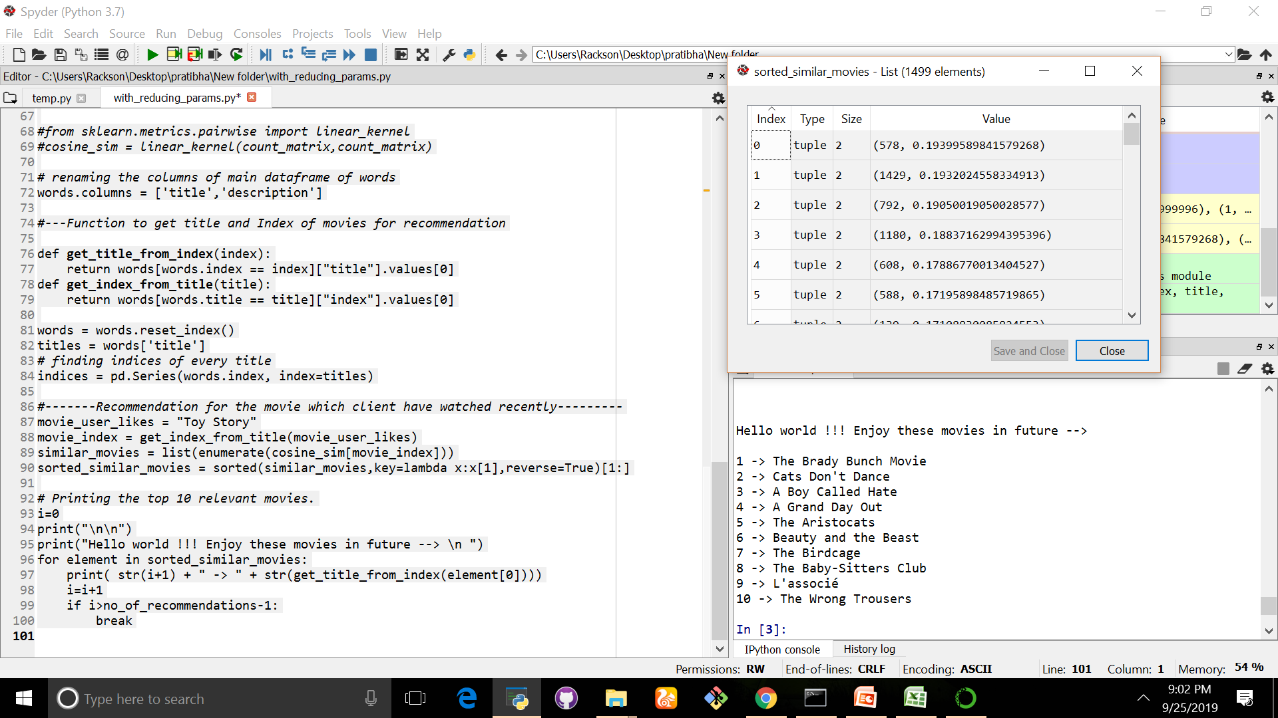
RESULTS
Results are based on selecting the top 10 movies using cosine similarity matrix in CPU version which can be controlled by variables as mention in there python files. In GPU version I have restricted it to 3 movies.
CF = confidence score
Toy Story for 1500 images with stemming CF = 19.39 % MAX

Slide 11
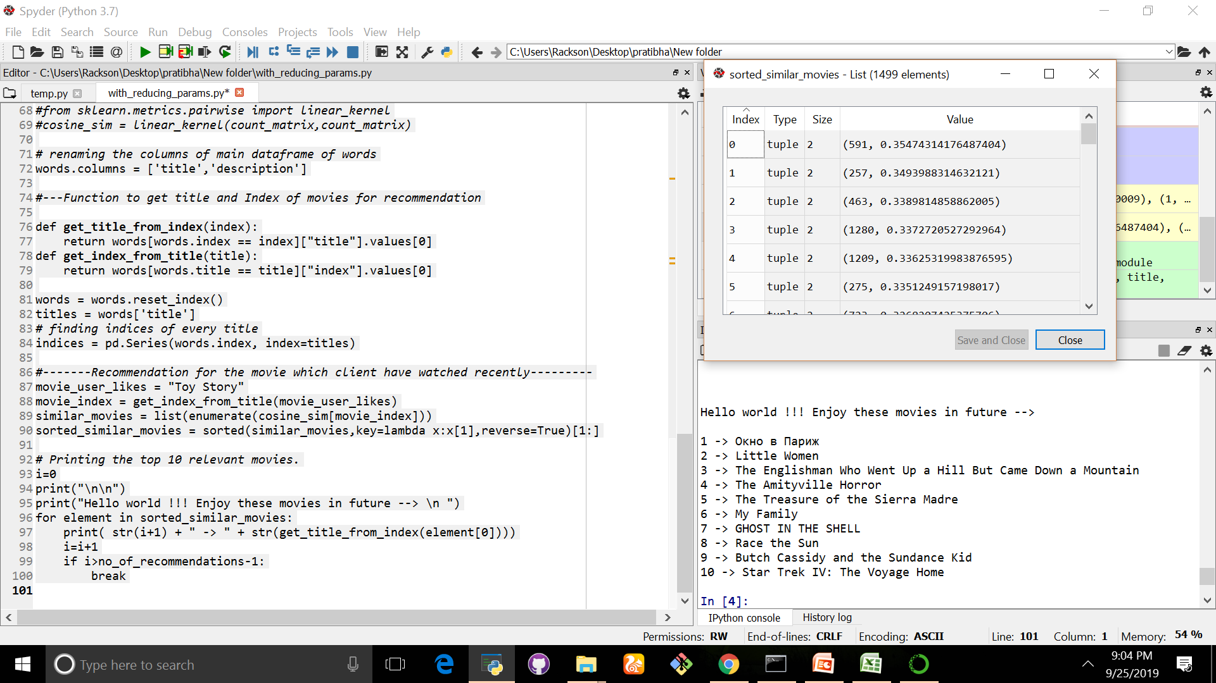
Toy Story for 1500 images with out stemming CF = 35.47 % MAX

Slide 12
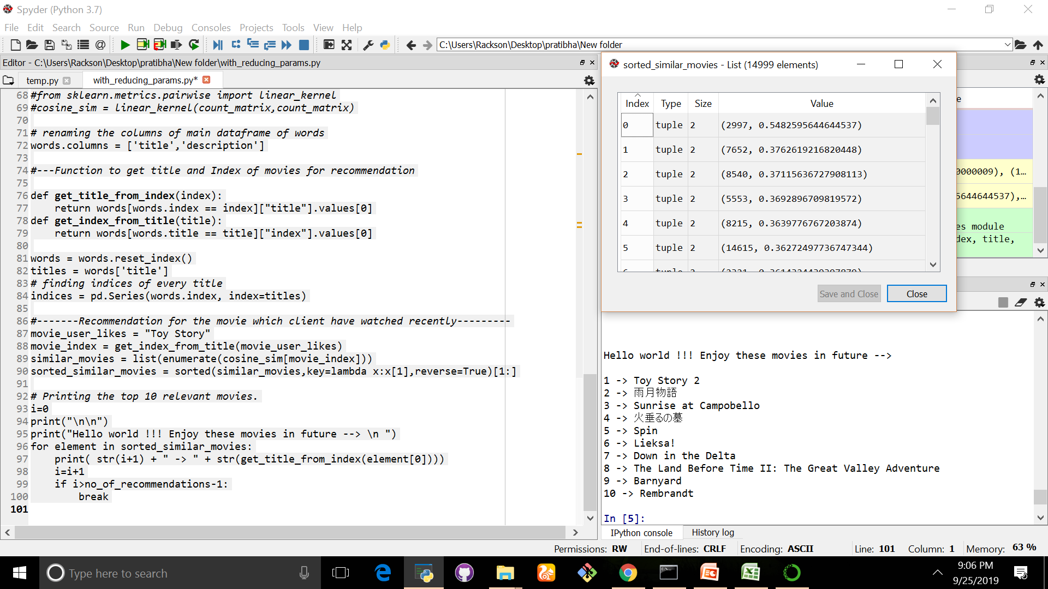
Toy Story for 15000 images with out stemming CF = 54.82 % MAX

Slide 13
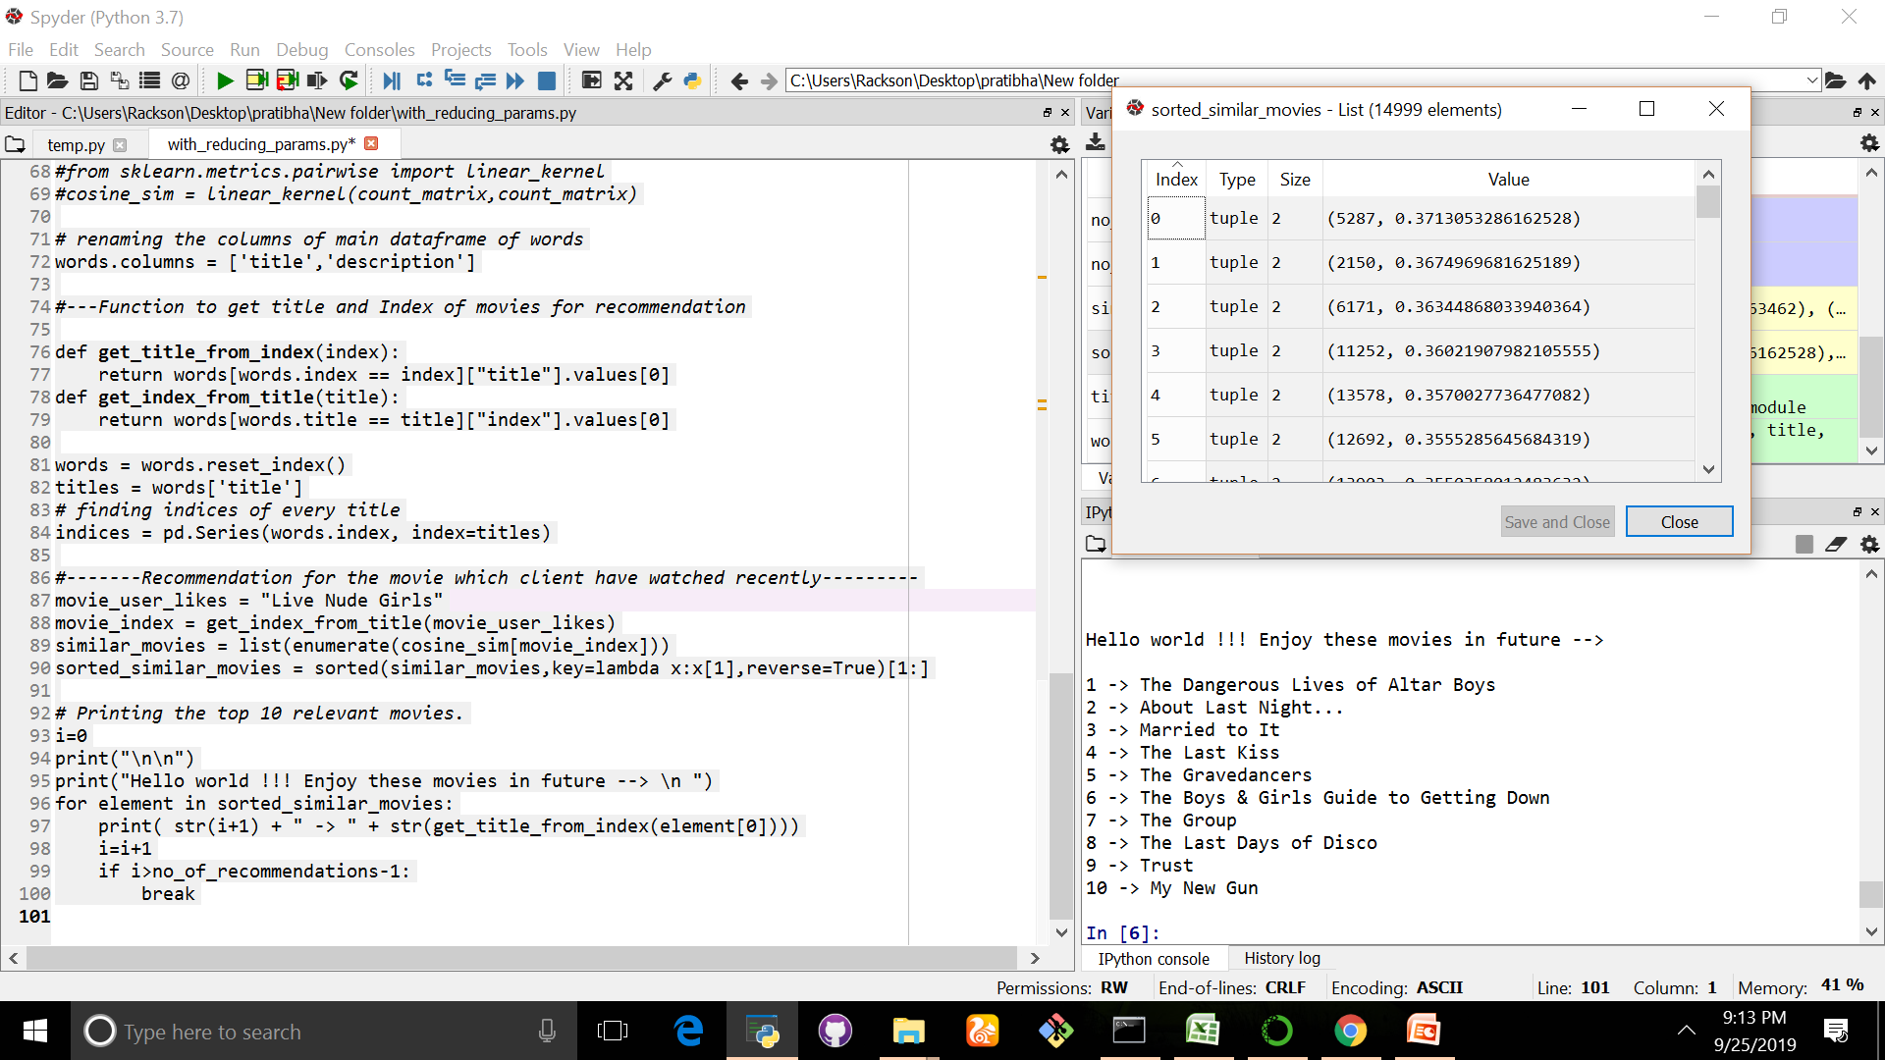
Live Nude GIRLS for 15000 images with out stemming CF = 37.13 % MAX

Slide 14
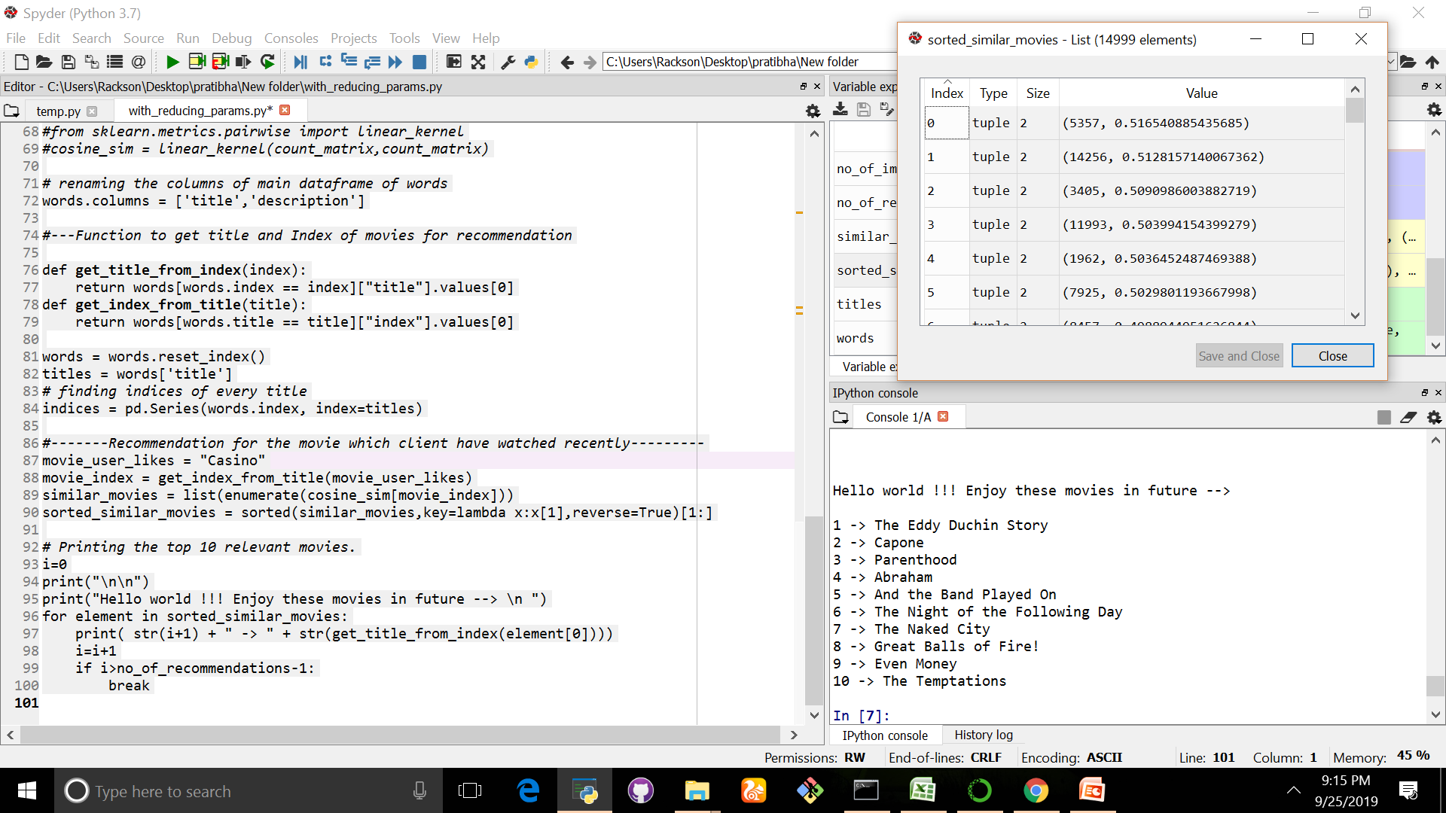
CASINO for 15000 images with out stemming CF = 51.65 % MAX

Slide 15
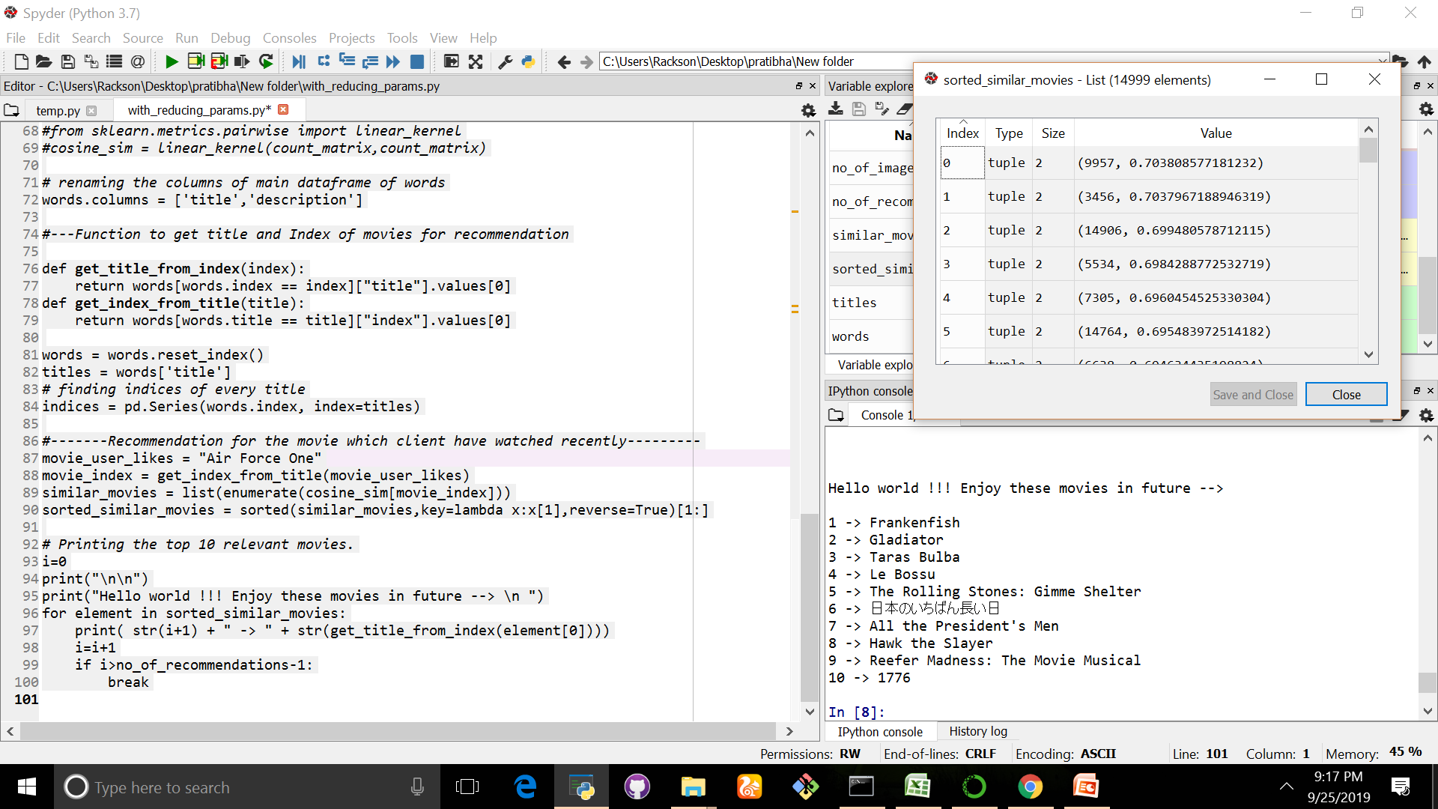
Air force one for 15000 images with out stemming CF = 70.38 % MAX

Slide 16
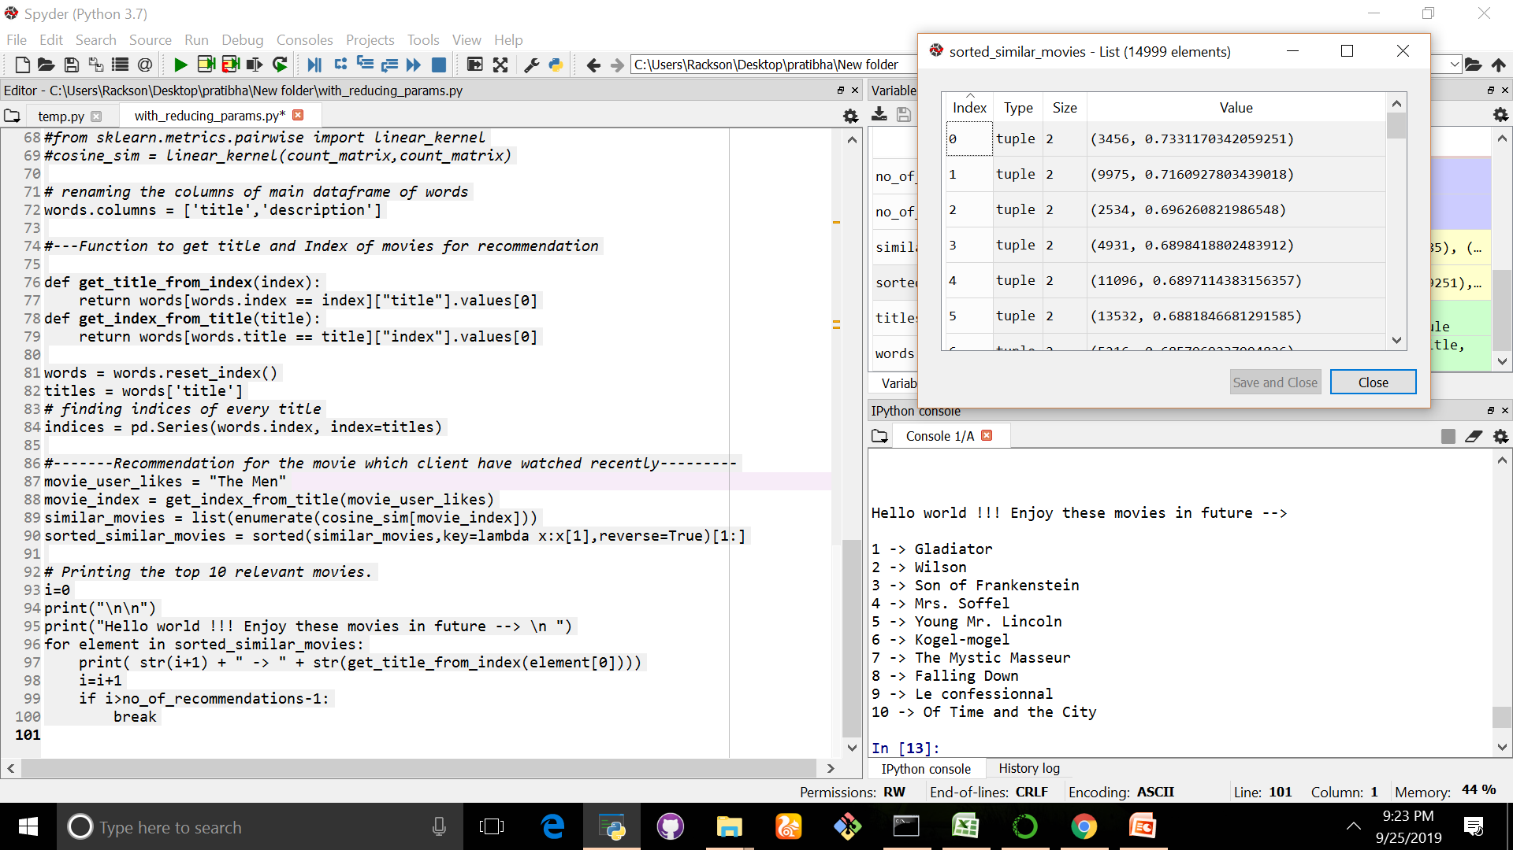
“The men” one for 15000 images with out stemming CF = 70.38 % MAX

