Slide 1

Agentic RAG & SLM
SCAN ME
By Damien Berezenko
https://linktr.ee/qdrddr
Notes:
Goal: better understand Agents & directions of its improvements and 2025 trends
Audience: Technical people, Students

Slide 2
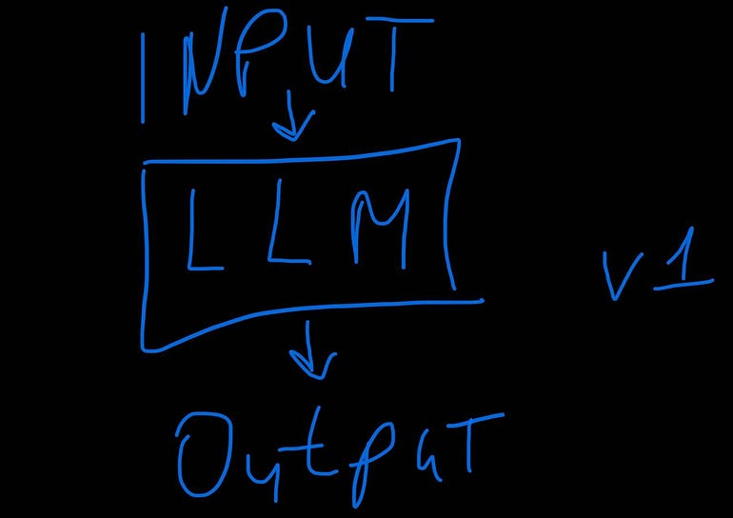
Evolution
To better understand Agents, we look at its evolution:
Prompt Engineering ➾ RAG ➾ Agents
https://linktr.ee/qdrddr
Notes:
It all started with LLM models. And naturally first step would be to to Prompt Engineer user requests to get better results.

Slide 3
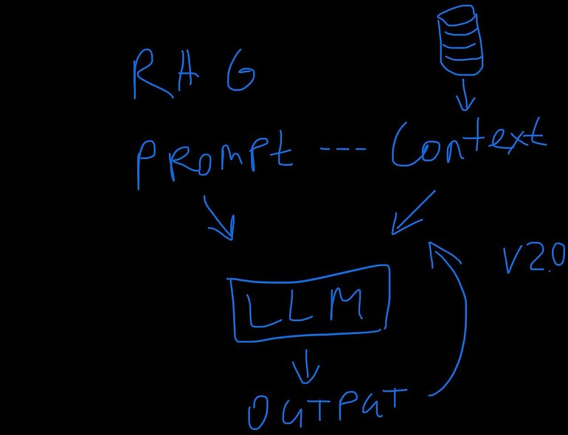
Retrieval-Augmented Generation (RAG)
Retrieve from an external Knowledge Source to be used as an additional context to generate a reply:
External Knowledge Source (outside the LLM model)
Easy Updates
Factual and more accurate
Provides sources that shaped the reply
https://linktr.ee/qdrddr
Notes:
Imagine this: A user asks a question, but the model's response feels incomplete or generic lucking some information. Here’s something we discovered: When we add extra information to a user’s question, the response improves dramatically. 💡
By ‘extra information,’ I mean external knowledge sources—anything outside the language model’s own training. 🌍 Think of live databases, up-to-date facts, business documentation, or specialized domain knowledge.
This is where RAG, or Retrieval-Augmented Generation, comes in. 🔍✨ Think of it as ability to speak with your data: 1️⃣ Retriever fetches the most relevant extra details from external sources
2️⃣ Blends it seamlessly with the original user question to give a much more grounded and accurate response.
The result? 🚀 A sharper, more insightful reply that better answers the user prompt.

Slide 4




Naïve RAG - 101
Retrieve – Semantic Search to Get Context
Augment – Prompt Engineering & Context
Generate – The answer
Stages:
Data Ingestion - Once
Runtime – Executed with each user request
PDF
DOCs
Files
Markdown
Chunks
Vector DB
RAG
https://linktr.ee/qdrddr
Notes:
Let’s break down how RAG works. It’s a two-step process:
1️⃣ Data ingestion
2️⃣ Runtime execution
👉 First, in the data ingestion phase, the developer in advance prepares the pipeline by preprocessing information and uploading it into a searchable database—often a vector store. Think of this as building a knowledge foundation.
👉 Then comes runtime execution. Each time when a user asks a question, the pipeline retrieves the most relevant pieces of information from that database. This information becomes the 'context' the language model uses to craft a response.
This is the foundational version of RAG: the 'naïve' implementation. It’s a simple single-shot interaction. It retrieves information and generates an answer in one go.
Not all documents are LLM-friendly. Reason? They all created for humans to interact visually via User Interface File formats like HTML, PDF, DOCX (Word Documents), and XLSX (Excel Spreadsheets) are often packed with visual elements—fonts, colors, tables, formulas, pictures, and graphs—that don’t translate neatly into text. These complexities can trip up your language model, making accurate processing difficult.
So, how do we handle this? The solution is to parse and extract the content into a machine-readable format documents. Markdown is an excellent choice—it’s lightweight and much easier for language models to process. And while there’s much more to say about this process, that’s a topic for another presentation.

Slide 5
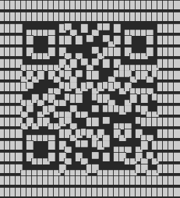






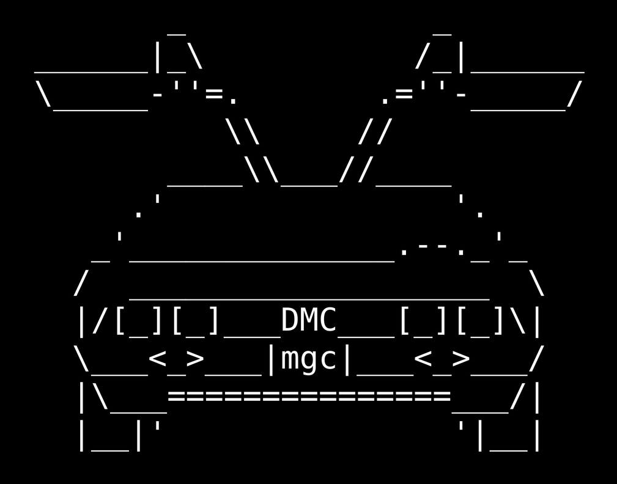


RAG: Ingesting & Retrieval
<div class="GARBAGE">
</div>
Context Retrieval
We ingest once, and occasionally add new or remove old docs:
Cleaning, Splitting Docs
Embeddings model generates vector coordinates for chunks
Save chunks with coordinates to Vector DB
User
Query
Ingestion & Index
Chunk
Docs
Vector
When a user posts a prompt each time:
Retrieve similar to the user prompt chunks from Vector DB
Augment the initial user prompt with this additional context
Generating an answer
Output
Reply
Prompt Instruction
Frozen LLM
https://linktr.ee/qdrddr
Notes:
Let’s take a closer look at the ingestion stage in a RAG pipeline—where the foundation is built.
1️⃣ First, cleaning the data is non-negotiable. Why? Because noisy or irrelevant content—things like ASCII art, leftover HTML tags, or other random artifacts—can confuse the language model.
2️⃣ After cleaning, the data is broken into smaller, manageable fragments - chunks.
3️⃣ For each chunk, we create vector embeddings—essentially, a mathematical fingerprint of the data you can think of as coordinates.
4️⃣ These embeddings are then stored in a vector database, ready for quick retrieval later.
Here’s where RAG shines: flexibility. You can seamlessly update the database—adding or removing documents in the background—without retraining the language model. That means you can keep your knowledge base fresh and relevant without interrupting operations.
But there’s more. RAG can even cite its sources. When generating a response, it can reference specific documents it pulled information from. Why does that matter?
1️⃣ It ensures factual accuracy.
2️⃣ It provides traceability—you can verify where the information came from.
3️⃣ And it gives users additional context to understand how the answer was formed.
This combination of fast retrieval, flexibility and transparency is what makes RAG a game-changer.

Slide 6
Vector DB, Embeddings, Semantic Similarity
Milvus
Weavite
Pinecone
City | Latitude | Longitude | Population
Chicago, IL | 41°88’18”N | -87°62’31”W | 2, 668,000
Cicero, IL | 41°84’56”N | -87°75’39”W | 81,919
Queen
Queen = [0.3, 0.9, 0.1]
Queen = [0.3, 0.9, 0.1]
King
King = [0.5, 0.7, 0.1]
King = [0.5, 0.7, 0.1]
-
Queen = [0.3, 0.9, 0.1]
Woman
Woman = [0.3, 0.4, 0.1]
Chicago, IL
Cicero, IL
[0.0, 0.5, 0.0]
Man
Woman = [0.3, 0.4, 0.1]
Woman = [0.3, 0.4, 0.1]
+
Man = [0.5, 0.2, 0.1]
Man = [0.5, 0.2, 0.1]
Man = [0.5, 0.2, 0.1]
King = [0.5, 0.7, 0.1]
https://linktr.ee/qdrddr
Notes:
Let’s unravel the world of embedding models, vector coordinates, and how they power data search in a Vector Database.
First, what exactly is a Vector Database? Picture it as a storage system of coordinate records—numeric representations of chunks of data with the original data just like on the table. These coordinates are created by embedding models, and here’s where the magic begins.
An embedding model takes a piece of data, processes it, and assigns it a set of coordinates inside something called latent space. This space is multi-dimensional and captures the relationships between different pieces of data.
Let’s simplify this with an analogy. Imagine mapping cities:
👉 Humans might compare locations looking at a map or using a table with latitude and longitude columns.
👉 Computers? The same table with text and coordinates can be used against algorithms to mathematically calculate the proximity.
Now, add another layer—like city populations. Suddenly, you’ve moved from two dimensions to three which is harder for humans with each additional dimension added. Computers excel at handling this kind of complexity for hundreds or thousands of dimensions.
Here is a twist, swap city coordinates with words. Embedding models assign coordinates to words in a multi-dimensional space—but instead of physical proximity, these coordinates represent semantic similarity or meaning of the words.
🔹 Synonyms like ‘big’ and ‘large’ are close together.
🔹 Antonyms like ‘big’ and ‘small’ are far apart in opposite directions.
Who determines these coordinates? Much like how humans created maps, we’ve built these multi-dimensional 'maps' for language through embedding models using dictionaries with synonymous and anomalous. These vectors are not just points—they include both a position in space and a direction, which is why they’re called vectors.
Here’s a fascinating math: if you take the vector for 'Queen,' subtract 'Woman,' and add 'Man,' you end up near the vector for 'King.' This reveals how embedding models intuitively capture semantic relationships.
But what about larger text—paragraphs, even whole documents? The process involves breaking the text into words, generating vectors for each, and averaging them to find a central point in latent space. This technique helps systems like Google Search Engine retrieve semantically similar content when you search the web.
Remember: embedding models are not interchangeable. If you’ve generated vectors and store data in a Vector Database using one model, you must use that same model to retrieve it. Switching models means starting over and re-ingesting the data with new vectors.
Finally, if you’re thinking about building a RAG pipeline, check out tools like Milvus, Weaviate, or Pinecone.
This is how we’re transforming the way we search, map, and understand information.

Slide 7














Advanced RAG Techniques
Retrieve
Augment
Generate
Ingestion
Split
Store
Context Retrieval
Output
Reply
Prompt Instruction
URLs
User
Query
DOCX
Naïve RAG
DOCX
Ingestion & Index
DOCX
Vector DB
Chunk
Docs
Chunk
Docs
Frozen LLM
Vector
Database
Pre-Retrieval
Query Routing
Rewriting
Expansion
Context Retrieval
Post-Retrieval
Output
Reply
User
Query
Rerank
Prompt Instruction
Advanced RAG
Ingestion & Index
Summary
Retrieval
Augmentation
Generation
Chunk
Docs
Frozen LLM
Vector DB
Vector
Fusion
Relevant
LLM
https://linktr.ee/qdrddr
Chunk
Prompt
Reply
User
Question
Notes:
Let’s start with the foundation: the simple, or naïve, RAG system. At its core, a naïve RAG retrieves additional information from an external source—typically a Vector Database or another backend system. It’s a straightforward process: a single retrieval step based on the user’s query.
But here’s the catch with naïve RAG—it has some major gaps: ❌ No error correction and No reflection ❌ No memory—it can’t remember past interactions. ❌ No ability to plan or handle multi-step, goal-oriented tasks.
❌ No ability to qualify and validate the retrieved data or understand if there is too much or not enough data
This is where we step in to making our RAG smarter.
Imagine we add pre-retrieval and post-retrieval steps to transform a simple process into an intelligent, multi-step pipeline. Let me show you how.
Before retrieving anything, we can refine the user’s query for Pre-retrieval Enhancements:
1️⃣ Breaking down complex questions into smaller, manageable sub-questions. This ensures more targeted and accurate results.
2️⃣ Hypothetical answers. Here, the LLM predicts what a relevant document might look like in the Vector Database. This often leads to better matches than using the original user query alone.
3️⃣ Smart routing. The system can analyze the query and decide which external source—a database, API, or other resource—is best suited to handle it.
While retrieving information, we can apply metadata filtering to narrow down results to Enhancements Retrieval. For example, if at indexing stage we’ve tagged chunks with metadata like author, creation date, or topic, the pipeline can filter by these attributes during retrieval improves relevance.
But even after retrieval, not all the results will be useful post retrieval. Here’s where re-ranking models come in. This specialized model evaluate the retrieved chunks, prioritize the most relevant ones, and discard the noise.
One common challenge with RAG pipelines is losing context. When we split documents into smaller chunks, the surrounding context is often lost, which can dilute the meaning. To address this, we can use:
👉 LLM-based compression techniques. Imagine taking a paragraph, adding surrounding context, and asking the model to rewrite it into a more concise, meaningful version. Then we use the newly created chunk to generate vectors with embedding model instead of the original chunk.
👉 Caching strategies to handle repetitive, long texts efficiently in cases such as just described compression technique—placing static content upfront and dynamic chunks at the end to save costs and resources.
👉 Similar technique can also be applied to embeddings, using the surrounding data as a context for a chunk preserving their semantic meaning in a vector database.
The Beauty of Advanced RAG
Here’s the best part: all of these enhancements work outside the LLM. By optimizing the pipeline, we can significantly improve response quality without touching the language model itself.
For specialized domains like legal, research, or customer service, an advanced RAG pipeline isn’t just an upgrade—it’s a game-changer.
So, the question isn’t whether RAG is good enough—it’s how far you can take it in your domain of interest.

Slide 8
Advanced RAG Engineering
Prompt Engineering
RAG Techniques (CoT, ReAct, ReWOO, HyDE, Reflection)
Memory, Planner
Step-Back Prompting
Code Generation & Execution
Top K, Similarity algorithm
Metadata Filtering
Guardrails
Full-Text Search Query Construction
Retrieval Window
Query Transformation
Sub-Query, Multi-Query
Pre-Retrieval
Query Routing
Rewriting
Expansion
Context Retrieval
Post-Retrieval
Output
Reply
Chunking size, Overlap &
Method, Judge Multiple indexes
Rule-based-retrieval
User
Query
Rerank
Prompt Instruction
Summary
Human feedback
Anonymization (Again)
Saving Strategies
Tracing & Evaluation
Chunk
Docs
Frozen LLM
Vector
Fusion
Dedup
Data cleaning
PII/PHI Anonymization
Document Parsers
Embedding Model
Chat Language, Context Size, Apply Metadata
Hierarchical index of linked chunks
Semantic Layer, Stacking technique
Model temperature
Guardrails (Again) Critique Selection
Domain Knowledge LLM
Fine-tune LLM
https://arxiv.org/abs/2312.10997
https://linktr.ee/qdrddr
Notes:
Improving RAG is like peeling an onion—each layer you remove reveals another opportunity for enhancement. So let’s explore how we can elevate a basic Naïve RAG system to something much more powerful—even beyond Advanced RAG.
Let's start with the Ingestion Phase: The foundation of any RAG system is the data it’s built on. Think of ingestion as your first line of defense.
1️⃣ Remove duplicates. Imagine the same document uploaded multiple times—it’s wasteful and distorts your retrieval results.
2️⃣ Clean your data. Strange artifacts like barcodes, random HTML tags, or even ASCII art? These can confuse your LLM and degrade the quality of responses.
3️⃣ Handle complex documents. PDFs or other rich formats should be converted into lightweight, machine-readable formats like Markdown to make processing easier for your LLM.
4️⃣ Watch out for data leakage. Anonymization is critical—scrub out personal identifiers, sensitive health info, or anything else that could compromise privacy.
As we say: garbage in, garbage out. Clean inputs lead to better results.
Now, let’s talk about splitting text into chunks—a deceptively simple yet critical step. The challenge? Context.
🔹 Too big, and costs balloon. Too small, and context is lost.
🔹 Use strategies that preserve semantic meaning when splitting.
🔹 Advanced systems can even dynamically pull adjacent chunks during retrieval
🔹 Apply stacking technique for storing the same data split in multiple ways across separate vector collections.
And don’t forget about the context window size of your embedding model—this determines how much information you can fit into a single query.
Here’s a tip: Hybrid search techniques—combining semantic search with full-text search—can amplify retrieval quality, merging the best of both worlds, especially when combined with metadata filtering.
Now, at retrieval phase we
🔸 Apply re-ranking. These refine results, filtering out irrelevant chunks and prioritizing what matters most.
Still not enough context? Advanced pipelines can dynamically fetch additional chunks on the go.
Once the data is retrieved, why not apply Smart Routing?
👉 To Route tasks to the right LLMs. For example, programming code might go to a code-optimized model, while healthcare queries could leverage a specialized medical LLM.
👉 Then we configure the model parameters, like adjusting the temperature setting to balance precision and creativity.
When the output is generated, the process isn’t over.
1️⃣ We better run another round of anonymization checks to ensure safety and privacy.
2️⃣ Add user feedback and chat history to improve responses over time.
And the very last thing is to trace and evaluate the result and probably start reconfiguring your RAG all over again for a couple of times. So, the question is—how far are you willing to take your RAG solution?
These small but impactful steps transform RAG from a simple retrieval system into a sophisticated, domain-adaptable powerhouse capable of handling even the most complex queries with precision and relevance.
With every improvement, we unlock new potential in how RAG systems can serve our needs one tiny step forward with each improvement and the trick here is to accumulate these small improvements that compound.

Slide 9
Practical pipeline example
BM25
Mix Retrieval
Sparse
Document
CoVe
Sub-Query
Evals Quality
Retrieve
Dense
Document
Query Expansion
Judge
Embeddings
Rerank
Selection
Generate
Response
Sub-Query
Generate
Document
LLM Critique
LLM Model
User Query
Sub-Query
Confidence-based active retriever
Query Transformation
Query~
Generate
Document
https://linktr.ee/qdrddr
Notes:
Let me take you on a journey through a real-world example – a pipeline from a well-established firm that wraps their RAG around LLMs. This is a great case study of how to structure and enhance the RAG pipeline.
The process starts with a User Query. At this stage, the pipeline decides whether to transform it into a database query or to expand it for better clarity and retrieval. After the query expansion we might involve techniques like splitting a complex question into sub-questions. This is where methods like Chain-of-Verification (CoVe) come in—breaking down the query into logical components and verifying the coherence for each.
Once the sub-questions are generated, we can leverage an LLM Judge to evaluate the quality of these sub-questions. This ensures that only the most meaningful ones move forward. The system then decides if additional external knowledge from a database would improve the response. If external knowledge is deemed necessary, we query the database, by using a hybrid search approach that combines vector-based semantic search and traditional full-text search for better accuracy.
Now that we’ve retrieved relevant documents, we move on to the re-ranking phase. Here, the system filters out semantically similar but irrelevant chunks and sorts the remaining ones by their relevance to the user query. Re-ranking typically uses specialized models designed to refine the selection and remove irrelevant chunks.
But we don’t stop there. Before generating the response, the system applies an LLM critique to the retrieved data. This critique evaluates the advantages and disadvantages of the dataset, adding a layer of quality control. Once the critique is complete, the final response is generated and delivered to the user.
One thing to remember: different domains may require unique pipeline configurations. Techniques that work well for in one domain—such as finance or legal—might not perform as effectively in another, like healthcare or programming. There’s no one-size-fits-all solution here.
So while this example pipeline is a strong starting point, it’s crucial to evaluate and adapt it to suit your specific use case. The key to success is continuous evaluation and iteration.

Slide 10
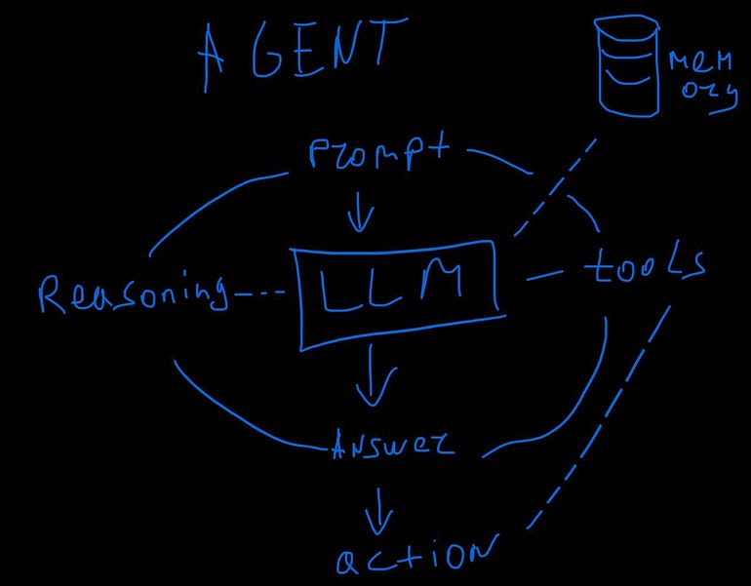
Agentic RAG
Agents can repeat steps, have a query capabilities and create step-by step planning to follow check and self-reflect, Tool interface for external environments such as internet search integrate with services and have memory for personalization.
https://linktr.ee/qdrddr
Notes:
Let’s dive into a topic of agents, tools, and function calling—key concepts for building dynamic, real-world applications around LLMs.
So, what exactly is an agent? It’s something that takes action and impacts the real world. For instance, if your system not only drafts an email but also sends it, or creates a meeting invite and schedules it in your calendar, that’s an agent.
On the other hand, if you’re just having a conversation in a chat without further action, that’s probably not an agent—it’s simply an interaction.
Agents rely on tools to connect with the external world. Tools are the mechanisms that enable agents to interact with systems like Gmail, Calendars, and pull Weather forecasting and Financial data via APIs. Think of them as the bridge between the agent and the world it influences.
Now, let’s talk about function calling. Function calling allows the model to produce strictly formatted outputs, such as JSON, making it incredibly effective for your pipeline to interface with systems like databases, APIs, or functions in your code.
Here’s an example: imagine you have a Python function with specific parameters and data types. You can prompt an LLM with function-calling capabilities to generate output that perfectly fits those requirements, ready to be used in your application.
Another scenario: let’s say you need data from a relational database. The LLM can create an SQL query tailored to your database schema. This also applies to vector databases, where dynamic filters might be applied based on the user’s query.
The best part? Most modern LLMs support function calling, making this functionality widely accessible for a variety of applications.
But here’s an interesting twist: not all tool use equates to agentic behavior. For example, retrieving data from the internet or filtering a database might feel like agent behavior but doesn’t actually change the world.
So, what truly sets agents apart? They can:
🔶 Repeat steps and iterate over processes.
🔶 Perform multi-step reasoning, breaking down complex queries into actionable steps.
🔶 Execute step-by-step planning, incorporating checks and self-reflection along the way.
🔶 Use tools to interact with external environments, such as querying APIs, conducting search queries, to integrating with services and databases.
🔶 Leverage memory to personalize and adapt over time, creating a more user-focused experience over time.
Now, here’s an interesting nuance: Features that leverage tools typically implemented as part of an agent framework, even if they don’t technically ‘change the world.’
In essence, agents don’t just understand—they act. By combining tools, function calling, and memory, they bridge the gap between LLMs and real-world applications, delivering solutions that don’t just inform but take meaningful action.

Slide 11
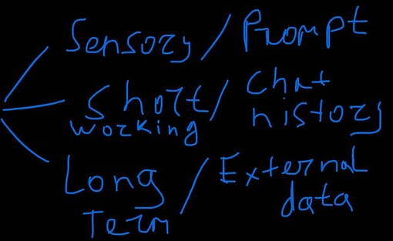

Conversation Memory
ZEP Memory (getzep/graphiti)
Mem0.ai, MS Kernel Memory
Anthropic’s ModelContextProtocol Memory
Topoteretes/Cognee
Letta / MemGPT
User Query
RAG
Memory
Response
https://linktr.ee/qdrddr
Notes:
Let’s talk about memory in chatbot conversations. While it’s not always essential, memory can dramatically enhance the user experience, making a chatbot feel more intelligent and personalized.
Have you ever noticed how, after a while, ChatGPT forgets something you mentioned earlier? [PAUSE]
That’s memory—or more accurately, the limits of it.
When we design chatbots, there are three types of memory to consider:
1️⃣ First, Sensory Memory. This is the memory within a single prompt. The model uses its built-in attention mechanism to process all the information in that one prompt—but once it responds, it forgets everything. Sensory memory can be improved with techniques like RAG, where the pipeline breaks down complex input into smaller queries and uses planning to generate more informed answers.
2️⃣ Next, Short-Term Memory. This works within a single conversation session. For example, if you say, ‘Let’s talk about my schedule,’ and later ask, ‘What’s next for me?’ the bot understands what 'next' refers to based on the context of your session. However, this memory resets when the conversation ends.
3️⃣ Finally, Long-Term Memory. This is what enables a chatbot to remember important details across multiple conversations—like your name, preferences, or frequently discussed topics. If you tell the bot, ‘I’m Damien,’ it can store that information and recall it in future interactions, making the experience feel persistent and personalized.
To highlight the importance of memory, imagine a user with dyslexia at the beginning of the chat stating that “I cannot read, please always speak to me”, now its always important to remember that context across all the conversations.
So how do we tackle forgetting, especially for long-term memory? One effective method is using tools to extract and store key information in a structured way, like a Knowledge Graph.
Here’s how it works: If you say, ‘Hey, I’m Damien. How are you?’ the system identifies the entity ‘Damien’ and stores this knowledge as a node in the Graph Database. It also records the relationship ‘HAS_NAME’ connecting you to that node. Later, if you ask, ‘How am I?’ the system queries the graph, retrieves the ‘HAS_NAME’ relationship and the corresponding node, and responds with, ‘You’re Damien.’
This approach scales, allowing the system to remember not just names but preferences, and past queries.
Memory is a key component of conversational AI, transforming chatbots from functional tools into truly engaging companions. By choosing the right memory model—whether sensory, short-term, or long-term—and leveraging techniques like sub-query creation, planning, and Knowledge Graphs, we can make chatbots smarter, more reliable, and deeply personalized.
Interestingly some researches are pointing out that having too much memory depending on the case can be both good or bad. And we have yet to find this balance.

Slide 12
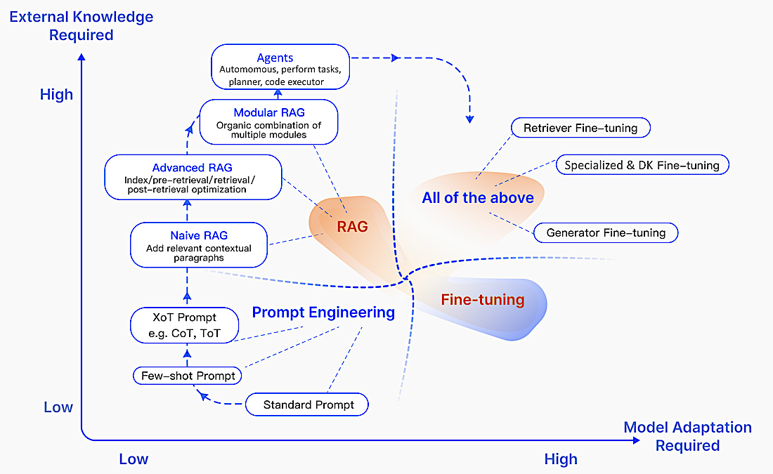
Optimization Methods: External Knowledge vs. Model Adaption
Inspired by https://arxiv.org/abs/2312.10997
https://linktr.ee/qdrddr
Notes:
Let’s explore the evolution of pipeline optimization and how it aligns with external knowledge and model adaptation.
Starting Simple: Start with prompt engineering.
1️⃣ At this stage, you’re crafting prompts to optimize your existing LLM without any changes to it.
2️⃣ If the results are inconsistent or you want to handle slightly more nuanced tasks, try a few-shot prompting technique. Here, you provide a few examples within the prompt itself to guide the model.
3️⃣ Once you’ve mastered basic prompt engineering, move to techniques like Chain-of-Thought (CoT) prompting. CoT encourages the model to explicitly produce step-by-step reasoning before arriving at a conclusion. This is particularly helpful for tasks requiring logical reasoning or multi-step answers.
What if the LLM’s built-in knowledge isn’t enough? That’s where RAG comes in and it’s time to integrate external knowledge using RAG. At this stage, you’re enriching the model’s responses by retrieving relevant data from external databases, like a Vector DB, and injecting it into the prompt context.
👉 RAG enables you to work with external knowledge sources without retraining the LLM, making it a cost-effective step forward.
👉 As your needs grow, you can develop an Advanced or Modular RAG: Modular RAG provides a higher level of abstraction making your pipeline even more flexible and customizable.
When to Consider Agentic RAG: Now, if your application requires to perform real-world actions—like sending an email, scheduling tasks, or dynamically retrieving additional data with each user query—you’re moving into the realm of Agentic RAG.
🔹 Agents go beyond retrieval; they plan, act, and perform tasks dynamically.
🔹 At this stage, you’ve developed a pipeline that can think, act, and fetch on demand, tailored to user-specific needs personalized with user feedback and chat history memory.
What If It’s Still Not Enough? So, you’ve optimized your RAG pipeline, implemented agents, evaluated the results and optimized your pipeline and still feel the performance isn’t meeting expectations? That’s when you start considering LLM fine-tuning or even building a custom model.
🔸 Fine-tuning involves training the LLM on your specific dataset to enhance its understanding of your domain.
🔸 If your needs are highly specialized and existing models lack the necessary flexibility, you may need to explore building your own model optimized for your unique use case.
The takeaway? Start simple, then scale. Move step by step—from basic prompt engineering to RAG and Agents and then to fine-tuning or custom models—only as needed. Fine-tuning and custom model development should only be considered when the preceding methods fail to deliver the desired results, as they involve significant cost and complexity.

Slide 13
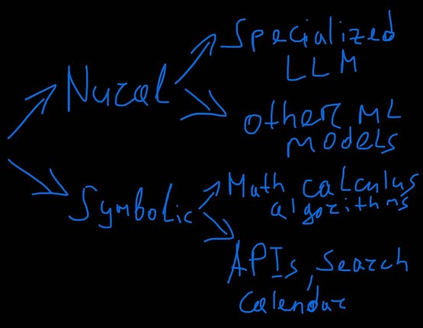
SLM & Price considerations
Function Calling: Functionary-Medium-v3.1 (FC) is better than Gemini-1.5-Pro-002 (Prompt) and almost the same as GPT-4o-mini-2024-07-18
BloombergGPT ranges from sentiment analysis and named entity recognition to question-answering in the financial domain and Time Series Prediction (stock price forecasting)
Language detector, grammar / punctuation, sentiment analysis, Gibberish / nonsensical detection, Named Entity and Relation extraction, mathematics, speech recognition and generation, SQL generation, Program Language generation, reranking, Nxcode-CQ-7B-orpo for python.
Example: BGE-EN-ICL Embedding is x10 cheaper than OpenAI text-embedding-3-large and much better quality (#2 vs. #38 on MTEB leaderboard)
https://linktr.ee/qdrddr
Notes:
As exciting as AGI (Artificial General Intelligence) is sounds, businesses don’t actually need it. What they truly care about are solutions that solve their specific problems—efficiently and cost-effectively.
Massive, mega-large LLMs may be impressive, but if they come with sky-high costs, they lose their appeal. What businesses really need are cost-optimized, domain-specific models tailored to their challenges.
I believe 2025 will be the year of small, specialized language models and agents. These models aren’t about being the biggest—they’re about being the most effective for a given task.
Take this example: Instead of using general-purpose models like Gemini 1.5 Pro or GPT-4 Turbo Mini for function-calling tasks, you could turn to a specialized model like Functionary-Medium. It’s optimized for that specific job, may costs less for inference, and delivers comparable quality.
Or consider BloombergGPT, a model fine-tuned for financial tasks like stock market sentiment analysis. It’s built for the financial domain, delivering precision where general-purpose models might fall short. This model is a prime example of how businesses are moving towards task-specific LLMs that deliver better outcomes for their niche.
And this isn’t just theory. We already see specialized models excelling in tasks like:
🔶 Language and nonsense detection
🔶 Grammar verification
🔶 Sentiment analysis
🔶 Named Entity Recognition (NER)
🔶 SQL query generation
🔶 Guardrails to prevent harmful or unethical misuse
Even embeddings are being optimized. OpenAI’s text-embedding-3-large ranks 38th on the MTEB leaderboard. But a competitor like BGE-ICL delivers comparable quality for a fraction of the cost—10x cheaper, in fact, while sitting on the 2nd place on the leaderboard. [PAUSE]
This is the new norm: Multi-Model RAG. Instead of defaulting to large, expensive models for everything, businesses are integrating smaller, specialized models into their pipelines. Some models excel in quality for narrow domains; others optimize for speed and cost.
Even major providers are catching on. OpenAI, for example, isn’t rushing to release GPT-5. Instead, they’re focusing on:
👉 Improving smaller, multi-language models
👉 Expanding agent capabilities for business needs
👉 Enhancing cost efficiency without sacrificing quality
The future of AI isn’t about having the largest model. It’s about having the right models—tailored, efficient, and specialized. For businesses, that’s how AI truly becomes a game-changer.
I encourage you to explore models and decompose your pipelines with smaller sub-tasks that can incorporate models with specific use cases instead of defaulting to massive, generic LLMs. Large Models are still needed and useful but as one of many other models in your RAG pipeline.

Slide 14
Final Thoughts
There are other LLM inferring providers out there
Use Small Language Models & Specialized Models for specific tasks
Use multiple models in a solution
Trace & Evaluate RAG results
Businesses do not care for AGI, they need affordable solutions for their use-cases
SCAN ME
https://linktr.ee/qdrddr

Slide 15
Frameworks
LangChain
LlamaIndex
Stanford NLP’s DSPy
LangFlow (build with LangChain) - LowCode
Unstructured.io, LlamaParse (LlamaIndex)
IBM’s Docling, VLMs, Reducto, MS MarkItDown
RAGas & Opik for eval, LangFuse tracing
https://linktr.ee/qdrddr
Notes:
Let’s take a look at some of the most notable frameworks that can help you build a custom Agentic RAG solution—tools designed to streamline the process of coding integrations, retrieval, language models, and agent-like behavior.
🔹 To start, I want to highlight these key frameworks: LangChain, LlamaIndex, and DSPy. These are powerful platforms for creating your Agentic RAG pipeline. Each has its unique strengths, but they all offer flexible ways to combine retrieval and generation with your chosen language model.
Now, for those of you just starting out—especially if you’re a visual learner—let me introduce LangFlow. This tool is a game-changer for you. It’s a low-code, drag-and-drop interface where you can visually design your pipeline. Simply use templates of RAG pipelines, drag and drop components, venture into customize them to your needs, and—if you want—dive deeper into the Python code to tune everything. It’s an intuitive way to learn how RAG and agents work under the hood while building something functional.
But converting complex files like PDFs or DOCX (Word Documents) into Markdown isn’t always straightforward. Here are a few standout document parsers to consider:
🔹 Unstructured, IBM Docling, LlamaParser combined with emerging and promising Multi-Modal LLMs and VLM models that can process files with both Text and Visually.
These tools bridge the gap between raw data and what your language model can handle efficiently.
Now, a word of caution. Preparing documents for your pipeline is a balancing act. You’ll need to account for the limitations of language models, the complexity of your data, and, of course, the costs—especially when scaling up. It’s a challenge, but mastering this step is absolutely critical for building an enterprise RAG solution.

Slide 16
Agentic Platforms
LangGraph
OpenAI Swarm
Microsoft AutoGen, Semantic Kernel & Azure AI Agent Service
PedanticAI
AWS Multi-Agent Orchestrator
Crew AI
Haystack
https://linktr.ee/qdrddr

Slide 17
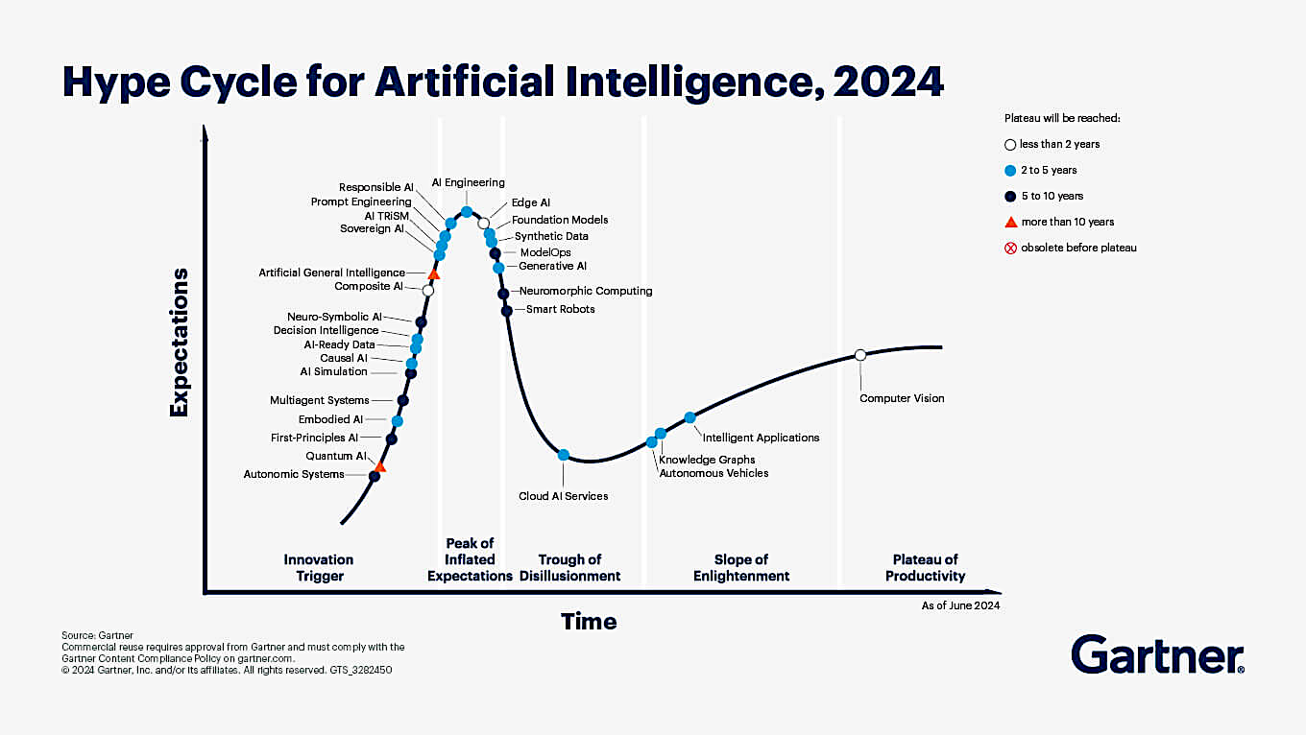
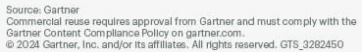
Hype Cycle for Artificial Intelligence, 2024
https://www.gartner.com/en/articles/hype-cycle-for-artificial-intelligence
https://linktr.ee/qdrddr

