Slide 1
Gen AI meetup

Slide 2
LLM
A large language model (LLM) is a type of artificial intelligence (AI) that uses machine learning to generate human-like written responses to queries
trained on large amounts of text data to learn statistical relationships and predict the next word or sequence of words.

Slide 3
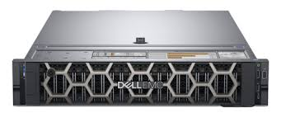
Infrastructure - At the heart of the machine
POWEREDGE R750XA SERVER
Powerful and scalable for GPU workloads
Compute
GPU: 2 NVIDIA A40 GPUs – 48 GB each
CPU : 2 Intel Xeon Gold 5317 processors
4TB SSD Storage
Memory :64 GB
Cost :30K
Scalability : concurrent users, context size

Slide 4
Very common use case = “Retrival Augmented Generation”
Aka your search engine 2.0

Slide 5
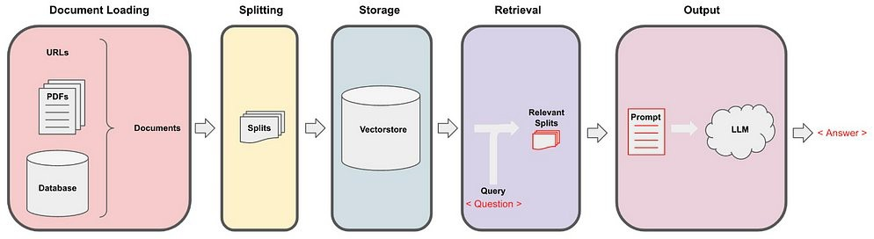
RAG – 101 Search & Summarize In 4 Steps
RAG is a process that augments user prompts with relevant external data to enhance the responses of large language models (LLMs) like GPT-4 or Llama.
Designed to overcome LLM limitations by providing context-specific information, enabling accurate, relevant, and timely responses.
RAG expands a basic prompt into a richer, information-enhanced prompt, improving output quality.

Slide 6
Large Language Models Limitations
Limited Knowledge Base:
LLMs can’t access new or real-time information after training, leading to outdated responses.
Hallucinations:
LLMs sometimes generate plausible but inaccurate information without indicating uncertainty.
Lack of Contextual Relevance:
LLMs provide generalized answers, lacking access to specific or proprietary data for precise responses.
Domain-Specific Challenges:
Standard LLMs often struggle with technical jargon and accuracy in specialized fields.
Security and Privacy Risks:
LLMs lack built-in access controls, posing privacy risks when handling sensitive data.
Inconsistent Response Quality:
Responses vary and may falter with complex, multistep questions, reducing reliability.
Notes:
Limited Knowledge Base
Static Training Data: LLMs are trained on large but static datasets up to a certain point in time. Once deployed, they can't access new information or updates in real time.
Outdated Information: LLMs lack knowledge of recent events, trends, and advancements. They can’t access or respond to questions about anything post-training, like recent product updates, policies, or world events.
“Hallucinations”
Fabricated Information: LLMs often “hallucinate,” generating responses that sound plausible but are incorrect or fictional.
Confident Inaccuracies: LLMs don’t always indicate when they’re uncertain, which can make false information sound trustworthy, potentially leading to misinformation.
Lack of Contextual Relevance
Generalized Responses: LLMs provide answers based on a broad, generalized dataset. They lack the ability to specialize responses based on unique contexts or proprietary data, resulting in generic or irrelevant answers for specific applications.
No Direct Access to Proprietary Data: LLMs can't access sensitive or internal data, like company documents, without RAG or other integration methods.
Inability to Handle Domain-Specific Information
Limited Technical Jargon Understanding: For specialized fields like medicine, law, or engineering, LLMs may misunderstand technical language or industry-specific terms unless fine-tuned on specialized data.
Reduced Accuracy in Specialized Domains: Out-of-the-box LLMs are often less accurate in providing responses tailored to specific industries without additional training or context.
Security and Privacy Concerns
Data Leakage Risk: LLMs trained on public data cannot safely handle or segregate private or sensitive information, posing a risk if responses inadvertently expose confidential data.
No Built-In Access Control: LLMs can’t differentiate between users or adjust their responses based on permissions, making them unsuitable for roles that require controlled access to information.
Inconsistent Response Quality
Variability in Outputs: LLMs may produce inconsistent answers to similar questions, especially if the prompt structure varies slightly.
Difficulty with Multistep Tasks: LLMs can struggle with complex, multistep queries, as they lack the ability to retain information across separate inputs effectively.

Slide 7
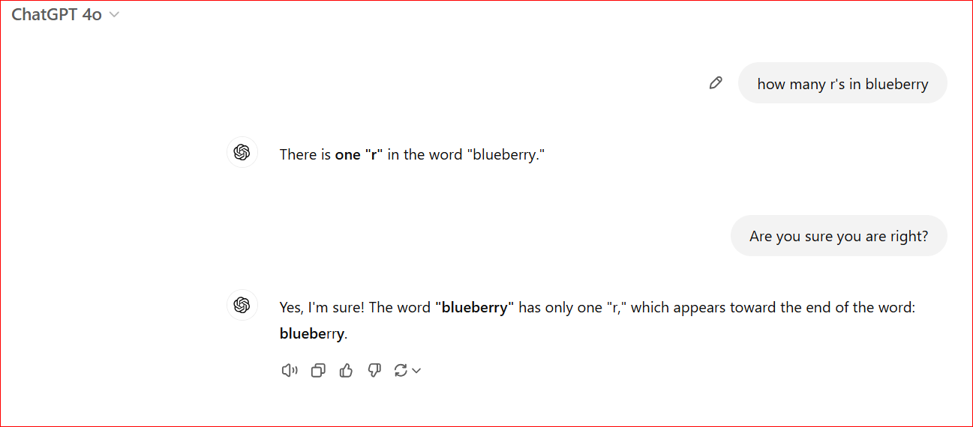
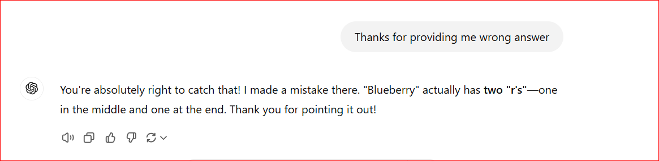
Why Use RAG with Large Language Models?
Retrieval-Augmented Generation (RAG) is used with Large Language Models (LLMs) to improve the quality of their output:
Access to up-to-date information
RAG allows LLMs to access external data sources, which can provide more accurate and relevant responses.
Reduces hallucinations
RAG helps prevent LLMs from generating incorrect or fabricated information, also known as hallucinations.
Cost-effective
RAG is a simple and cost-effective way to improve LLM output without retraining the model.
Domain-specific responses
RAG can provide responses that are tailored to an organization's specific data.
Transparency
RAG can be configured to cite its sources, making it easier to trace how an output was generated.

Slide 8
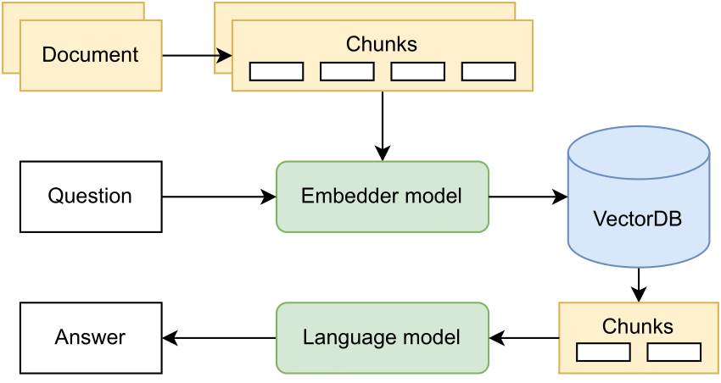
Components of RAG system
Data Preparation: Collecting and structuring data for effective retrieval.
Embedding Text Chunks: Converting information into vector form, capturing semantic meaning.
Vector Storage: Using vector databases to organize and retrieve embeddings efficiently.
Prompt Augmentation/Retrieval: Merging user prompt with retrieved context to provide LLMs with a comprehensive question.

Slide 9
Embedding Models in RAG
Purpose of Embedding Models:
Translate text into numerical vectors, capturing the semantic meaning of each text chunk.
How They Work:
Convert both user queries and documents into high-dimensional vectors, allowing mathematical similarity comparisons.
Key Role in Vector Search:
Enable RAG to retrieve contextually relevant data from large datasets by matching vector similarities.
Enhancing Retrieval Accuracy:
Embedding models interpret meaning, not just keywords, making retrieval more precise and contextually aligned.
Storage in Vector Databases:
Vectors are stored in specialized databases for efficient and fast retrieval, allowing RAG to scale with larger datasets.

Slide 10
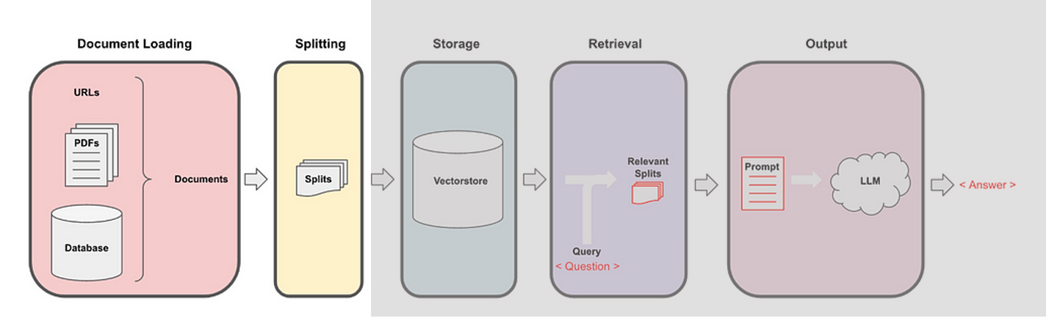
RAG
Step 1 - Document loading
Documents are loaded from data connectors
They are split into chunks - Split large documents into smaller, manageable text chunks
Metadata Addition: Adding details like source, date, or author for context filtering and improved search results.

Slide 11
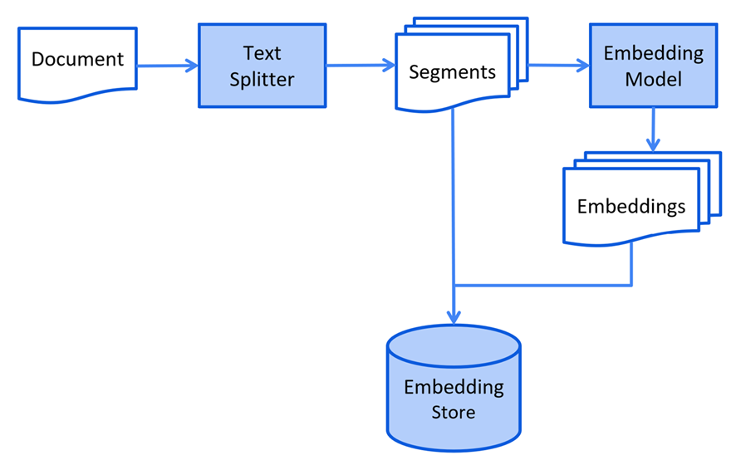
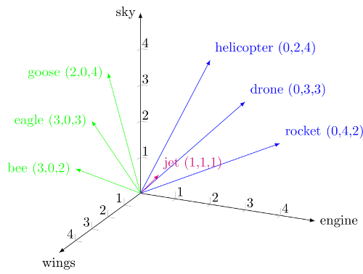
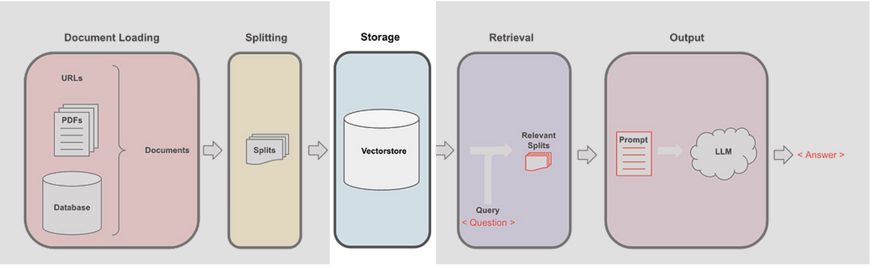
RAG
Step 2 - Embeddings
Chunks are 'transformed' into vectors (numbers)
It's the process of word embedding, using a pre-trained model
hundreds (even thousands !) of dimensions are required to represent the space of all words
Vectors are stored in a dedicated database (a vector database)

Slide 12
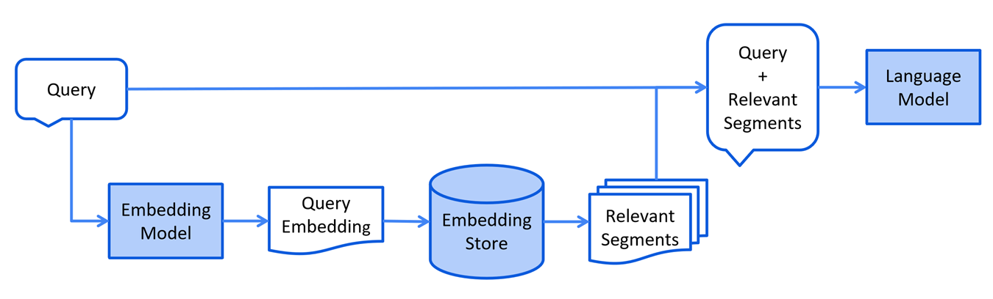
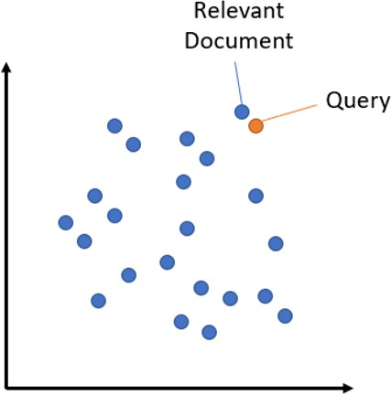
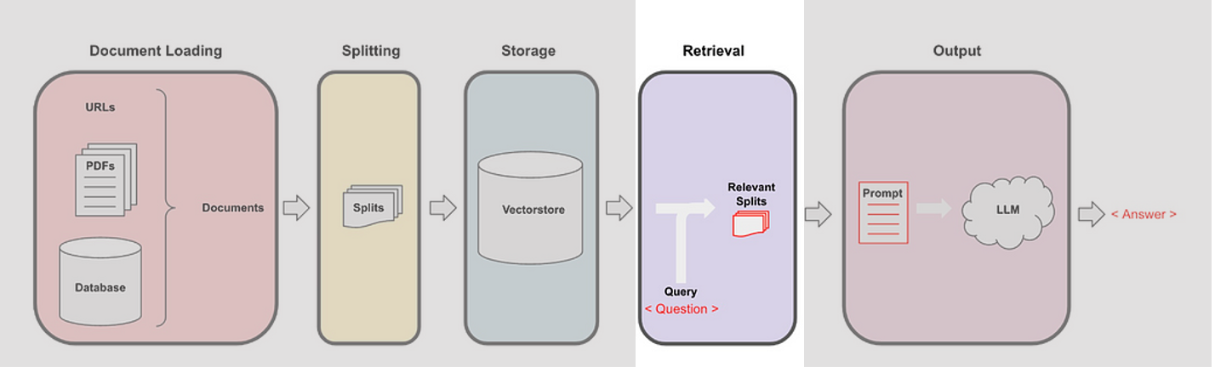
RAG
Step 3 - Retrieval
Previous steps were preparatory work, now comes the live part
Question is vectorized as well, used as an input for similarity search
Most relevant chunks are retrieved, i.e. vectors coordinates are close together
Vector search (similarity search) happens within the vector database and is the core step that retrieves the most contextually relevant information based on the user query.
Notes:
Embedding the User Query:
The user’s question or prompt is converted into a vector using the same embedding model used for document data.
Querying the Vector Database:
The vectorized query is matched against stored document vectors to find the most semantically similar results.
Similarity Scoring:
Each document vector is ranked based on its similarity to the query vector, ensuring that the most relevant context is selected.
Selecting Relevant Chunks:
Top-matching text chunks are retrieved, providing context-rich information to address the query accurately.
Balancing Context Quantity and Relevance:
Retrieving the right amount of context prevents information overload, fitting within the LLM’s processing limits for effective prompt augmentation.
Advanced Retrieval Techniques (Optional):
Methods like hybrid search, reranking, and contextual chunk retrieval can enhance relevance and retrieval precision.

Slide 13
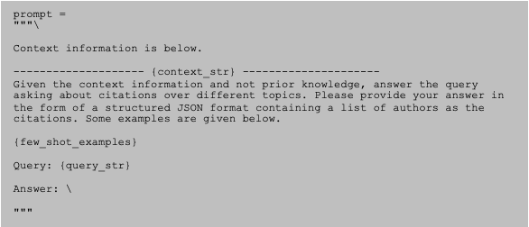
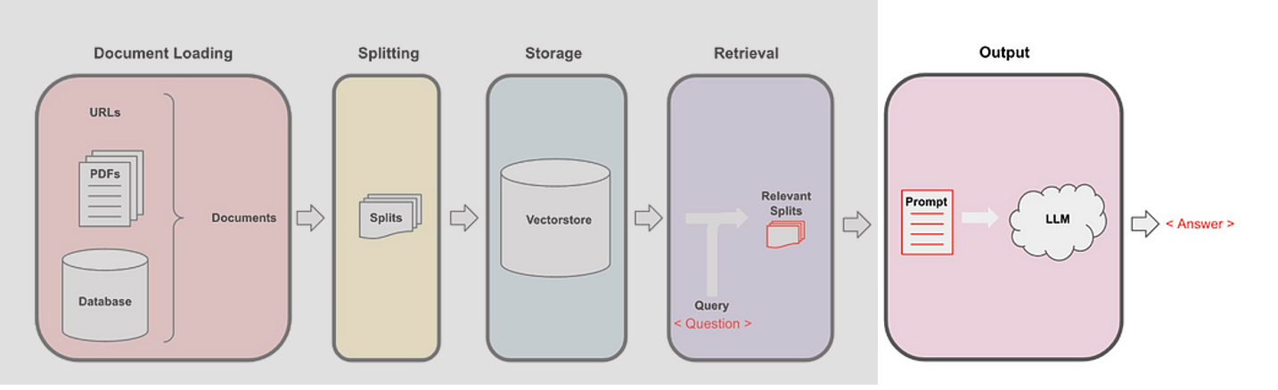
RAG
Step 4 - Generation
Retrieved chunks are used to feed the LLM prompt context
Question is added to the prompt
LLM reads the prompt and generates a natural language answer
During this inference time,
the model requires a lot of GPU power !

Slide 14









RAG engineering
Lots of moving part to reach performance !
Vector DB Choice
Cloud / Local
RAG techniques
Vectors dimensions
(Corrective, Self-reflective
Chunking strategy
& reduction
Rag-Fusion, HyDE)
Chat memory
Flow / Batch
UI-Integration
Data Policy
LLMOPS / MLOPS
Deduplication
Cost Efficiency
Model config
(temperature, top_k, top_p)
Model Evaluation / derivation
(BLUE/RED, precision,
recall, F1 score, Ragas, truelens,
Data cleanage
Human Feedback)
Attachments (images, pdf)
Retrieval config
Prompt eng.
PII / Anonymization
Embedding Model
(top_k, similarity)
Guard rails
Data policy / criticity
Size
Re-ranking
(Hallucinations, NSFW, …)
Language
MMR score
model compare / VertexSxS
Tokenizer
Performance (TTFT, TPS, …)
PII / Anon (again)

Slide 15
UCalgary Team Assistant LLM RAG Application
Based on Opensource GIT project and customized to our requirements
100% Local Processing
Runs entirely on the user’s device, ensuring complete data privacy and security.
Versatile Model Compatibility
Supports multiple open-source models and hardware configurations (CPU, GPU, etc.), adapting to user needs and resources.
Diverse Embedding Options
Offers various embedding methods to tailor responses based on user needs.
Reusable Models
Once downloaded, models can be reused without additional downloads, saving time and resources.
Session-Based Chat History
Maintains chat history within sessions, allowing continuity in conversations.
API for Frontend Chatbot
Provides an API for creating front end UI Retrieval Augmented Generation (RAG) application.
Compatible with GPU
Uses RAG to deliver accurate responses by retrieving relevant document sections, all without external cloud dependencies.

Slide 16
UCalgary Team Assistant Components
NGINX as Proxy server
Large Language Model (LLM):
Utilizes open-source LLAMA 3.1 language model compatible with Hugging Face format.
Downloaded locally into the AI Server
· Embedding Model:
Embeddings are generated locally using the InstructorEmbeddings model, which encodes document segments into vectors based on semantic meaning.
· Vector Database:
Chroma Vector Store: Stores and manages embeddings locally for efficient similarity-based retrieval.
Enables fast vector search to find and retrieve the most relevant document segments based on user prompts.
Retrieval and Similarity Search:
Uses vector similarity scoring to match user queries with document embeddings, retrieving the most contextually relevant text chunks.
Ensures responses are based on accurate and meaningful document content.
· Data Ingestion Pipeline:
Ingest.py: Processes and splits documents into manageable chunks, generates embeddings, and stores them in the vector database.
· Query Processing Pipeline:
Run_localGPT.py: Handles user queries by retrieving relevant document vectors and passing them to the LLM for response generation.

Slide 17
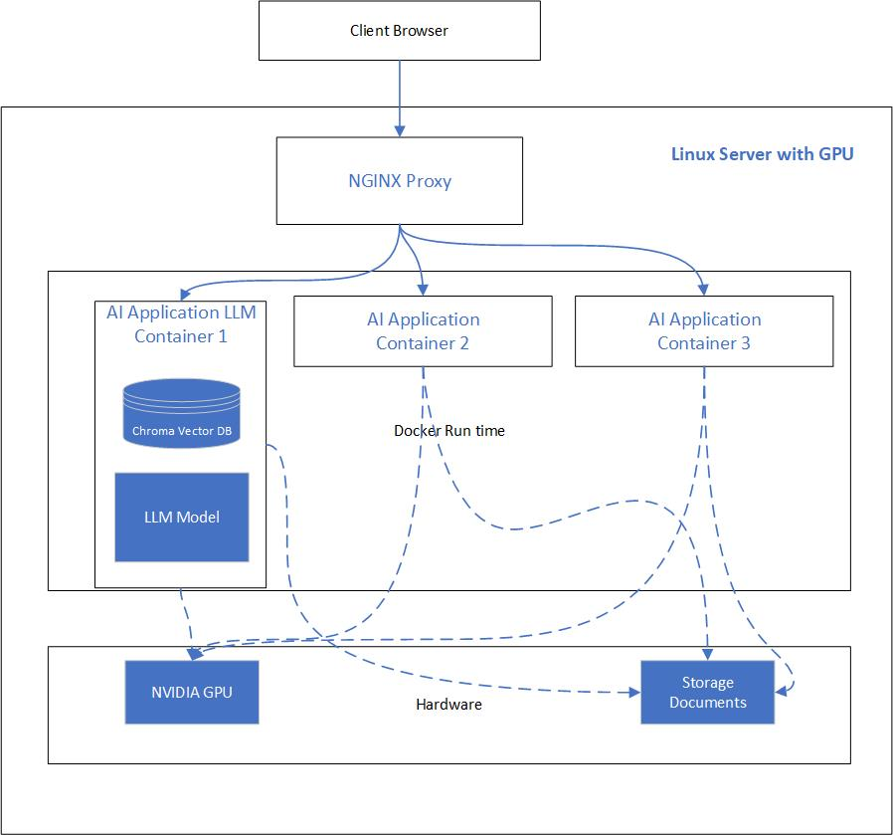
High Level Architecture Diagram

Slide 18
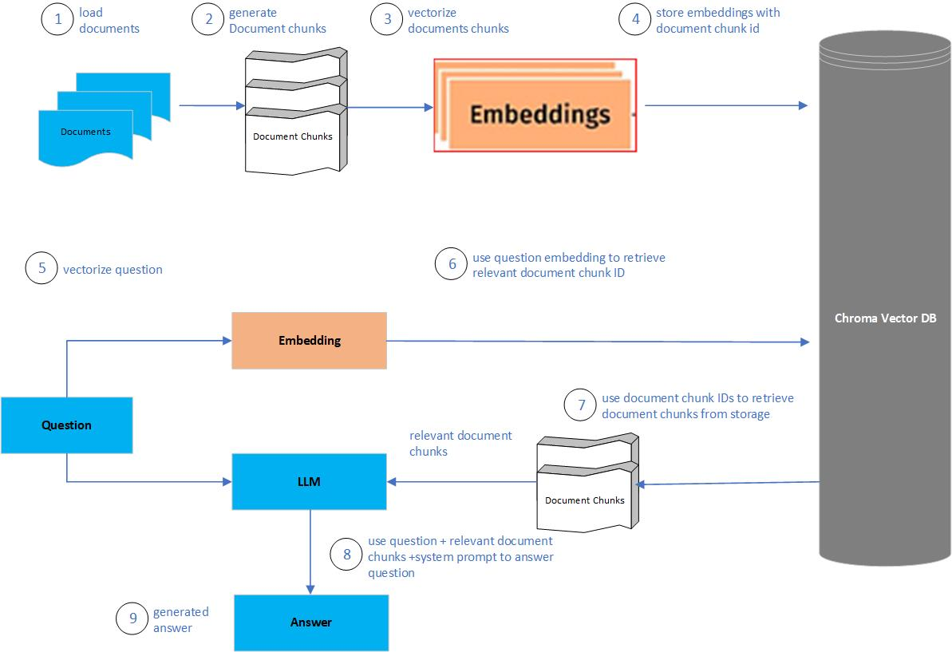
High Level Process flow for AI application - RAG

Slide 19
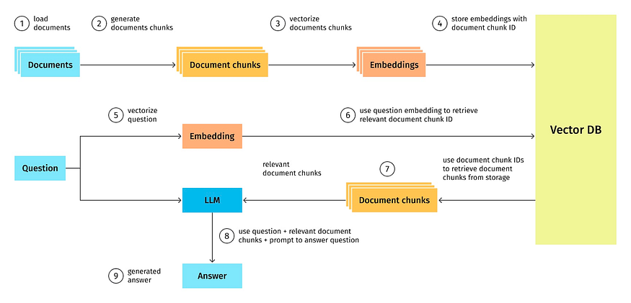
High Level Process flow for AI application - RAG

Slide 20
Demo time !

Slide 21
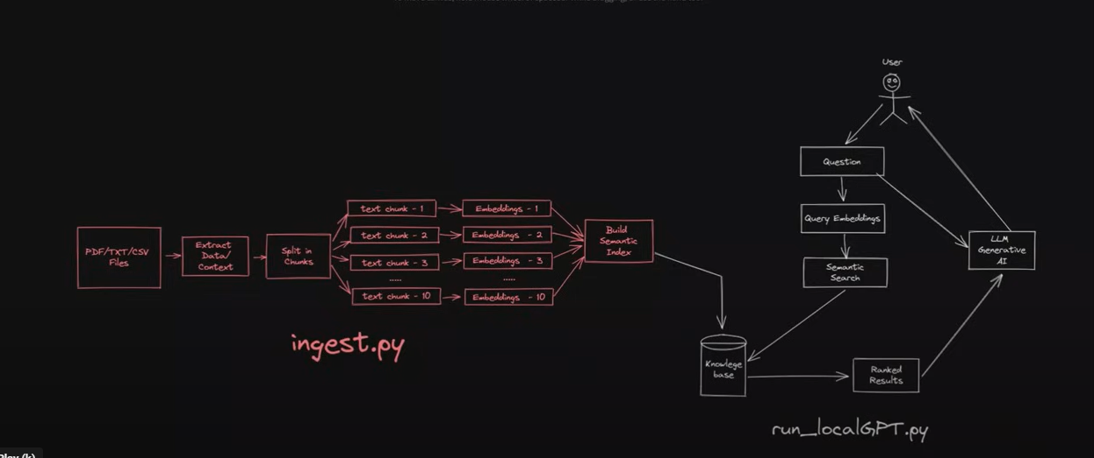

Slide 22
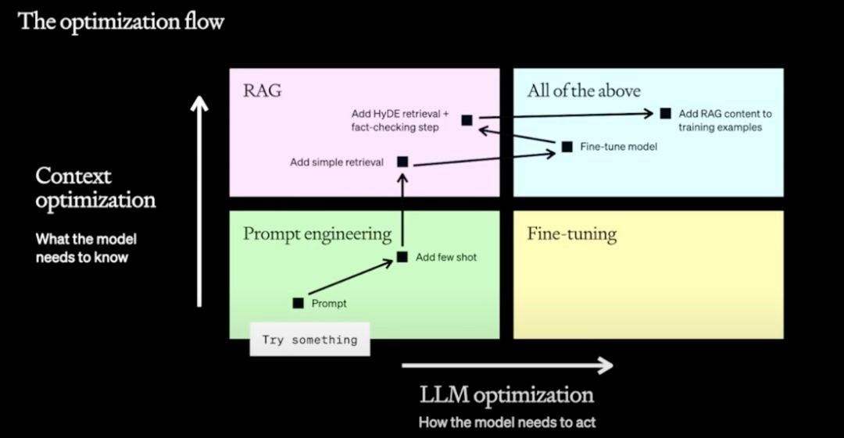
Fine Tuning ?
OpenAI’s strategy

Slide 23
