Slide 1



Deep Learning Based Prediction of Signal Peptides in Proteins Using Sequence and Physicochemical Feature Integration
TEAM 1
BL.SC.U4AIE24224 - JAYAVEER VENKATA SAI MADDALI
BL.SC.U4AIE24234 - KRISHNA KARTHIK PATHRI
BL.SC.U4AIE24201 - A PRANAV

Slide 2
Table of Contents
01 — Abstract
02 — Introduction
03 — Literature Survey
04 — Dataset Description
05 — Methodology
06 — Model Architecture
07 — Results & Analysis
08 — Applications
09 — Limitations
10 — Future Work
11 — Conclusion

Slide 3
Abstract
Signal peptides are short amino acid sequences responsible for directing proteins toward secretion pathways and cellular localization.
This work proposes a hybrid deep learning framework integrating:
1.BioBERT embeddings (768-D)
2.Physicochemical protein features
3.CNN–BiLSTM–Attention architecture
Dataset:
1930 protein sequences collected from UniProtKB
Objective:
Predict whether proteins contain signal peptides
Results:
Mean AUC-ROC ≈ 0.7938+-0.1092
Main Finding:
Architecture choice significantly affects biological embedding performance.

Slide 4
Introduction
Signal peptides are short amino acid sequences found at the N-terminal of proteins.
They play an important role in protein secretion and localization.
Traditional Experimental identification is slow, expensive and labor intensive.
Deep learning provides automated prediction using protein sequences.
Proposed approach integrates:
1. BioBERT sequence embeddings
2. Physicochemical properties
3. CNN-BiLSTM-Attention model

Slide 5
Literature Survey
Existing Models
DeepSig – Used CNNs for signal peptide prediction and improved sequence modelling.
SignalP 5.0 – Deep neural network-based prediction and improved prediction accuracy.
SignalP 6.0 – Used protein language models for improved accuracy.
USPNet – Organism-independent prediction using PLMs with better generalization.
TSignal – Transformer-based architecture with attention based learning.
Key Observation
Recent models combine:
Deep sequence embeddings
Attention mechanisms
Physicochemical information
Research Gap
Existing models increasingly preserve sequence context.
Need for better integration of:
Protein embeddings
Physicochemical properties
Context-aware architectures

Slide 6
Dataset Description
Data Source : UniProtKB
Positive Class: Proteins containing signal peptides
Negative Class: Proteins without signal peptides (Cytoplasmic proteins)
Dataset Size
Total sequences: 1930 proteins (980 signal + 950 non-signal)
Extracted Features
Sequence Features:
BioBERT embeddings
Amino acid representation
Physicochemical Features:
Molecular weight
Hydrophobicity
Aromaticity
Instability index
Isoelectric point
Aliphatic index
Final Representation: 768-D embeddings and 6 physicochemical features = 774-dimensional feature vector

Slide 7
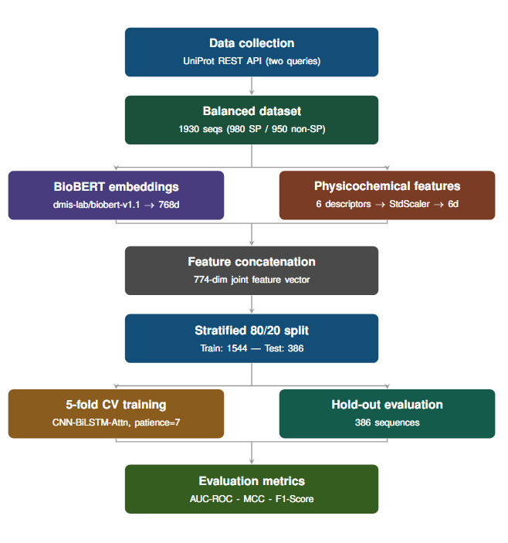
Methodology
Data collected from UniProtKB REST API.
Positive class: Signal peptide proteins
Negative class: Cytoplasmic proteins without signal peptides
Final balanced dataset has 1930 sequences

Slide 8
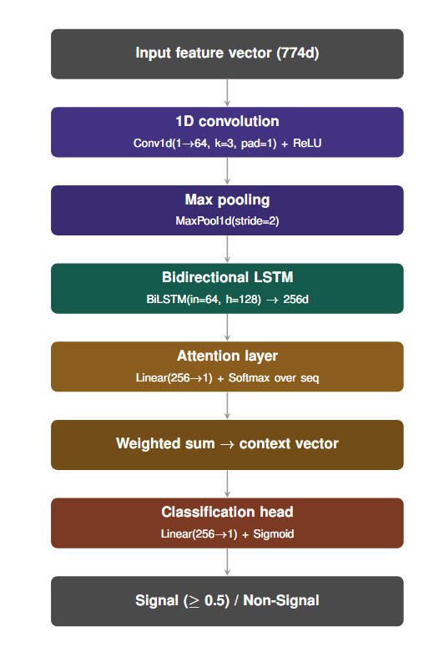
Model Architecture
CNN Layer
1D convolution with ReLU and MaxPooling.
BiLSTM Layer
Captures bidirectional sequence dependencies.
Attention Layer
Highlights important temporal features.
Output Layer
Fully connected layer with Sigmoid activation.
Predicts:
Signal peptide
Non-signal peptide

Slide 9
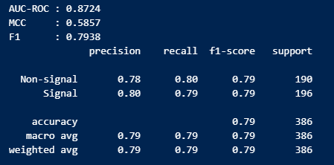
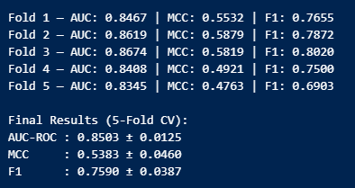

Results & Analysis

Slide 10
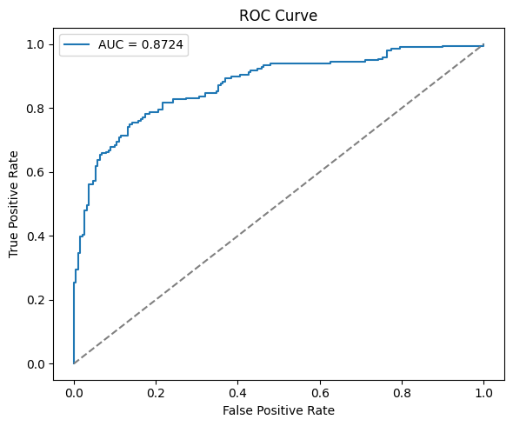
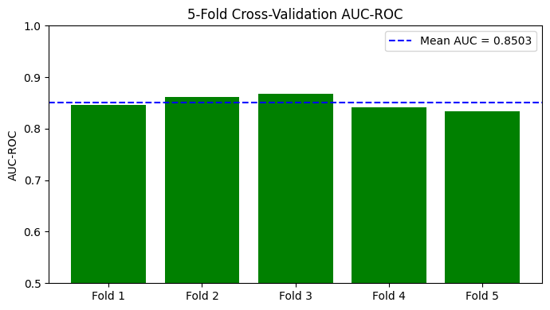
Results & Analysis

Slide 11
Applications
Protein Engineering
Helps design proteins with improved secretion efficiency for industrial enzymes, vaccines, and therapeutic proteins.
Drug Discovery & Pharmaceuticals
Supports identification of secretory proteins useful in developing protein-based drugs and targeted therapies.
Protein Function Prediction
Assists researchers in determining the localization and biological role of newly discovered proteins.
Biotechnology & Synthetic Biology
Improves engineered organisms and protein production systems used in industrial and biological applications.

Slide 12
Limitations
Small Dataset Only 1,930 sequences compared to millions used by SignalP and DeepSig.
Short Sequence Bias Model misclassifies short cytoplasmic proteins like KRAS (41 residues). Training data didn't have enough short non-signal sequences to learn this boundary
Binary Classification Only Model only says signal or non-signal — it can't tell you where the cleavage site is, which is important for actual biological use.
BioBERT Not Protein-Specific BioBERT was trained on biomedical text and PubMed papers, not protein sequences. It understands biology but not protein biochemistry as deeply as protein-specific models.
Single Organism Bias Dataset pulled from UniProt reviewed entries which skews toward well-studied organisms (human, mouse, E. coli). Model may perform poorly on exotic organisms or metagenomic sequence

Slide 13
Future Works
ESM-2 Instead of BioBERT Replace BioBERT with Meta's ESM-2 — trained purely on 250 million protein sequences.
Expand Dataset to 5,000+ Sequences Fetch more sequences from UniProt across eukaryotes, gram-positive and gram-negative bacteria to improve generalizability across diverse organisms.

Slide 14
Conclusion
Developed hybrid deep learning framework
Combined BioBERT embeddings with physicochemical properties
Dataset preparation successful
Architecture mismatch reduced performance
Sequence-preserving models may improve prediction

Slide 15
References
[1] Savojardo, C., Martelli, P. L., Fariselli, P., & Casadio, R. (2018). DeepSig: Deep learning improves signal peptide detection in proteins. Bioinformatics, 34(10), 1690–1696.
[2] Armenteros, J. J. A., Tsirigos, K. D., Sønderby, C. K., Petersen, T.N., Winther, O., Brunak, S., ... & Nielsen, H. (2019). SignalP 5.0 improves signal peptide predictions using deep neural networks. NatureBiotechnology, 37(4), 420–423.
[3] Zhang, W., Pan, X., & Shen, H. (2020). Signal-3L 3.0: Improving signal peptide prediction through combining attention deep learning with window-based scoring. Journal of Chemical Information and Modeling, 60(7), 3679–3686.
[4] Teufel, F., Armenteros, J. J. A., Johansen, A. R., G´ıslason, M. H., Pihl, S. I., Tsirigos, K. D., ... & Nielsen, H. (2022). SignalP 6.0 predicts all five types of signal peptides using protein language models. Nature Biotechnology, 40(7), 1023–1025.
[5] Shen, J., Yu, Q., Chen, S., Tan, Q., Li, J., & Li, Y. (2023). USPNet: Unbiased organism-agnostic and highly sensitive signal peptide predictor with deep protein language model. Nature Computational Science.
[6] Dumitrescu, A., Jokinen, E., Kellosalo, J., Paavilainen, V. O., &L¨ahdesm¨aki, H. (2022). TSignal: A transformer model for signal peptide prediction. Bioinformatics, 39(Supplement 1), i347–i356.
[7] Zeng, S., Wang, D., Li, J., & Xu, D. (2024). Parameter-efficient fine-tuning on large protein language models improves signal peptide prediction. Genome Research, gr.279132.124.
[8] Rij, T. V., & Mian, M. A. (2023). Signal peptide efficiency: From high- throughput data to prediction and explanation. ACS Synthetic Biology, 2(2), 390–404.
[9] Dai, X., Meng, X., Zhou, Y., Li, Z., Ji, Y., Schwaneberg, U., & Li, Z. (2025). De novo design of high-performance sec-type signal peptide via a hybrid deep learning architecture. JACS Au.

Slide 16

Thank You for your Attention

