Slide 1

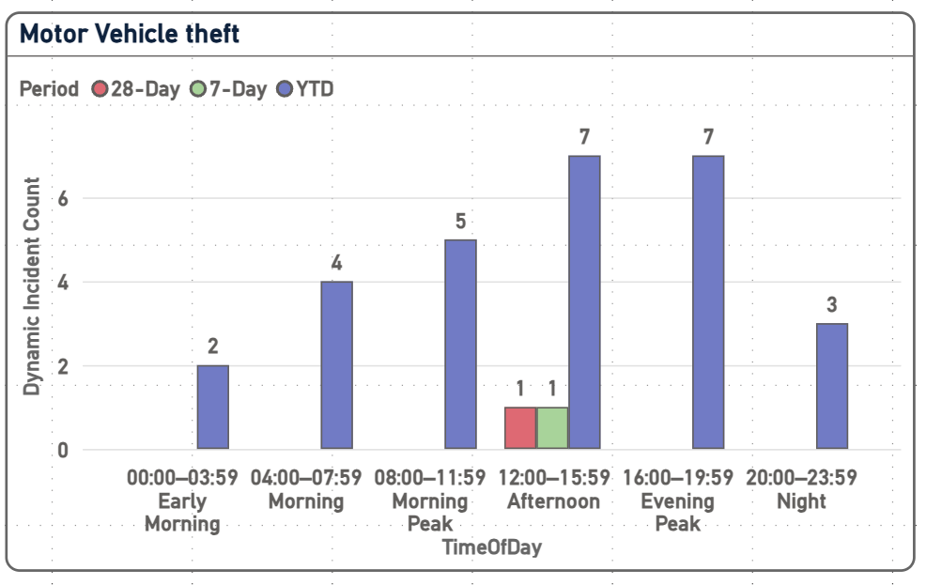
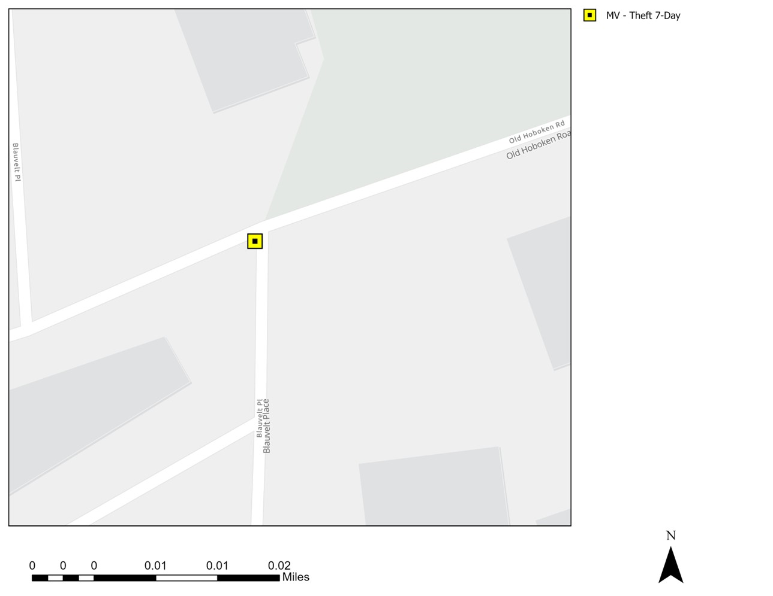
Strategic Crime Reduction Analysis
Prepared by PO R. Carucci
Motor Vehicle Theft
Pattern Offenders/Suspects
See attached for further details.

Slide 2
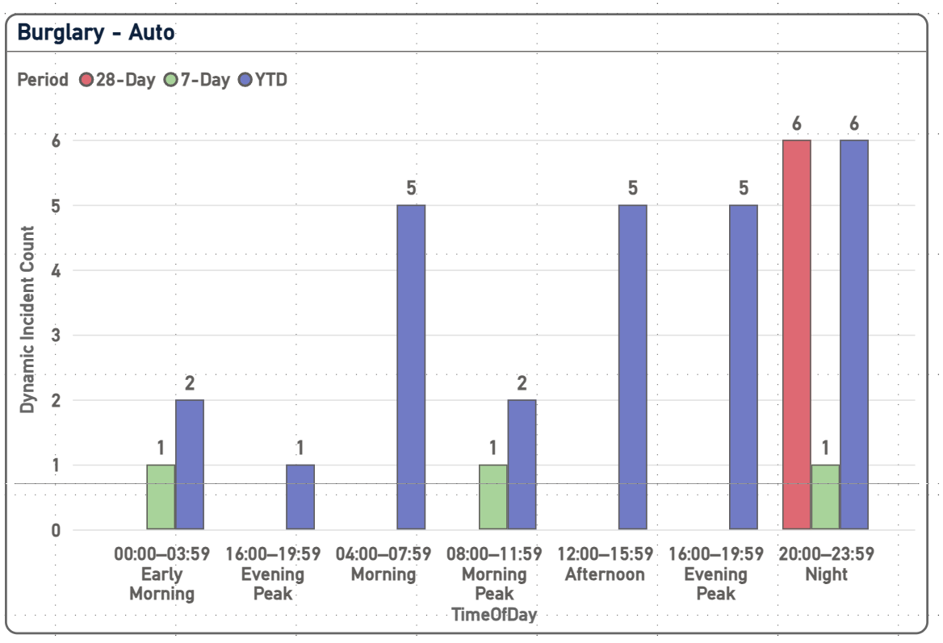
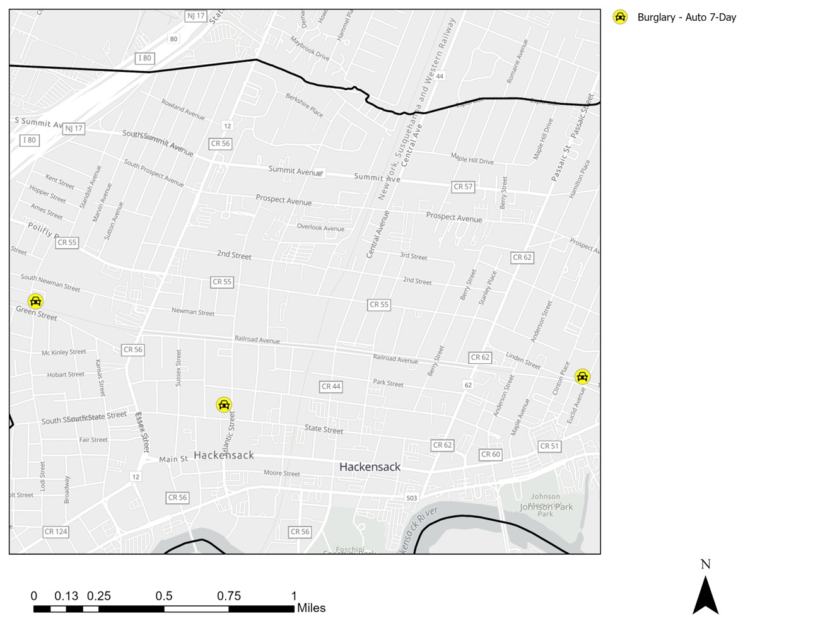
Strategic Crime Reduction Analysis
Prepared by PO R. Carucci
Motor Vehicle Burglary
Pattern Offenders/Suspects
See attached for further details.

Slide 3
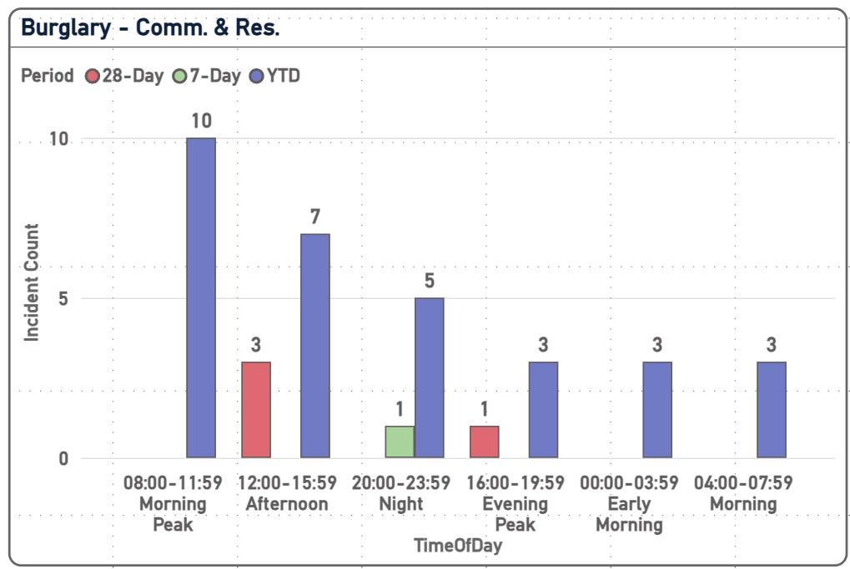
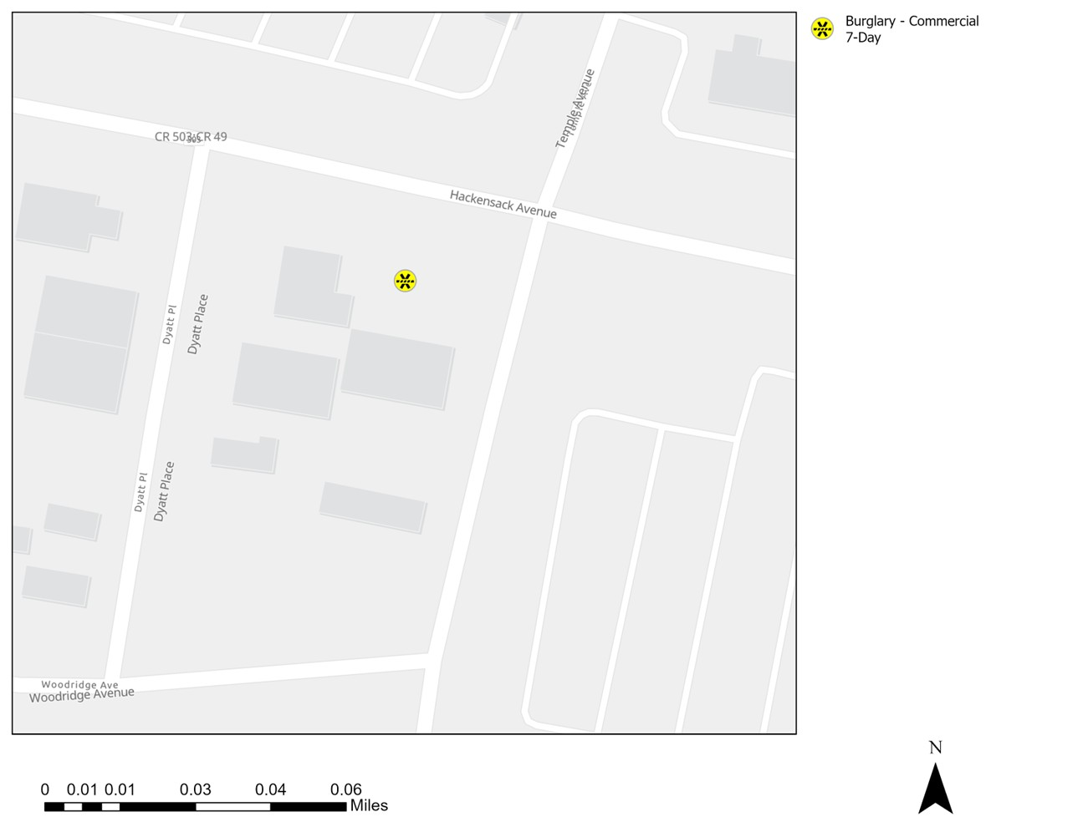
Strategic Crime Reduction Analysis
Prepared by PO R. Carucci
Residential & Commercial Burglaries
Pattern Offenders/Suspects
See attached for further details.

Slide 4
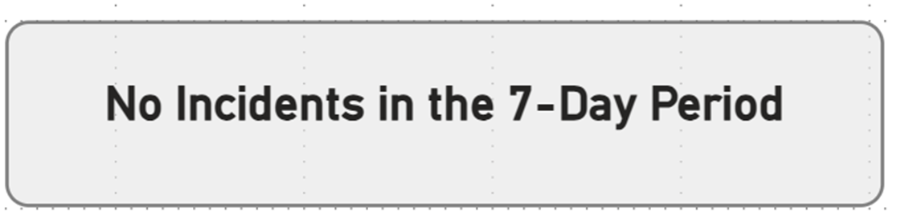
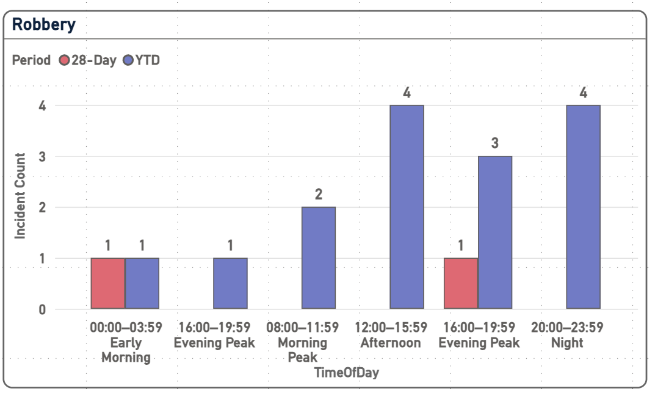

Strategic Crime Reduction Analysis
Prepared by PO R. Carucci
Robbery
Pattern Offenders/Suspects

Slide 5
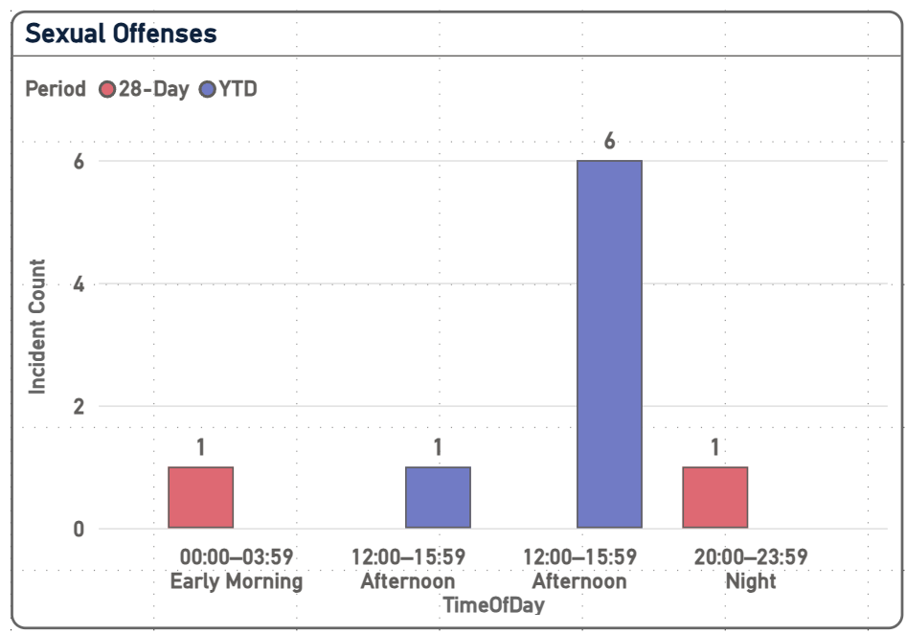
Strategic Crime Reduction Analysis
Prepared by PO R. Carucci
Sexual Offenses
Pattern Offenders/Suspects

