Slide 1

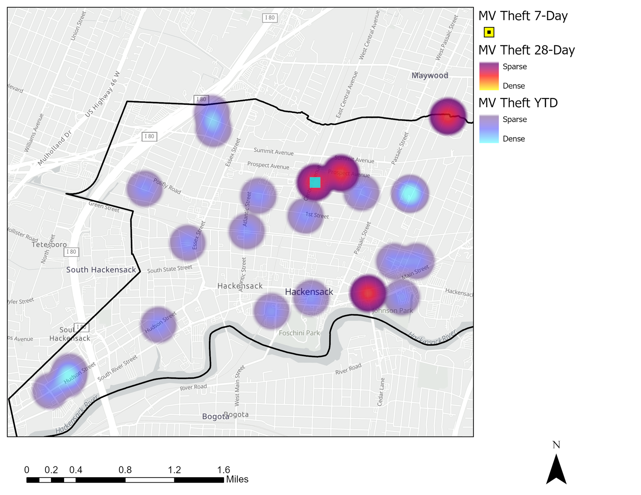
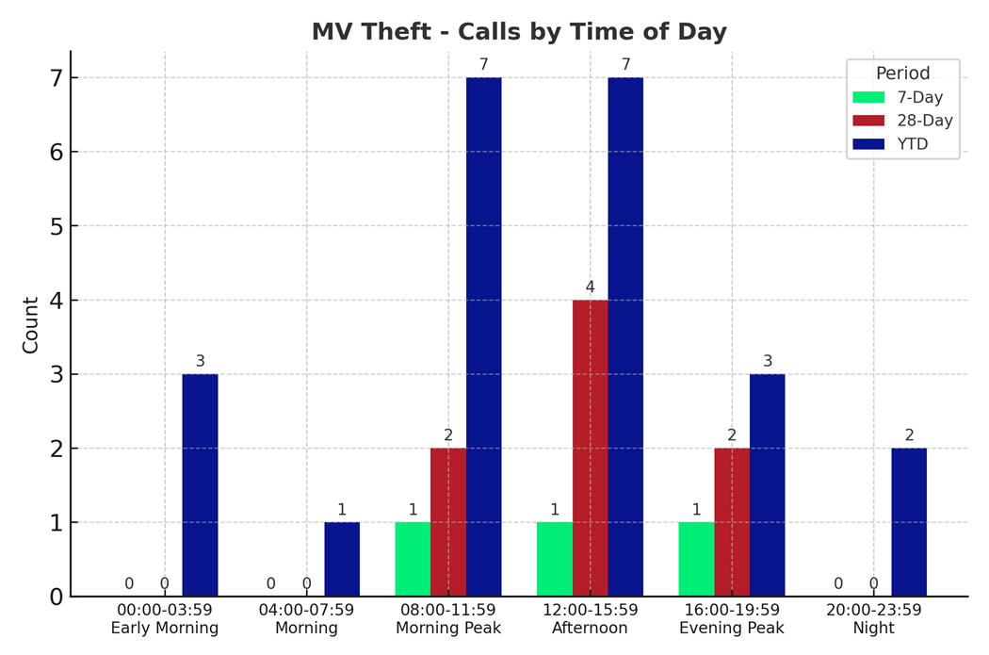
Strategic Crime Reduction Analysis
Prepared by PO R. Carucci
Motor Vehicle Theft
Pattern Offenders/Suspects

Slide 2
Strategic Crime Reduction Analysis
Prepared by PO R. Carucci
Motor Vehicle Burglary
Pattern Offenders/Suspects

Slide 3
Strategic Crime Reduction Analysis
Prepared by PO R. Carucci
Residential & Commercial Burglaries
Pattern Offenders/Suspects

Slide 4
Strategic Crime Reduction Analysis
Prepared by PO R. Carucci
Robbery
Pattern Offenders/Suspects

Slide 5
Strategic Crime Reduction Analysis
Prepared by PO R. Carucci
Sexual Offenses
Pattern Offenders/Suspects

