Slide 1

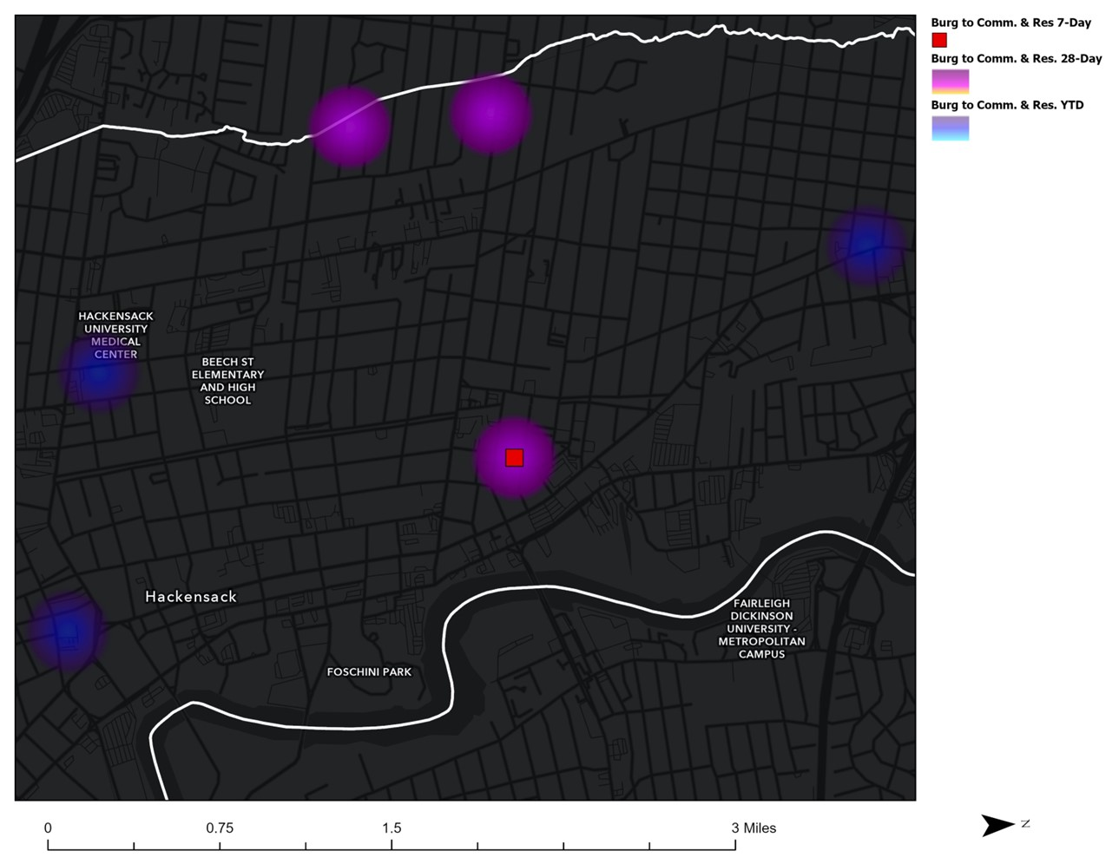
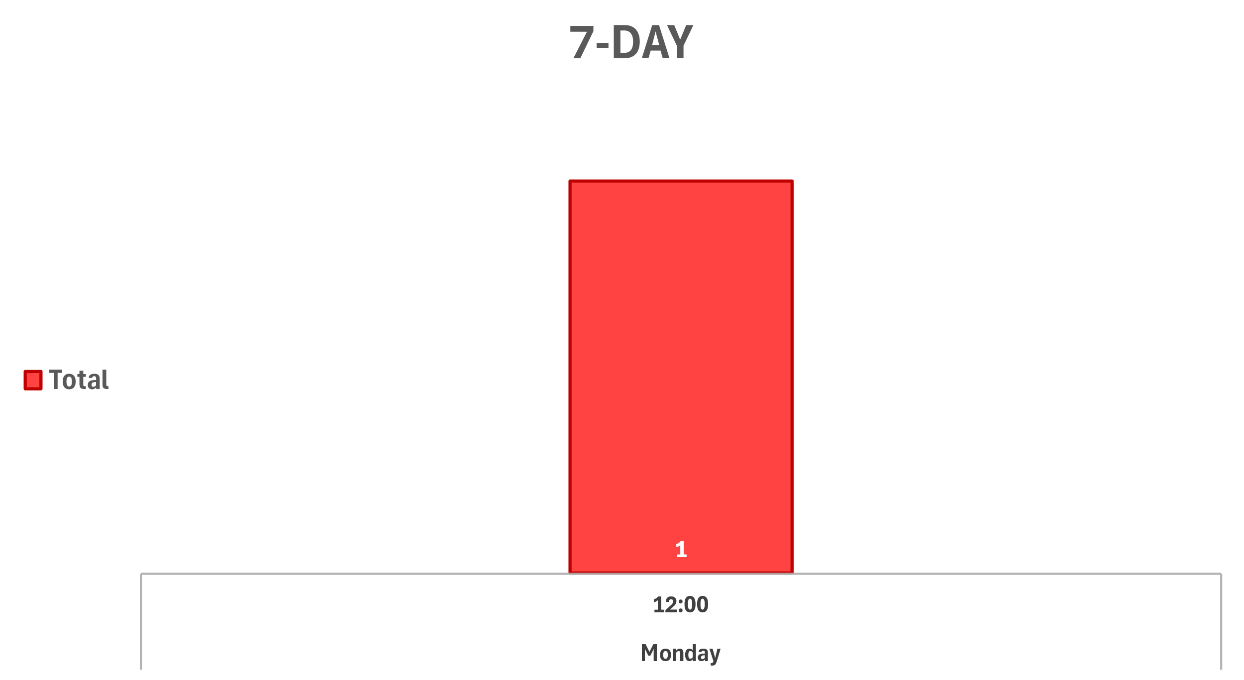
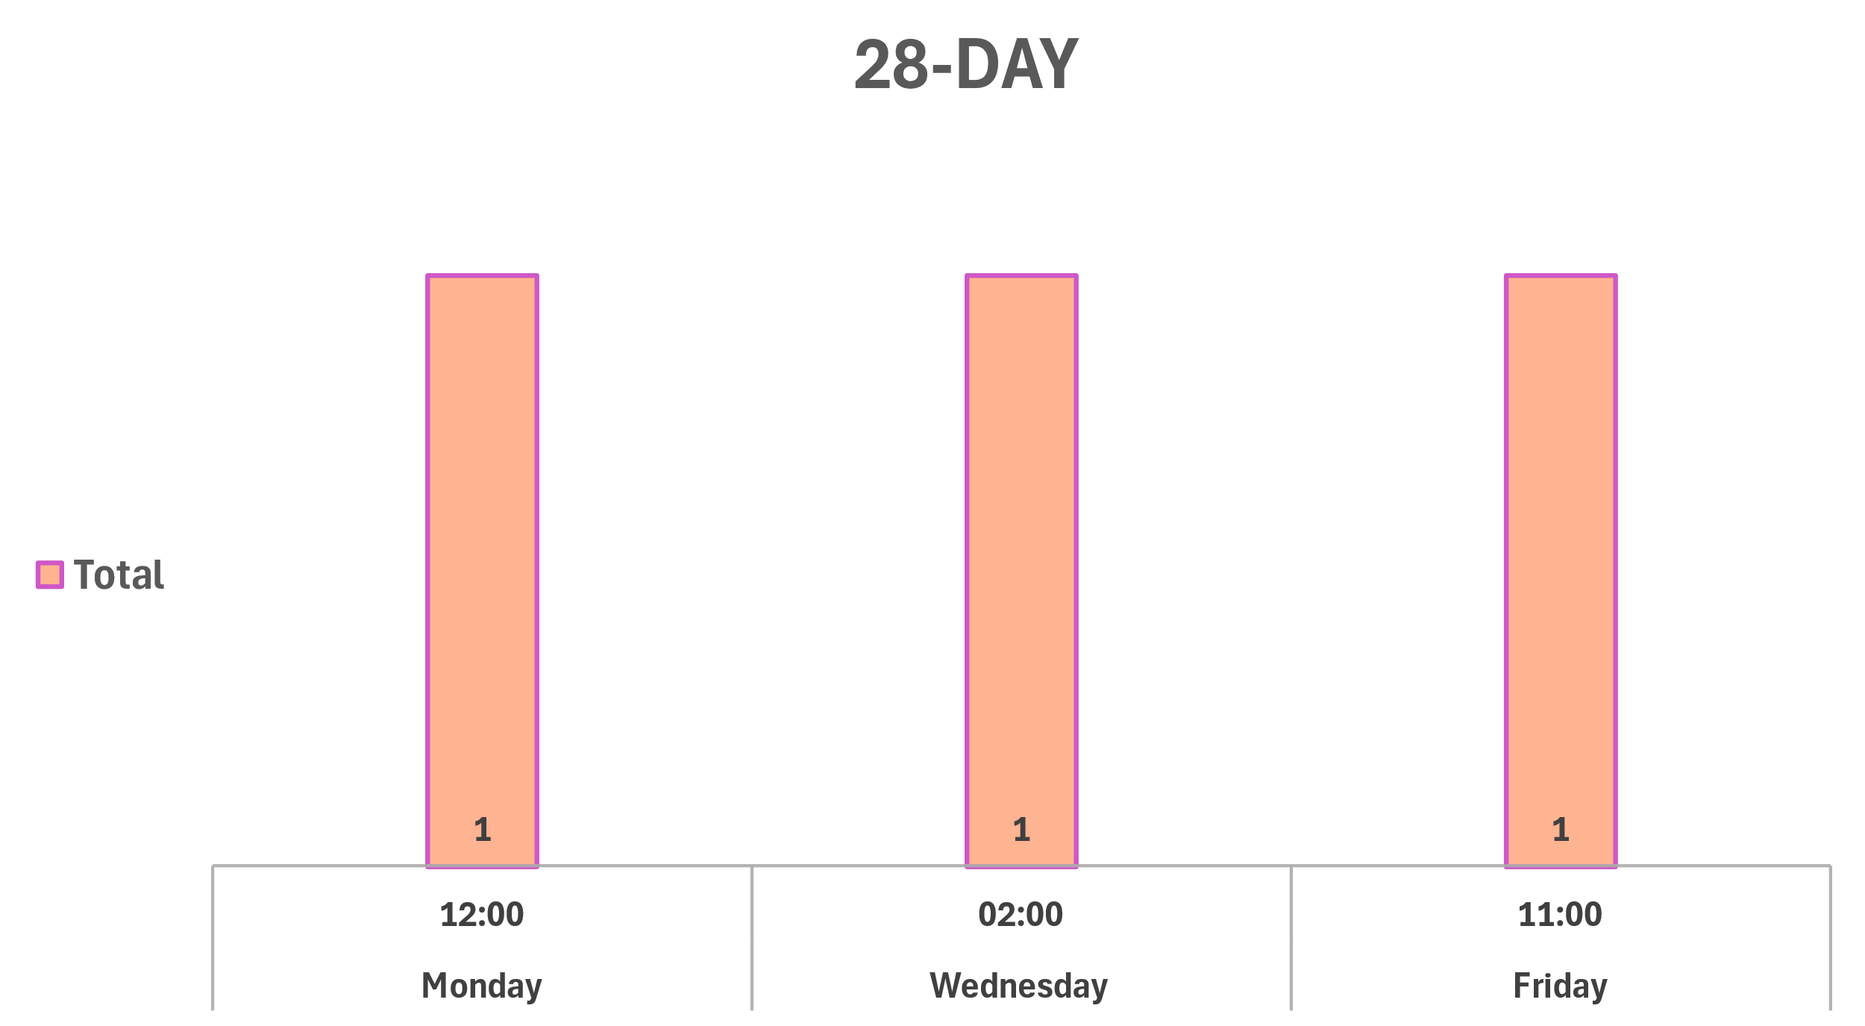
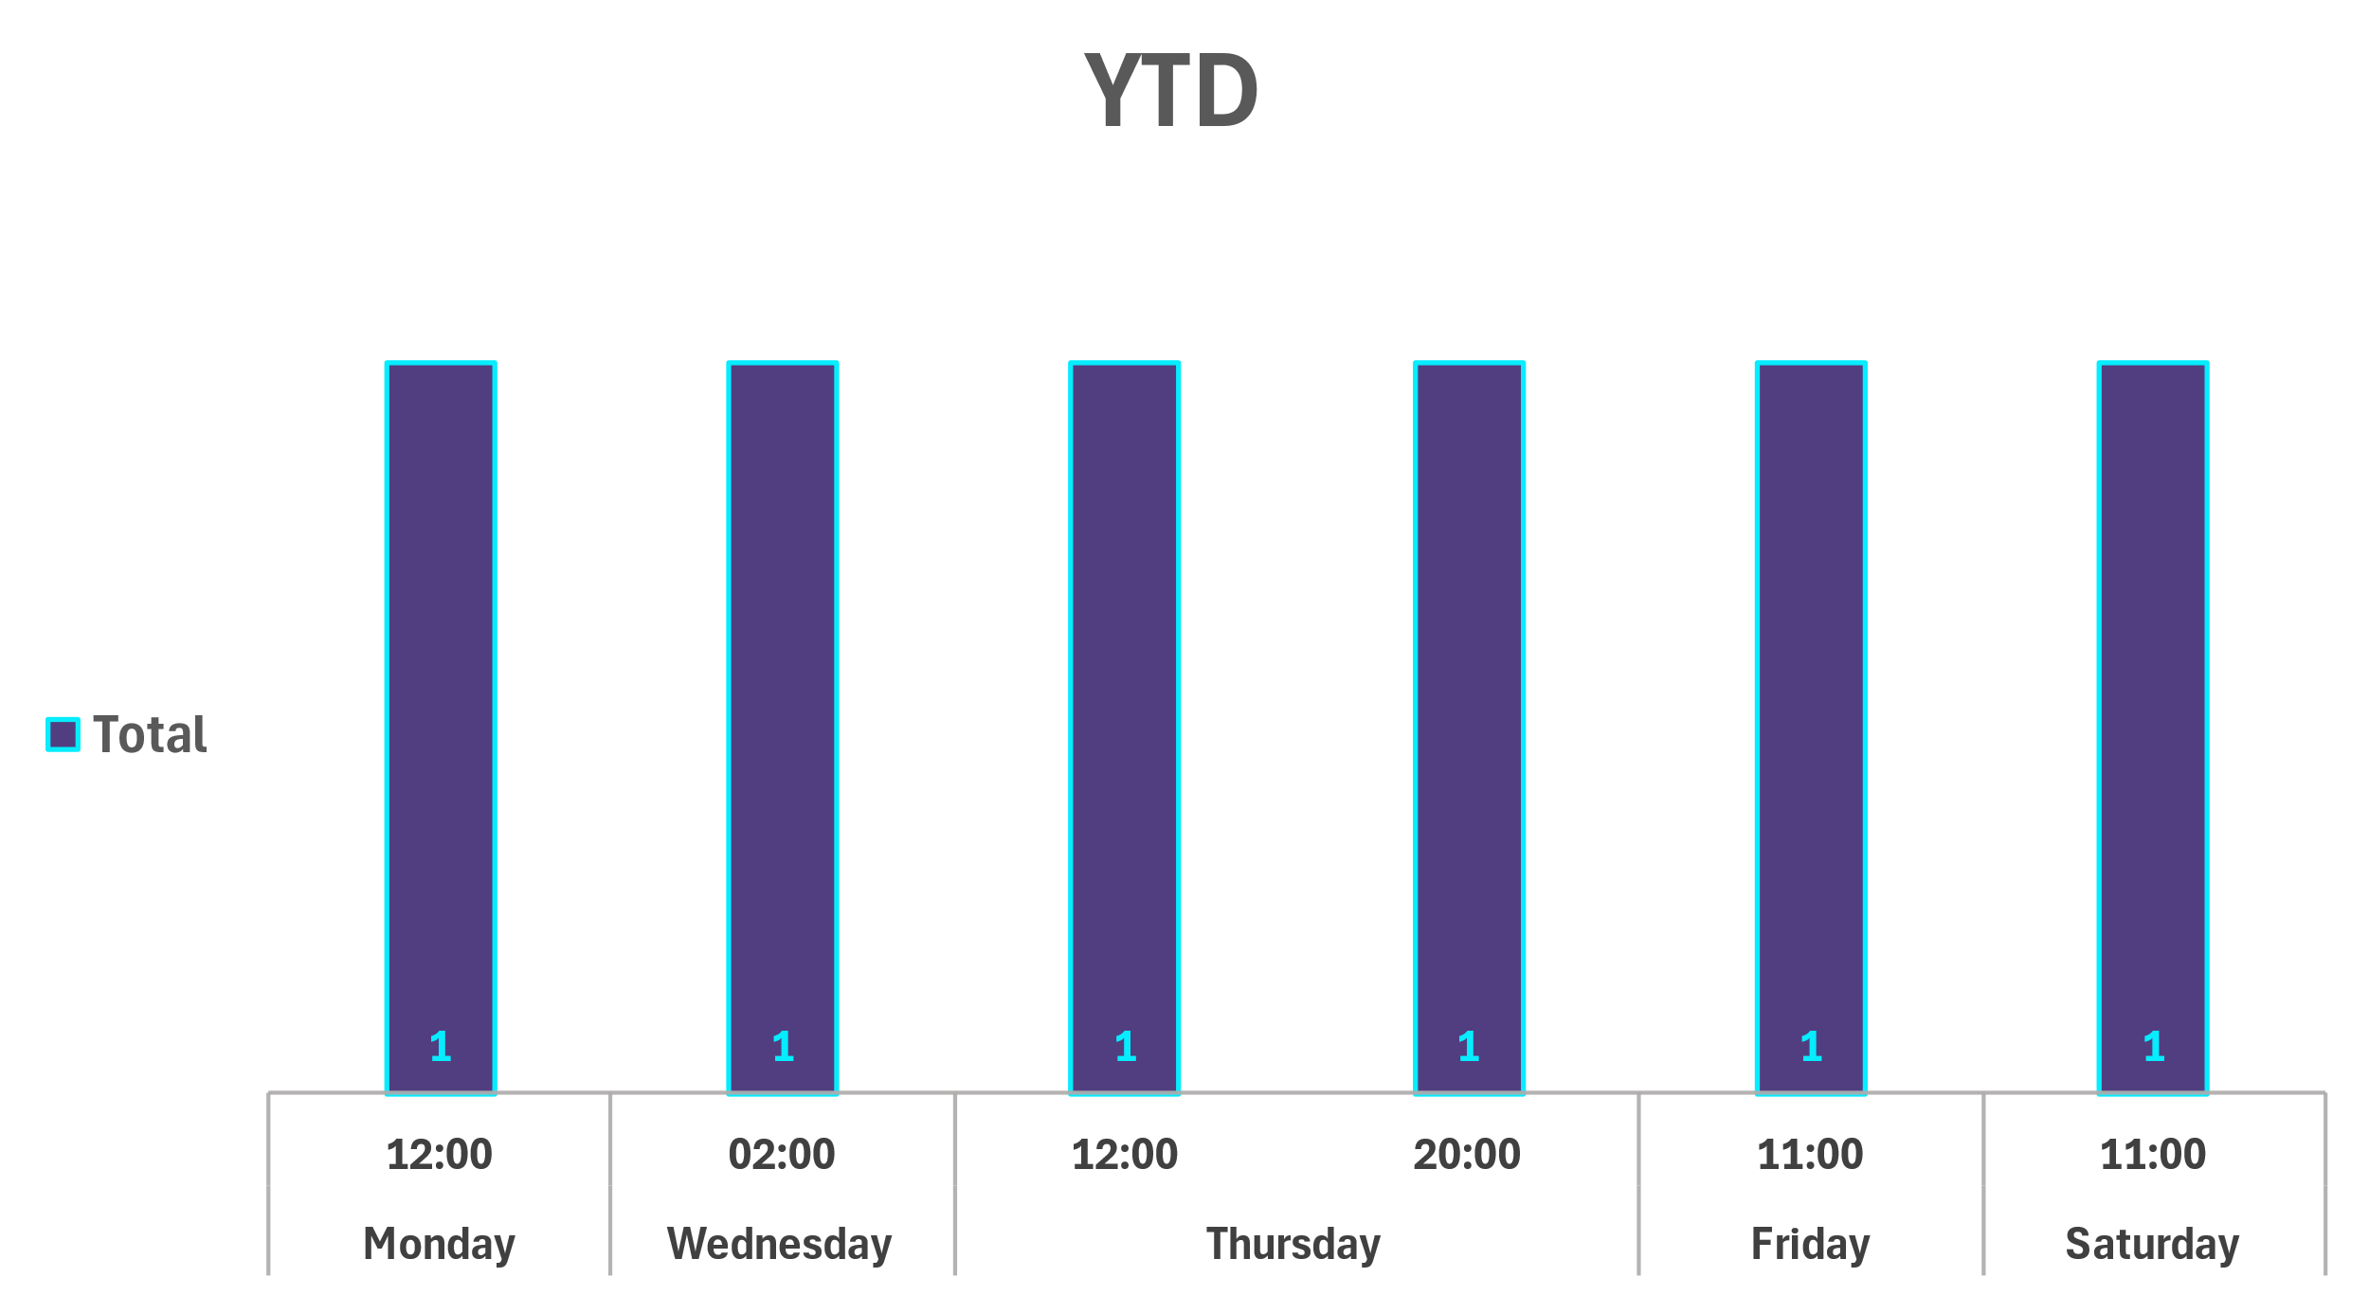
Strategic Crime Reduction Analysis
Prepared by PO R. Carucci
Crime/Topic
Spatial Assessment
Residential and Commercial Burglaries
Pattern Offenders/Suspects
Burglary - Commercial Incident
02/17 at 12:00 at 35 Pangborn Place access to the basement was gained by unknown means (no fore entry was observed)
Suspect: Unknown.

Slide 2
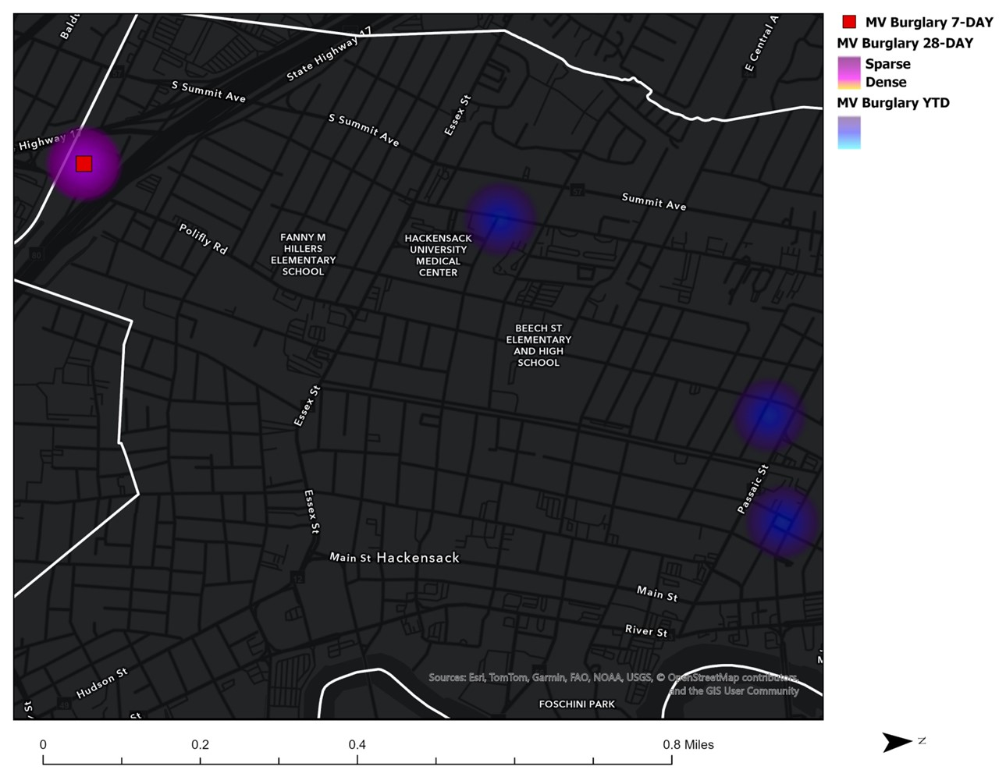
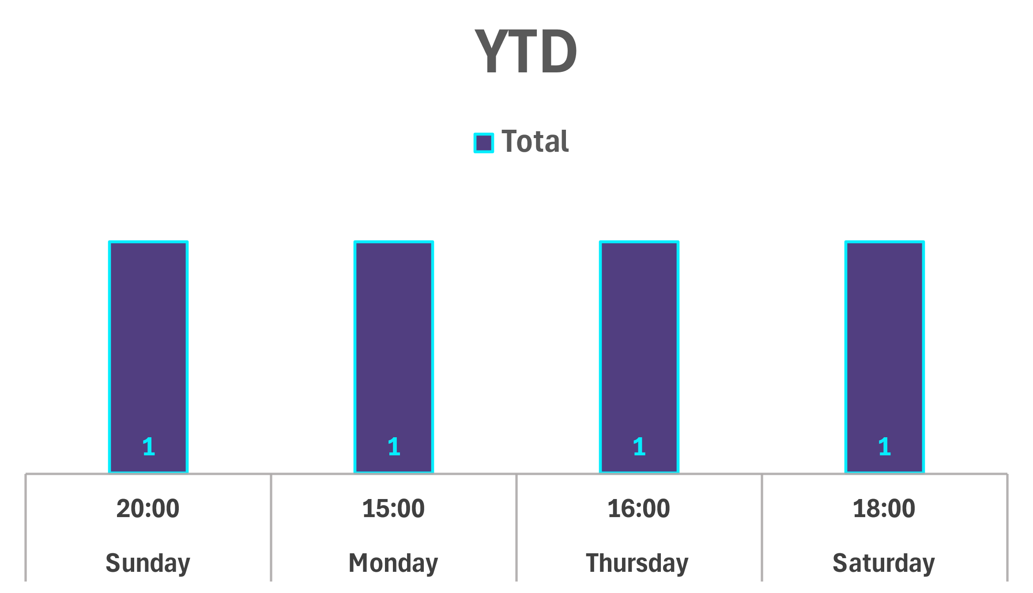
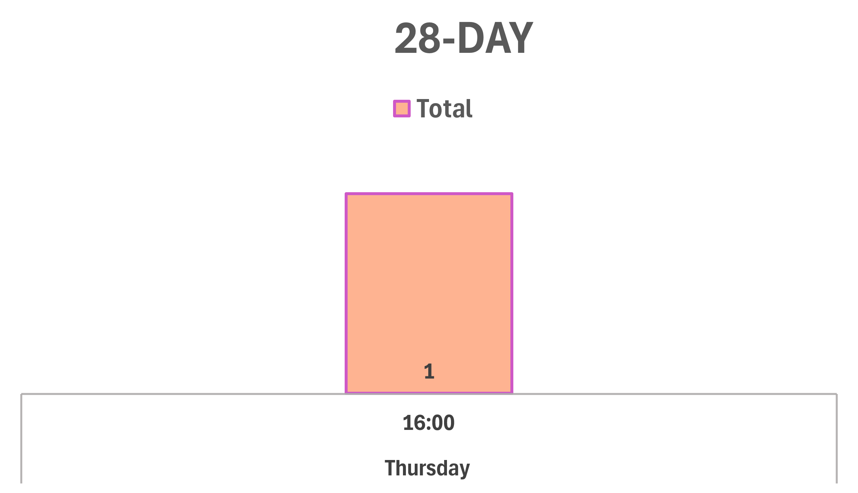
Strategic Crime Reduction Analysis
Prepared by PO R. Carucci
Crime/Topic
Spatial Assessment
Motor Vehicle Burglary
Pattern Offenders/Suspects
N/A
No Incidents occurred in the previous 7 days.

Slide 3
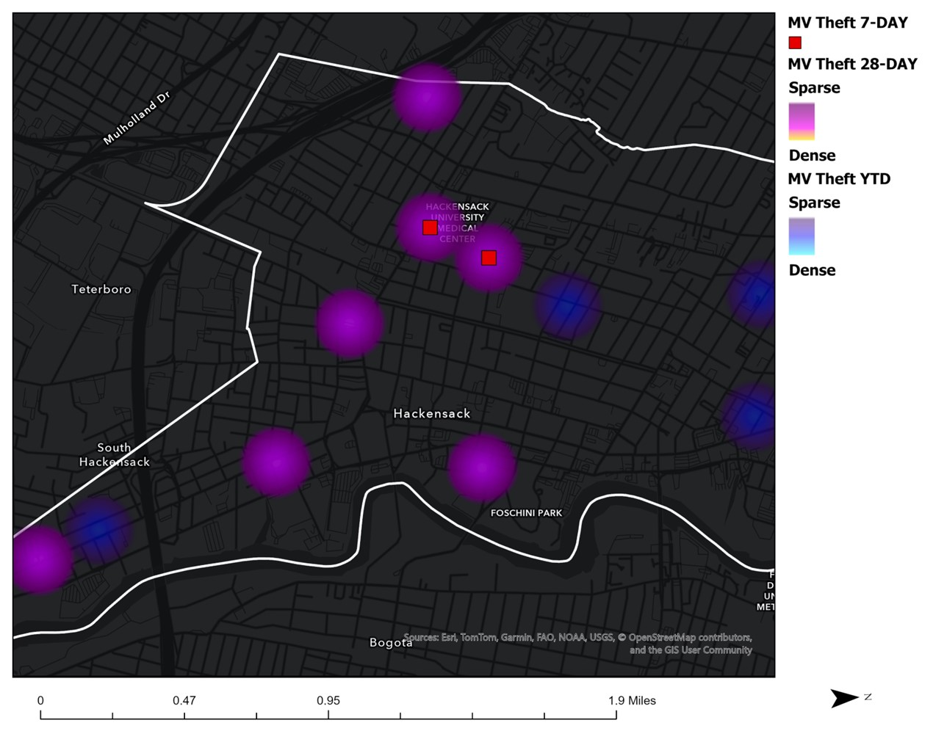
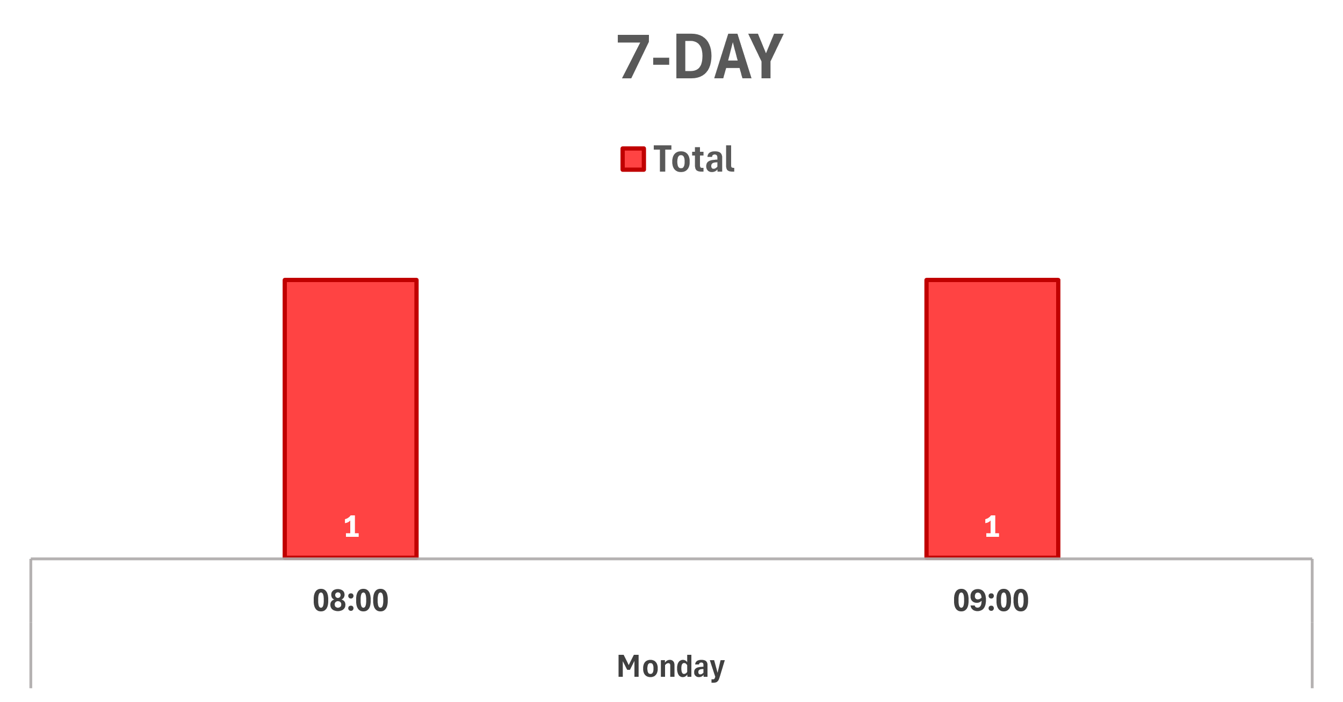
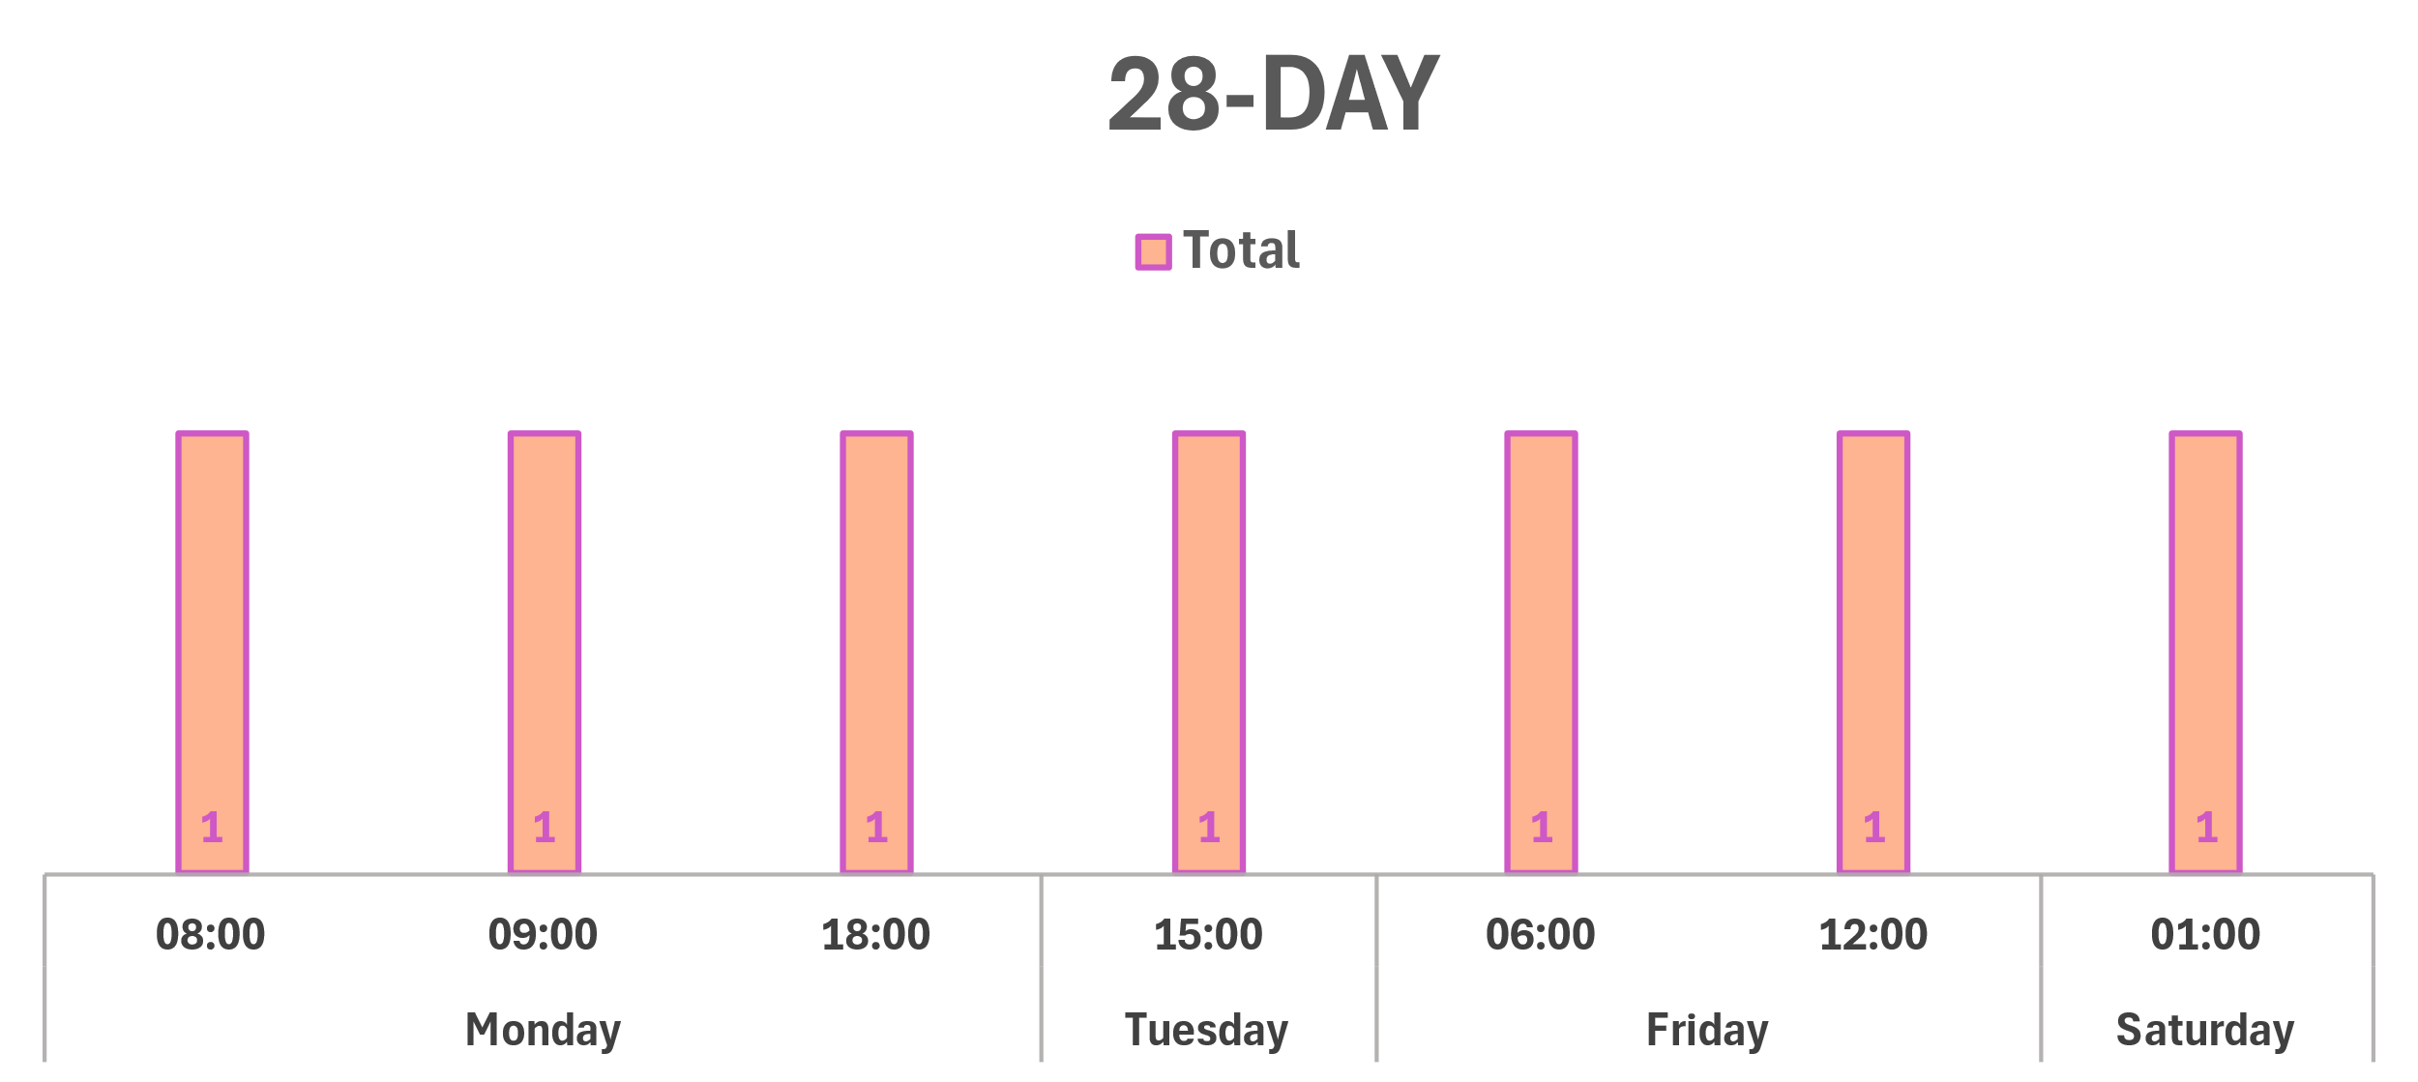
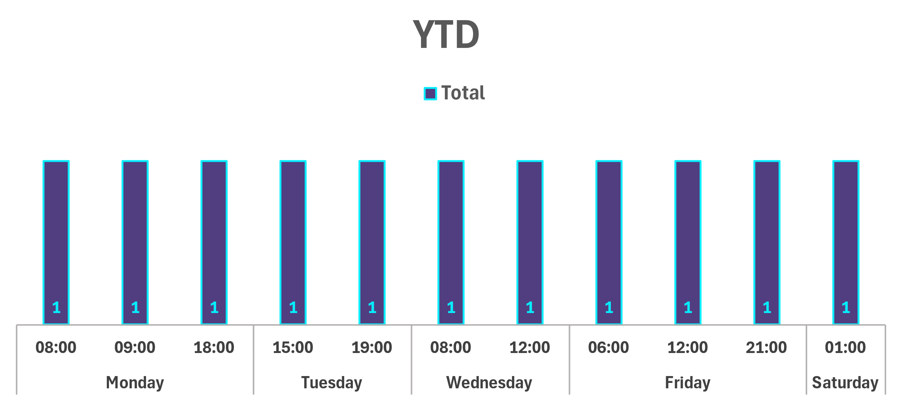
Strategic Crime Reduction Analysis
Prepared by PO R. Carucci
Crime/Topic
Spatial Assessment
Motor Vehicle Theft
Pattern Offenders/Suspects
MV Theft Incidents 7-Day:
02/17 at 08:22 at Second St, 100 Block. NJ-L17PUM a HONDA, ACC was taken from a private parking Lot
02/17 at 09:31at Prospect Ave, 0 Block, NJ-Z53RVG HONDA, ACC was taken from a private parking garage
Suspect: Unknown.

Slide 4
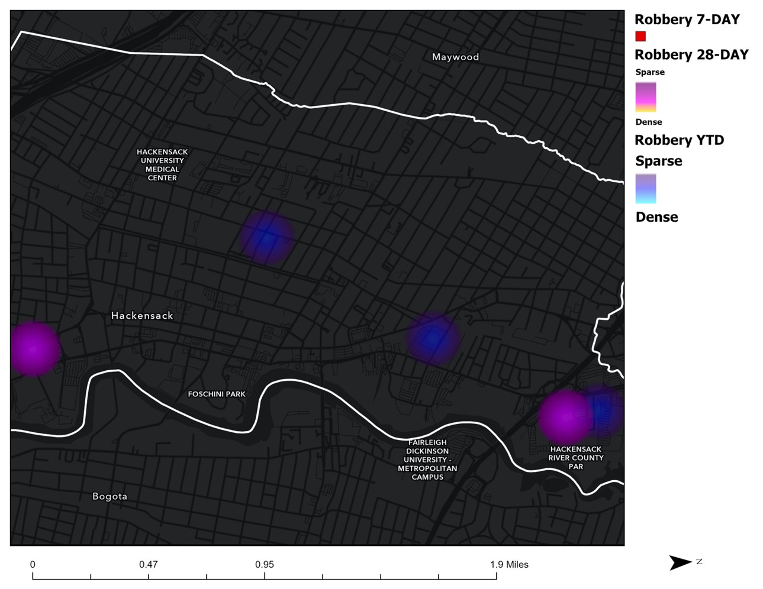
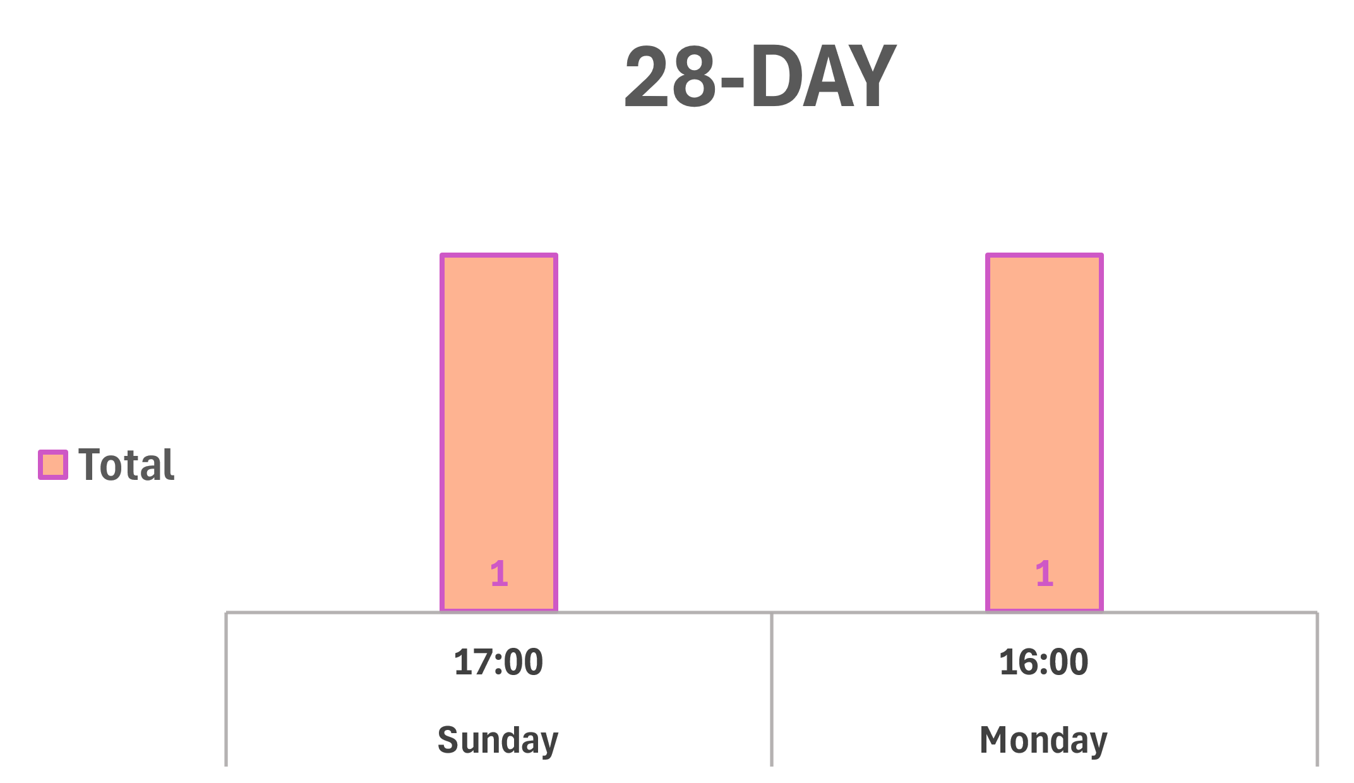
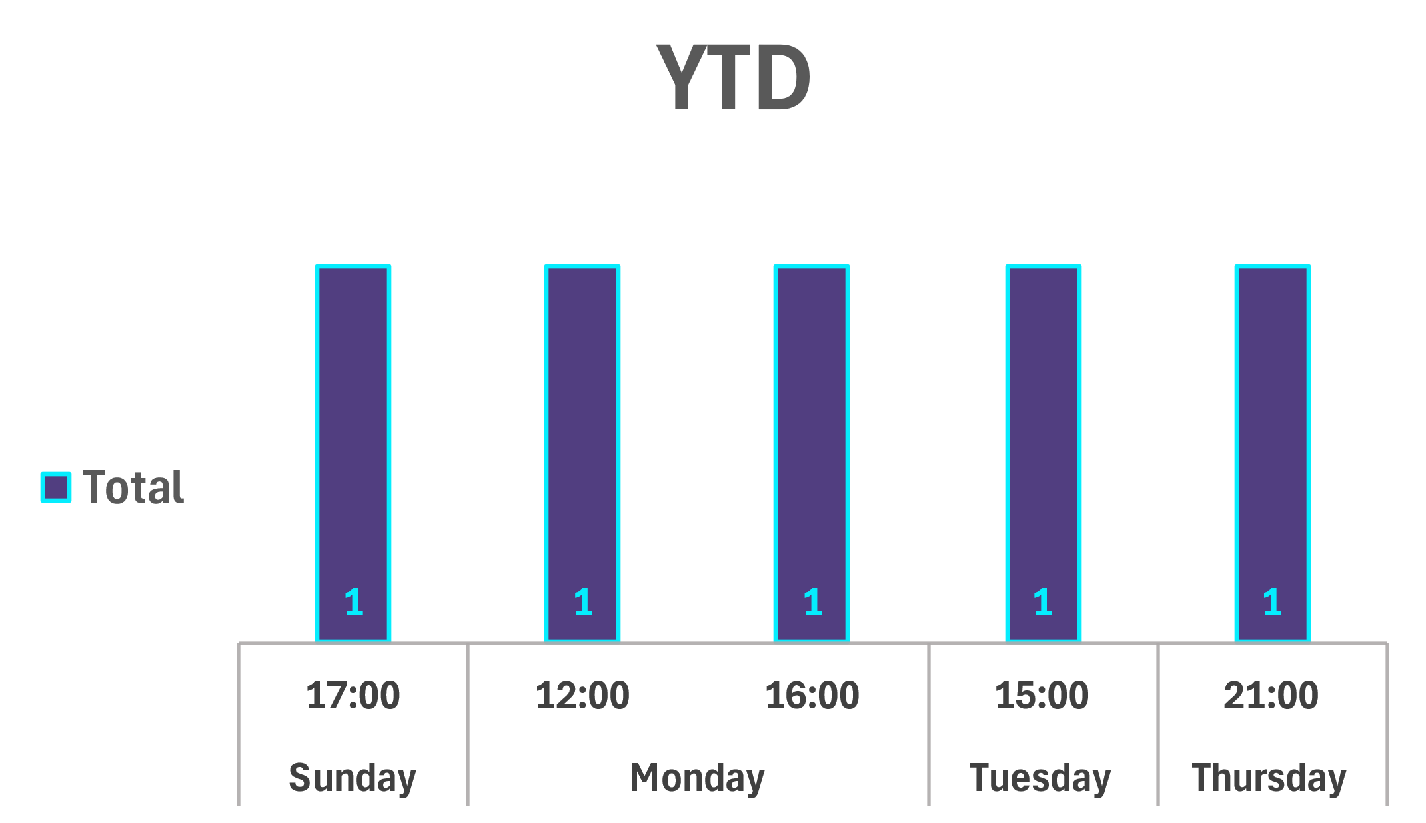
Strategic Crime Reduction Analysis
Prepared by PO R. Carucci
Crime/Topic
Spatial Assessment
Robbery
Pattern Offenders/Suspects
N/A
No Incidents occurred in the previous 7 days.

Slide 5
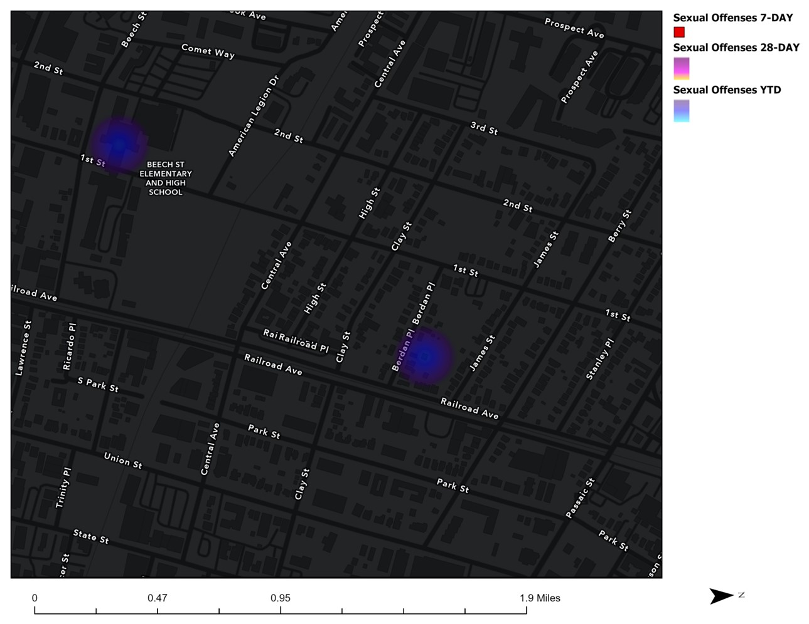
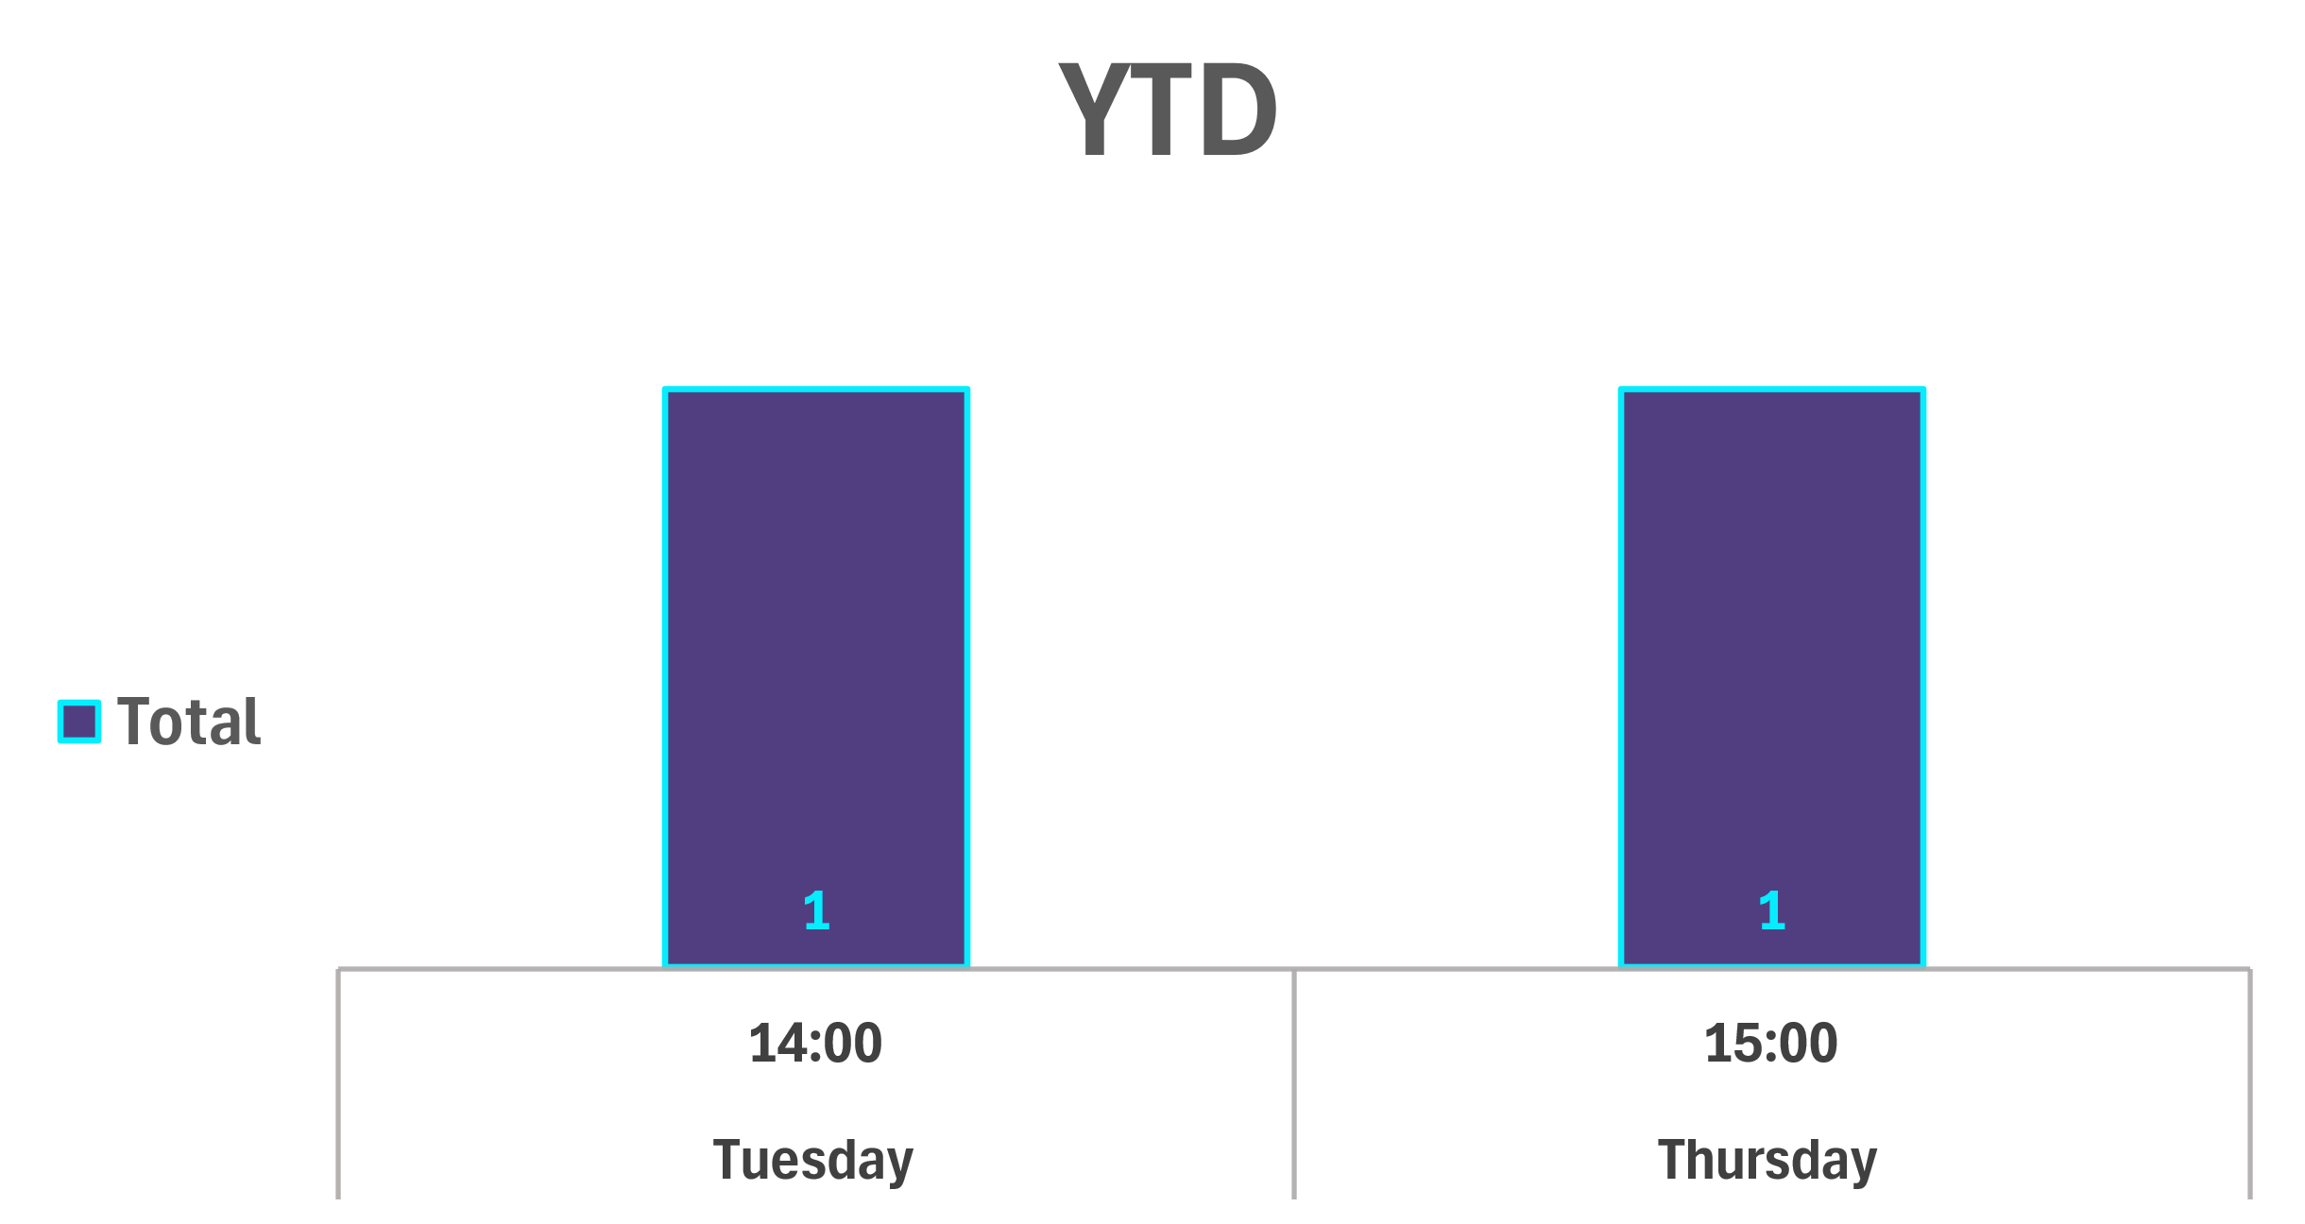
Strategic Crime Reduction Analysis
Prepared by PO R. Carucci
Crime/Topic
Spatial Assessment
Sexual Offenses
Pattern Offenders/Suspects
N/A
No Incidents occurred in the previous 7 or 28 cycles.

