Slide 1

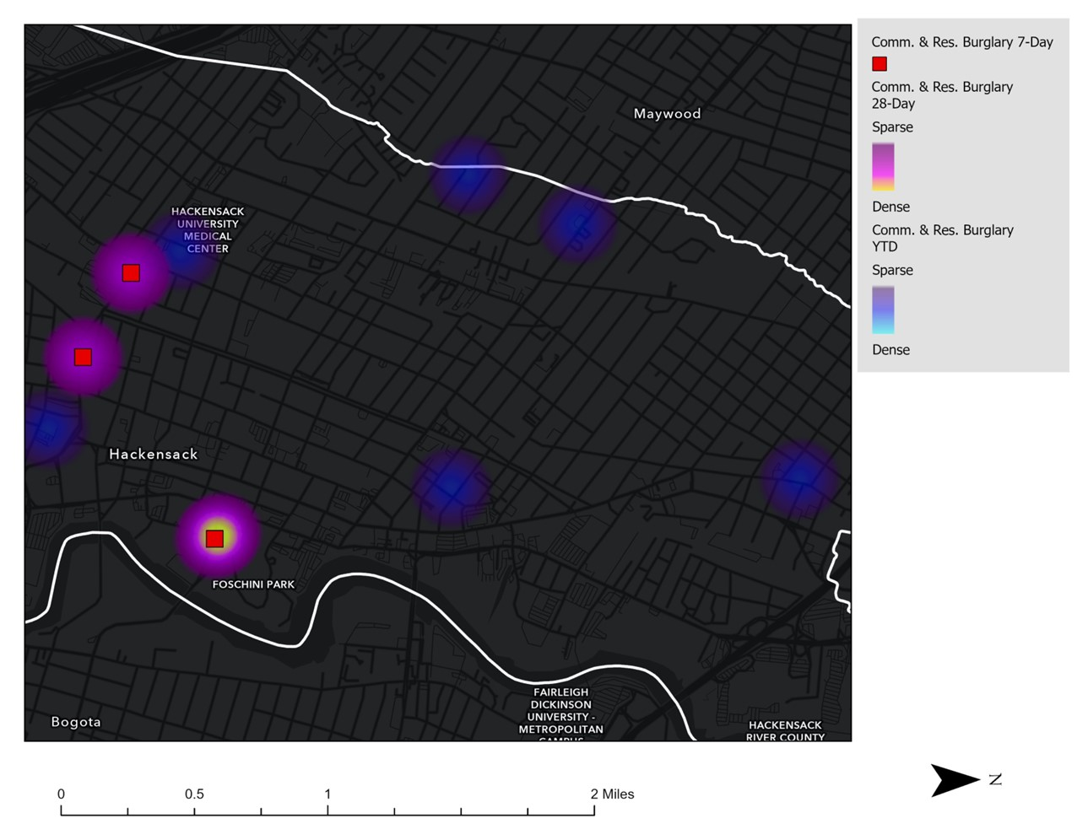
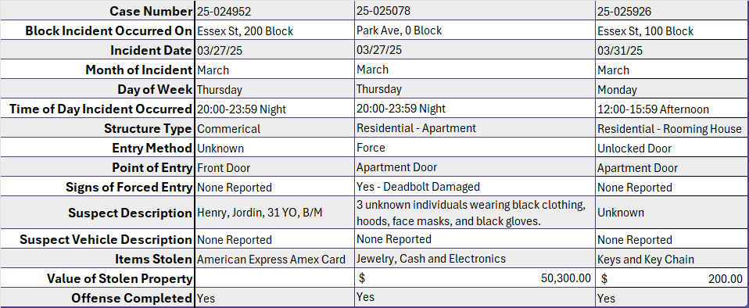
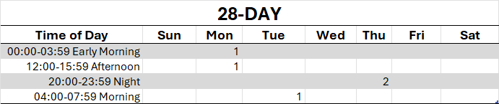
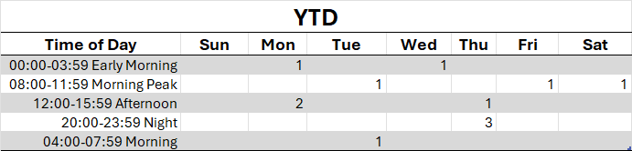
Strategic Crime Reduction Analysis
Prepared by PO R. Carucci
Crime/Topic
Spatial Assessment
Residential and Commercial Burglaries
Pattern Offenders/Suspects

Slide 2
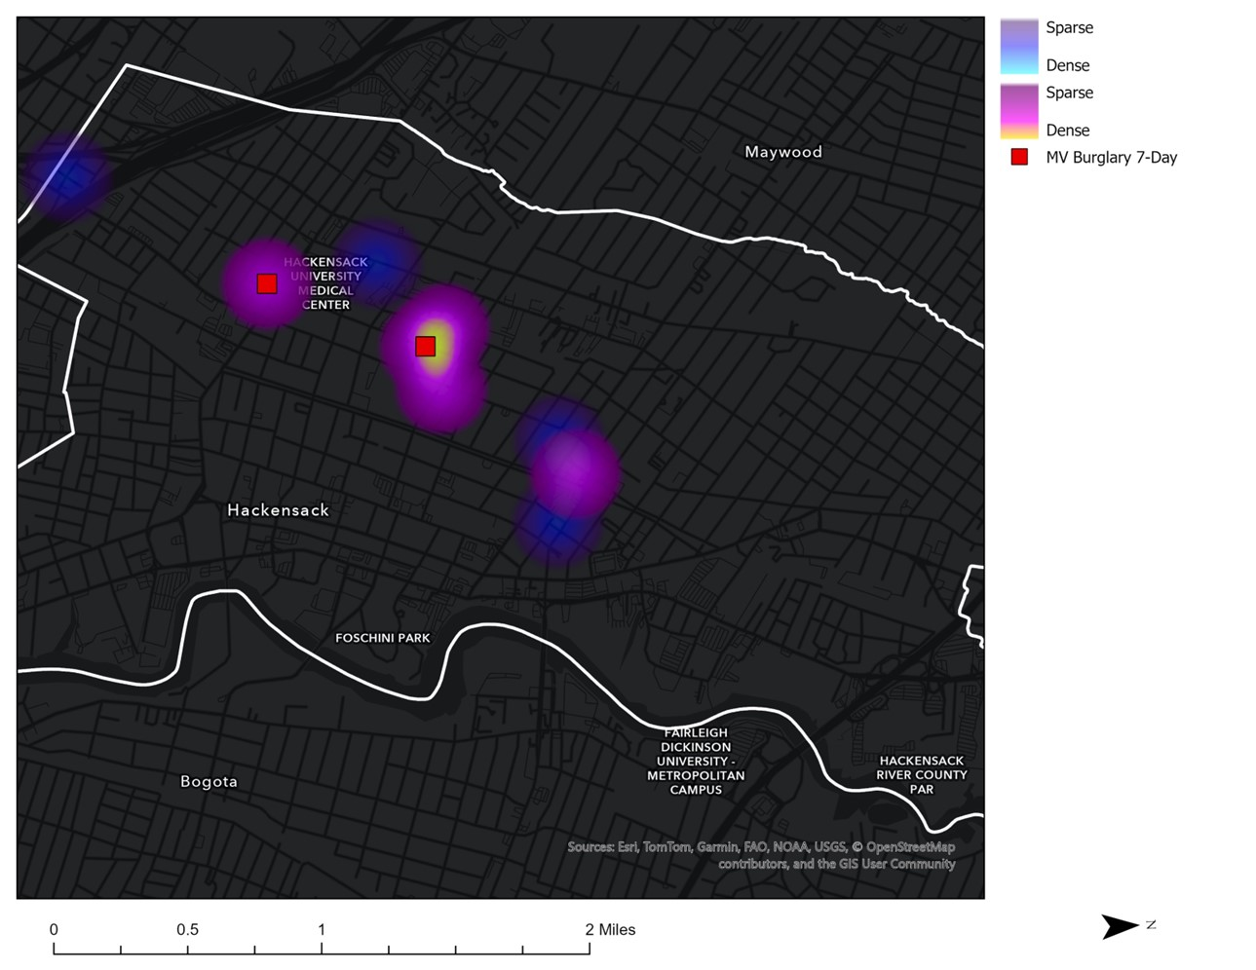
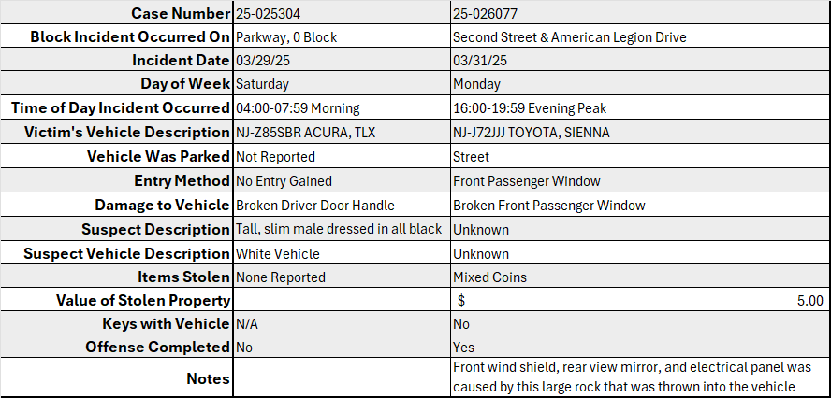
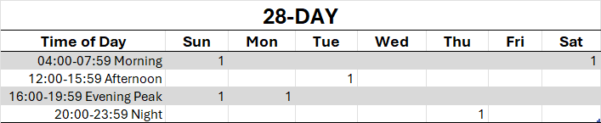
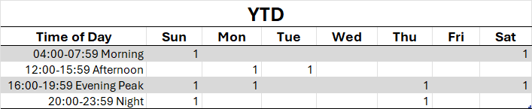
Strategic Crime Reduction Analysis
Prepared by PO R. Carucci
Crime/Topic
Spatial Assessment
Motor Vehicle Burglary
Pattern Offenders/Suspects

Slide 3
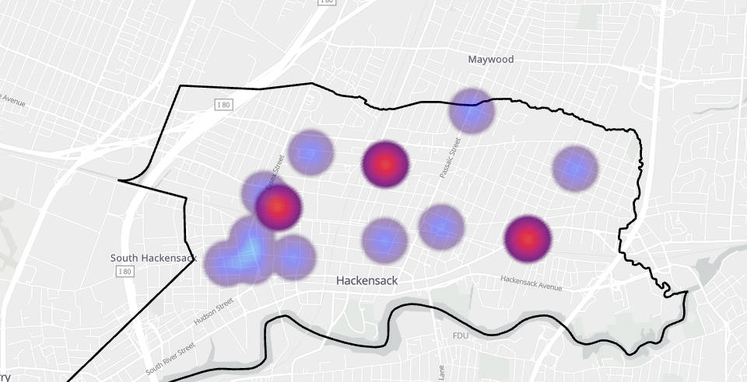
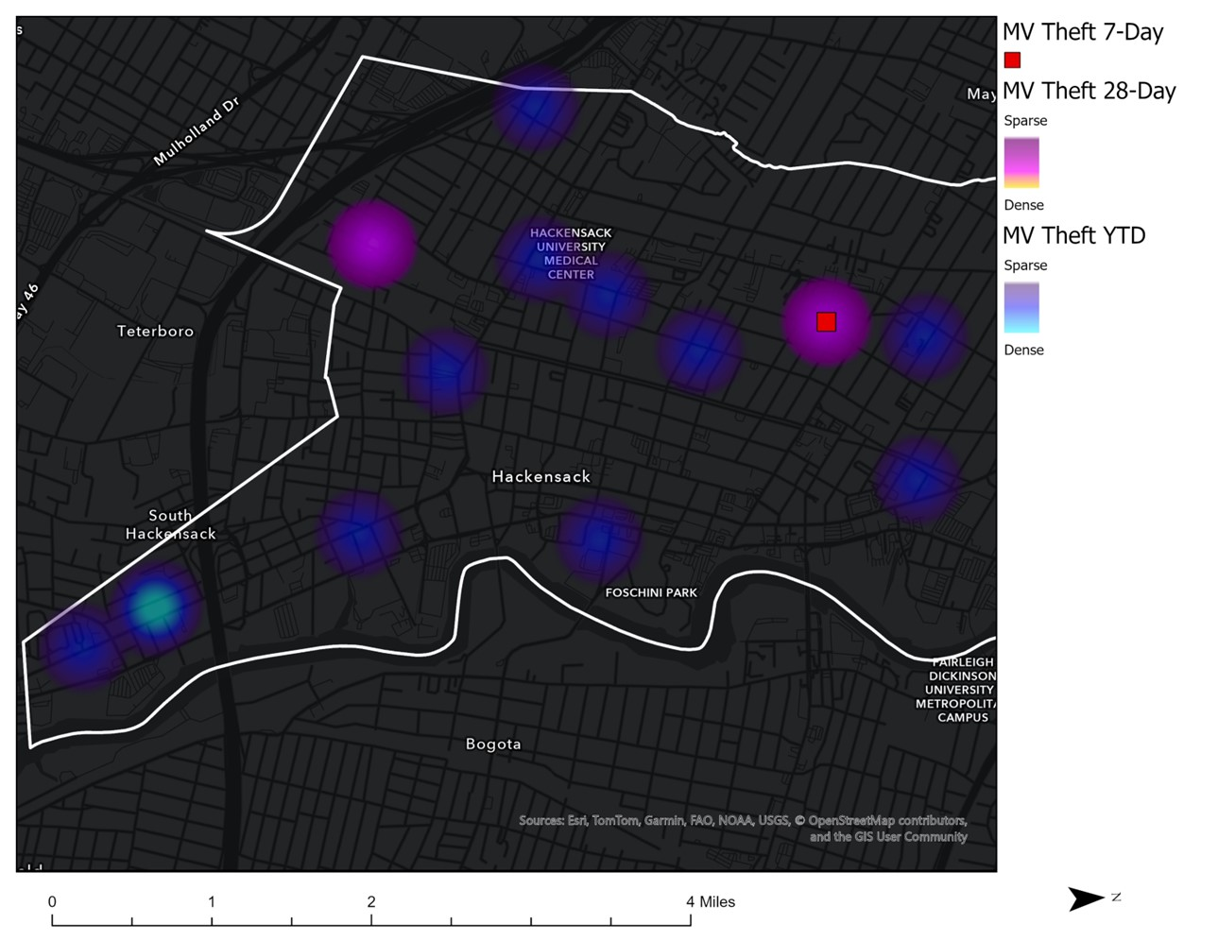
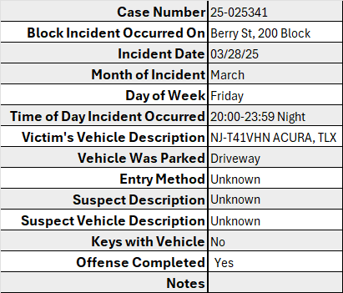
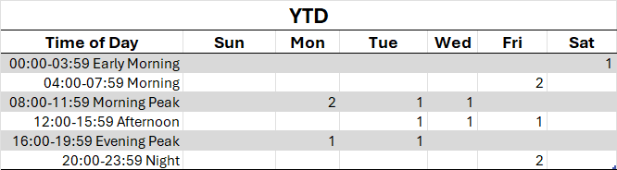
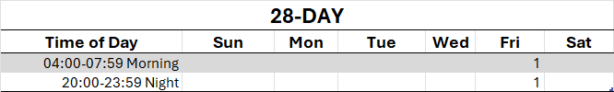
Strategic Crime Reduction Analysis
Prepared by PO R. Carucci
Crime/Topic
Spatial Assessment
Motor Vehicle Theft
Pattern Offenders/Suspects

Slide 4
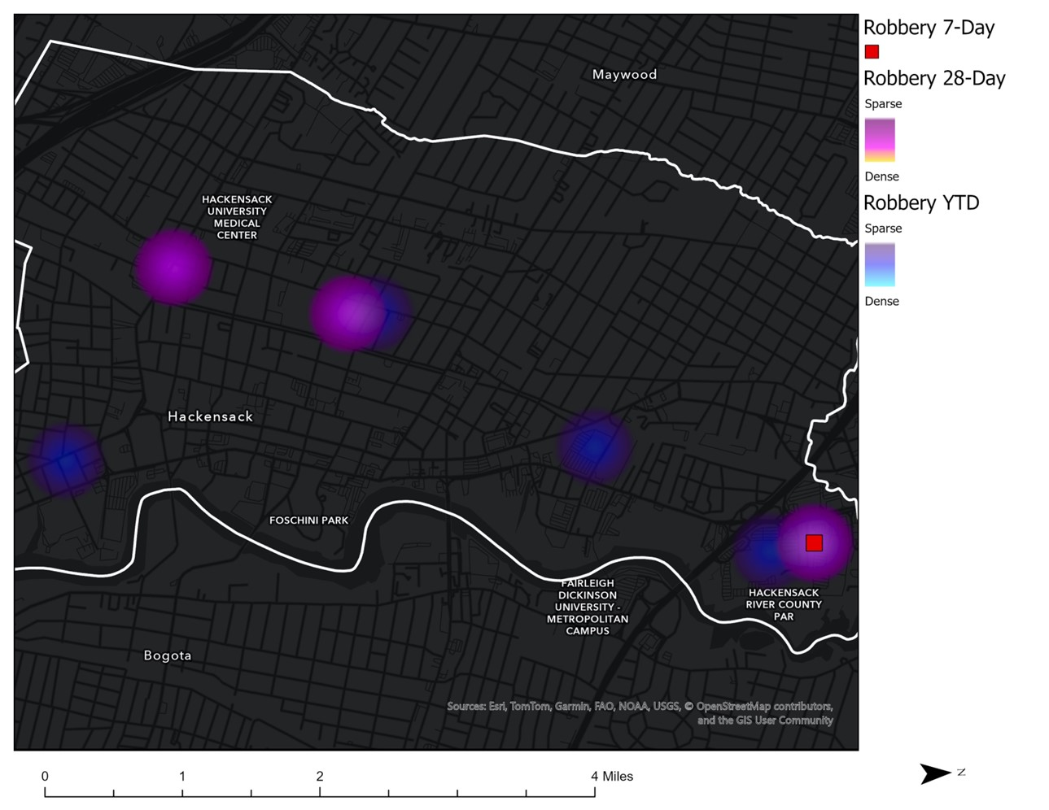
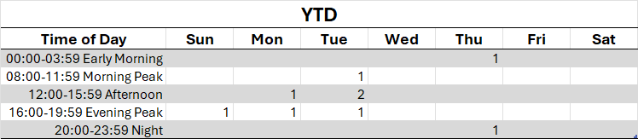
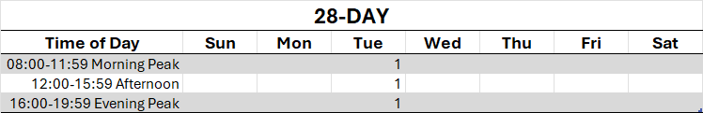
Strategic Crime Reduction Analysis
Prepared by PO R. Carucci
Crime/Topic
Spatial Assessment
Robbery
Pattern Offenders/Suspects

Slide 5
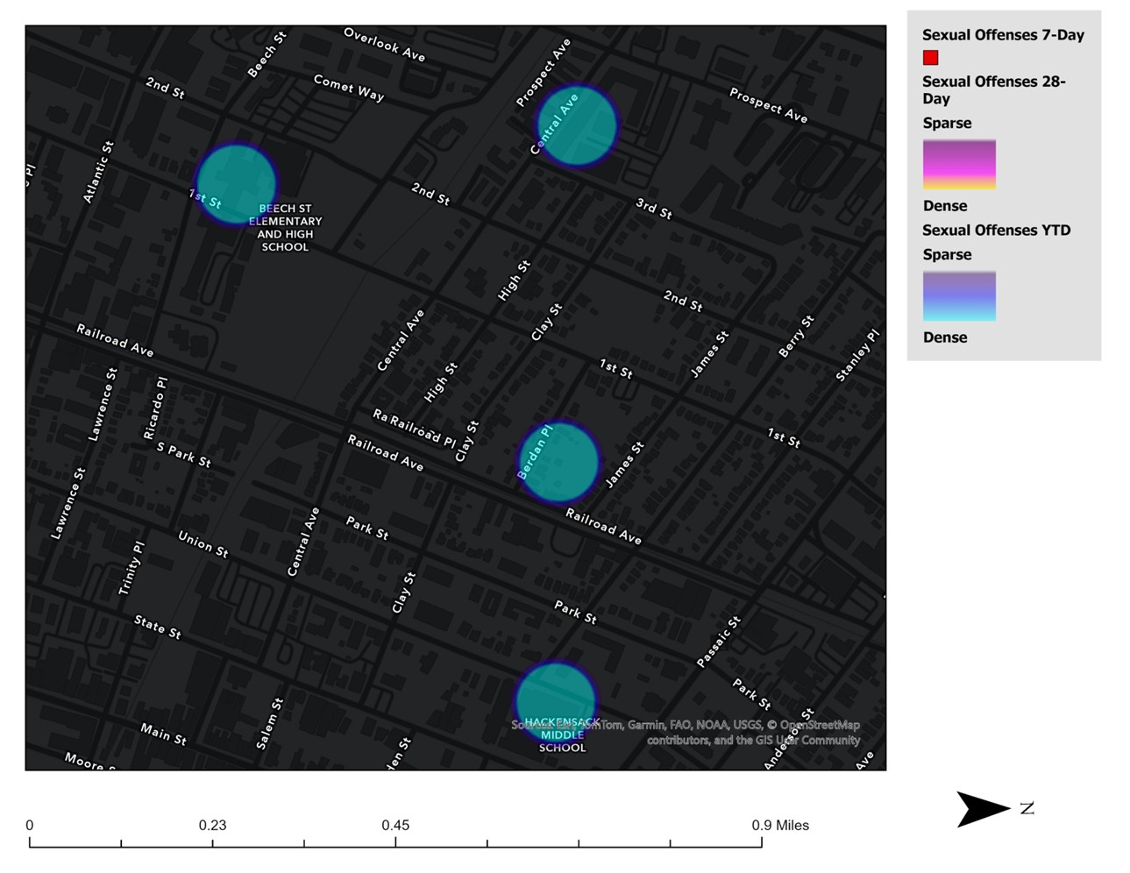
Strategic Crime Reduction Analysis
Prepared by PO R. Carucci
Crime/Topic
Spatial Assessment
Sexual Offenses
Pattern Offenders/Suspects
N/A
No Incidents occurred in the previous 7 days or 28 days.

