Slide 1

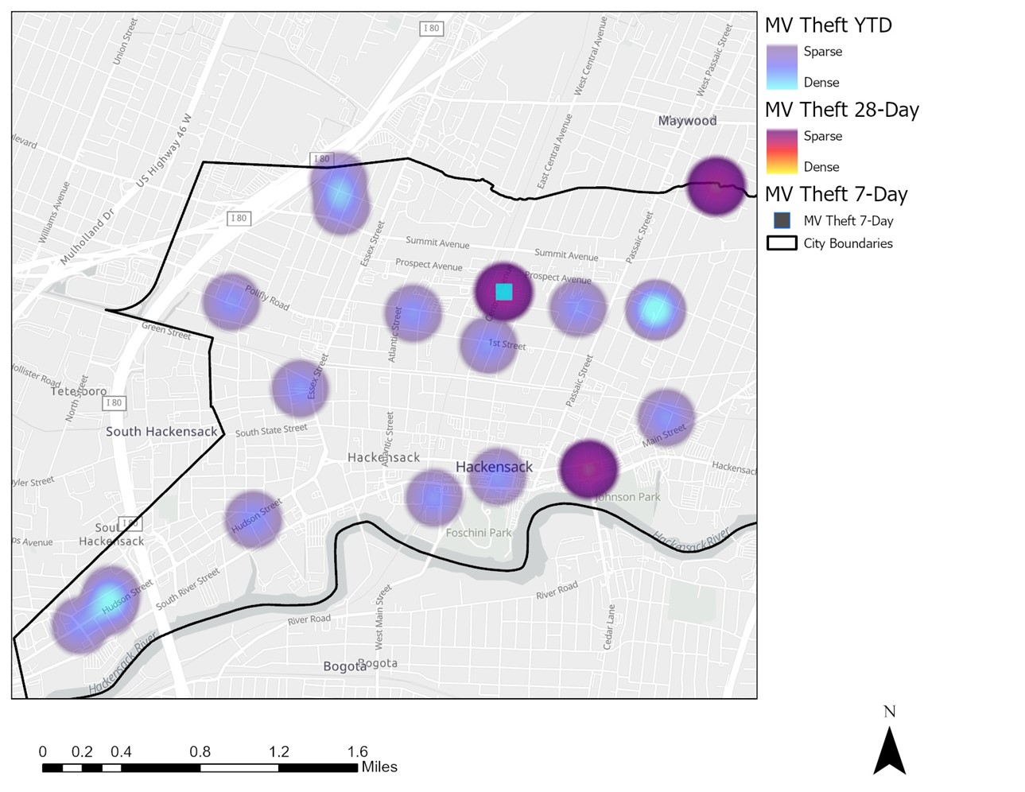
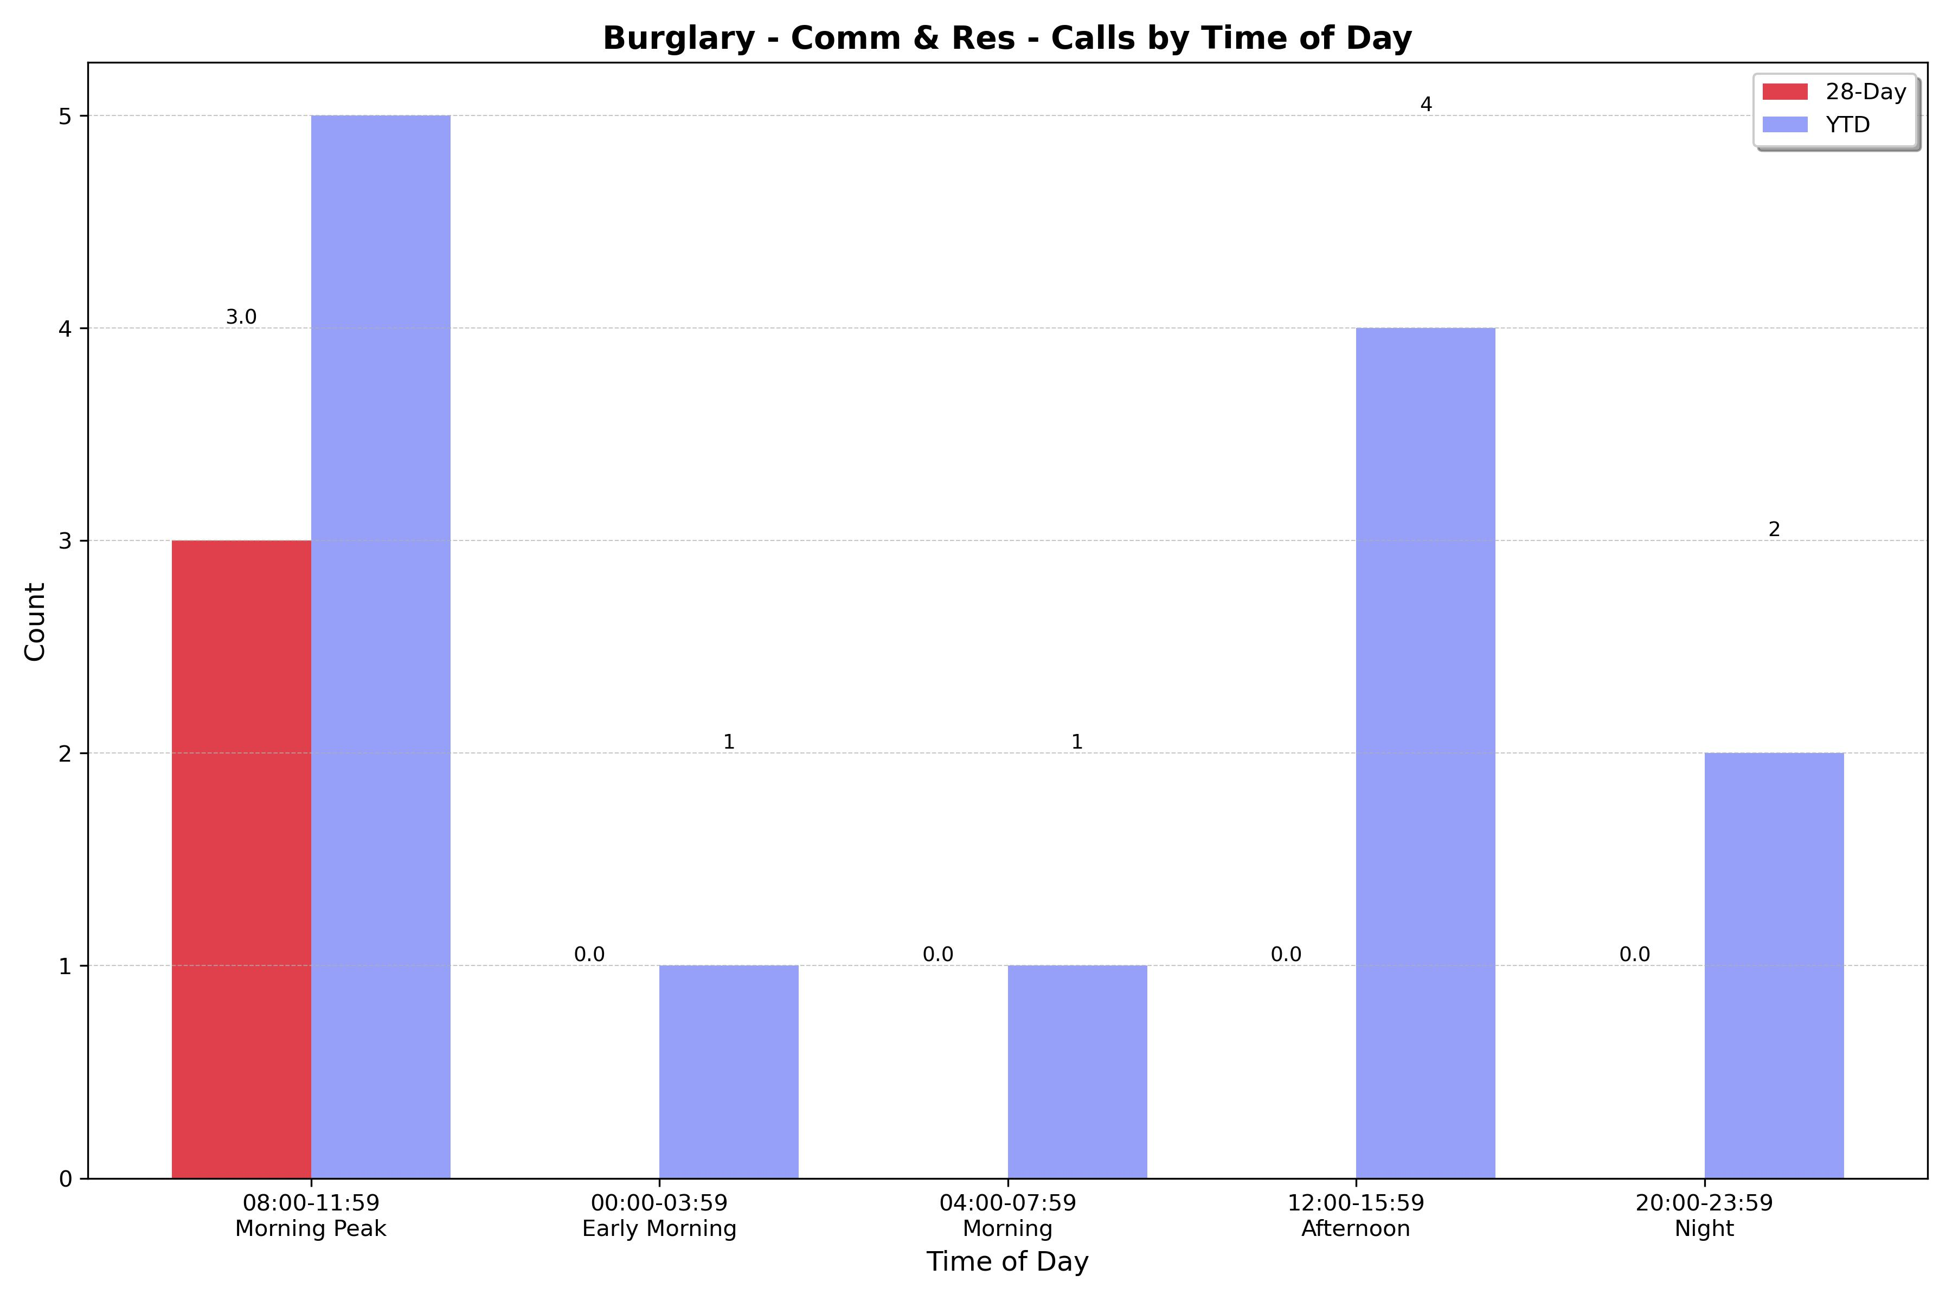
Strategic Crime Reduction Analysis
Prepared by PO R. Carucci
Motor Vehicle Theft
Pattern Offenders/Suspects

Slide 2
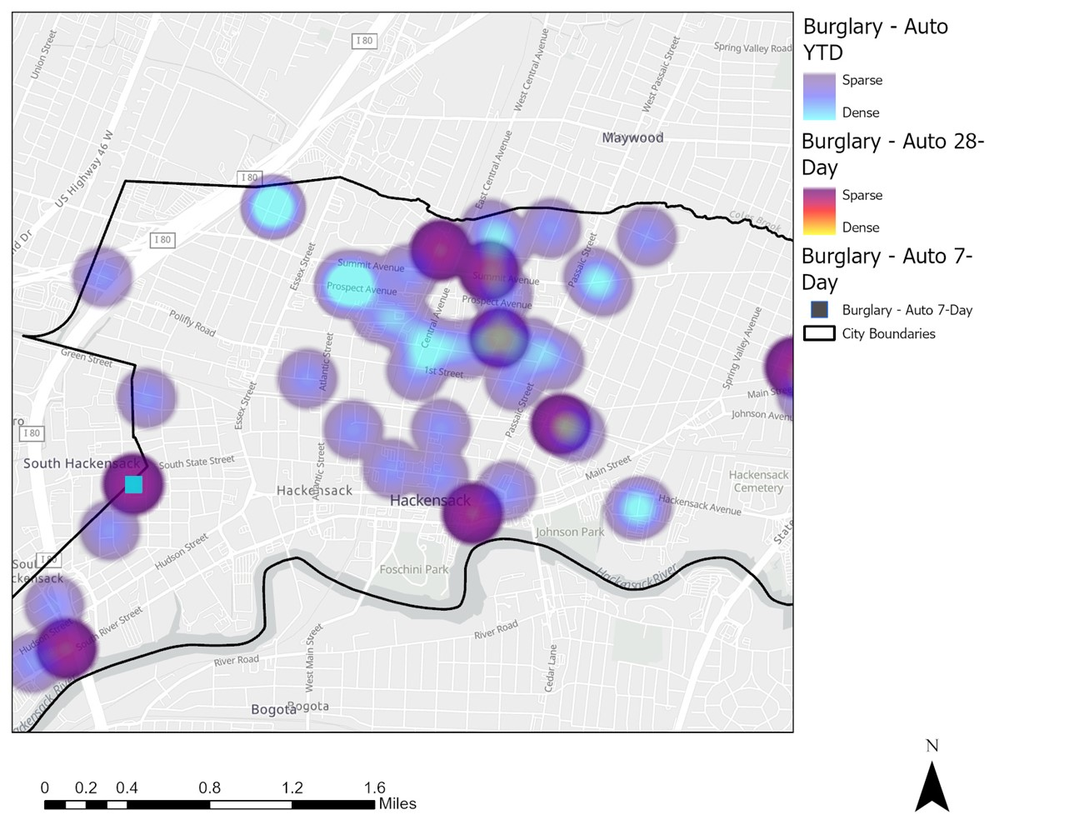
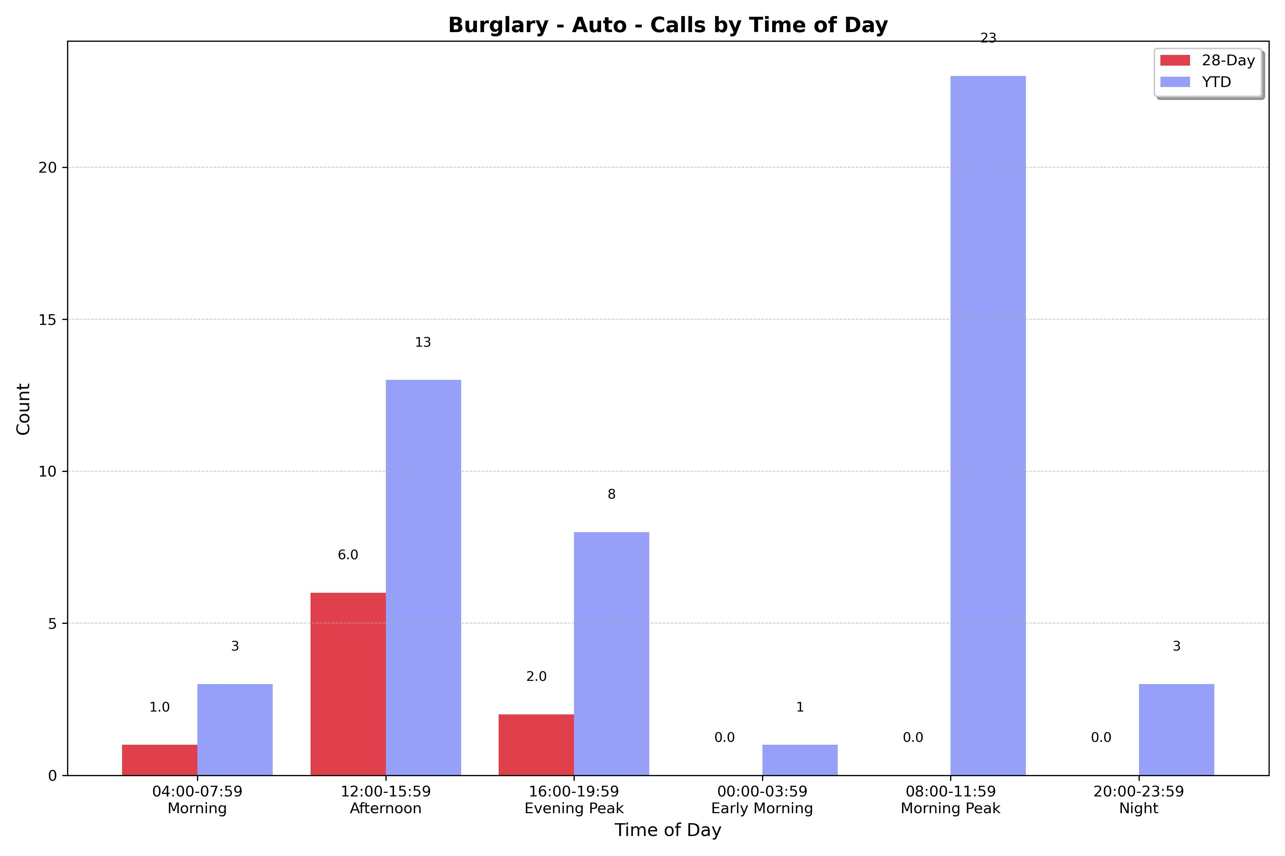
Strategic Crime Reduction Analysis
Prepared by PO R. Carucci
Motor Vehicle Burglary
Pattern Offenders/Suspects

Slide 3
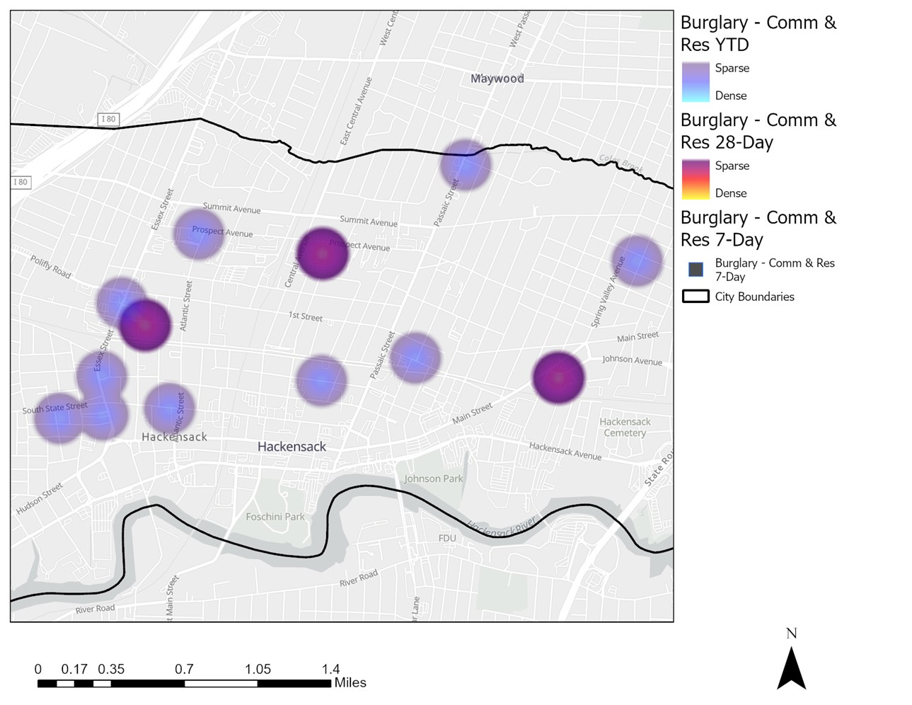
Strategic Crime Reduction Analysis
Prepared by PO R. Carucci
Residential and Commercial Burglaries
Pattern Offenders/Suspects
N/A

Slide 4
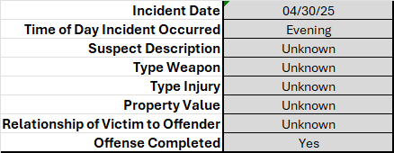
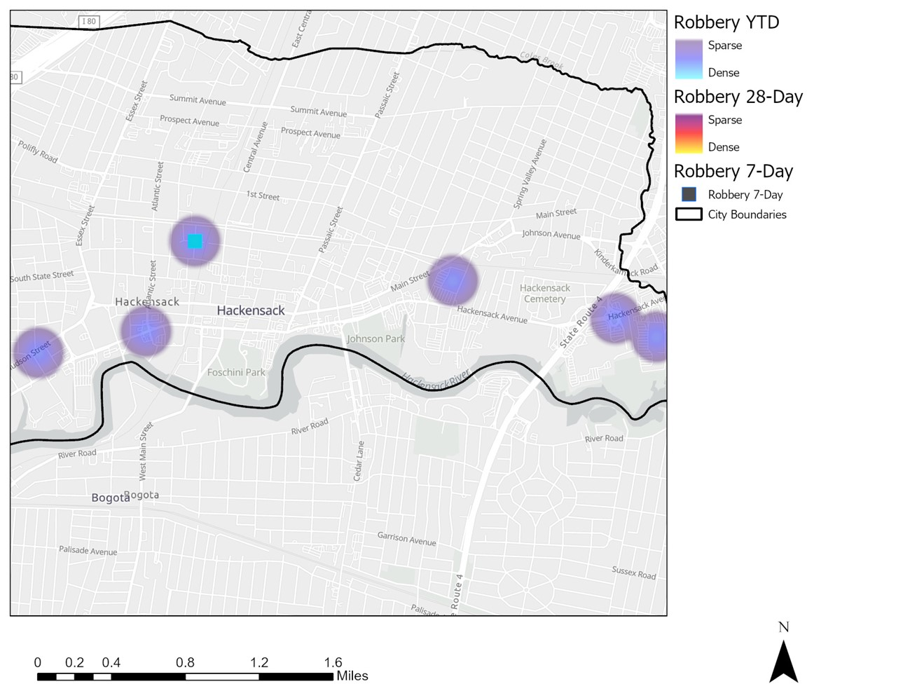
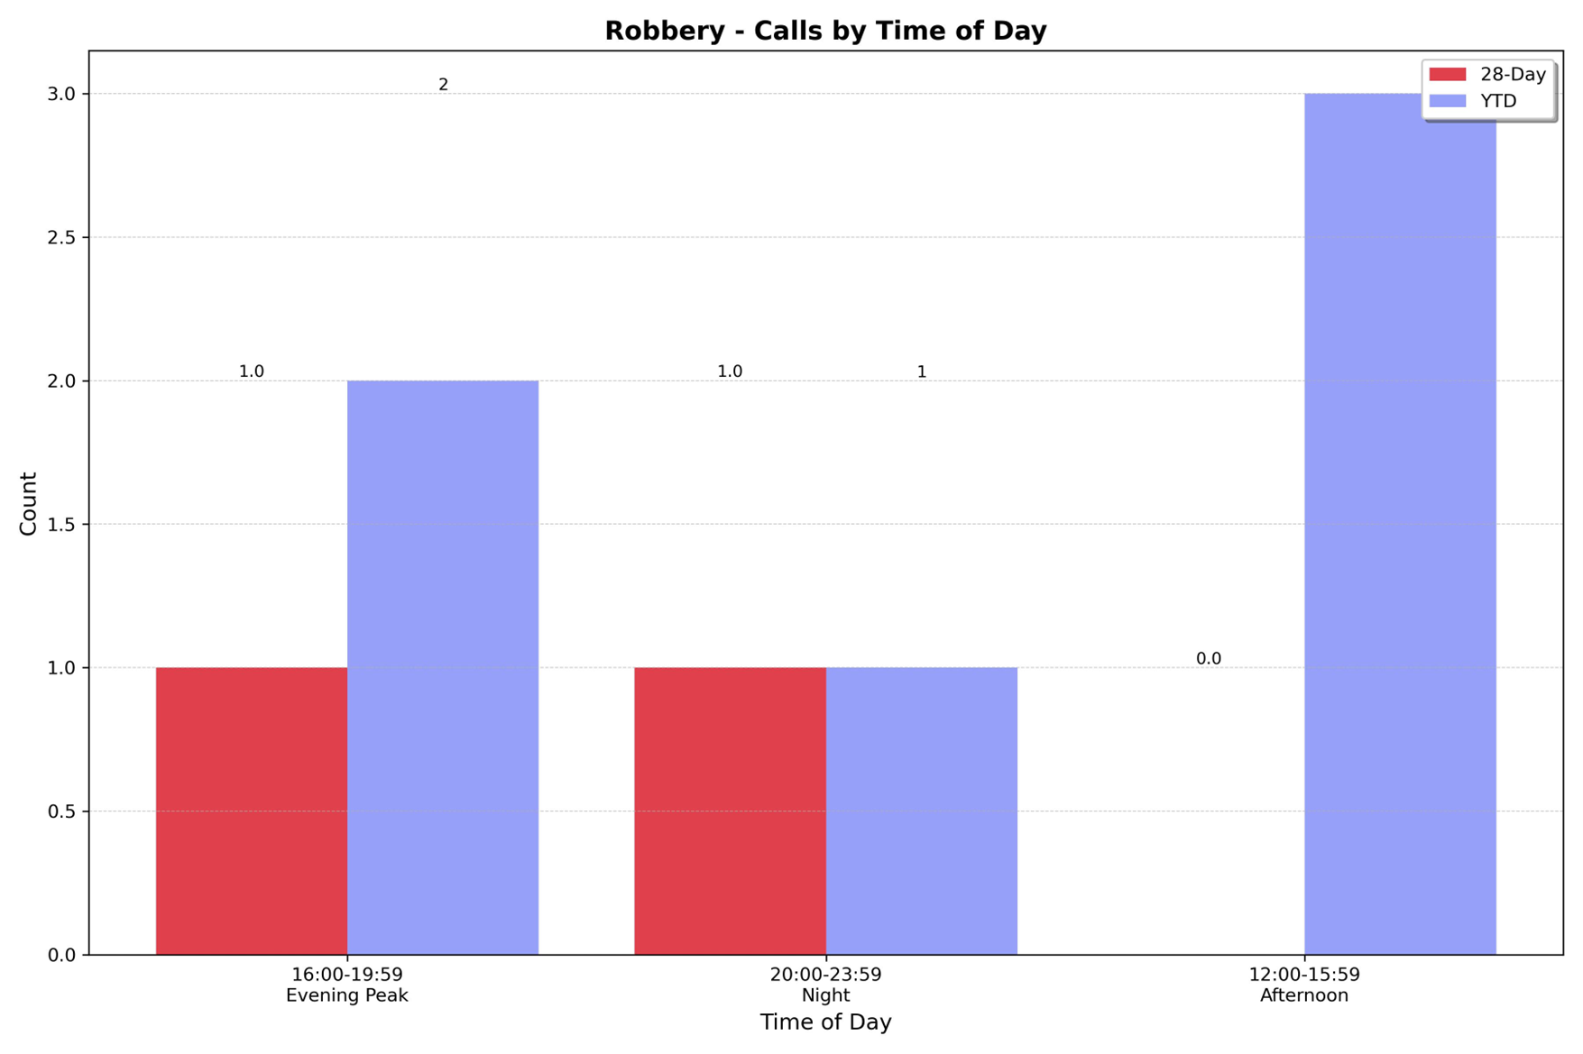
Strategic Crime Reduction Analysis
Prepared by PO R. Carucci
Robbery
Pattern Offenders/Suspects

Slide 5
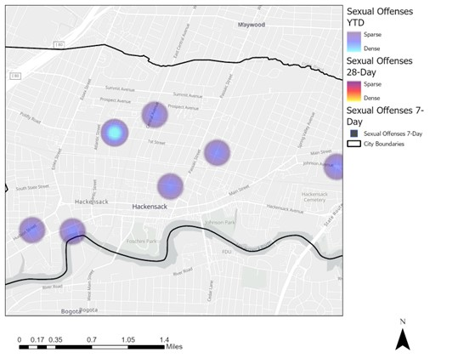
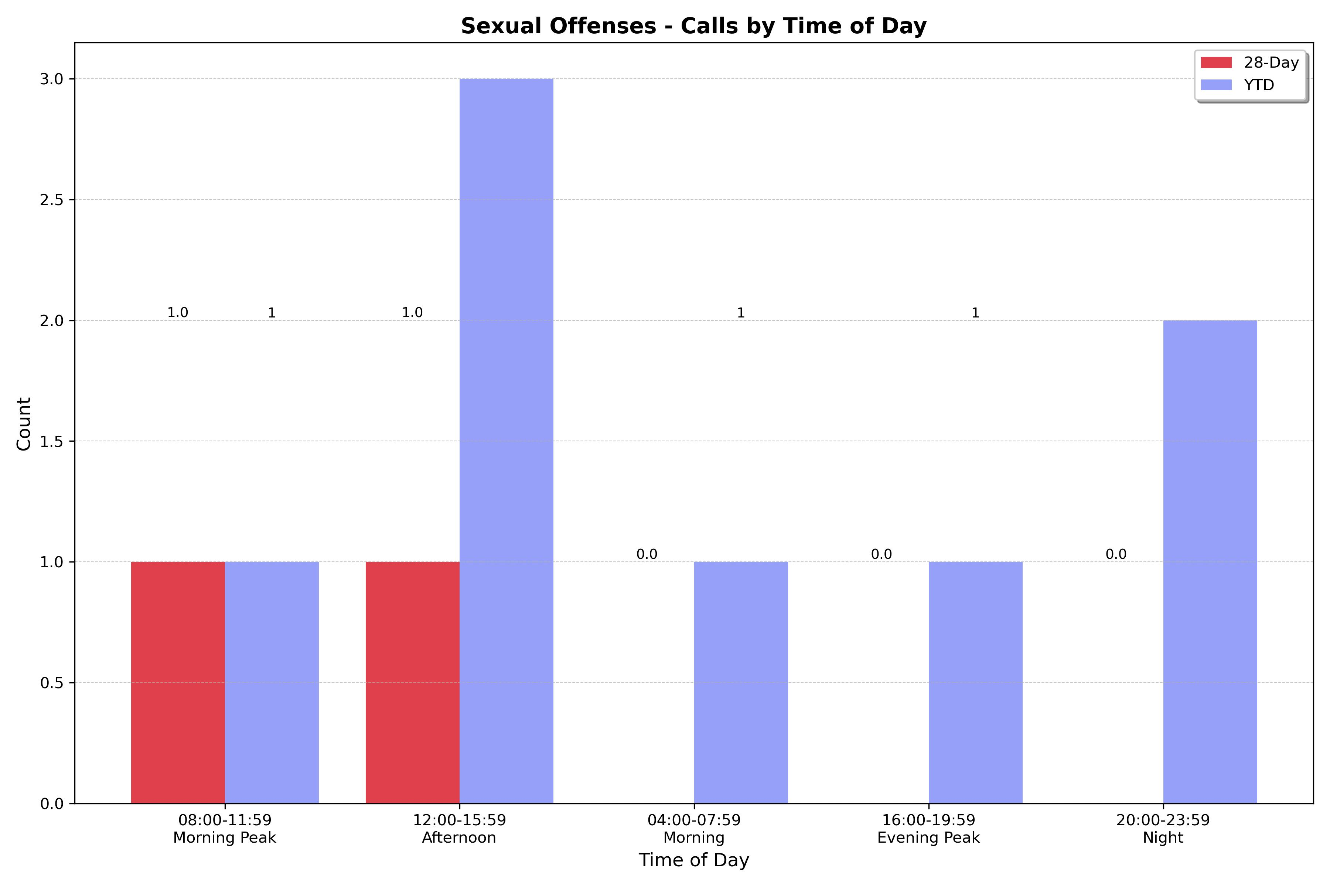
Strategic Crime Reduction Analysis
Prepared by PO R. Carucci
Sexual Offenses
Pattern Offenders/Suspects
N/A

