Slide 1

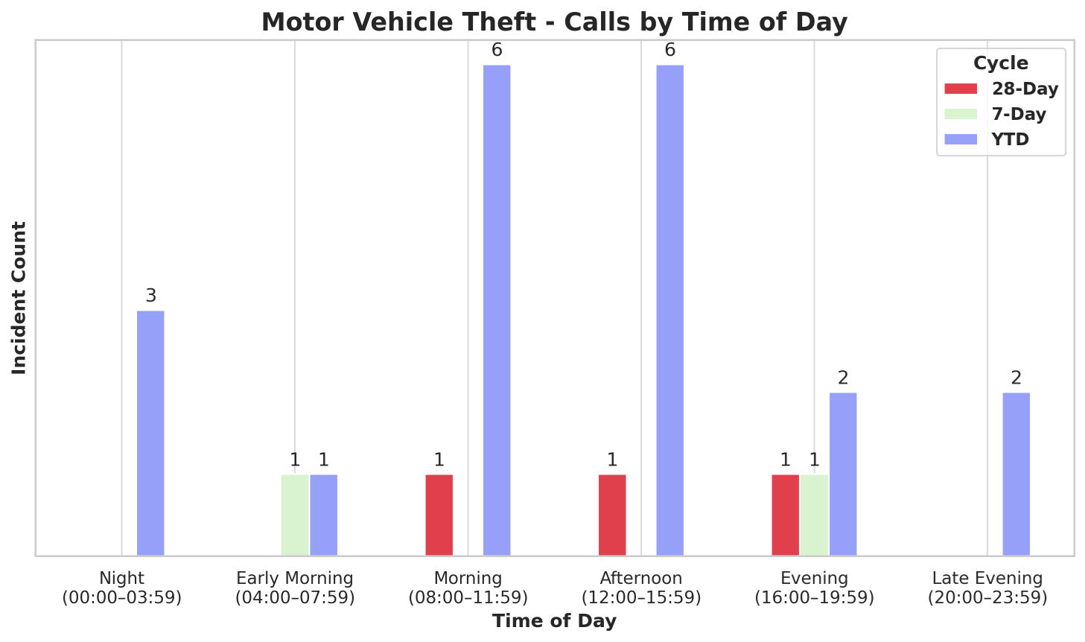
Strategic Crime Reduction Analysis
Prepared by PO R. Carucci
Motor Vehicle Theft
Pattern Offenders/Suspects

Slide 2
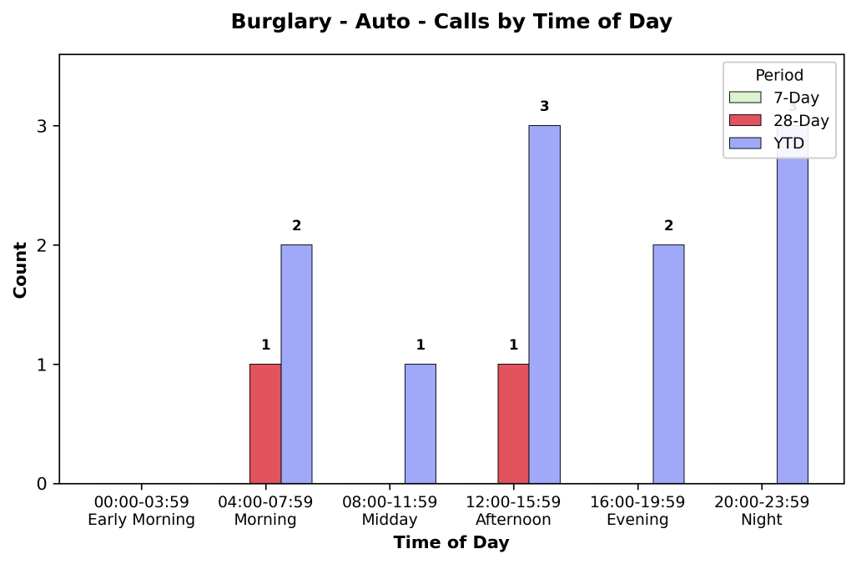
Strategic Crime Reduction Analysis
Prepared by PO R. Carucci
Burglary - Auto
Pattern Offenders/Suspects
Weekly Incident Report
0 incidents recorded (7-day period)

Slide 3
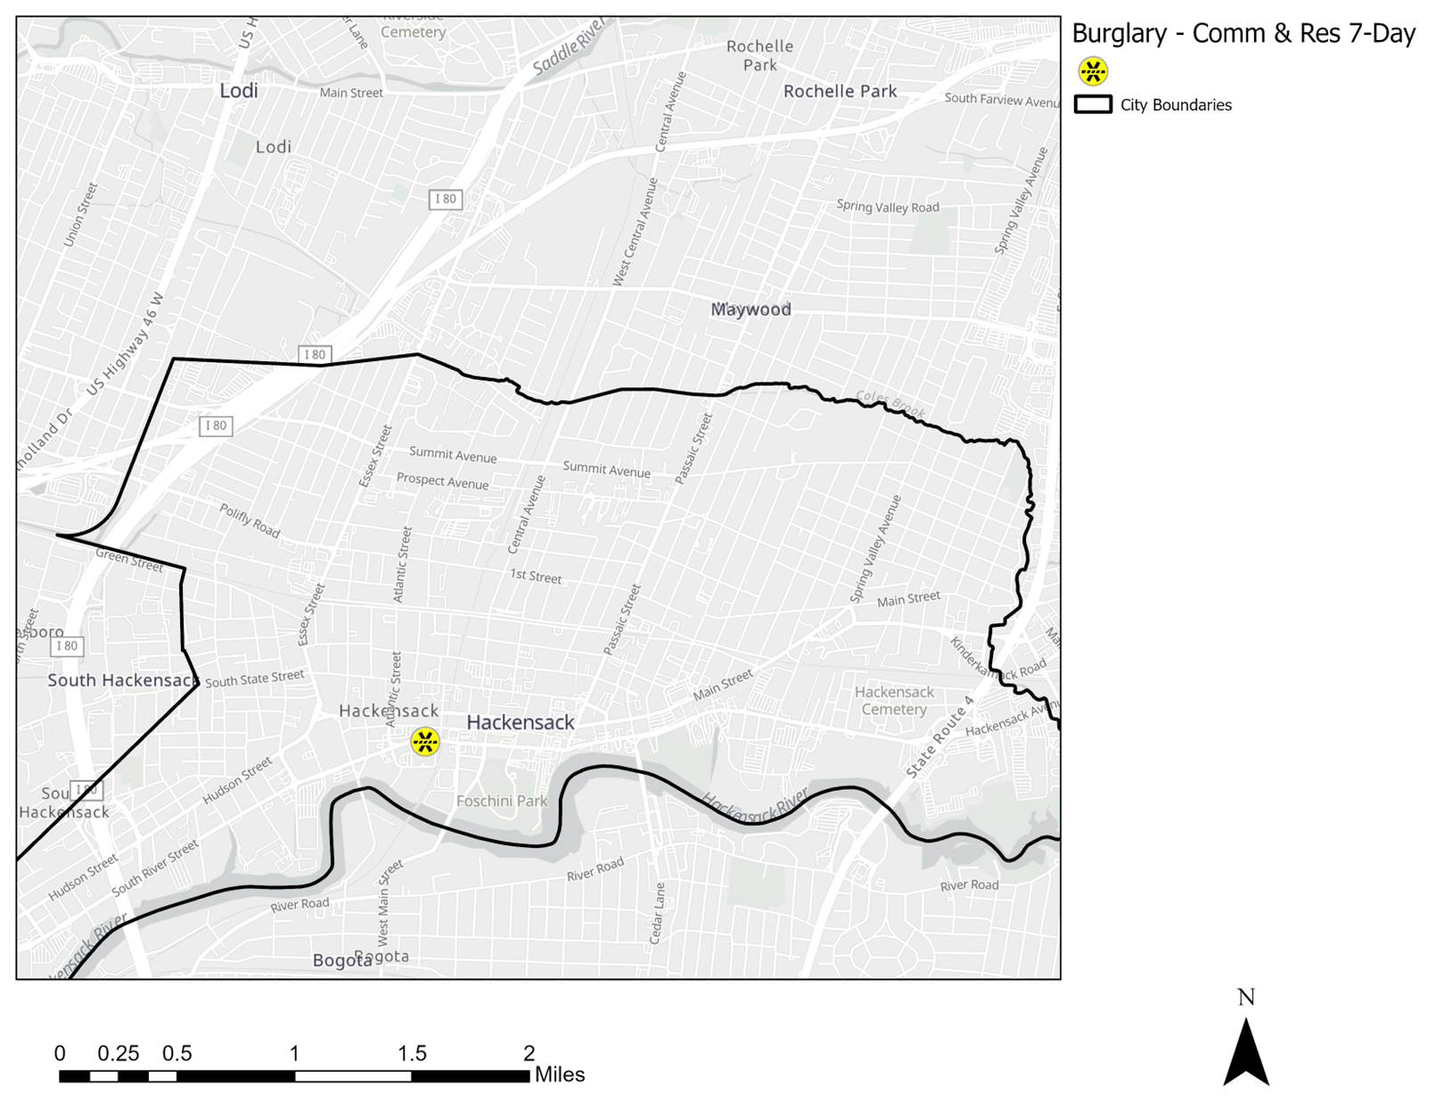
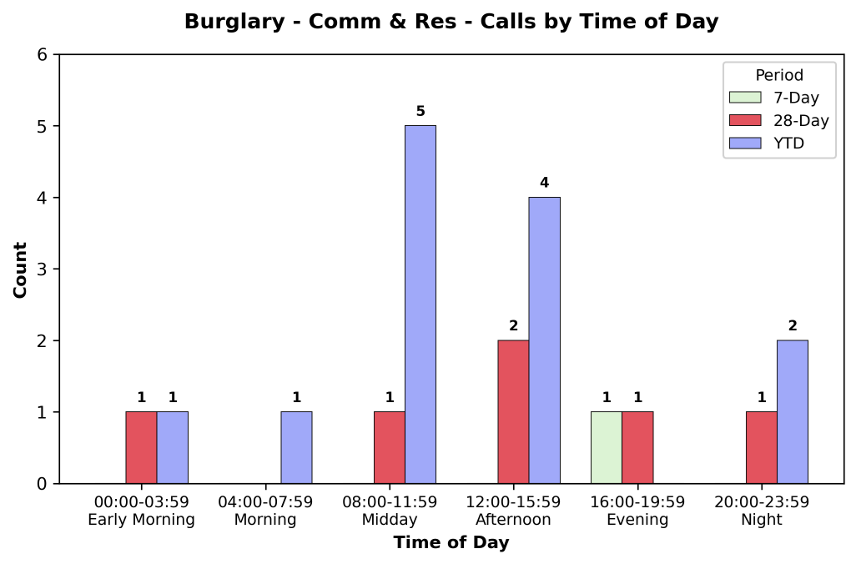
Strategic Crime Reduction Analysis
Prepared by PO R. Carucci
Residential and Commercial Burglaries
Pattern Offenders/Suspects
Access to the apartment is controlled by a key fob. The victim discovered the front door ajar and reported that a pair of blue suit pants and his Social Security card were missing. The total value of the stolen items is $1,200.

Slide 4
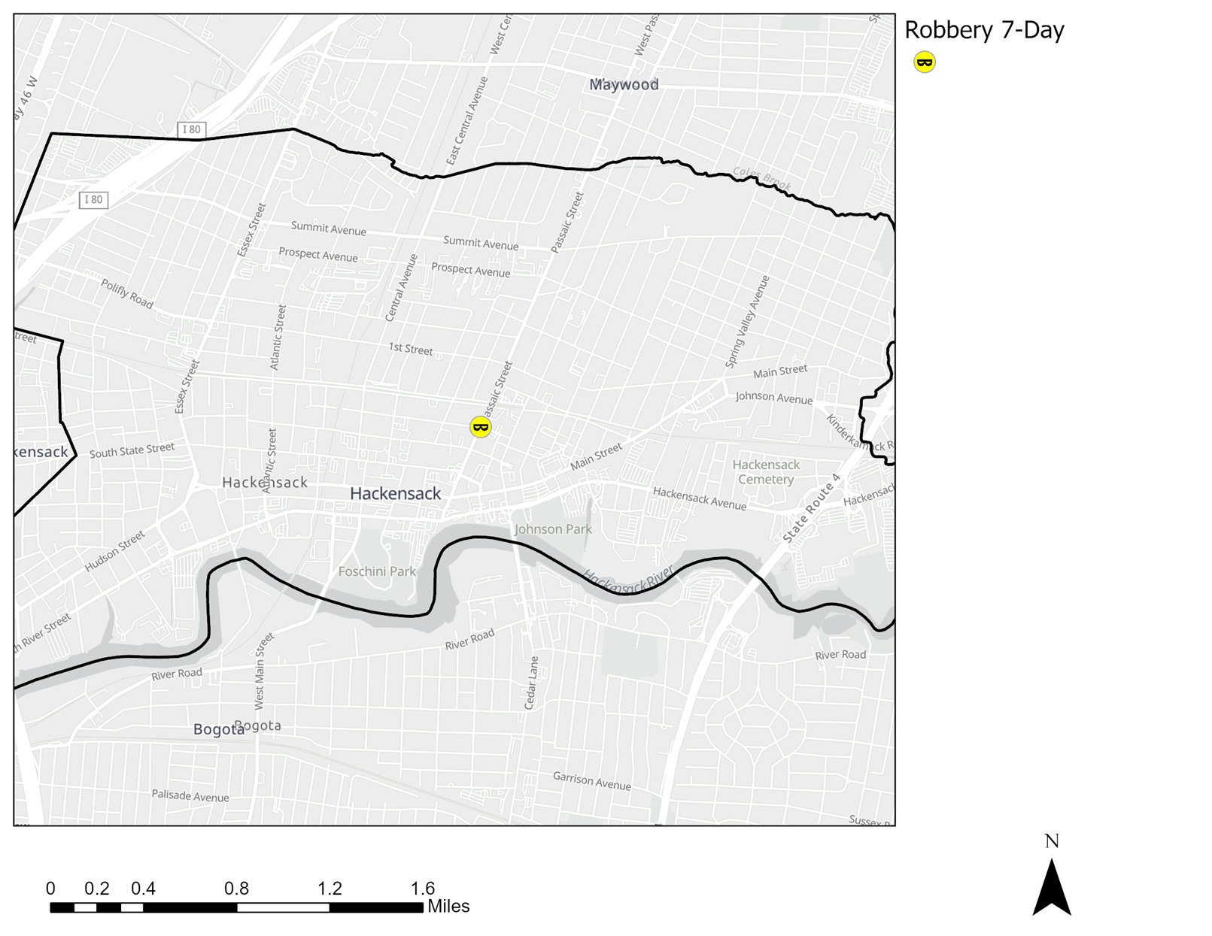
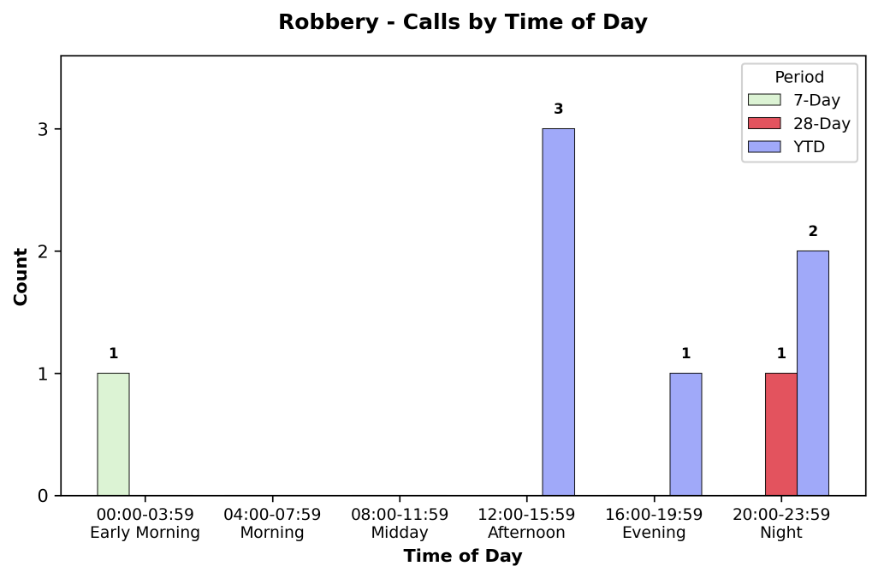
Strategic Crime Reduction Analysis
Prepared by PO R. Carucci
Robbery
Pattern Offenders/Suspects
Robbery Incident Summary – 505 S. River Street
Date/Time: 05/26/25, approximately 23:27 hours
Location: 505 S. River Street & E. Moonachie Road
Suspect Vehicles: White BMW sedan, Green BMW sedan, Blue Honda/Toyota (unknown plates)
Incident:
Victim John Rannella approached three vehicles blocking parking spaces and asked them to move.
Shortly after, suspects exited their vehicles at the intersection and assaulted Rannella, striking him with punches and a water bottle, causing facial lacerations.
Victim William Burke intervened and was also assaulted. During the altercation, Burke’s phone was stolen by the suspects before they fled the scene.
Surveillance video available for review.

Slide 5
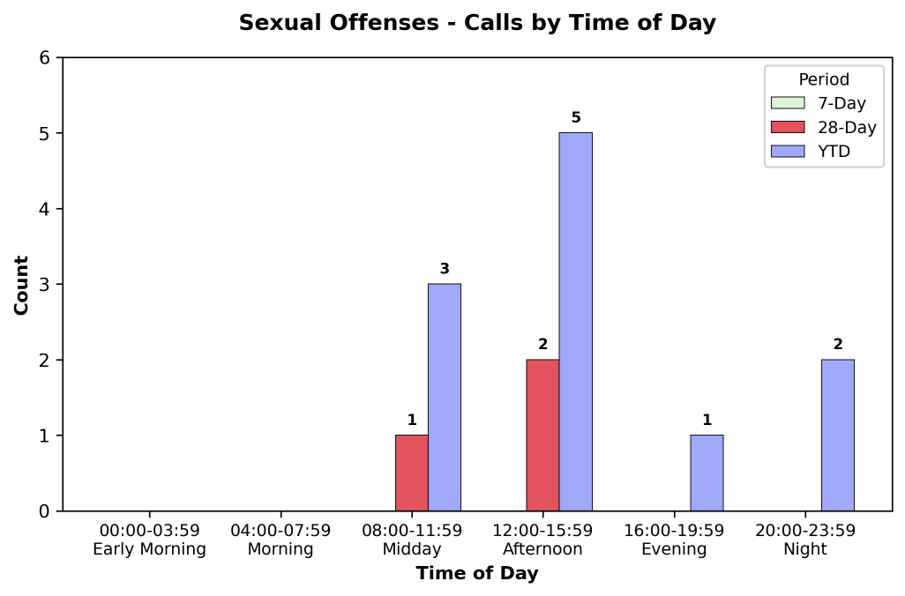
Strategic Crime Reduction Analysis
Prepared by PO R. Carucci
Sexual Offenses
Pattern Offenders/Suspects
Weekly Incident Report
0 incidents recorded (7-day period)

