Slide 1

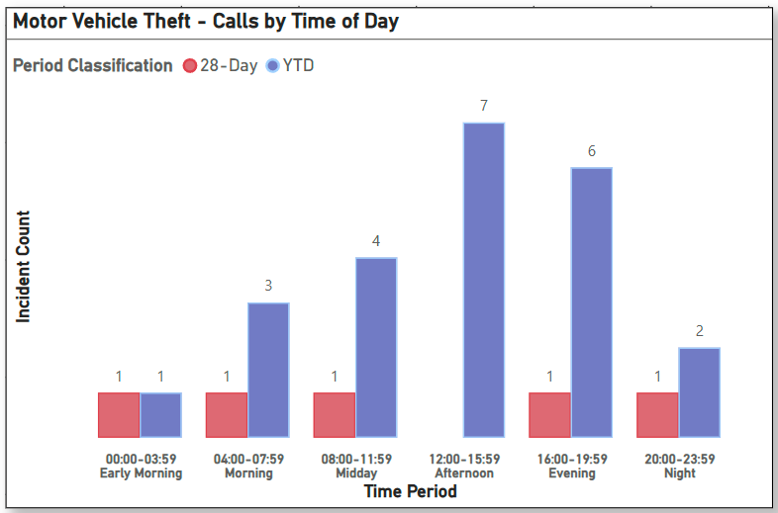
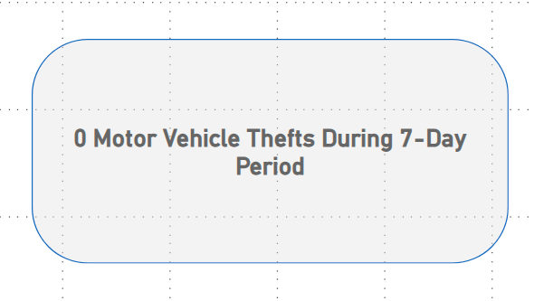
Strategic Crime Reduction Analysis
Prepared by PO R. Carucci
Motor Vehicle Theft
Pattern Offenders/Suspects

Slide 2
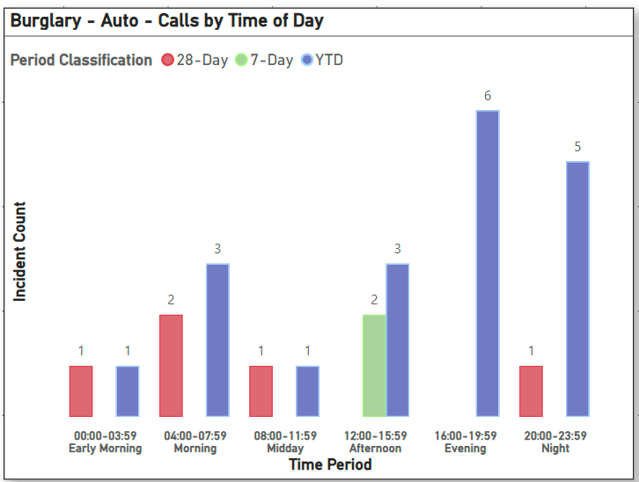
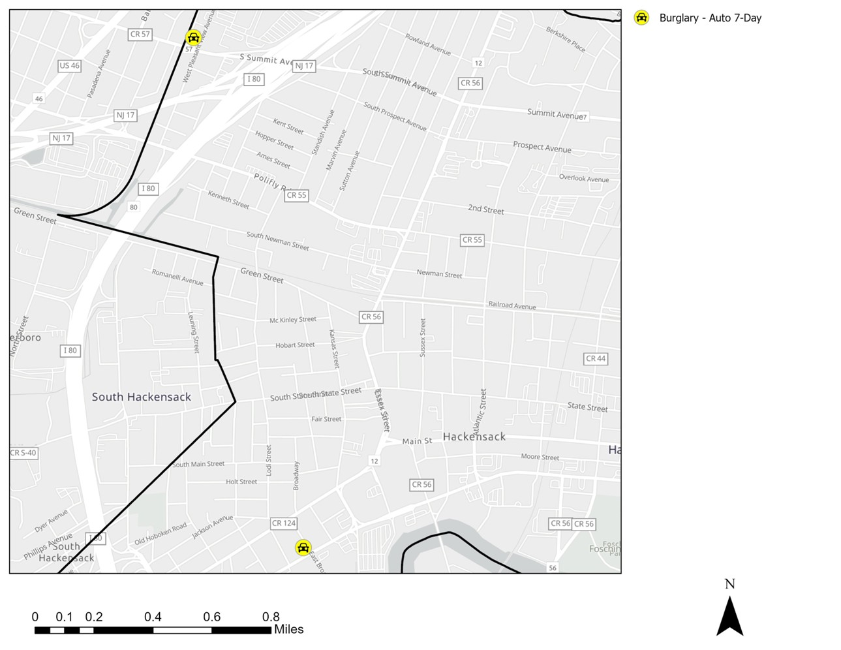
Strategic Crime Reduction Analysis
Prepared by PO R. Carucci
Motor Vehicle Burglary
Pattern Offenders/Suspects
Date: 06/25/2025 Location: 355 W Pleasantview Ave Type: Burglary to Auto Summary: Victim David Cohen parked his vehicle at approx. 1245 hrs with windows down. Upon return approx. 1 hour later, interior was found disturbed and wallet missing. Wallet contained $80–$100 and 3 credit cards. No forced entry observed. Victim declined evidence processing. Loss estimated at $90–$110. Notification forms completed.
Date: 06/30/2025 Location: [Address Not Provided] Type: Burglary to Auto Summary: Victim discovered his work vehicle had been forcibly entered between 1500 hrs on 06/29 and 0730 hrs on 06/30. Lock and ignition were damaged; tools valued at approximately $5,000 stolen. Notable items include laser tools, saws, compressor, and Milwaukee-brand tools/batteries. No suspects reported. Victim notification form completed. D/Sgt. P. Williams advised.

Slide 3
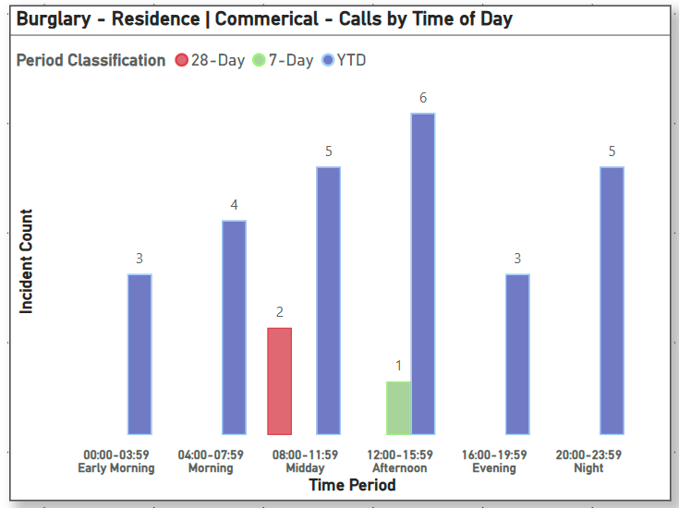
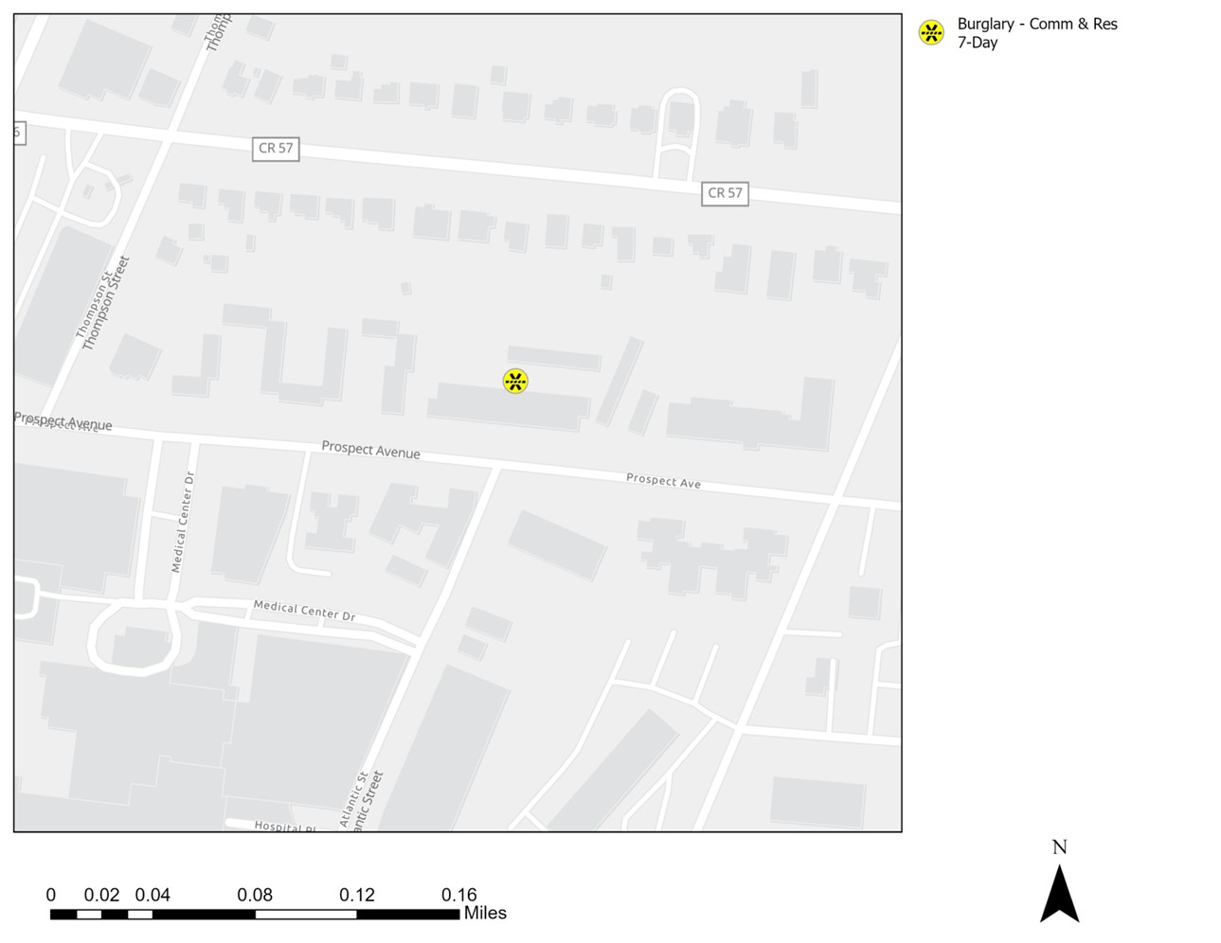
Strategic Crime Reduction Analysis
Prepared by PO R. Carucci
Residential & Commercial Burglaries
Pattern Offenders/Suspects
Date: 06/27/2025 Location: 77 Prospect Type: Residential Burglary Summary: Victim reported apartment was burglarized while napping between 1100–1300 hrs. Entry was made through an unlocked door. Items stolen included $70 cash, credit cards, and food stamps. Victim, who is hard of hearing, did not hear entry. Scene was disturbed before officer arrival.
Date: 06/26/2025 Location: Police Headquarters Type: Residential Burglary Summary: Victim Santos De La Cruz reported the theft of a floor safe containing $2,000 cash, jewelry (valued at $900), and the safe itself ($200) for a total estimated loss of $3,100. Last seen on 06/23/2025; discovered missing on 06/26/2025 at 1900 hrs. No signs of forced entry.

Slide 4
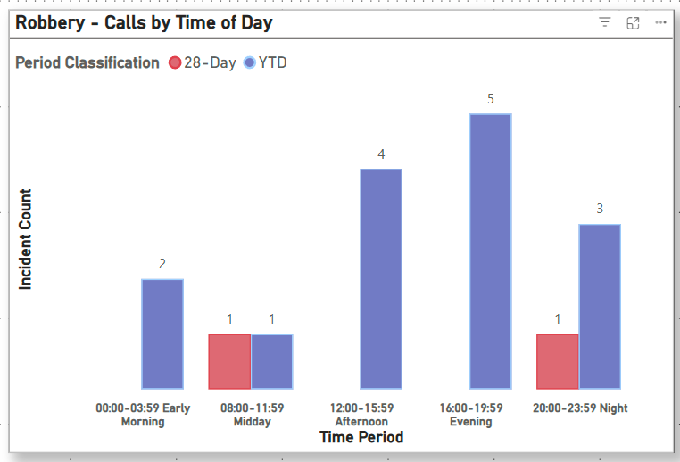
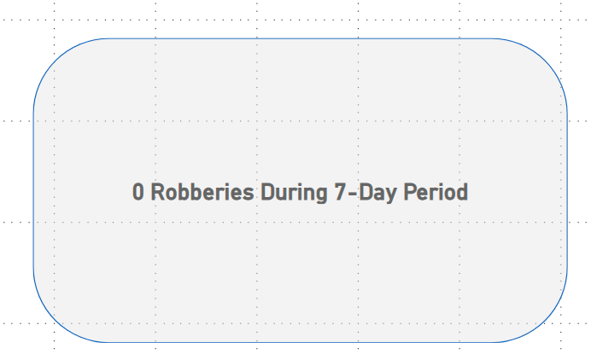
Strategic Crime Reduction Analysis
Prepared by PO R. Carucci
Robbery
Pattern Offenders/Suspects

Slide 5
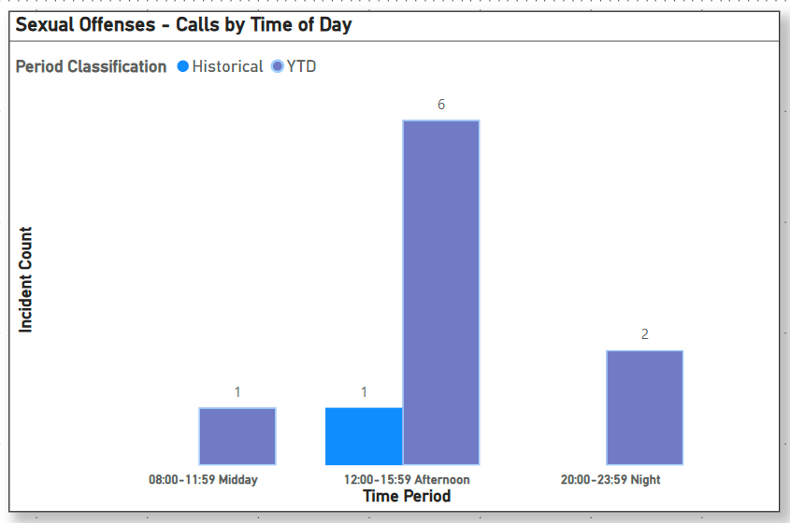
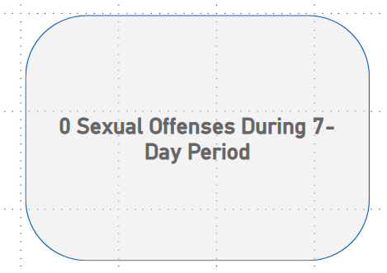
Strategic Crime Reduction Analysis
Prepared by PO R. Carucci
Sexual Offenses
Pattern Offenders/Suspects

