Slide 1

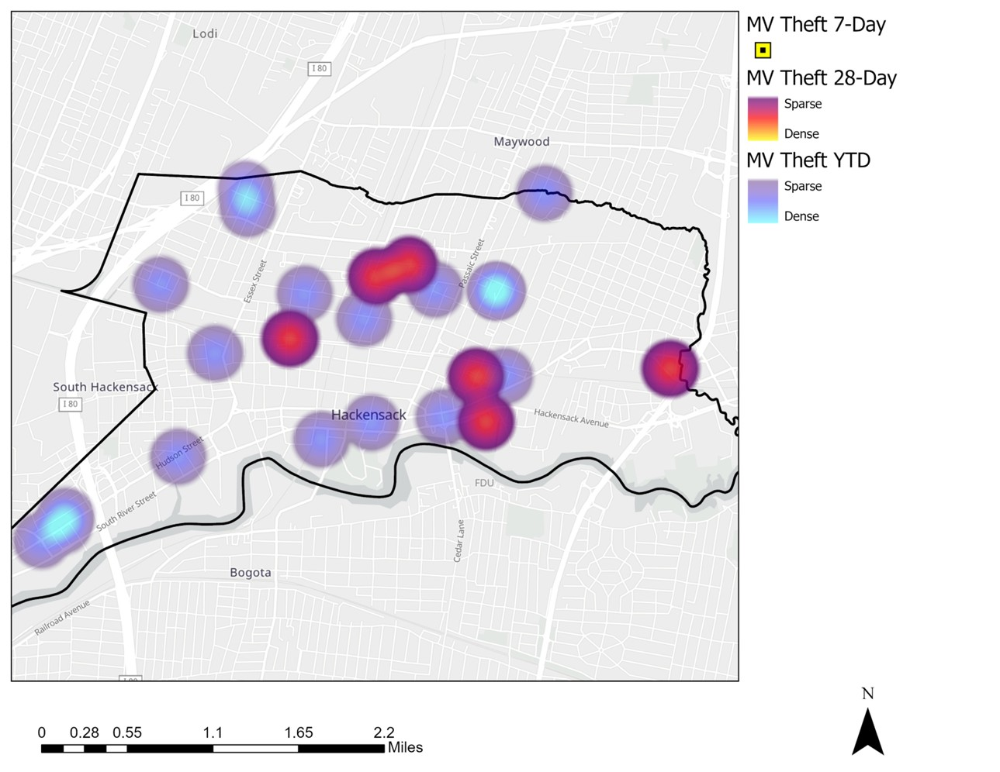
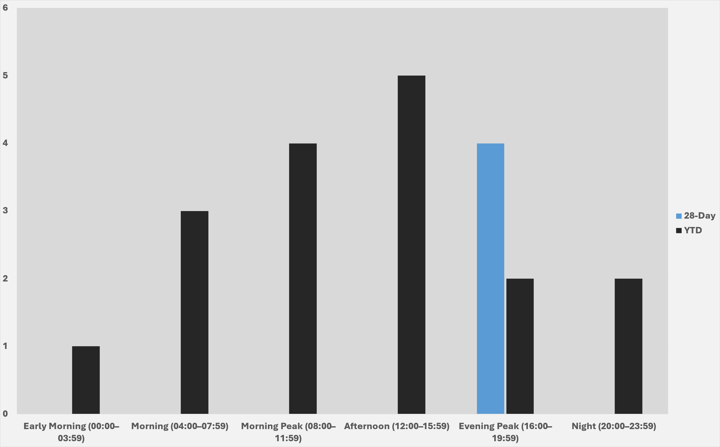
Strategic Crime Reduction Analysis
Prepared by PO R. Carucci
Motor Vehicle Theft
Pattern Offenders/Suspects
Data is no longer pulling from the report due to a shift to CAD-based sourcing. A fix is planned, and the section will be updated in the coming weeks.

Slide 2
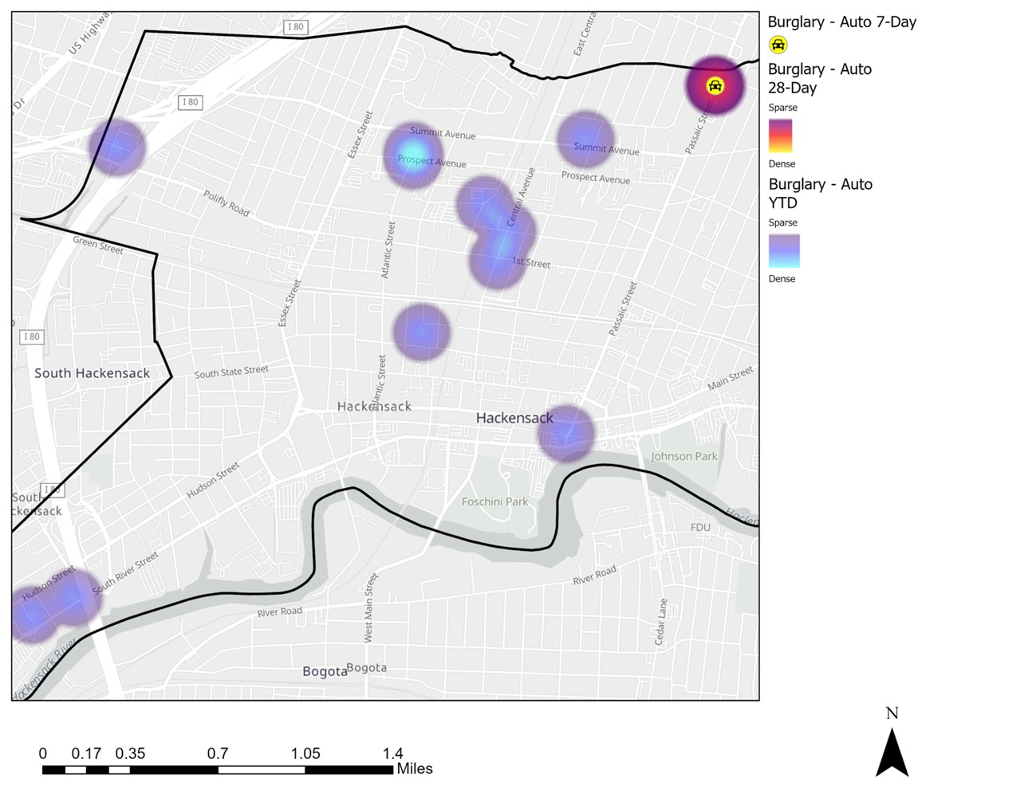
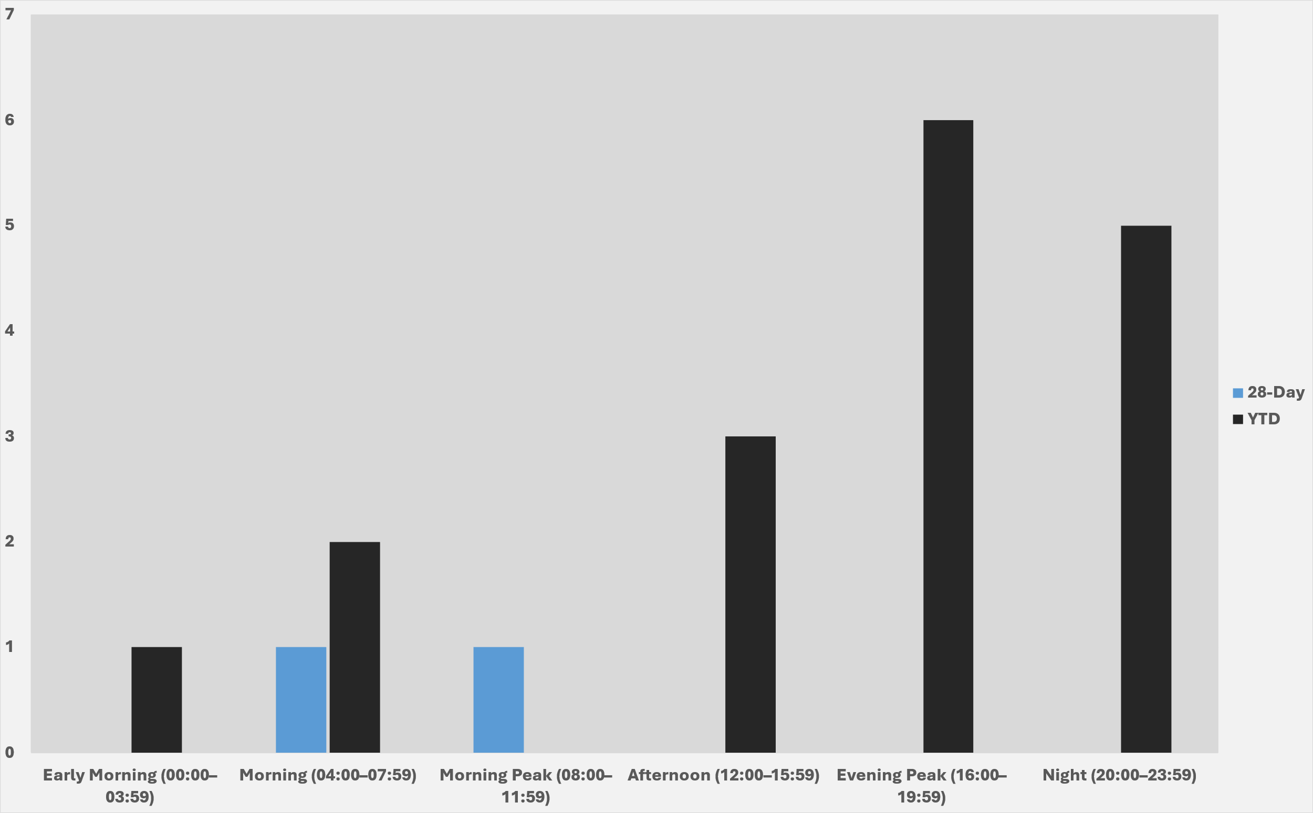
Strategic Crime Reduction Analysis
Prepared by PO R. Carucci
Motor Vehicle Burglary
Pattern Offenders/Suspects
Data is no longer pulling from the report due to a shift to CAD-based sourcing. A fix is planned, and the section will be updated in the coming weeks.

Slide 3
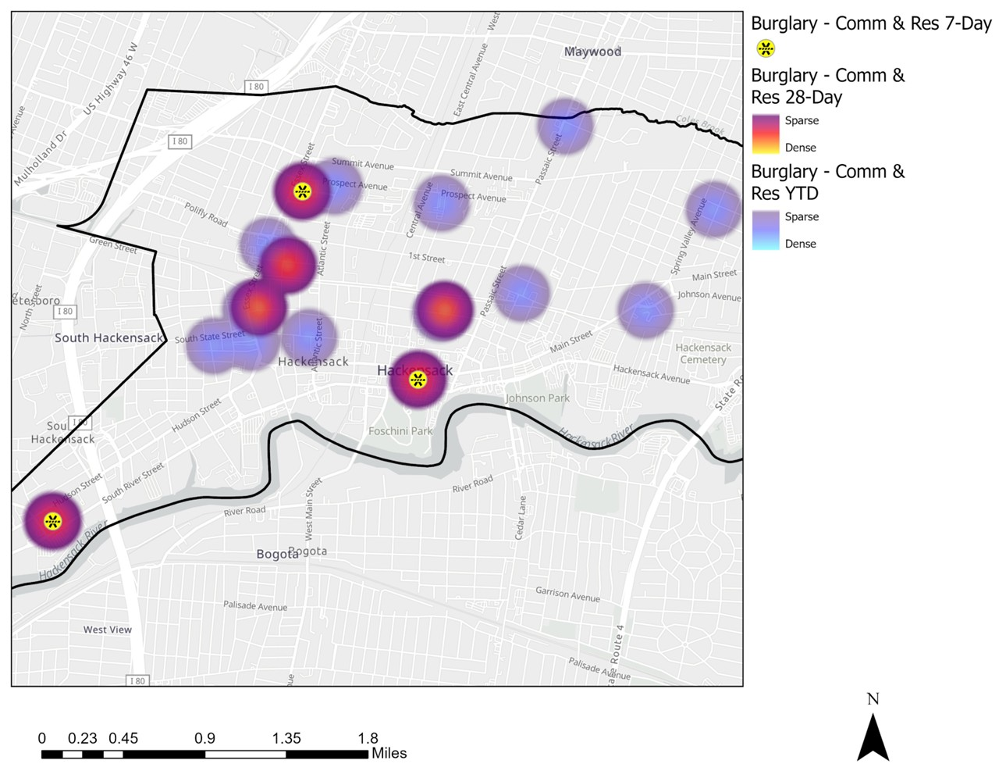
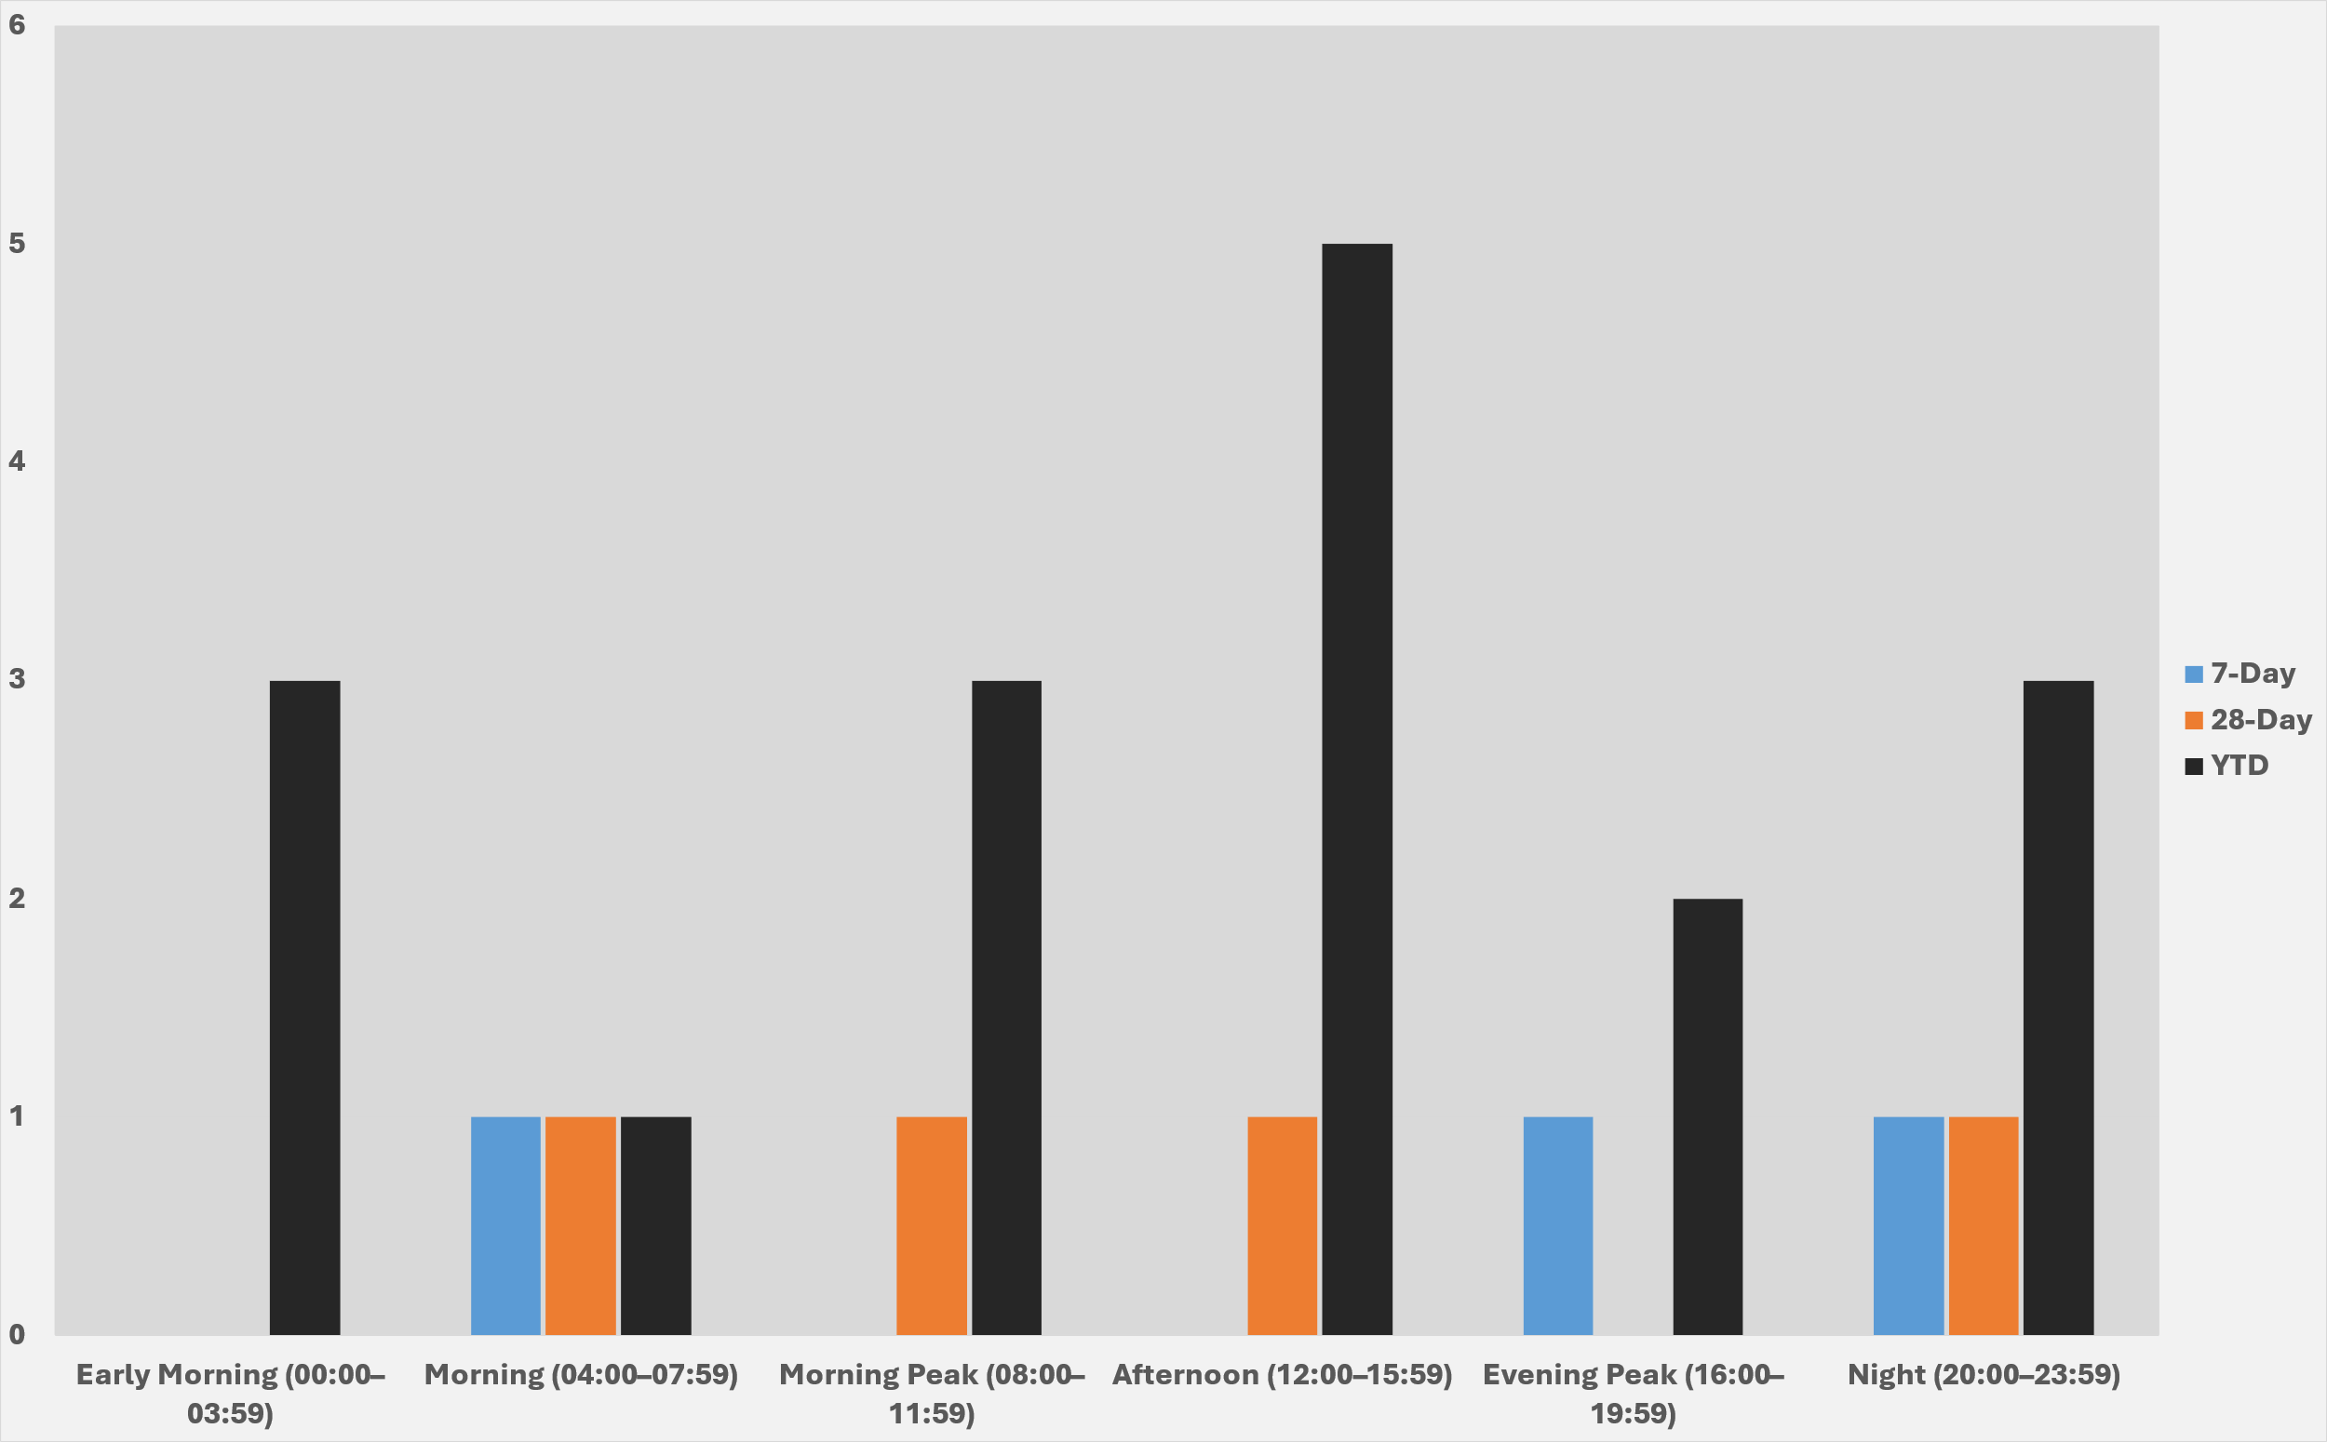
Strategic Crime Reduction Analysis
Prepared by PO R. Carucci
Residential and Commercial Burglaries
Pattern Offenders/Suspects
Data is no longer pulling from the report due to a shift to CAD-based sourcing. A fix is planned, and the section will be updated in the coming weeks.

Slide 4
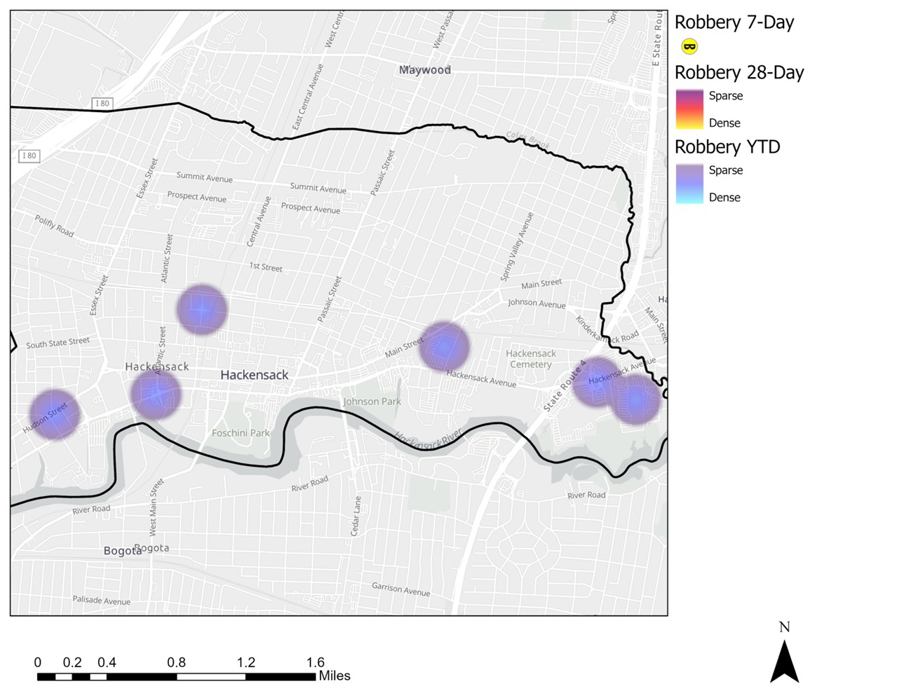
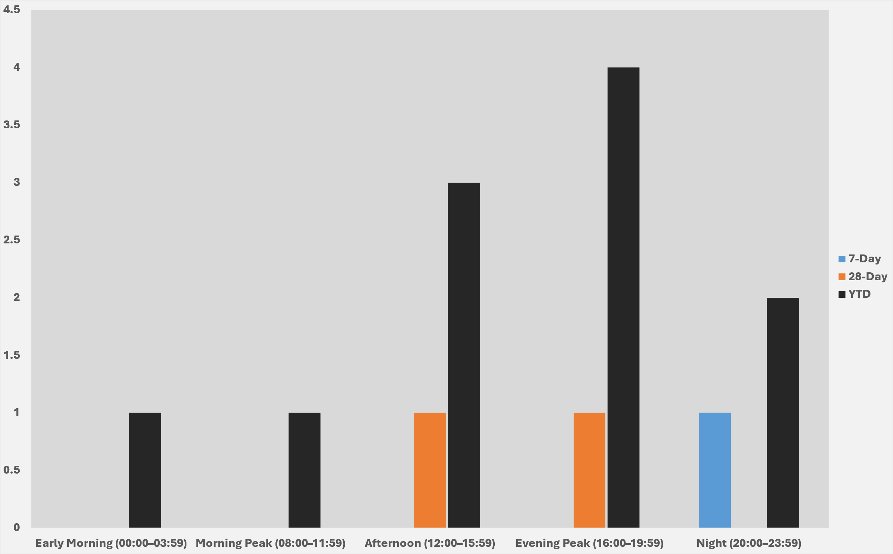
Strategic Crime Reduction Analysis
Prepared by PO R. Carucci
Robbery
Pattern Offenders/Suspects
Data is no longer pulling from the report due to a shift to CAD-based sourcing. A fix is planned, and the section will be updated in the coming weeks.

Slide 5
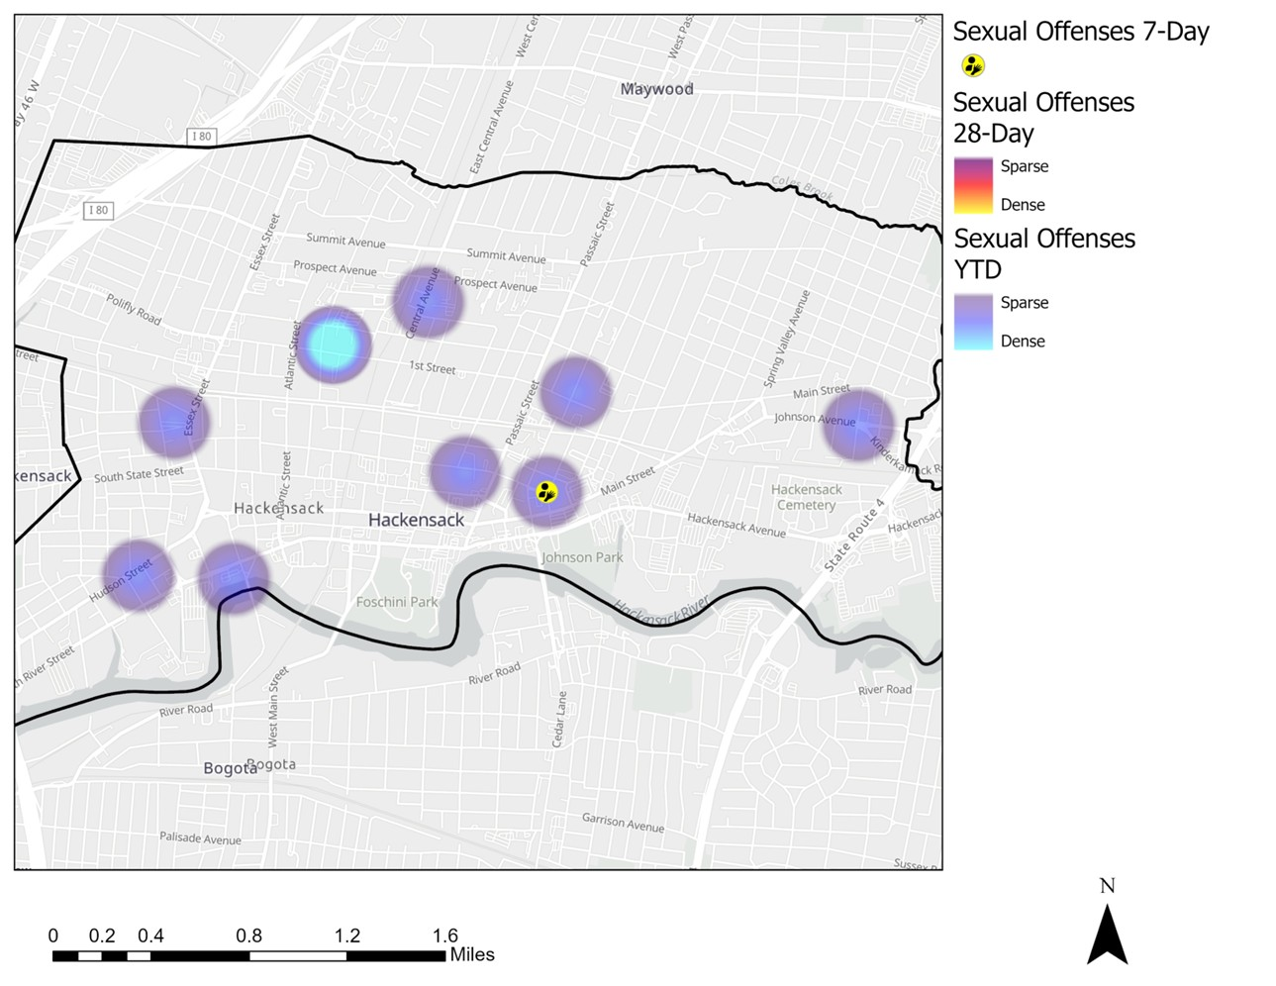
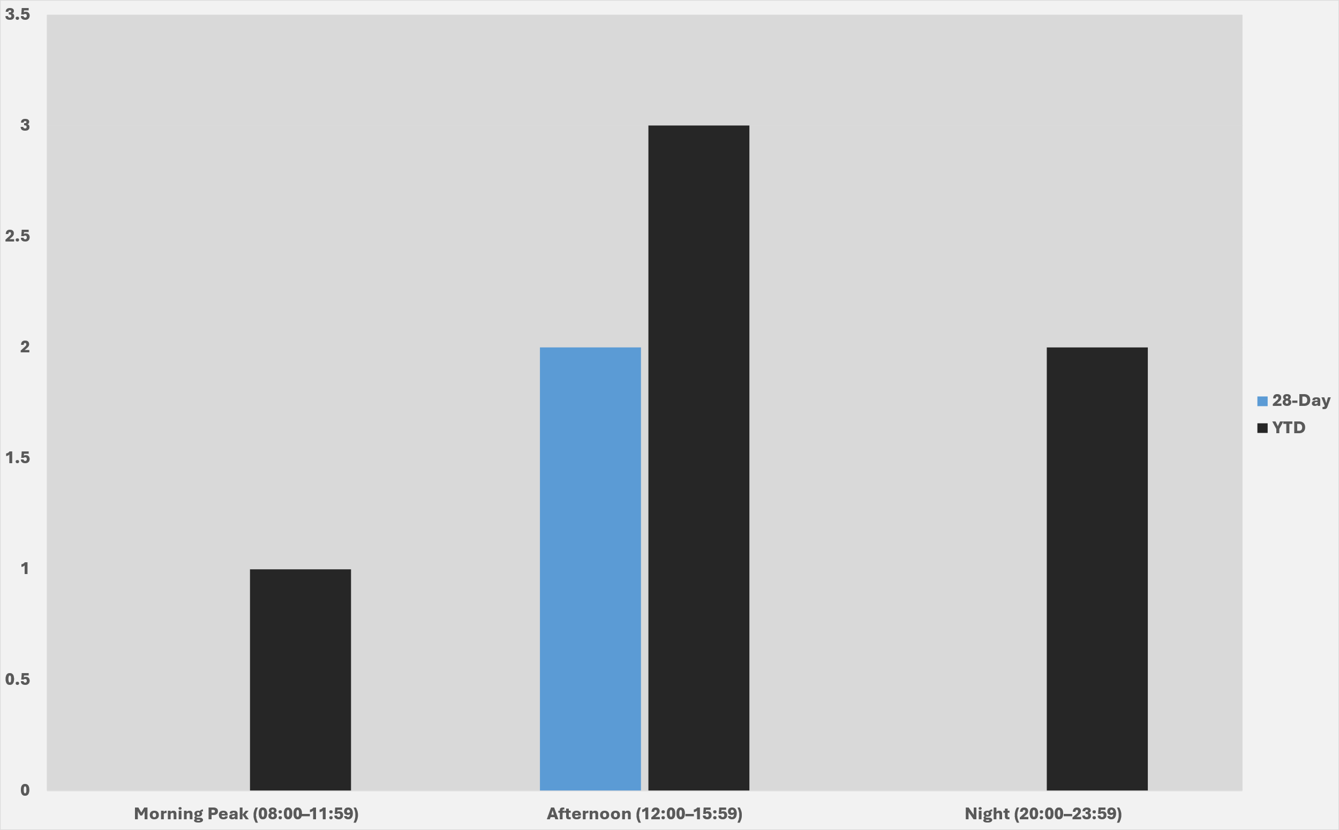
Strategic Crime Reduction Analysis
Prepared by PO R. Carucci
Sexual Offenses
Pattern Offenders/Suspects
Data is no longer pulling from the report due to a shift to CAD-based sourcing. A fix is planned, and the section will be updated in the coming weeks.

