Slide 1

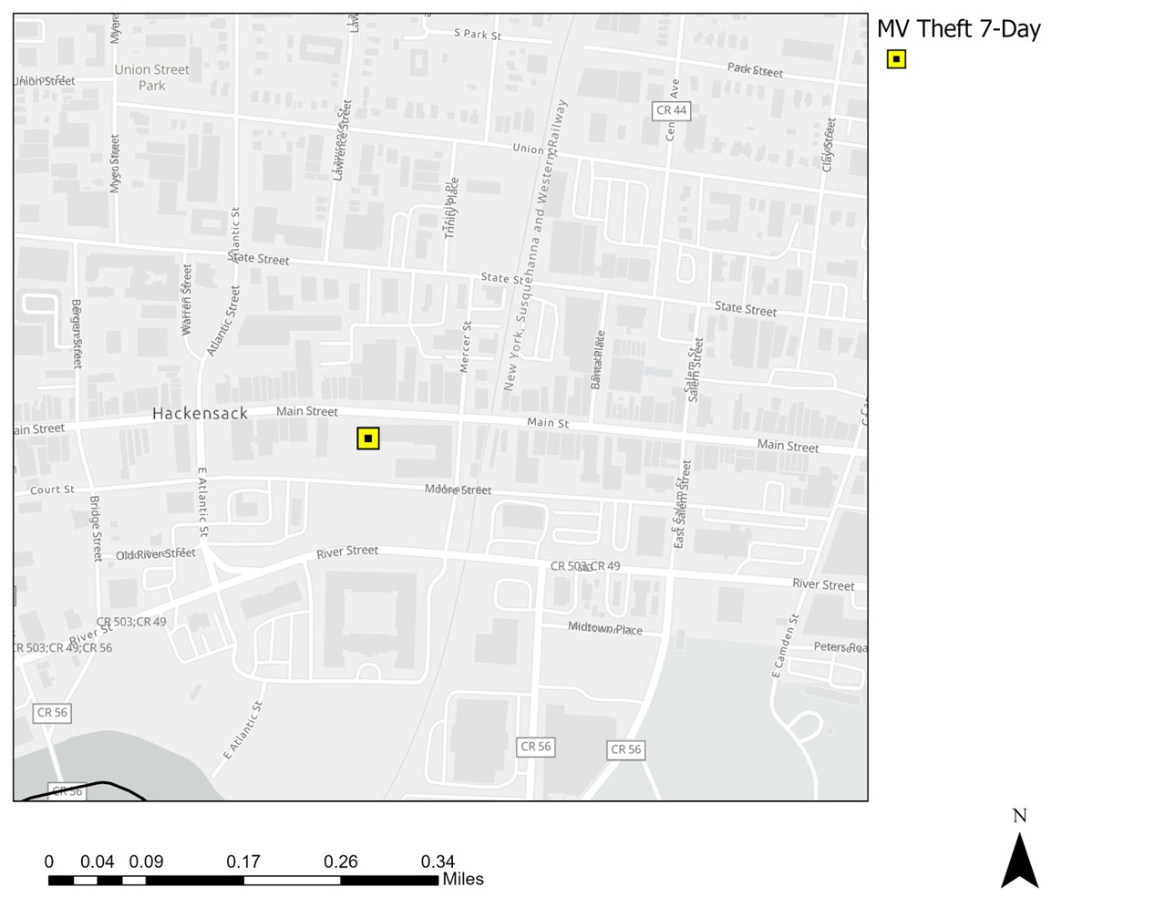
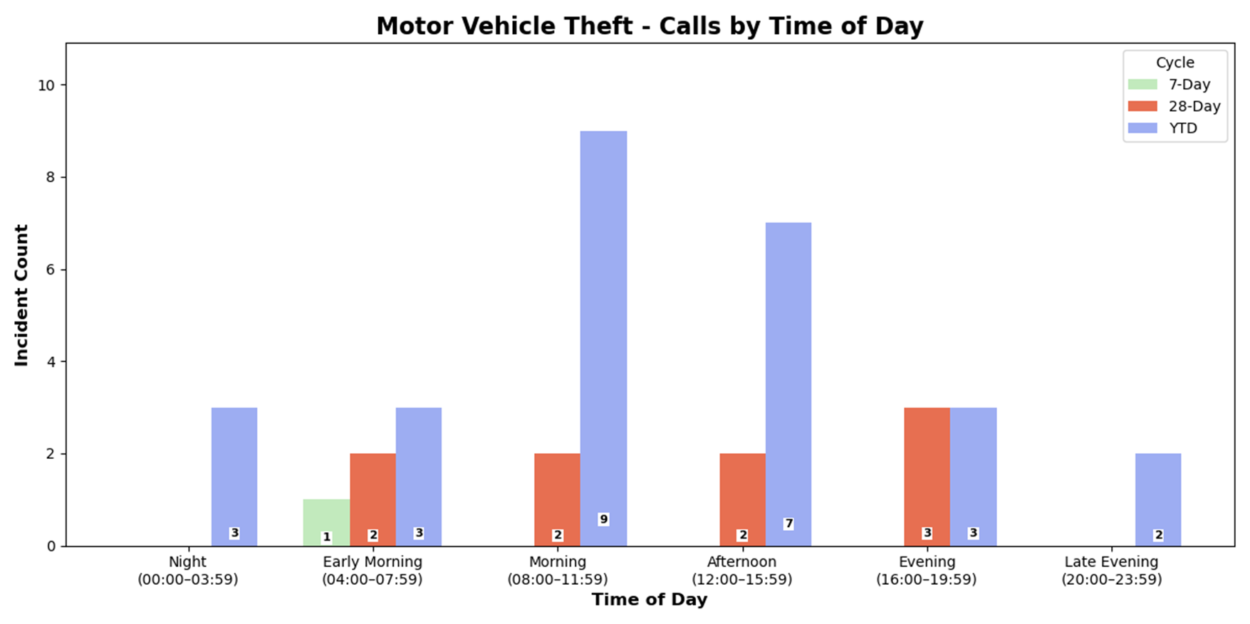
Strategic Crime Reduction Analysis
Prepared by PO R. Carucci
Motor Vehicle Theft
Pattern Offenders/Suspects
Date/Time: 6/11/25, approximately 04:31-04:32 hours
Location: 150 Main Street
Suspect Vehicles: None
Suspect: Black male, approximately 30 years old, wearing black hooded sweatshirt, black sweatpants, and black sneakers
Incident: Victim Andryk Inojosavalor, an Amazon driver, parked his vehicle (NJ Reg V82UPJ) in front of 150 Main Street, leaving it unlocked with the key inside. While delivering a package, he observed a suspect approach and drive off with the vehicle east on Mercer Street. Estimated vehicle value: $8,500.00 USD. Stolen items inside vehicle include wallet ($30.00), $20.00 cash, 2 license plates ($20.00), 1 Bank of America Debit Card, 1 Bank of America Credit Card, 1 Capital One Debit Card, 1 Capital One Credit Card, 1 BJ's Membership Card, 1 Mercantile Credit Card, and undelivered Amazon packages. Total estimated value of stolen items: $8,570.00.
Victim: Andryk Inojosavalor was the primary victim. No additional victims reported.

Slide 2
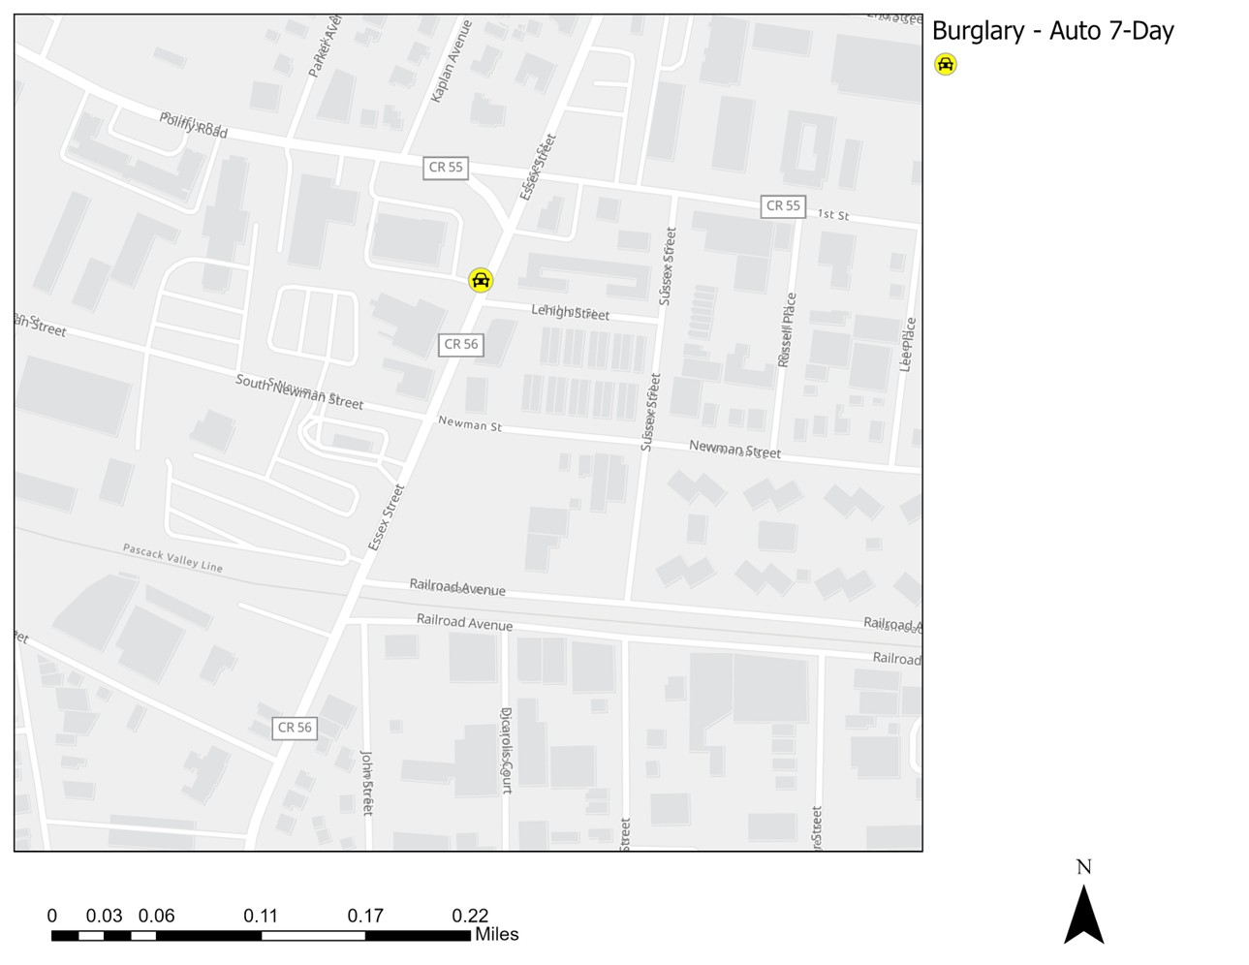
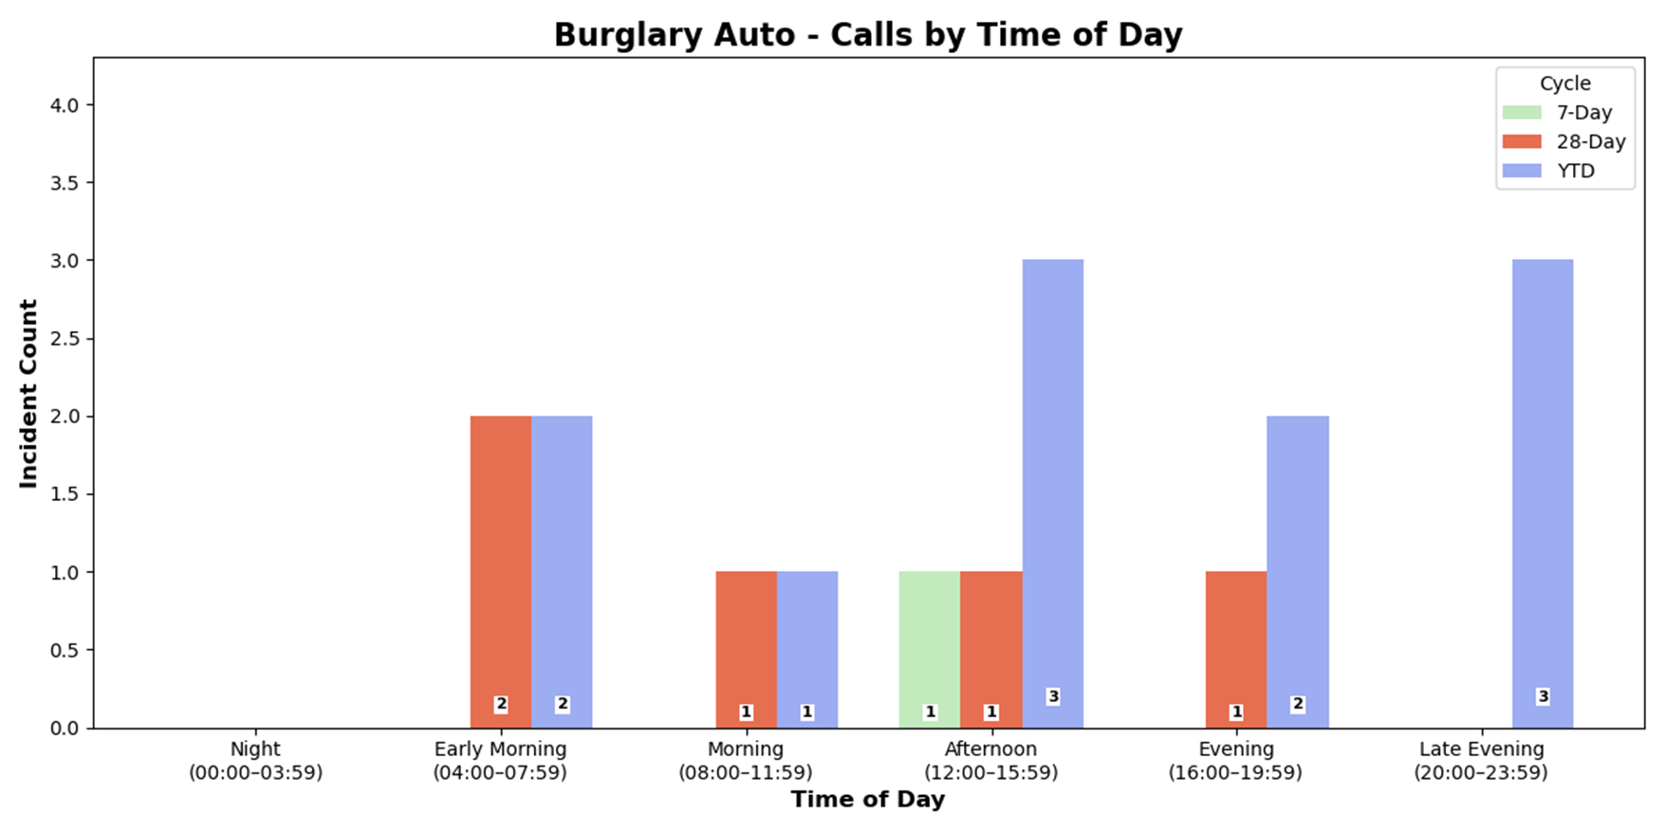
Strategic Crime Reduction Analysis
Prepared by PO R. Carucci
Burglary - Auto
Pattern Offenders/Suspects
Slide Title: Incident Classification
Initial Dispatch: Burglary to Auto
Report Title: Labeled as "Suspicious Incident"
Classification: Not deemed a Burglary to Auto

Slide 3
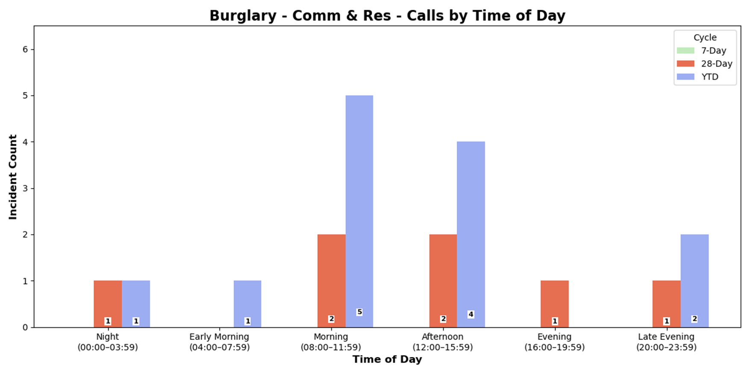
Strategic Crime Reduction Analysis
Prepared by PO R. Carucci
Residential and Commercial Burglaries
Pattern Offenders/Suspects
Weekly Incident Report
0 incidents recorded (7-day period)

Slide 4
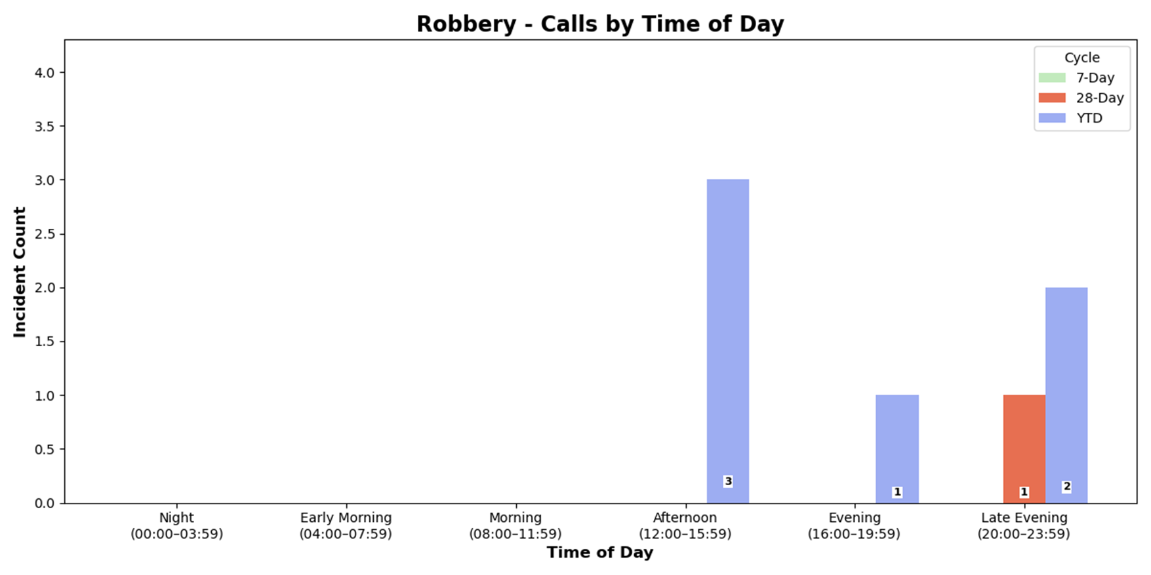
Strategic Crime Reduction Analysis
Prepared by PO R. Carucci
Robbery
Pattern Offenders/Suspects
Weekly Incident Report
0 incidents recorded (7-day period)

Slide 5
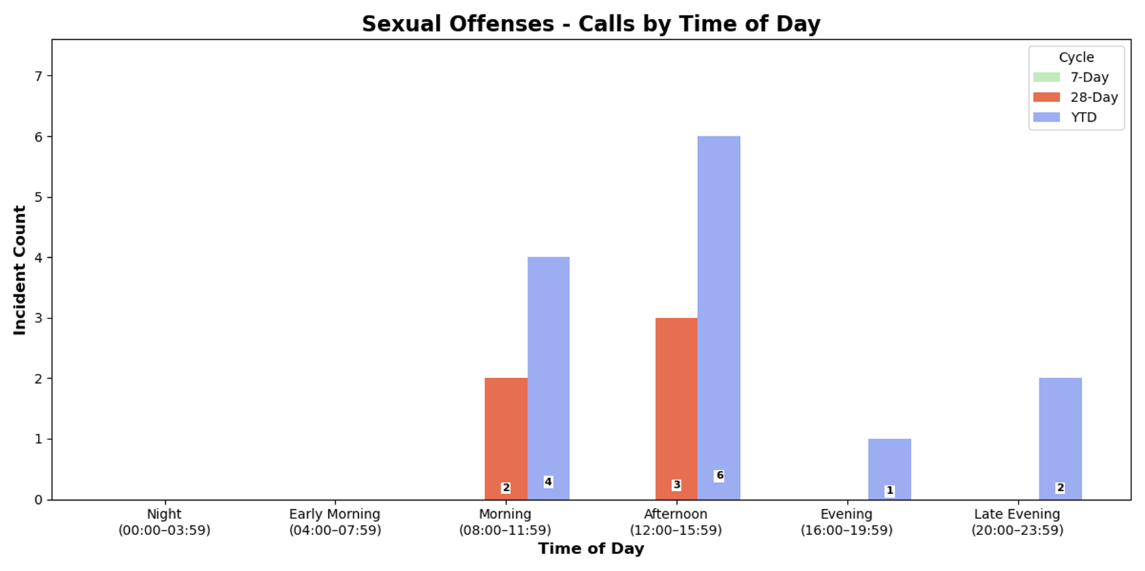
Strategic Crime Reduction Analysis
Prepared by PO R. Carucci
Sexual Offenses
Pattern Offenders/Suspects
Weekly Incident Report
0 incidents recorded (7-day period)

