Slide 1

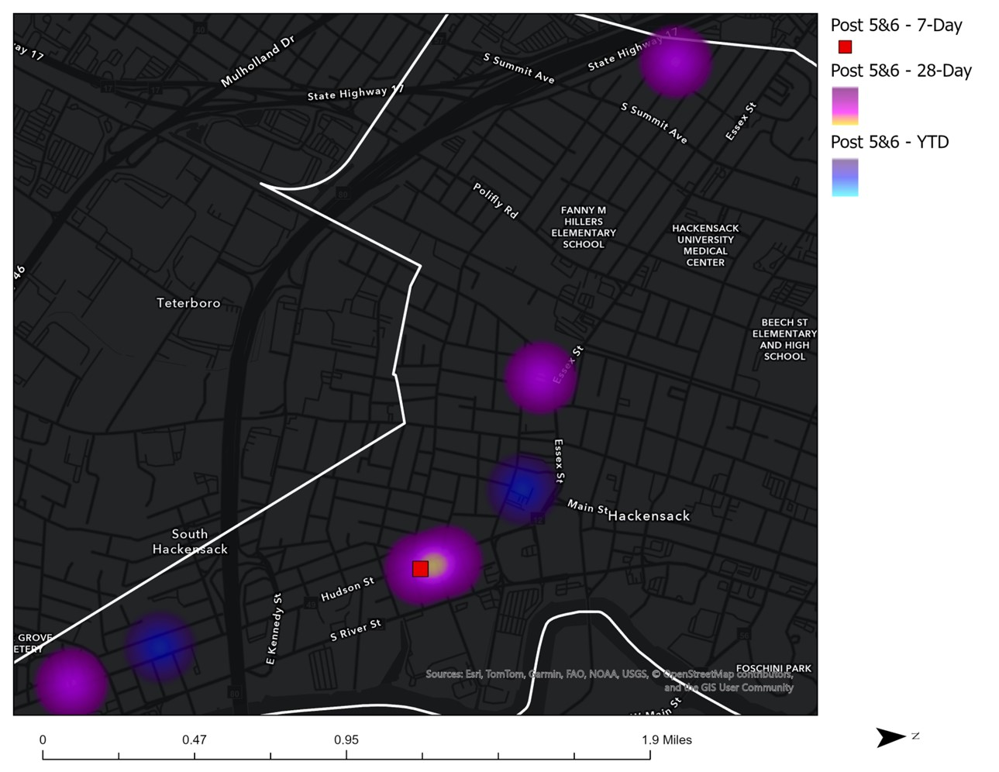
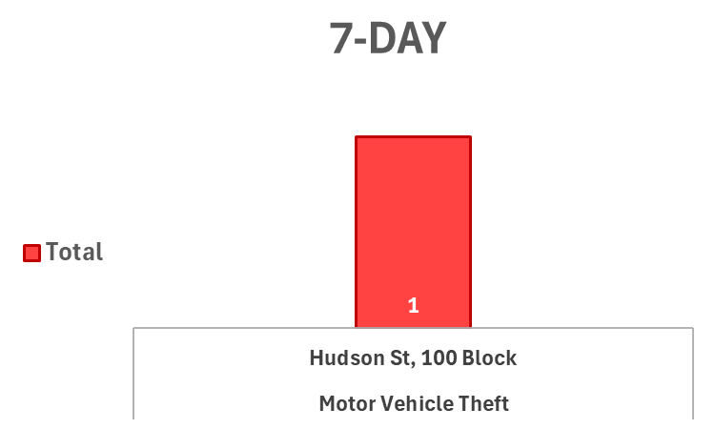
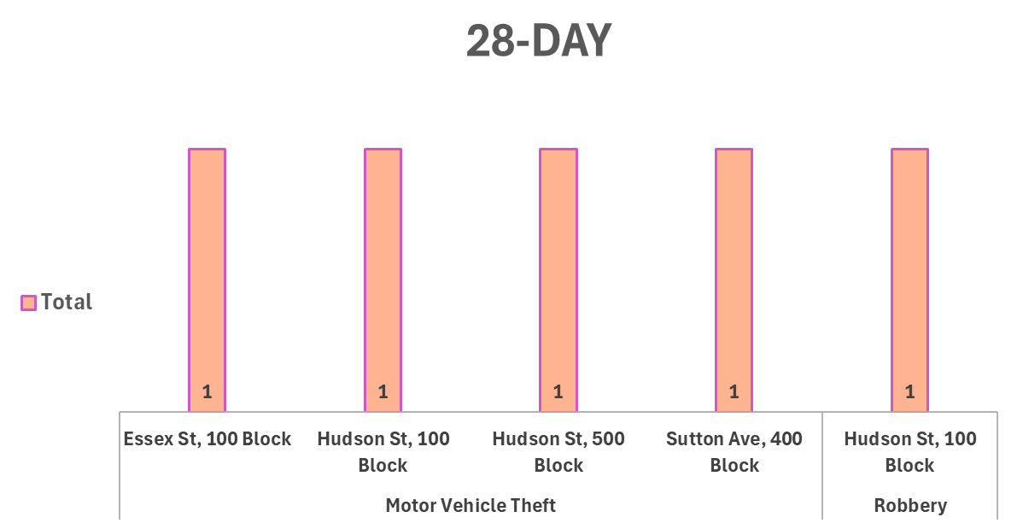
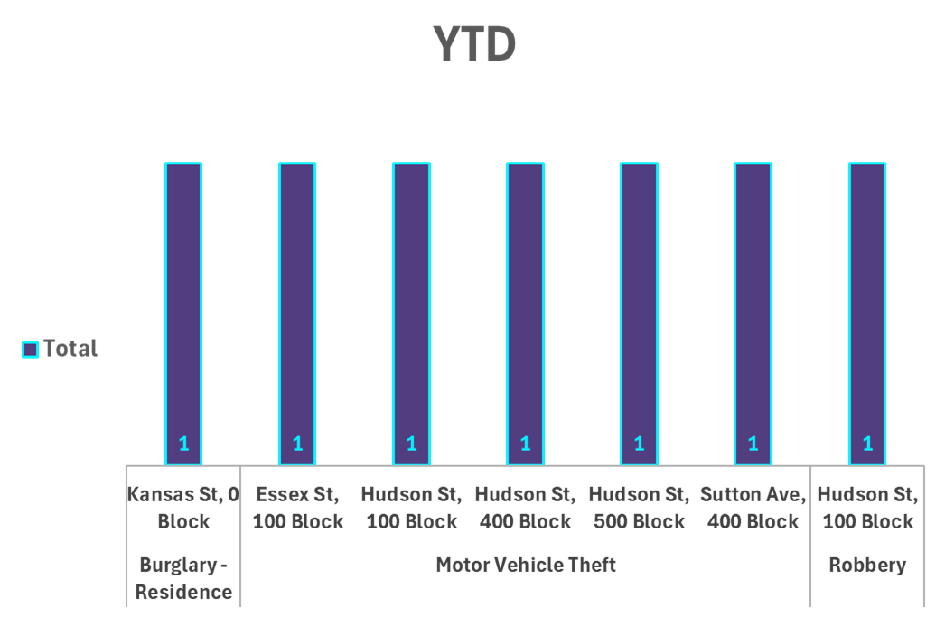
Place Based Strategic Crime Reduction Analysis
Prepared by PO R. Carucci
Post 5 &6
Spatial Assessment
Pattern Offenders/Suspects
Motor Vehicle Theft Incident
02/07 at 06:35 at 170 Hudson Street a Dodge, CAR was taken from victim’s driveway.
Suspect: Unknown.

Slide 2
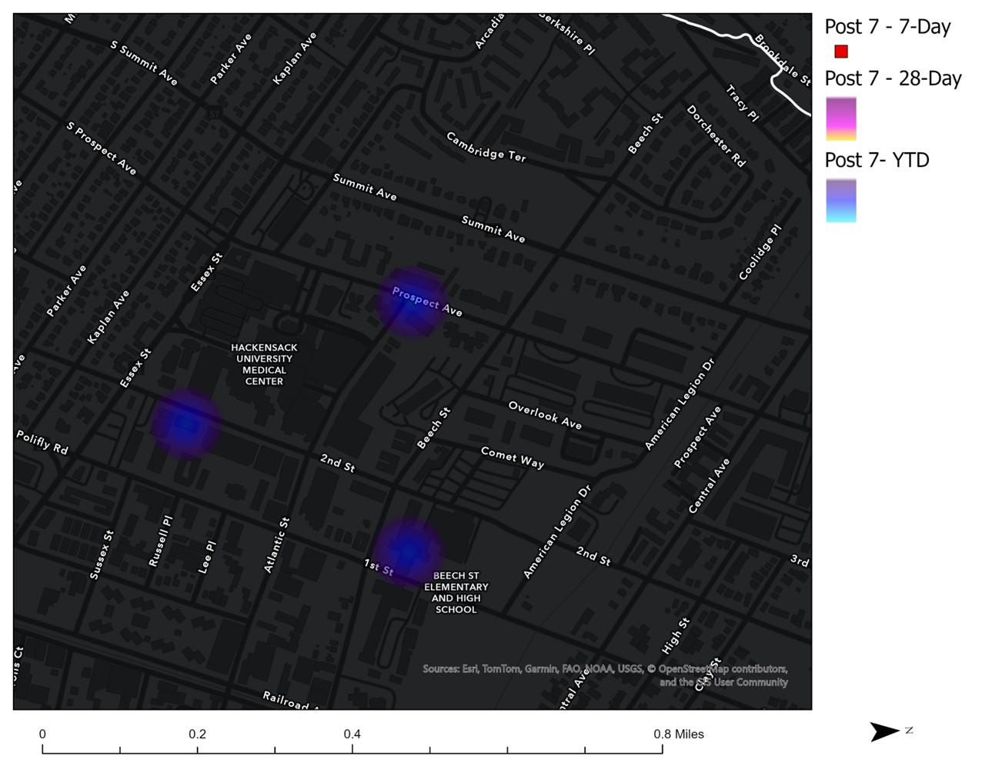
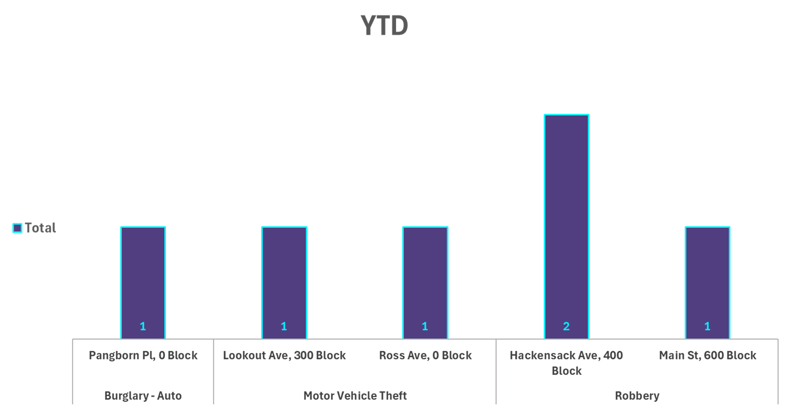
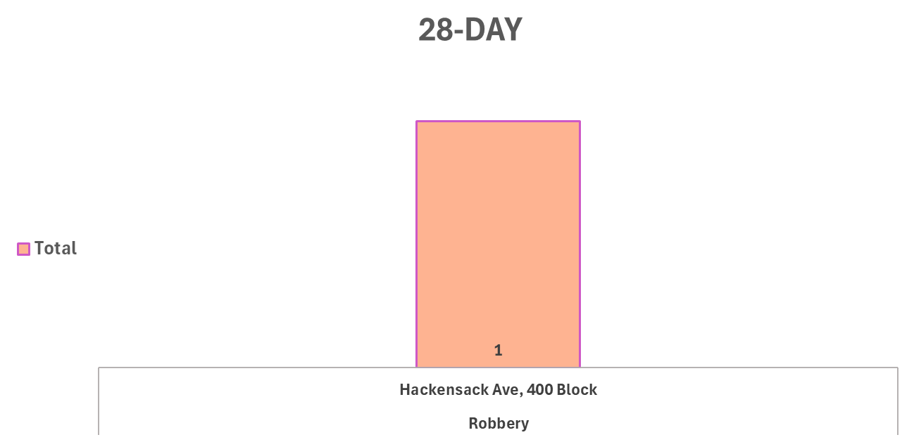
Place Based Strategic Crime Reduction Analysis
Prepared by PO R. Carucci
Post 7
Spatial Assessment
Pattern Offenders/Suspects
N/A
No Incidents occurred in the previous 7 days.

Slide 3
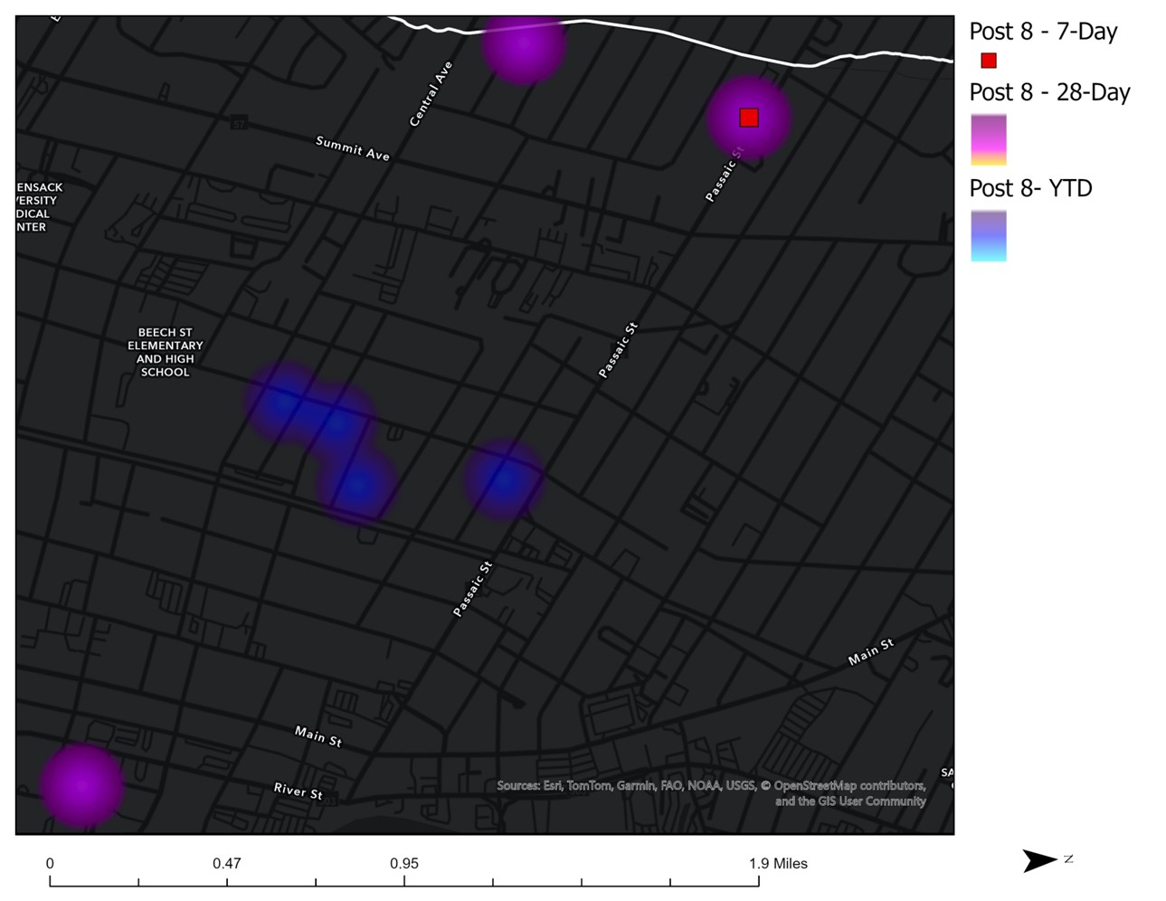
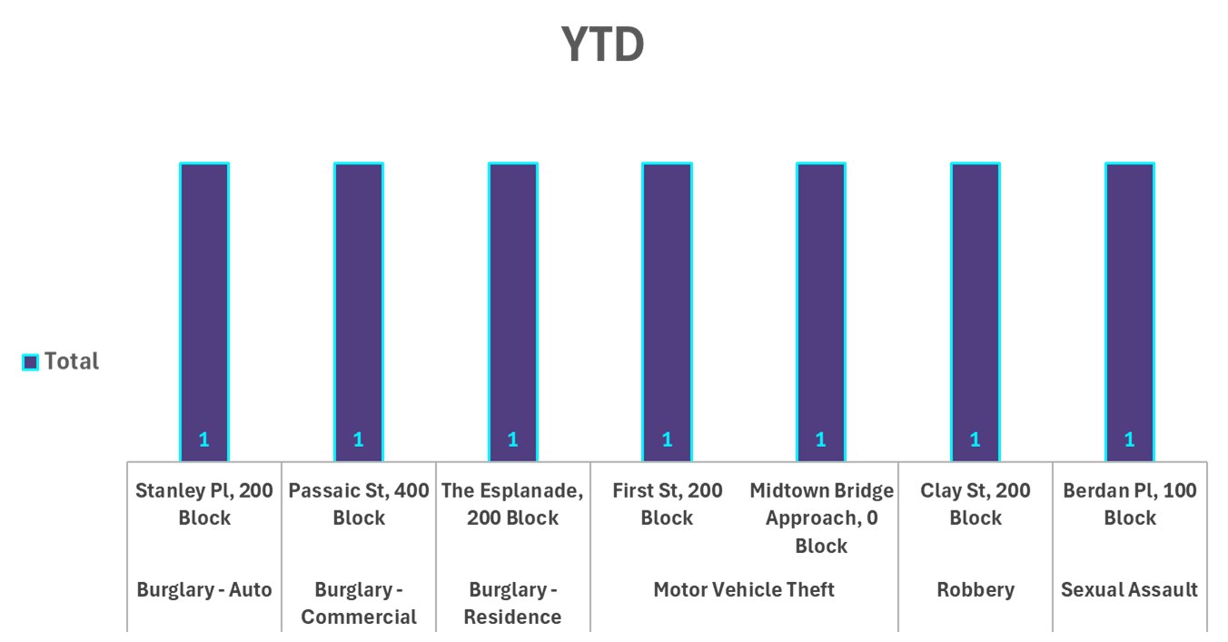
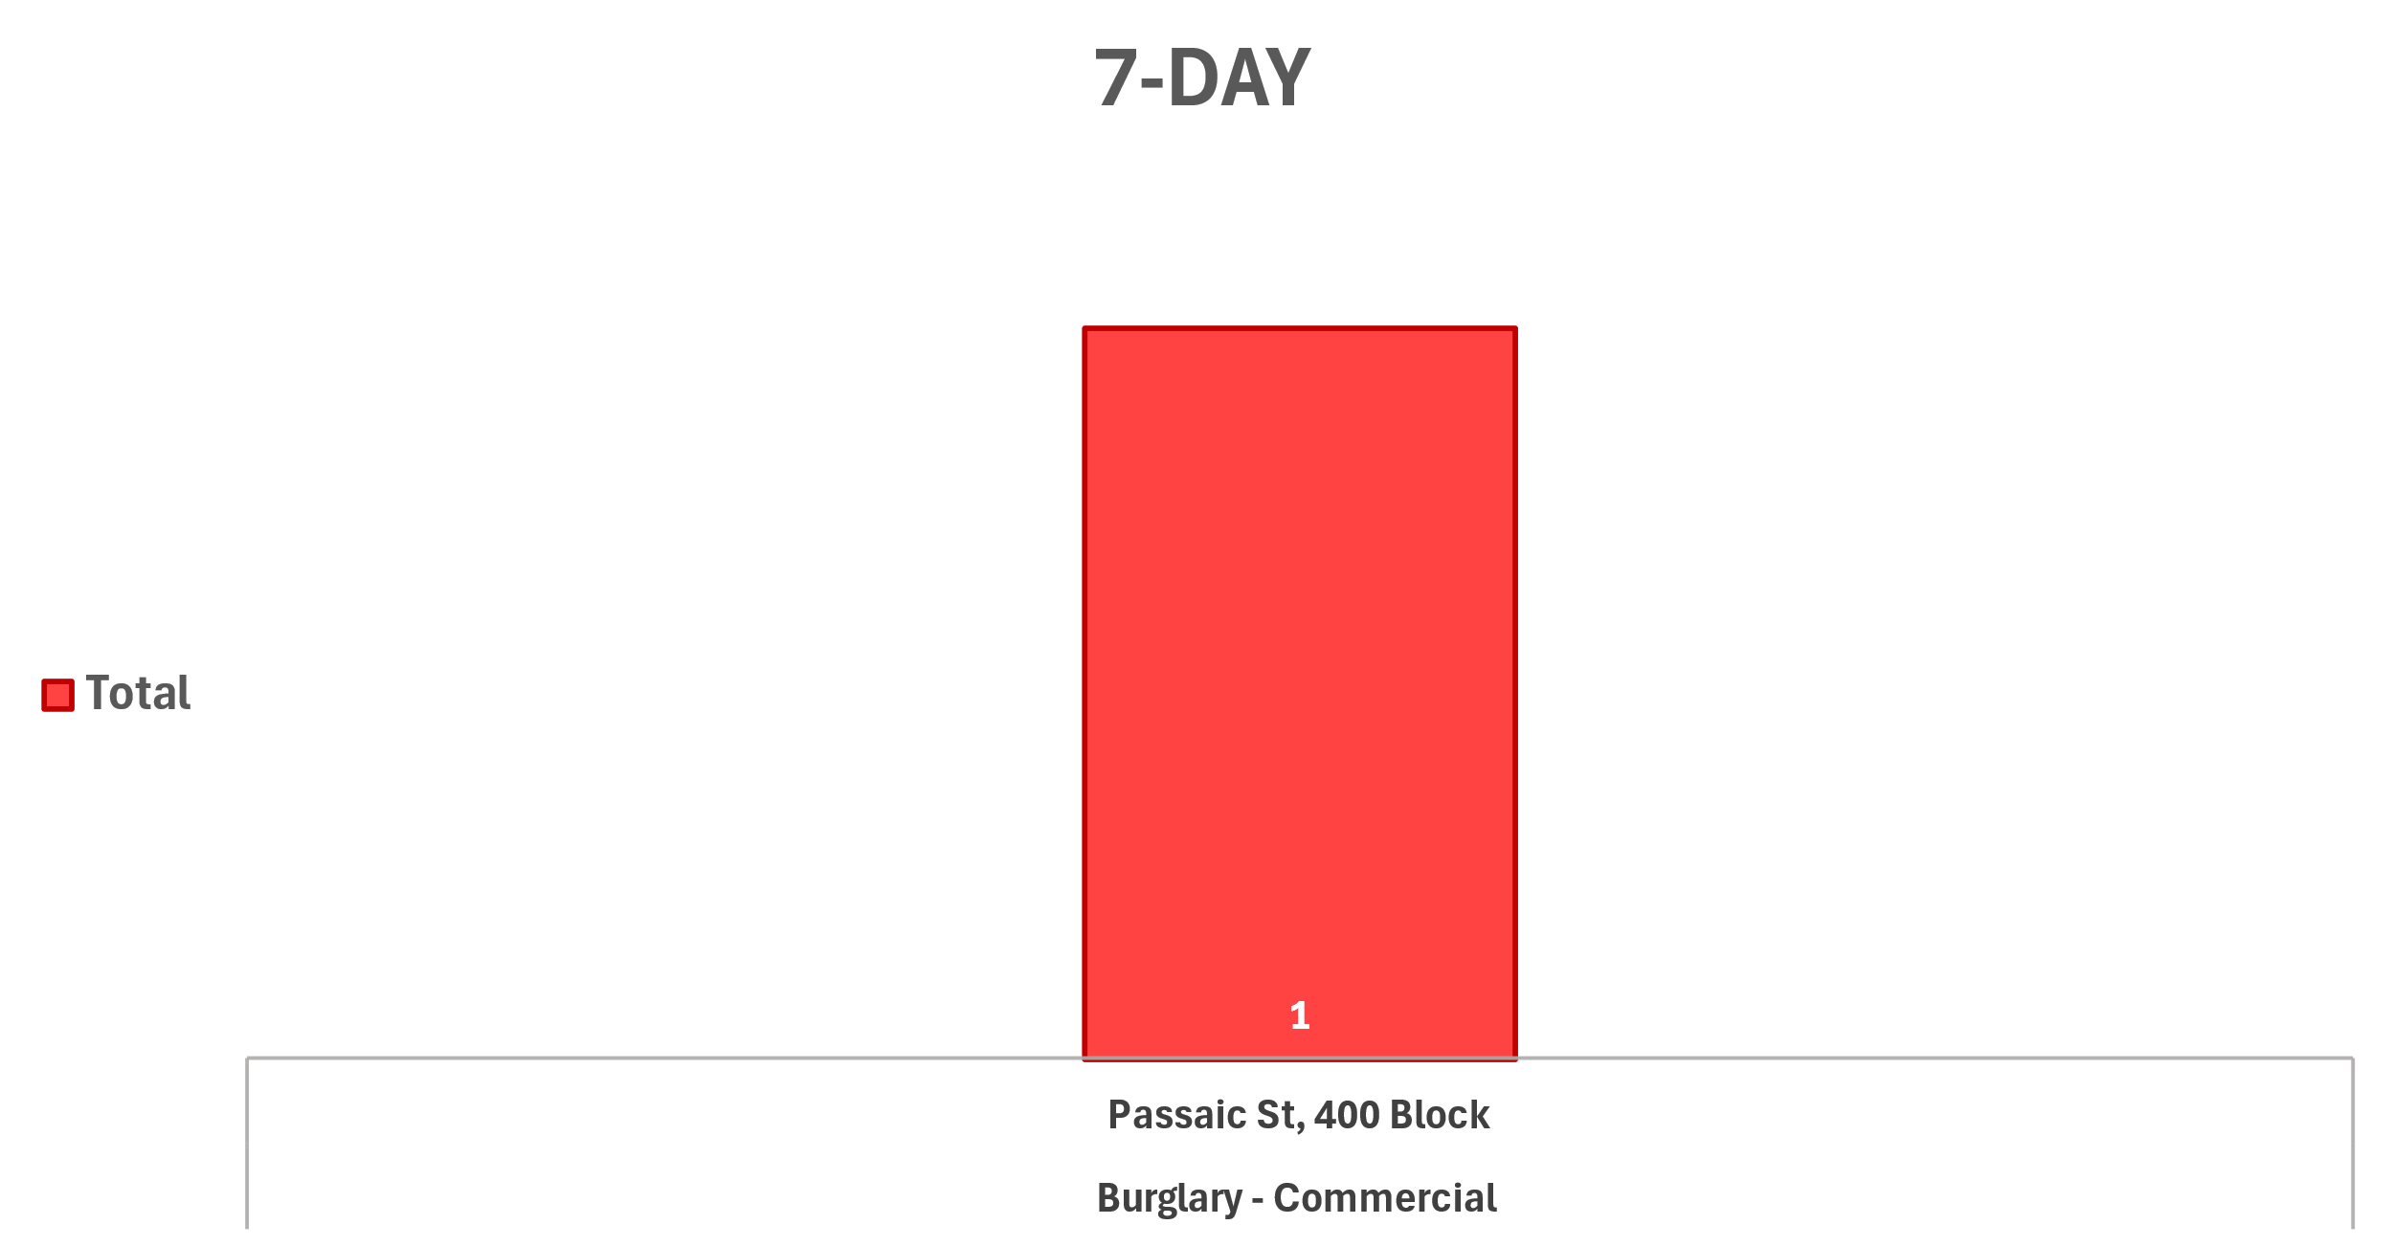
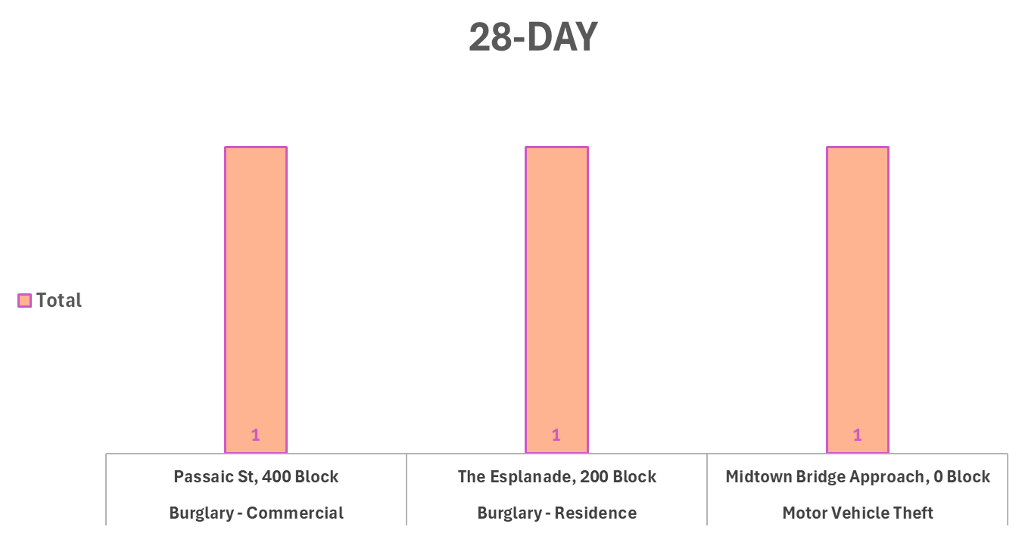
Place Based Strategic Crime Reduction Analysis
Prepared by PO R. Carucci
Post 8
Spatial Assessment
Pattern Offenders/Suspects
Commercial Burglary 7-Day:
02/05 at 03:00 at 411 Hackensack Ave. (Pharmacy) main entrance glass door was shattered
Suspect: Unknown.

Slide 4
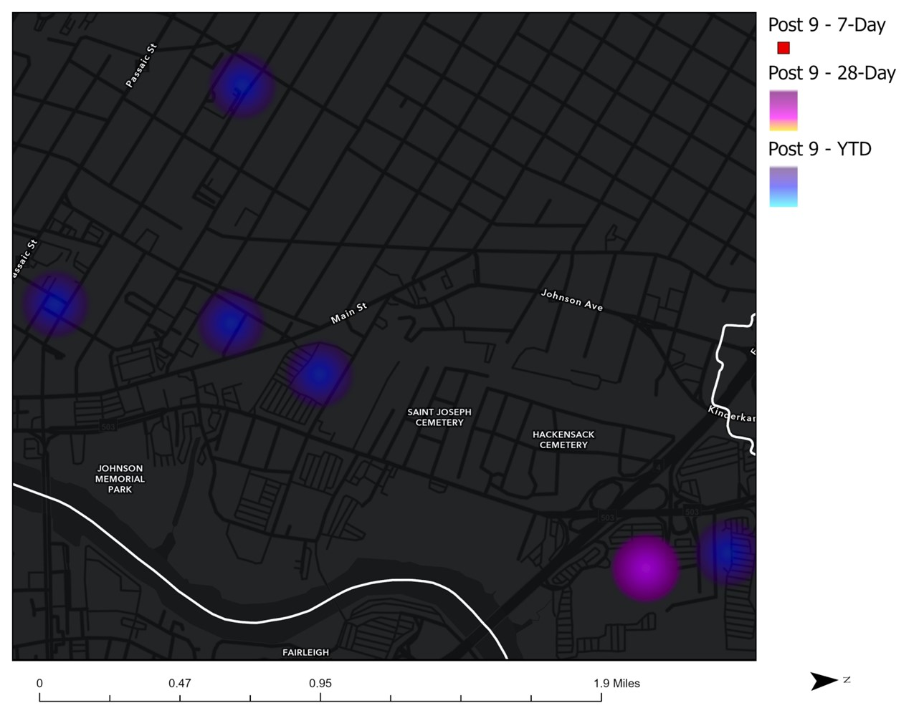
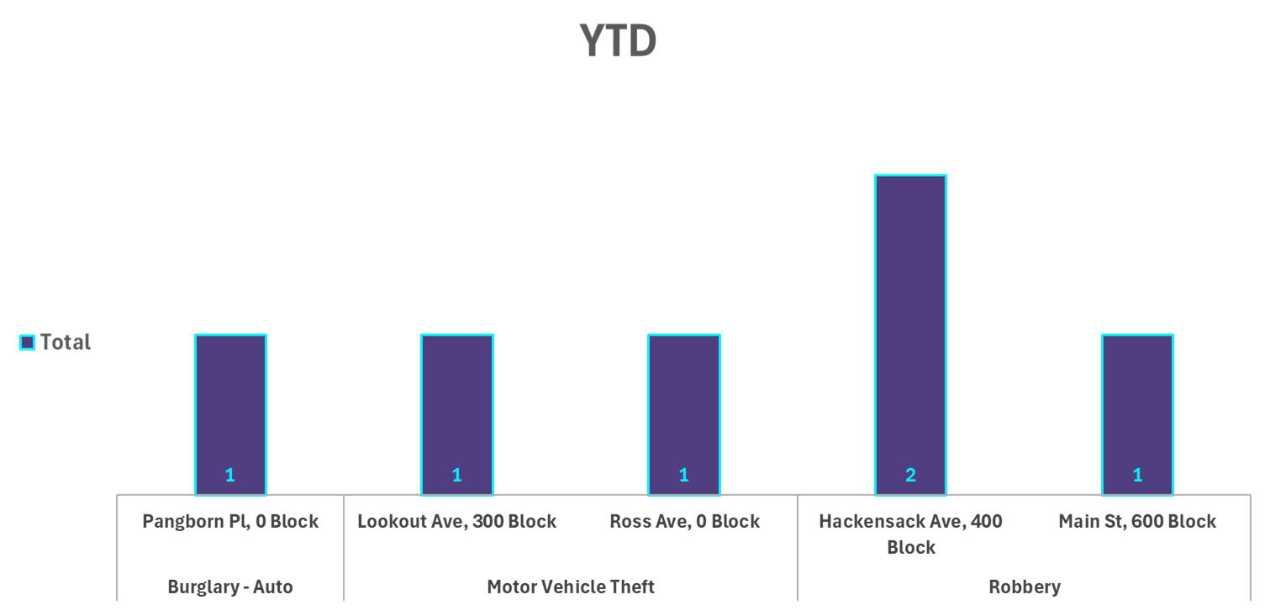
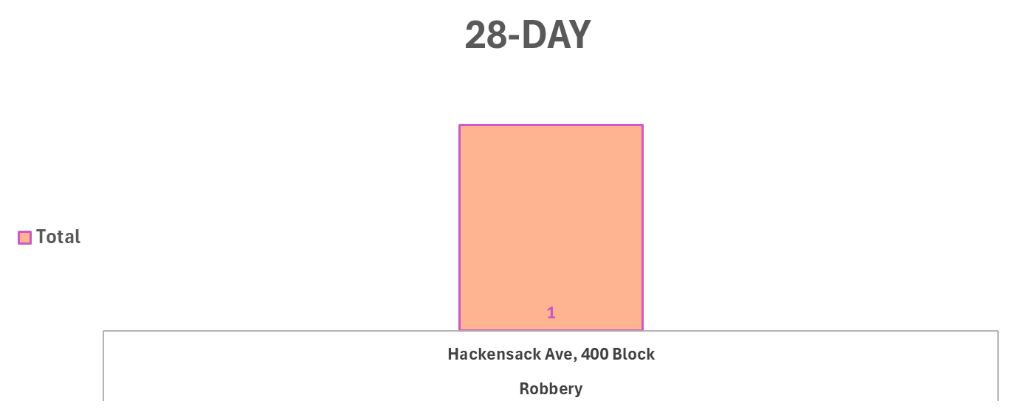
Place Based Strategic Crime Reduction Analysis
Prepared by PO R. Carucci
Post 9
Spatial Assessment
Robbery
Pattern Offenders/Suspects
N/A
No Incidents occurred in the previous 7 days.
No Incidents occurred in the previous 7 days.

