Slide 1
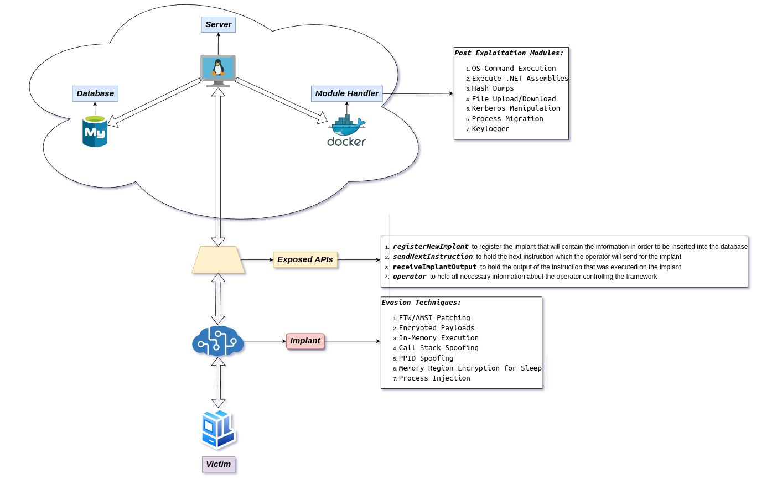
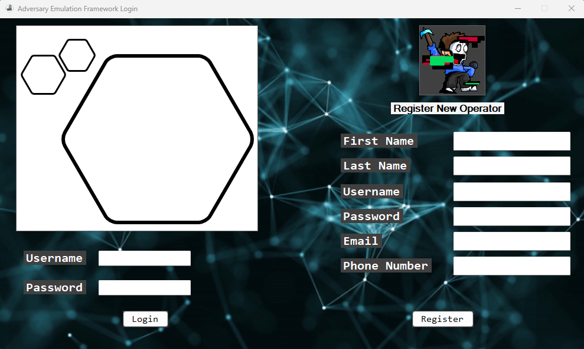
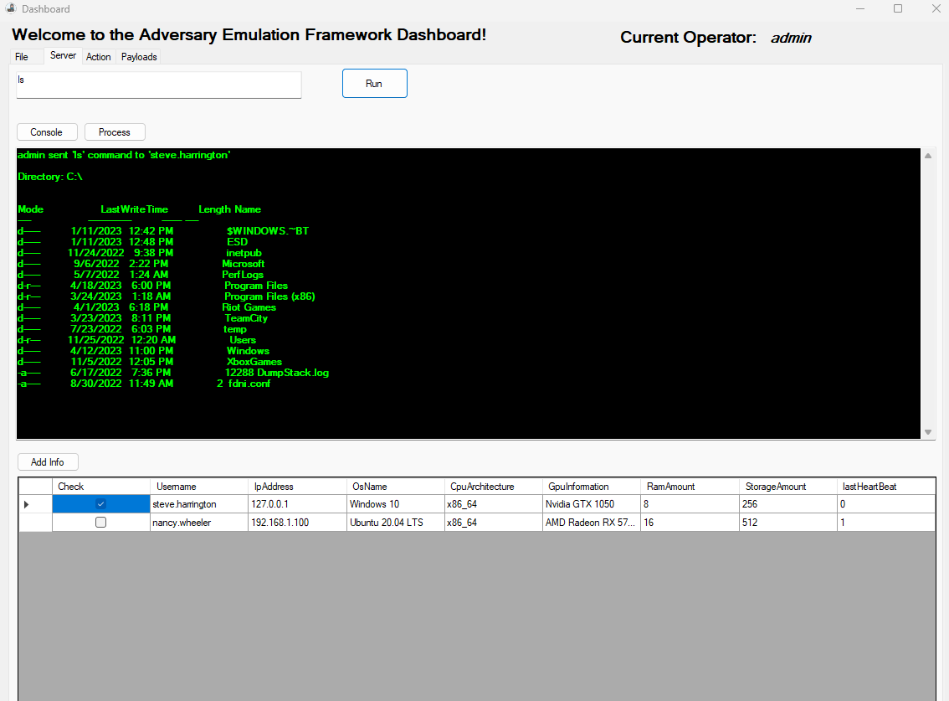
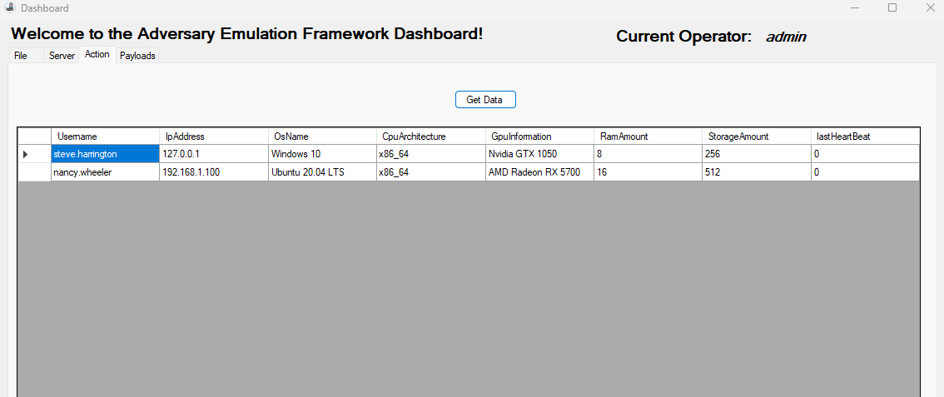
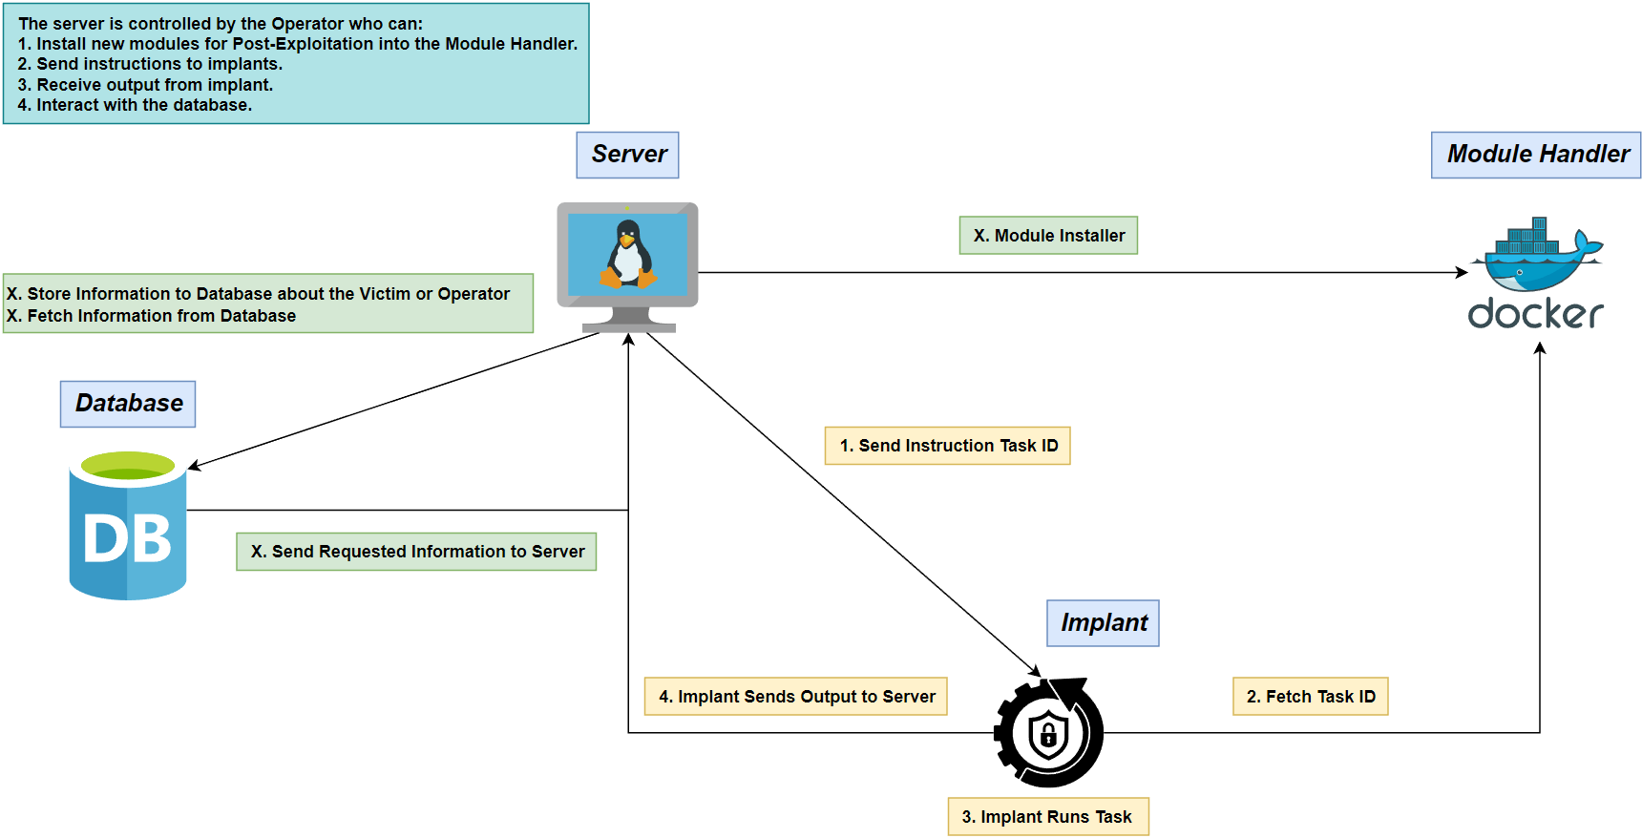
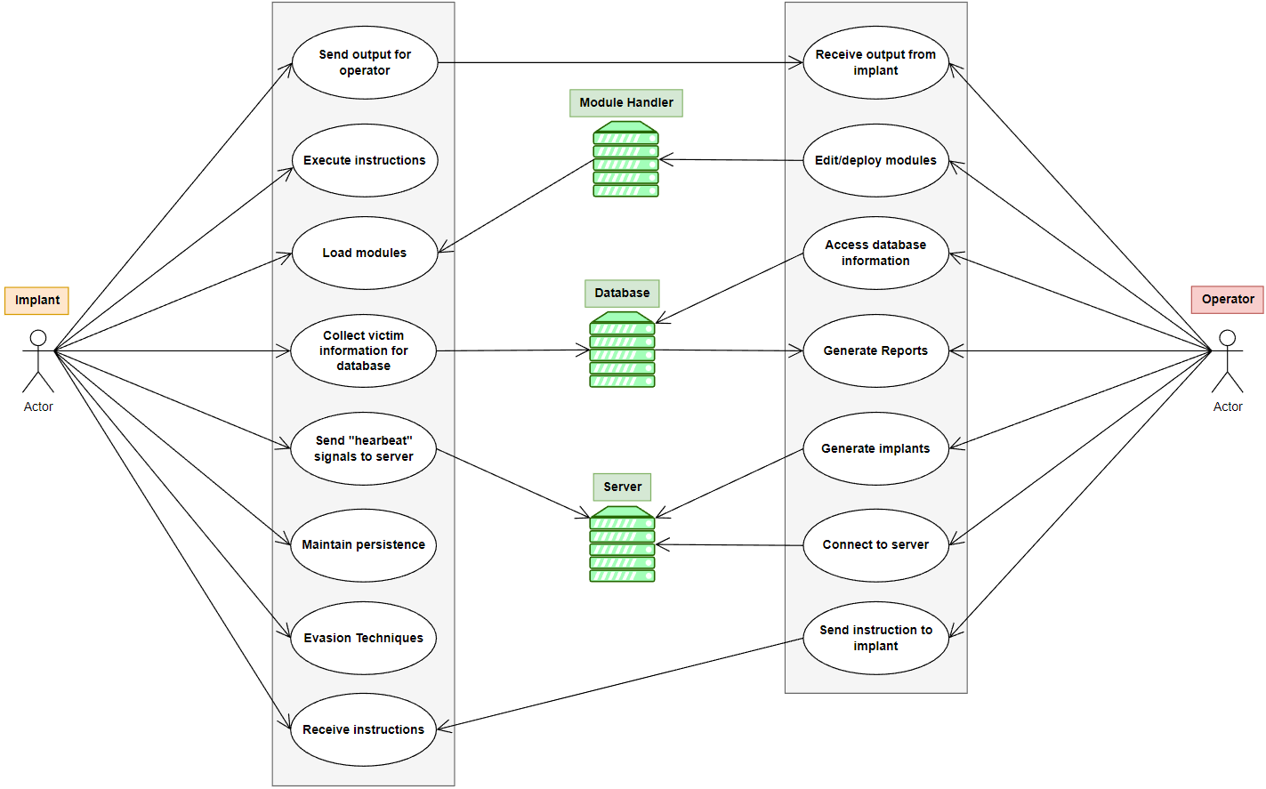



Adversary Emulation Framework
Kiara Rivera, Genesis Resto, Carlos Roque
krivera786@email.uagm.edu, gresto19@email.uagm.edu, croque16@email.uagm.edu
Mentors: Prof. Alcides Alvear Suarez & Robel Campbell
Introduction
Results
Abstract
The digital realm is constantly besieged by ever-changing malicious software that easily penetrates all protective barriers, operates maliciously without the user's awareness, and covertly extracts confidential information. Gaining insight into the workings of these harmful programs empowers us to more effectively counteract them.[1].
Architecture Diagram
The purpose of the Architecture Diagram is to simulate how the command-and-control framework would look like for the operator with the functionalities it is expected to have.
Objectives
Develop a framework that offers a structured and strategic approach to managing complex networked systems and offers various options to expose these malware evasion techniques. This framework should employ the following to enhance its effectiveness and resilience:
Dynamic Evasion – Variable Syscalls, ETW/AMSI Patching
In-memory Execution – Download Cradles, Microcontroller
Encrypted Payloads – AES-256, XOR
Figure 6. Architecture Model
Methodology
Concept Diagram
The objective of the Concept Diagram is to illustrate how the entire system will be working together.
Figure 7. Login Screen
Figure 8. Dashboard for Operators
Figure 9. Action Dashboard Tab
FUTURE WORK
In our upcoming efforts, we anticipate developing all features to operate as described below:
The system will be built to create a special tool called an implant. If the operator already has this tool, the system will take it in and manage it, otherwise the system will make one, manage it, and get it ready to run. Then, it sets up a communication channel for the tool and the server to talk to each other.
If it is the first time the implant registers, it should collect system information from the victim. If it is not the first time, the implant should wait for the server to send commands before proceeding with any actions.
The implant should cover evasion techniques that range from code obfuscation all the way through its life in memory to perform heap encryption when it’s dormant, and many more.
Using tools such as debuggers [2], we can analyze the internals of defense software to uncover new vectors for evasion.
Figure 1. Concept Diagram
Use Case Diagram
The Use Case Diagram is used to determine the functions of the Implant and Operator.
Figure 2. Use Case Diagram
The implant employ various evasion tactics to avoid detection and collect victim information for database.
References
Figure 3. Implant
[1] Y. Ye, T. Li, D. Adjeroh, and S. S. Iyengar, “A Survey on Malware Detection Using Data Mining Techniques,” ACM Computing Surveys, vol. 50, no. 3, pp. 1–40, Jun. 2017, doi Available at: https://doi.org/10.1145/3073559.
[2] Domars (2023) WinDbg Overview - windows drivers, WinDbg Overview - Windows drivers | Microsoft Learn. Microsoft. Available at: https://learn.microsoft.com/en-us/windows-hardware/drivers/debugger/windbg-overview (Accessed: January 30th, 2023).
[X] R. Tahir, “A Study on Malware and Malware Detection Techniques,” International Journal of Education and Management Engineering,vol.8, no. 2, pp. 20–30, Mar. 2018, doi Available at: https://doi.org/10.5815/ijeme.2018.02.03.
[X] E. Chaffey, D. Sgandurra, and R. Holloway, “Malware vs Anti-Malware Battle -Gotta Evade 'em All!,” 2020. Accessed: March 10th, 2023. [Online]. Available at: https://core.ac.uk/download/pdf/340199834.pdf
The database helps storing and managing data related to victims, and operators securely. Also, enforce consistency and validation to avoid errors and corruption.
Figure 4. Database
The server can send instructions to the implant and receive the output, help storing victim information in a database, and you can customize your own implant.
Figure 5. Server
1

