Slide 1
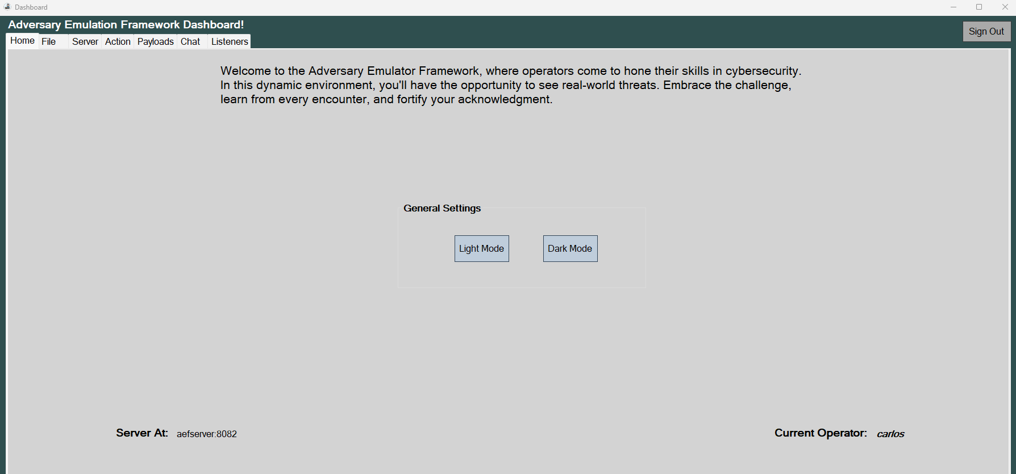

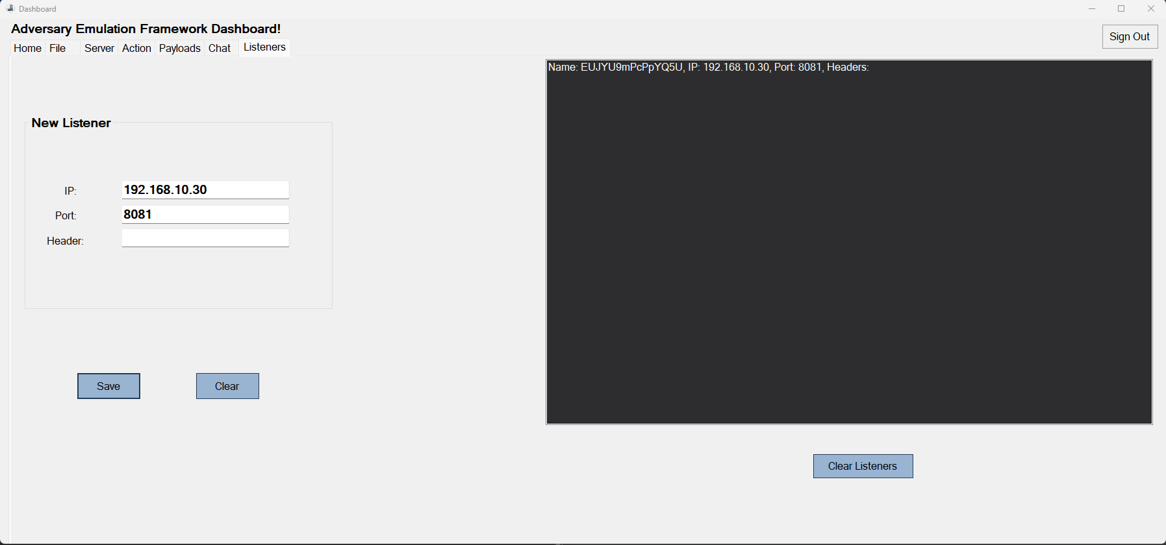


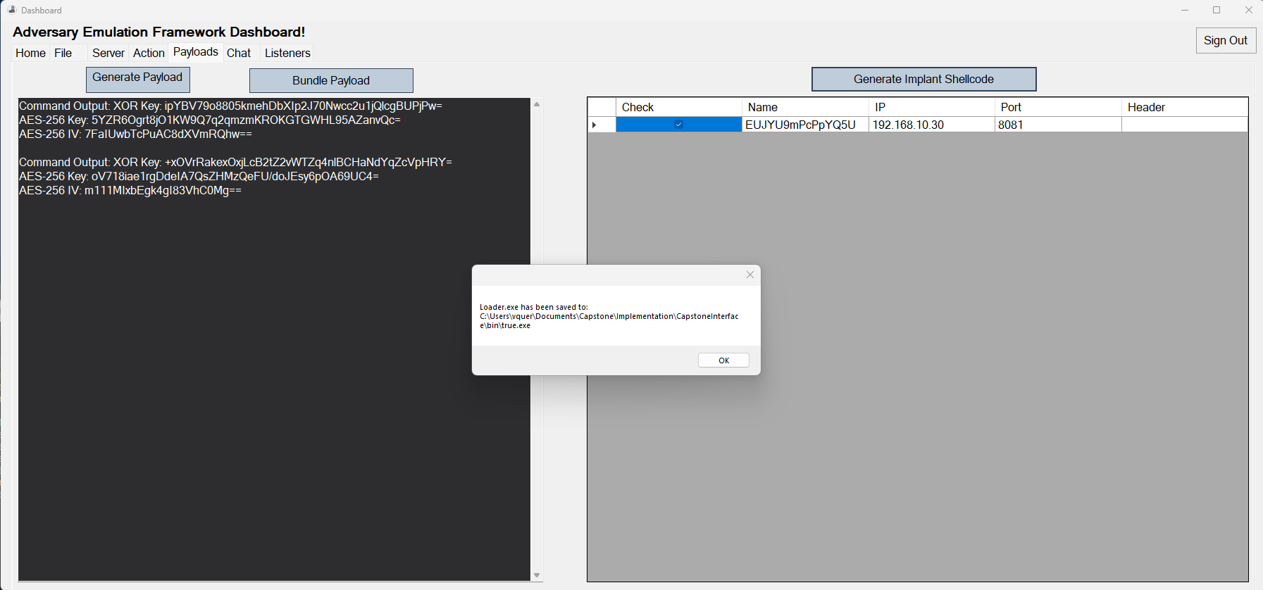
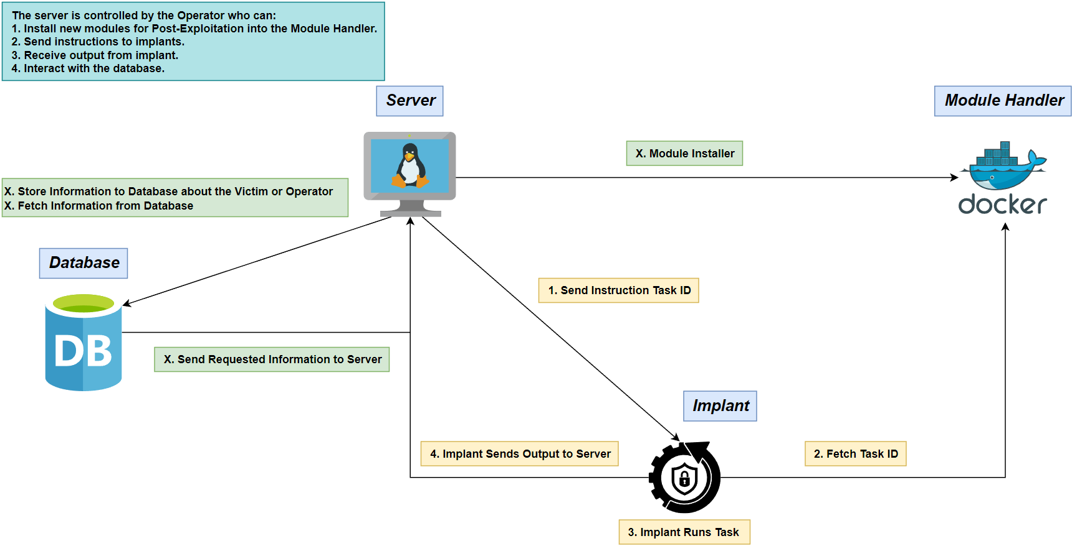
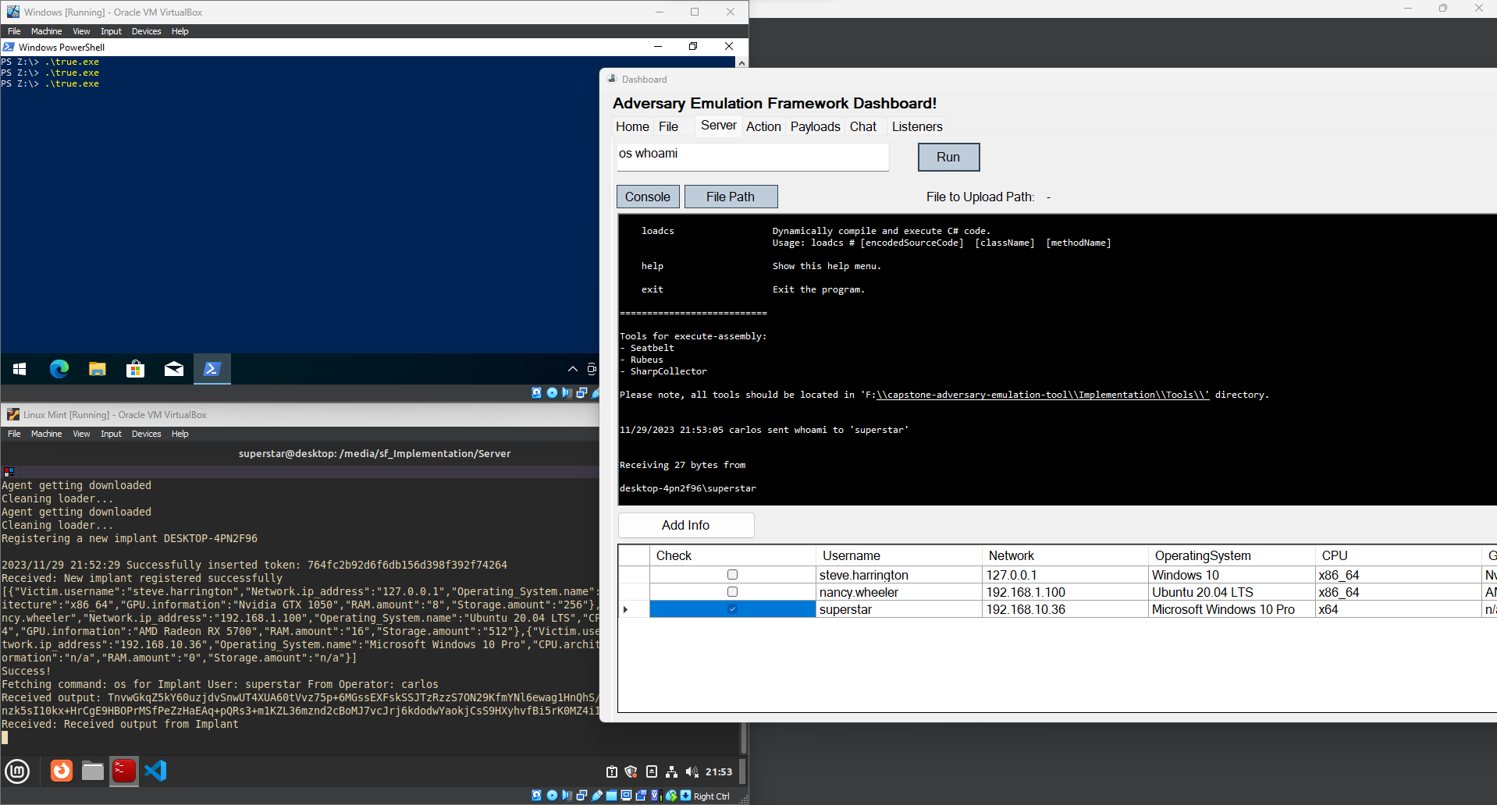
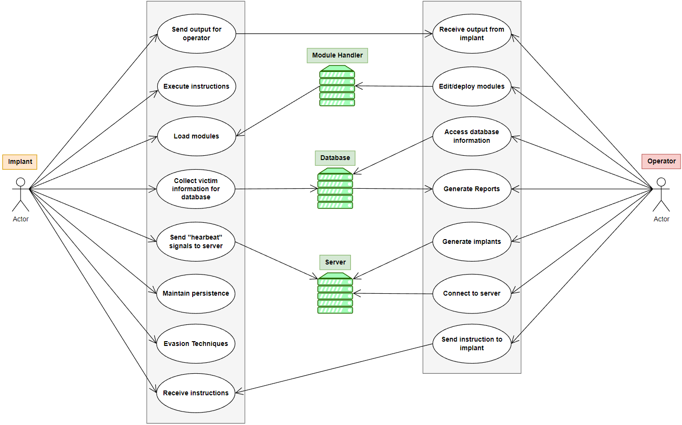
Your Poster Title Goes Here, containing strictly essential words
Kiara Rivera, Genesis Resto, Carlos Roque
krivera786@email.uagm.edu, gresto19@email.uagm.edu, croque16@email.uagm.edu
Mentor: Prof. Alcides Alvear Suarez
Introduction
Results
In the current state of anti-malware systems, defenders focus on a broad understanding of modern malware evasion techniques that their systems have the capability to detect, but the knowledge gap between malicious actors and security engineers makes these systems look frail. We decided to create an innovative command and control framework to provide more effective dynamics in the complex world of malware using the following techniques to enhance its effectiveness and resilience against threats:
Dynamic Evasion –ETW/AMSI Patching & Hardware Breakpoints
In-memory Execution – Shellcode Frameworks
Encrypted Payloads – AES-256, XOR
Objectives
Figure 6. Dashboard for Operators
The implant employ various evasion tactics to avoid detection and collect victim information for database.
Figure 1. Implant
The database store and manage data related to victims, and operators securely. Also, enforce consistency and validation to avoid errors and corruption.
Figure 2. Database
The server send instructions to the implant and receive the output, help storing victim information in a database, and let you customize your own implant.
Figure 7. Listener Creation
Figure 3. Server
Methodology
Concept Diagram
The objective of the Concept Diagram is to illustrate how the entire system will be working together.
Figure 8. Implant Generation
Figure 4. Concept Diagram
Figure 9. Command Execution and Output Retrieval
Use Case Diagram
The objective of the Use Case Diagram is to determine the functions of the Implant and Operator.
Future Work
In the dynamic field of cybersecurity, advancing evasion frameworks requires a multifaceted strategy for adaptability against evolving threats. The framework's scope must expand by incorporating evasion techniques tailored for diverse operating systems, enhancing versatility and overall utility. Sustained research is crucial to stay ahead of malware tactics, ensuring the proactive integration of the latest evasion techniques to effectively counter emerging threats.
References
[x] Microsoft (2023, February). Dynamic Language Runtime Overview - .NET Framework. Microsoft Learn. https://learn.microsoft.com/en-us/dotnet/framework/reflection-and-codedom/dynamic-language-runtime-overview
[x] The Wover (2019, May). Donut – Injecting .NET Assemblies as Shellcode. TheWover. https://thewover.github.io/Introducing-Donut/
Figure 5. Use Case Diagram
Robel Campbell

