Slide 1
Cast O Mech
Manufacturers of all types of GDC, PDC & machining component

Slide 2
ABOUT US
Cast O mech is in the field of aluminum casting used in verity of sector like auto, power,Valve, textile and many more..
Our castings components will be use in many different Engineering and Industrial machinery applications throughout India. We deliver lightweight, high-strength aluminum castings that can be supplied "ready-for-integration" and enable significant cost savings and many other benefits to the customer.

Slide 3
Vision
Our Vision is to be recognized as the best- in-class organization by our customers & market segment while ensuring superior earnings for re-investment in growth of the organization.
Mission
To achieve customer satisfaction at utmost level by providing them first class products that create recognition of the organization in global market.

Slide 4
ORGANIZATION CHART
Managing Director
Mr. Bhavin Patel
Production Engineer
Machine Operator
Helper 1
Helper 2
QA & QC
Mr.Riyan vhora
Account Department
Store
Store keeper
Accountant
Production Department
Quality Department

Slide 5
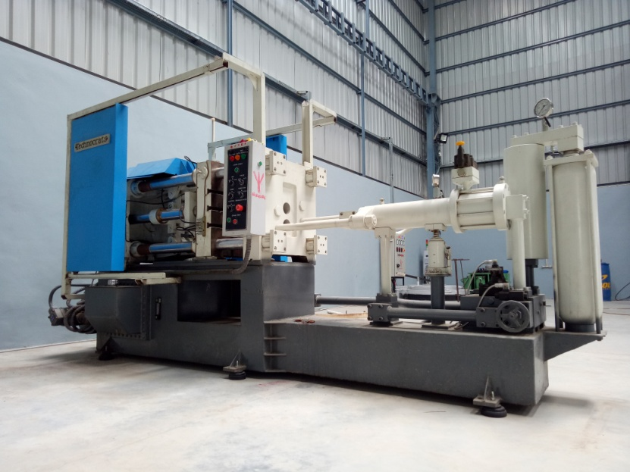
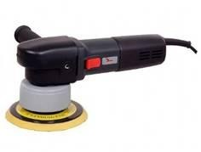
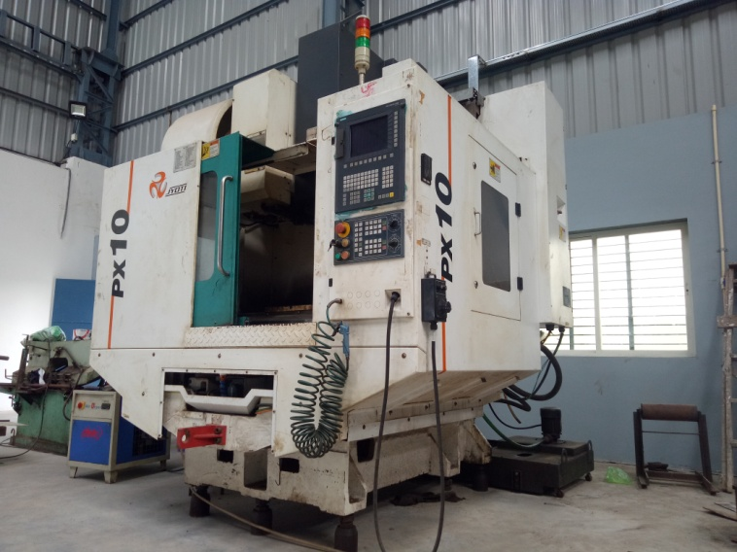
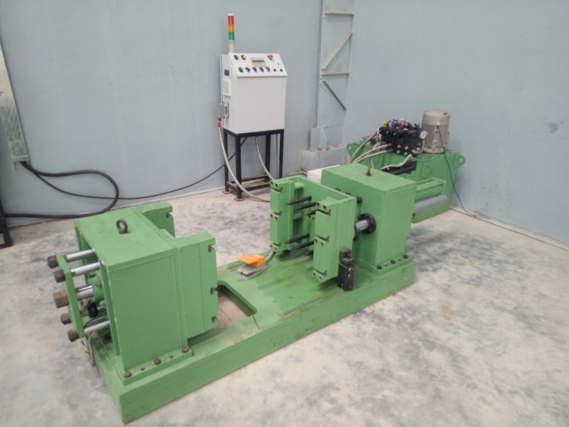
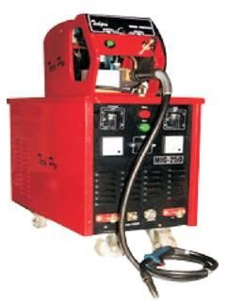
MANUFACTURING FACILITIES
PDC( pressure die casting)
GDC( gravity die casting)
VMC ( vertical milling machine)
Welding & linishing

Slide 6

Aluminium Pressure die casting
Aluminum Pressure die casting is defeated high volume run parts with more slender divider thicknesses. Die casting is a metal forcing so as to throw process that is described liquid metal under high pressure into a mold cavity. The mold cavity is made utilizing two solidified device steel dies which have been machined into shape and work comparatively to an infusion mold amid the procedure .

Slide 7
Aluminium Gravity die casting
Aluminum Gravity Die Casting is a repeatable throwing process utilized for non-ferrous combination parts, a permanent mould casting method,where the melted metal is poured from a furnace to the mould, and also the cavity fills with no force aside from gravity.

Slide 8
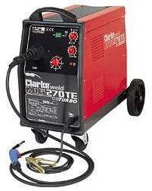
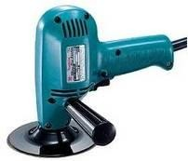
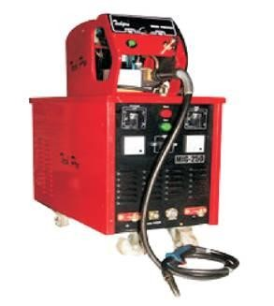
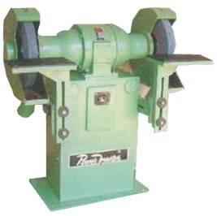
Welding & Finishing
Co2 MIG Welding
Huge Capacity of Welding with 6 Welding stations
Sander & Grinder
Separate Area for Finishing

Slide 9
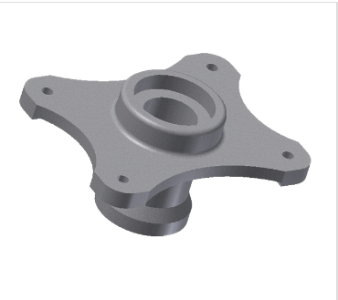
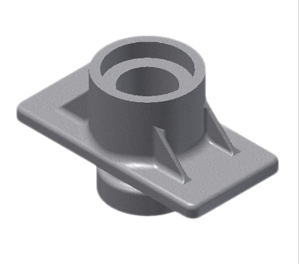
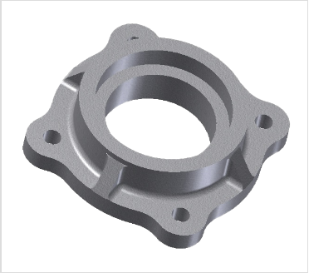
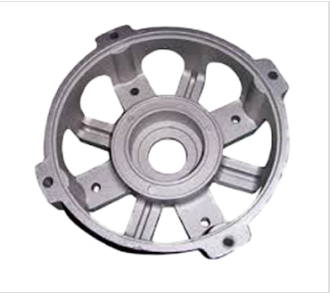
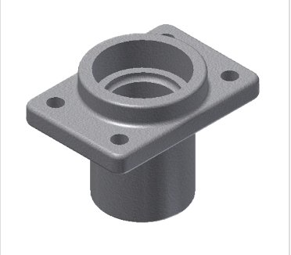
General Engineering Applications
Products
Due to light weight, good resistance to corrosion, good weldability, excellence machinability, various customers have been getting small batch components in aluminium. Like,

Slide 10
Contact Us
Cast O Mech
Plot No. 112,POR industrial park, B/H Hotel sahyog, N.H.No.8,POR,Vadodara. 391243
Mo .No.: +919879759943
Email : castomech@gmail.com

