Slide 1
The Communication Tax
Isolating and Scaling the Coordination Costs of Multi-Agent LLM Coding Systems

Slide 2
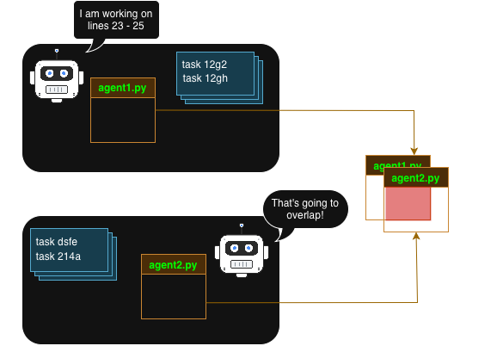
CooperBench
* Tasks are overlapping
* Meaningful Coordination essential
Individual Test Suite ran POST merge
both_passed When both test suites pass

