Slide 1


NEXT GEN EMPLOYABILITY PROGRAM
CREATING A FUTURE-READY WORKFORCE
Student Name :
RADHAKRISHNAN B
Student ID :
College Name :
STU671790bdb27471729597629
Sri Krishna College of Engineering and Technology

Slide 2
CAPSTONE PROJECT SHOWCASE
Project Title
Online Auction Platform with React and ExpressJS Framework (P2)
Abstract | Problem Statement | Project Overview | Proposed Solution | Technology Used | Modelling & Results | Conclusion | Q&A

Slide 3
Abstract
1
Real-Time Bidding System – The platform enables buyers and sellers to engage in competitive bidding, ensuring a transparent and dynamic auction experience.
2
Secure & Scalable Architecture – Built using ReactJS (frontend) and ExpressJS (backend), the system ensures robust security, seamless user authentication, and efficient scalability.
3
User-Friendly Interface – Intuitive design for listing products, placing bids, and tracking auctions in real-time, enhancing the overall user experience.
4
Secure Transactions & Notifications – Integrated payment security and real-time alerts for bid updates, auction status, and user actions, ensuring a seamless auction process.

Slide 4


Problem Statement
Online Auction Platform with React and ExpressJS Framework' => "In the digital era, traditional auction systems have evolved into dynamic online platforms where buyers and sellers from across the globe can interact in real-time to buy and sell goods through competitive bidding. This project focuses on developing a modern online auction platform using React for the frontend and Express.js for the backend, offering a seamless and real-time auction experience. The platform will allow sellers to list products and buyers to place bids, all while providing secure payments, user-friendly interfaces, and scalable performance.

Slide 5

Project Overview
The Online Auction Platform is a web-based system that facilitates real-time bidding, allowing sellers to list items and buyers to place bids competitively. Built using ReactJS for the frontend and ExpressJS for the backend, the platform ensures a seamless, interactive, and scalable auction experience. It features secure user authentication, real-time bid tracking, auction management, and secure payment integration. The system provides notifications for bid updates, ensuring transparency and engagement. Designed for efficiency and scalability, the platform enhances traditional auction systems by bringing them into the digital era.

Slide 6
Proposed Solution
The Online Auction Platform leverages ReactJS for an interactive and dynamic user experience and ExpressJS for a robust backend.
The platform offers secure user authentication, allowing sellers to list auction items and buyers to place bids in real-time. WebSockets or polling mechanisms ensure instant bid updates.
The system integrates payment gateways for secure transactions and employs MongoDB for efficient data management. Admin features include auction moderation, user management, and analytics.
This solution modernizes traditional auctions, providing a scalable, user-friendly, and transparent bidding environment.

Slide 7
Technology used
•Frontend: React – Provides a dynamic and user-friendly interface for seamless interaction.
•Backend: Express.js – Handles server-side logic, API requests, and authentication.
•Database: MongoDB – Stores user details, auction listings, and bid history efficiently.
•API Communication: Axios – Facilitates smooth interaction between frontend and backend.
•Security:
Password Encryption: Ensures secure storage of user credentials.
Authentication: JWT (JSON Web Token) – Manages secure user sessions.
•API Testing: Postman – Used for testing and validating backend API endpoints.

Slide 8
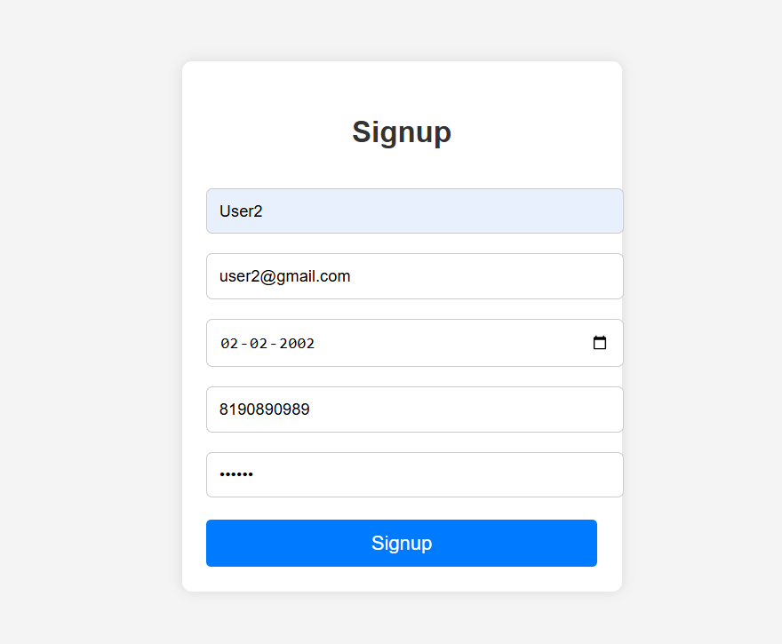
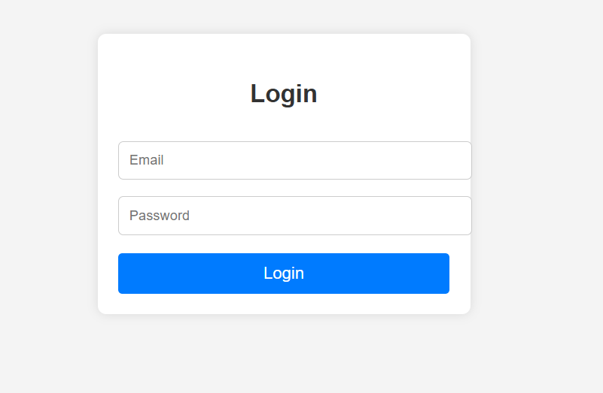
Modelling & Result

Slide 9
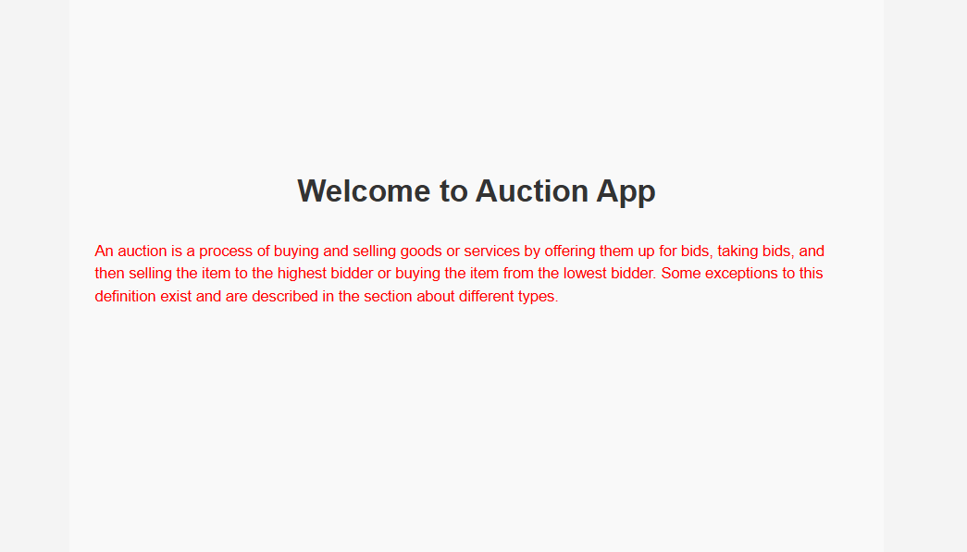
Modelling & Result

Slide 10
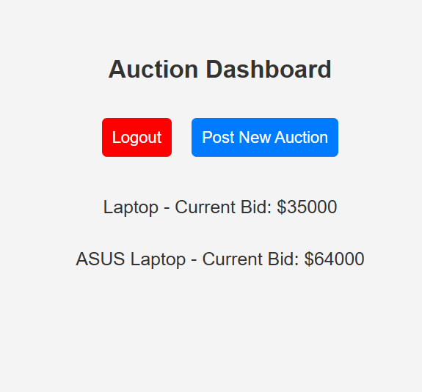
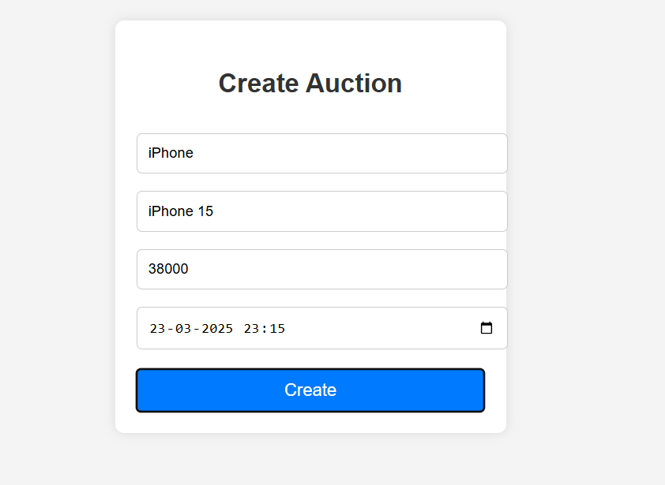
Modelling & Result

Slide 11

Conclusion
The Online Auction Platform built using React and ExpressJS provides a seamless and real-time bidding experience for buyers and sellers. By integrating secure authentication, real-time updates, and a user-friendly interface, the platform ensures smooth transactions and competitive auctions. The use of MongoDB for scalable data storage and WebSockets for live bidding enhances performance and responsiveness. With future enhancements like AI-powered price predictions and blockchain-based security, this platform has the potential to revolutionize online auctions, making them more transparent, efficient, and accessible.

Slide 12


Notes:
Thank You !!

