Slide 1



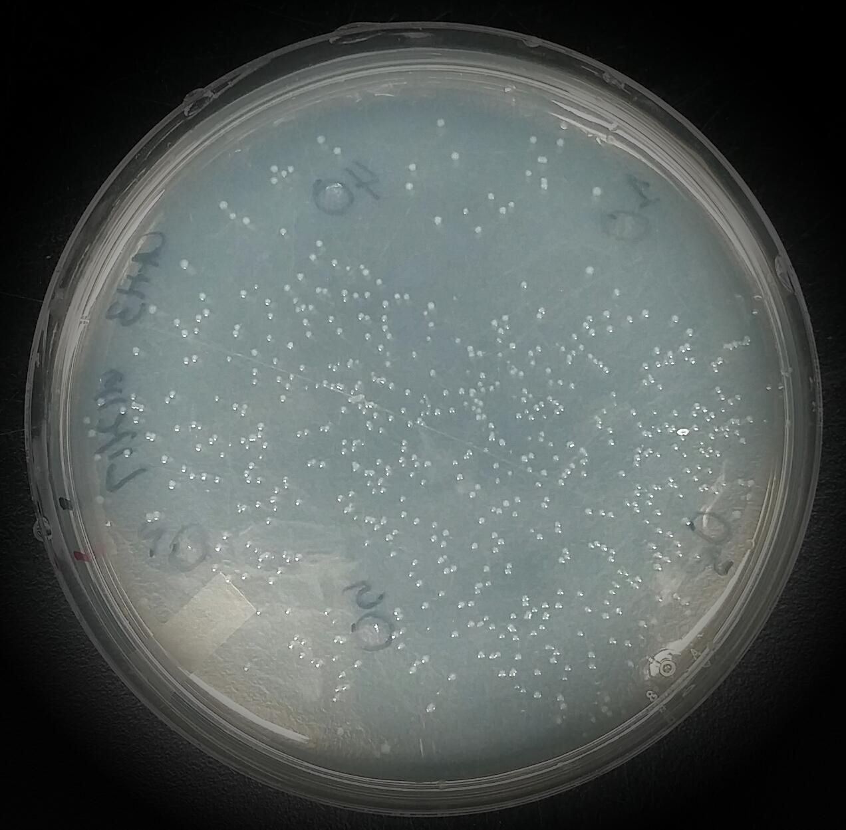
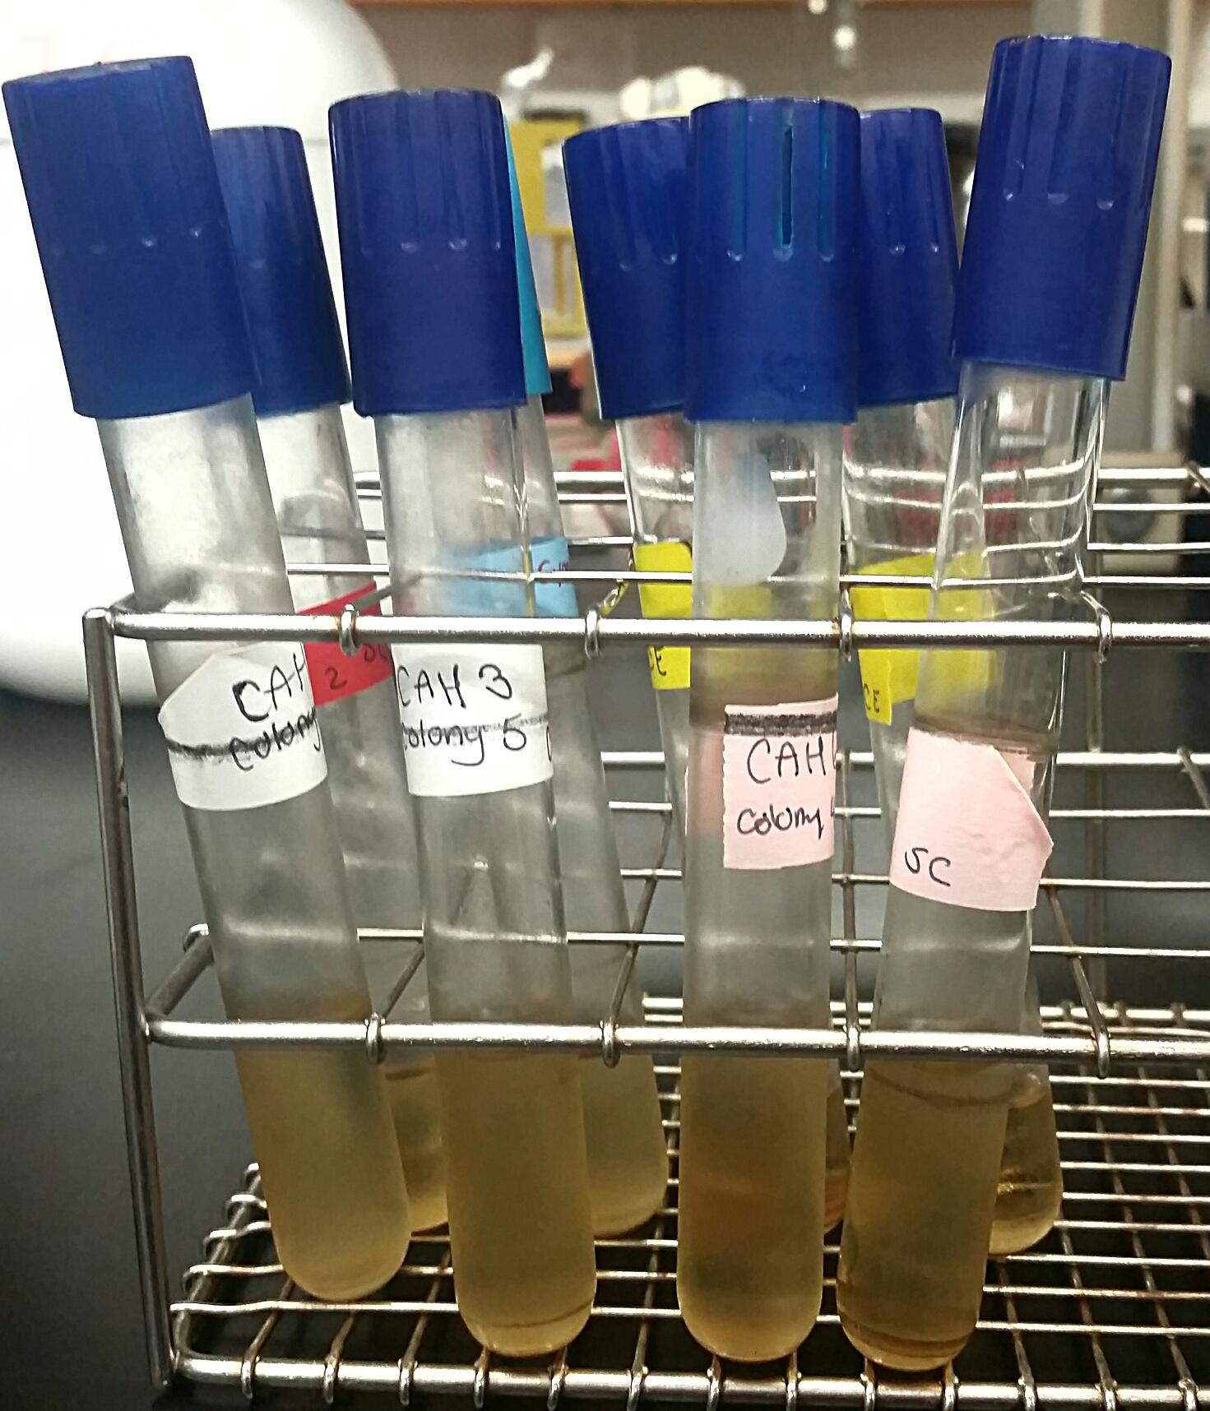
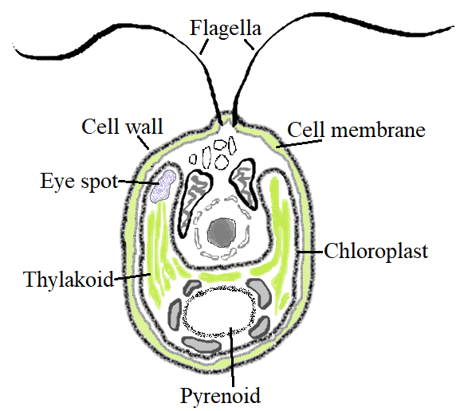
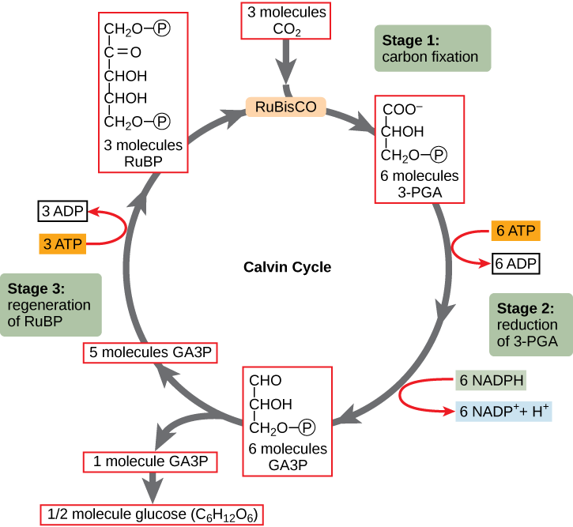
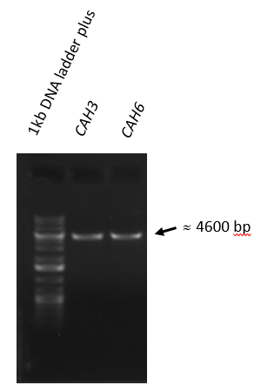
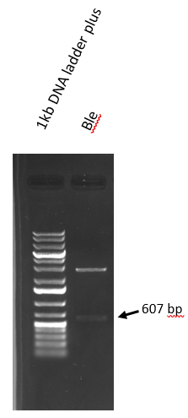
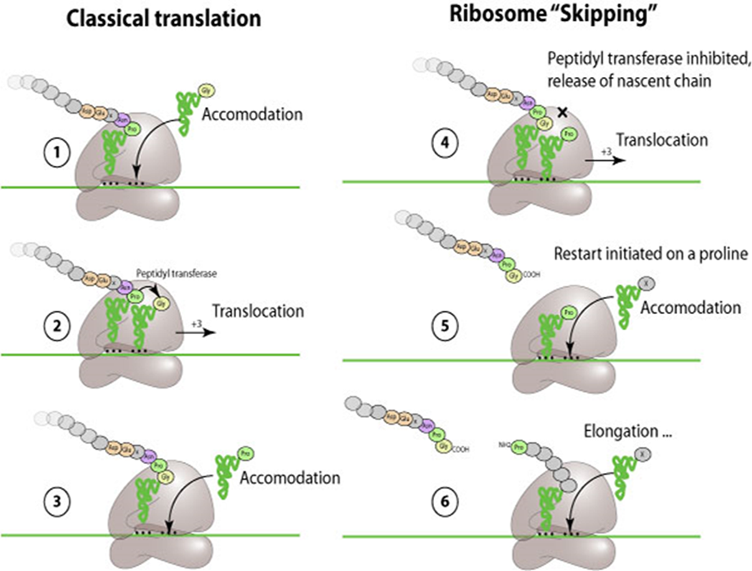
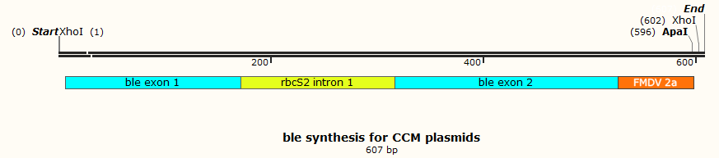
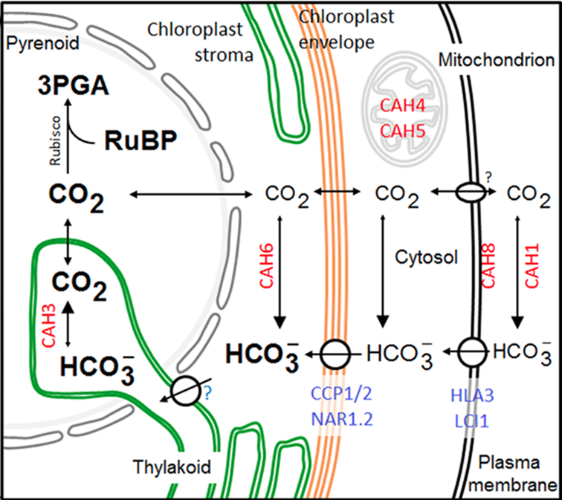
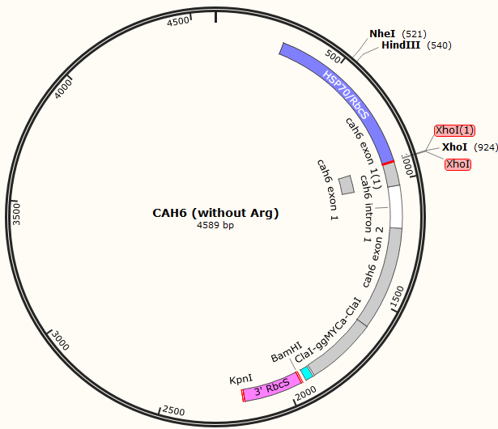
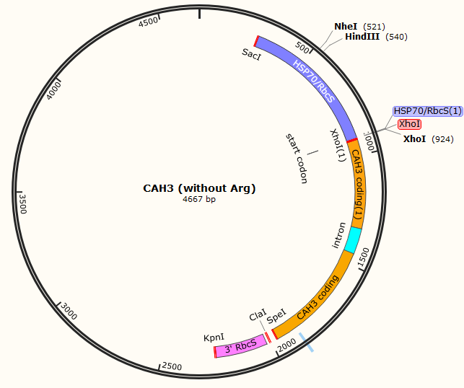
Overexpression of Two Carbonic Anhydrase Enzymes to Amplify Algal Cell Growth
Sarah Carpe¹, Charity Ensor¹, Lian Jackson¹, Amrita Madabushi¹, Stephen M. Miller² ¹Arts and Sciences, Biotechnology Program, Baltimore City Community College, 2901 Liberty Heights Ave, Baltimore, MD 21215
²Department of Biological Sciences, UMBC, 1000 Hilltop Circle, Baltimore, MD 21250
Introduction
Methods
Future Directions
Green algae are photosynthetic plant-like organisms with great promise as a source of sustainable biofuels. Production of biofuels from algae is a sustainable alternative to fossil fuels. Chlamydomonas reinhardtii (Fig 1.), a single celled microalga, is the most widely used model organism for algal biofuel production research . Many tools are available for molecular genetic manipulation of C. reinhardtii; it is easy to culture, making it an excellent platform for biotechnology research. The limiting factor for algal growth, carbon dioxide (CO₂), is the focus of our algal biofuel research. Certain enzymes play a role in intracellular CO₂ uptake, a crucial part of the Calvin Cycle (Fig 2.), as well as conversion into carbohydrates and eventually lipids. These enzymes can be manipulated using Ble (Bleomycin + viral 2A peptide fragment). (Fig 3.) to improve photosynthesis and growth. The focus of this study are two genes that encode enzymes involved in CO₂ uptake. Carbonic anhydrase 6 (CAH6) (Fig 4.) converts CO₂ into carbonate in the chloroplast stroma, increasing carbon flow into the pyrenoid, where CO₂ fixation into carbohydrates takes place. Carbonic anhydrase 3 (CAH3) (Fig 4.) converts carbonate back into CO₂ in the pyrenoid. Over expression of these enzymes should improve photosynthesis and thus cell growth.
Cell Culture
Using aseptic technique we plated competent cells containing plasmids onto LB Amp plates. The plasmids have either CAH3, CAH6, or Ble coding regions. Plates were at 37°C for 12-18 hours.
Utilizing recombinant DNA technology, we will take generated vectors with CAH3 or CAH6 coding regions and connect them to an insert Ble gene sequence with the hope of increasing expression of these proteins. The Ble sequence encodes a selectable marker protein; if expressed it will indicate successful transformation. Using a pulse of electrical current to momentarily open the pores of the cell membrane, a technique called electroporation, we will introduce these vectors into C. reinhardtii. We will use western-blot analysis to determine transgenic protein expression. Finally, we will use an algal multicultivator to observe and compare growth of our transformants to a control strain using optical density measurements. If overexpression of CAH3 or CAH6 improves growth in C. reinhardtii, then our methods can be applied to other algal species, such as Chlorella vulgaris, a biotechnology production organism.
Inoculation
Autoclaved toothpicks were used to pick up individual colonies. Colonies were introduced to 7.5mL of LB amp media via toothpick. Tubes were allowed to grow overnight at 37°C in shaker incubator.
DNA Purification
DNA was purified using a plasmid cleanup kit. The samples were further purified using ethanol precipitation technique, then nanodropped to check DNA concentration (ng/μl). Each sample was digested using restriction enzyme Xho1, then a diagnostic gel was run.
Conclusion
Chlamydomonas reinhardtii
Figure 1. Cell model of Chlamydomonas reinhardtii, a green microalga with two flagella, showing the chloroplast and its components, as well as the cell wall and membrane. Ensor, C., Carpe, S.. August 2nd, 2017.
In-Gel Ligation
A low-melt agarose gel was used to isolate Ble, CAH3, and CAH6 fragments after XhoI digestion. Isolated Ble and CAH3, or isolated Ble and CAH6, were incubated with DNA ligase.
Algal biofuel production is a sustainable alternative to fossil fuels and has more potential than ethanol produced from corn, another alternative fuel source. Transformation of these genes into Chlamydomons reinhardtii would bring scientists closer to successfully developing a more economic sustainable energy source.
Transformation
Ligation products will be transformed into chemically competent cells. Cells will be plated and selected for ampicillin resistance, then DNA from surviving colonies will be analyzed.
The Calvin Cycle
Figure 2. A Diagram of the Calvin Cycle; a set of chemical reactions that takes place in the chloroplast during photosynthesis resulting in production of Glyceraldehyde 3-phosphate, a carbohydrate used as an immediate nutrient that can be converted into sugar or lipids. OpenStax, Biology. OpenStax CNX. May 27, 2016 http://cnx.org/contents/185cbf87-c72e-48f5-b51e-f14f21b5eabd@10.53.
References
Results
Duanmu, D., Wang, Y., & Spalding, M. H. (2009, February). Thylakoid lumen carbonic anhydrase (CAH3) mutation suppresses air-Dier phenotype of LCIB mutant in Chlamydomonas reinhardtii. Retrieved June 21, 2017, from https://www.ncbi.nlm.nih.gov/pubmed/19074623
Ghoshal D, Goyal A. (2000). Carbon concentration mechanisms in photosynthetic microorganisms. Indian J Biochem Biophys, 37(6), 383-94. Retrieved from https://www.ncbi.nlm.nih.gov/pubmed/11355625
Grossman, A. R., Harris, E. E., Hauser, C., Lefebvre, P. A., Martinez, D., Rokhsar, D., … Zhang, Z. (2003). Chlamydomonas reinhardtii at the Crossroads of Genomics . Eukaryotic Cell, 2(6), 1137–1150. http://ec.asm.org/content/2/6/1137
Ma, Y., Pollock, S. V., Xiao, Y., Cunnusamy, K., & Moroney, J. V. (2011, June 01). Identification of a Novel Gene, CIA6, Required for Normal Pyrenoid Formation in Chlamydomonas reinhardtii. Retrieved June 23, 2017, from http://www.plantphysiol.org/content/156/2/884.long
Scaife, M. A., Nguyen, G. T., Rico, J., Lambert, D., Helliwell, K. E., & Smith, A. G. (2015). Establishing Chlamydomonas reinhardtii as an industrial biotechnology host. The Plant Journal, 82(3), 532–546. http://onlinelibrary.wiley.com/doi/10.1111/tpj.12781/full
Sharma, P., Yan, F., Doronina, V. A., Escuin-Ordinas, H., Ryan, M. D., & Brown, J. D. (2011, December 2). 2A peptides provide distinct solutions to driving stop-carry on translational recoding. Retrieved June 22, 2017, from https://www.ncbi.nlm.nih.gov/pmc/articles/PMC3326317/
Yamano T., Fukuzawa H. (2009). Carbon-concentrating mechanism in a green alga, Chlamydomonas reinhardtii, revealed by transcriptome analyses. J Basic Microbiol, 49(1), 42-51. http://onlinelibrary.wiley.com/doi/10.1002/jobm.200800352/pdf
Classical Translation Vs. Ribosome “Skipping”
Figure 3. A comparison of classical translation and ribosome “skipping”; peptidyl transferase inhibited following translation of 2A peptide fragment. Ribosomal Skipping. Retrieved August 2nd, 2017 from http://viralzone.expasy.org/914?outline=all_by_species
We successfully isolated CAH3 and CAH6 plasmids, as well as Ble fragment, then confirmed using gel electrophoresis.
Acknowledgements
Carbon Concentrating Mechanisms in Chlamy
Figure 4. Illustration of the CO₂ concentrating mechanism of Chlamydomonas reinhardtii, showing inorganic carbon transport proteins LCI1, HLA3, CCP1/2 and NAR1.2, and carbonic anhydrases CAH1, CAH3, CAH4/5, CAH6 and CAH8. Jungnick, N., Ma, Y., Mukherjee, B. et al. Photosynth Res (2014) 121: 159.
These results were obtained as part of the Research Experience and Mentoring (REM) program in the Department of Biological Sciences at the University of Maryland Baltimore County. This program is funded by a grant (REM supplement to NSF-EFRI-1332344) from the National Foundation (NSF) Directorate for Engineering (ENG) Office of Emerging Frontiers in Research and Innovation (EFRI). We also thank Jose Ortega, Rudolph Park, Erin Pueblo, Jacqueline Rivera, Holly Asbury, Jihye Yeon, Newton Bosire, and Kimuel Villanova for technical assistance and helpful discussions.

