Slide 1
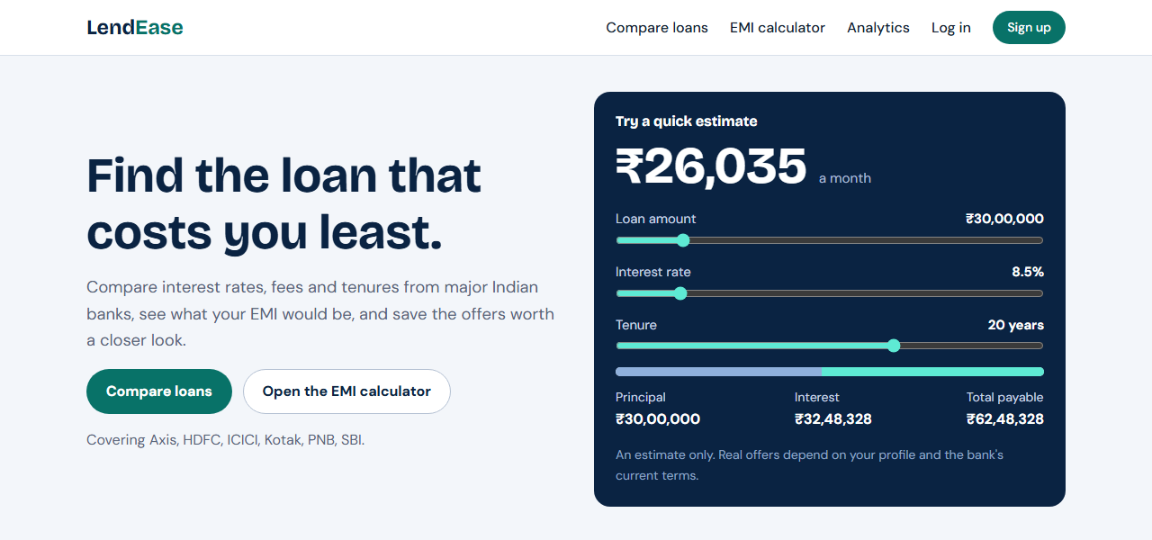
LENDEASE
Loan Comparison & Financial Analytics Platform
TITLE: LendEase, a loan comparison website
SUBTITLE: Compare rates, calculate EMI, decide
BY: [Your name]
SEAT NO: [Your seat number]
PROJECT TYPE: [Minor / major project and subject]
YEAR: 2026-27

Slide 2
Introduction
What is LendEase? A website that puts loan offers from six major Indian banks side by side, so a borrower can compare interest rates, fees and monthly EMI in one place.
Why this project? Every bank lists its rates on a different page in a different format. Comparing them by hand is slow, and a small difference in rate changes the total cost by lakhs over a long loan.
Project goal: Build a complete web application with a real database: compare loans, calculate EMI, save offers, manage the data as an admin, and show analytics as graphs and pie charts.
Important: LendEase is a comparison and learning tool, not a lender. It uses reference data, and every record shows its source and last-updated date.
At a glance
6
banks: SBI, HDFC, ICICI, Axis, Kotak, PNB
5
loan types: home, personal, car, education, business
30
loan products in the database

Slide 3
Problem Statement
Challenge
Our solution
Impact
Loan information is scattered across bank websites.
Each bank quotes a range of rates, fees and tenures in its own format.
Working out the EMI for each offer by hand is slow and easy to get wrong.
One website backed by a MySQL database of loan products.
Filter by loan type, amount, tenure, bank and rate.
EMI is calculated automatically for every offer.
Graphs and pie charts summarise the data.
Comparison in seconds instead of visiting six websites.
Lowest rate and lowest EMI highlighted clearly.
Users can save offers and repeat earlier searches.
Admins can update rates, with every change recorded.
Result: a working website, live at lendease-ten.vercel.app

Slide 4
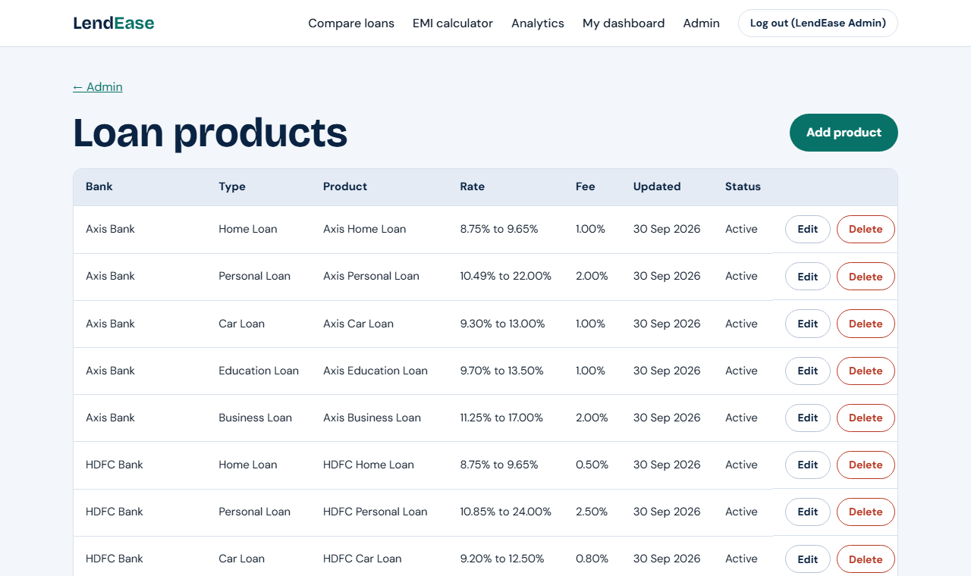
Dataset
Source: reference data modelled on the ranges banks advertise publicly. It is demo data for this project, not live rates.
Composition: 6 banks x 5 loan types = 30 loan products, stored in MySQL.
Sample activity: 2 demo accounts with saved offers and search history, so the dashboard and charts have data.
Fields stored for each loan product
Bank, loan type and product name
Lowest and highest interest rate
Minimum and maximum amount and tenure
Processing fee
Source URL and last-updated date
The loan products table, as shown in the admin panel

Slide 5
Methodology Overview
1
2
3
4
Requirements
Database design
Sample data
Backend
Decide the pages, features and data needed
6 tables with keys and constraints
Load 6 banks and 30 loan products
Flask routes and SQL queries in app.py
5
6
7
8
Frontend
Analytics
Testing
Deployment
HTML templates, CSS and JavaScript
GROUP BY queries drawn as charts
48 automated tests with pytest
Hosted on Vercel with a cloud database
Step-by-step approach: each step was finished and checked before starting the next.

Slide 6
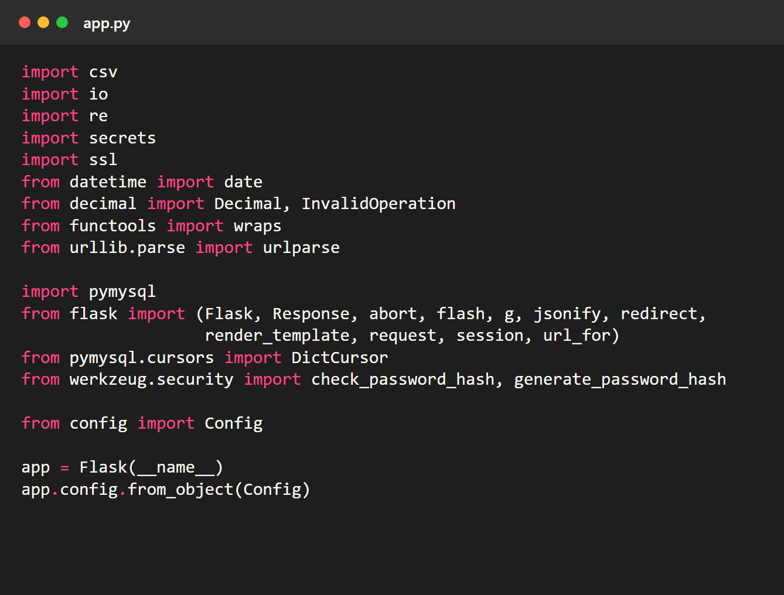
Technologies Used
Python
What: General-purpose programming language.
Why: Simple to read, with good web and database libraries.
Where: All backend code in app.py and the helper scripts.
Flask
What: A small Python web framework.
Why: Turns Python functions into web pages and APIs.
Where: Every route: home, compare, login, admin, analytics.
MySQL
What: Relational database.
Why: Tables, keys, JOINs and GROUP BY fit loan data well.
Where: Stores banks, loan products, users and saved offers.

Slide 7
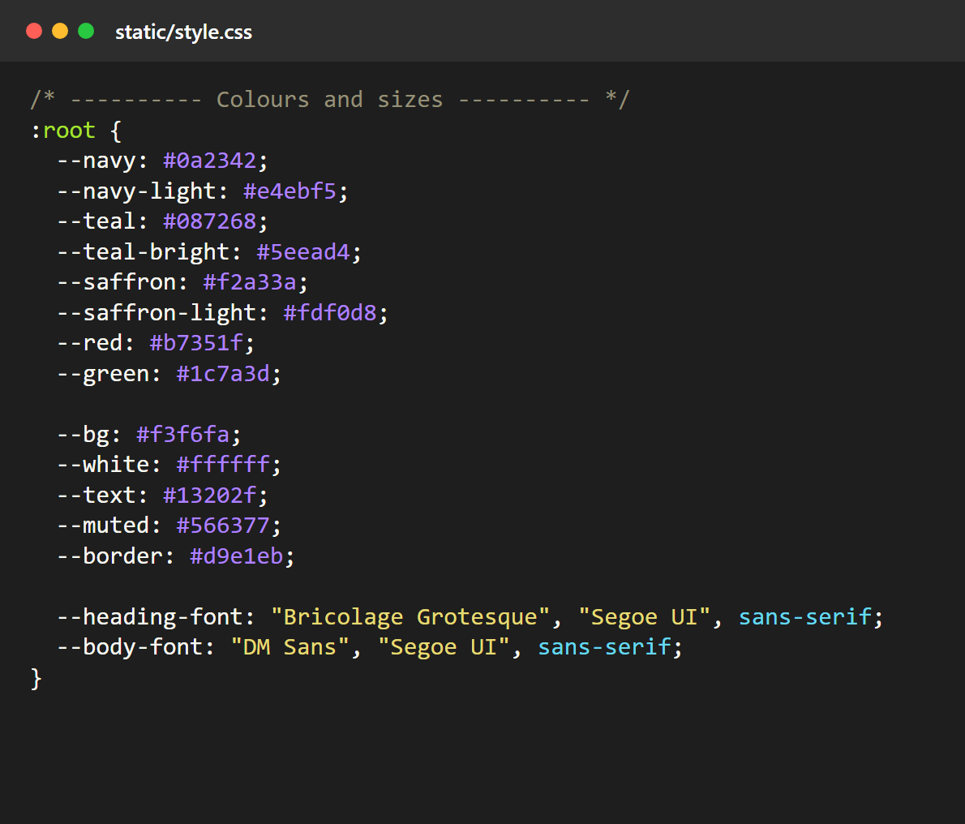
Technologies Used (continued)
PyMySQL
What: Python driver for MySQL.
Why: Runs raw SQL with %s placeholders, with no ORM.
Where: The query() and execute() helpers in app.py.
HTML, CSS and JavaScript
What: The languages of the browser.
Why: No front-end framework is needed for this site.
Where: templates/, static/style.css and static/script.js.
Chart.js
What: JavaScript charting library.
Why: Draws bar, line and pie charts from JSON data.
Where: The ten charts on the Analytics page.

Slide 8
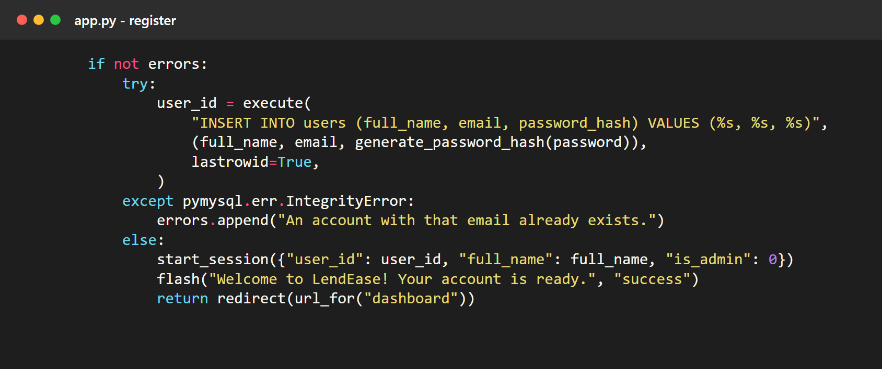
Technologies Used (tools)
Werkzeug security
What: Password hashing functions.
Why: Passwords are never stored as plain text.
Where: Register and login.
pytest
What: Python testing tool.
Why: Checks the code automatically after every change.
Where: 48 tests in the tests/ folder.
Vercel and TiDB Cloud
What: Hosting for the website and for the database.
Why: Puts the project on the internet for free.
Where: The live website.

Slide 9
Database Design
banks
loan_products
loan_rate_history
bank_id (primary key)
name, short_name
website_url
product_id (primary key)
bank_id (foreign key to banks)
rates, amounts, tenure, fee
source_url, last_updated
history_id (primary key)
product_id (foreign key)
changed_by (foreign key to users)
old rates, note, date
comparison_history
users
saved_offers
history_id (primary key)
user_id (foreign key to users)
loan_type, amount, tenure
user_id (primary key)
full_name, email (unique)
password_hash, is_admin
saved_id (primary key)
user_id, product_id (foreign keys)
UNIQUE (user_id, product_id)
Six tables. Each arrow goes from a parent table to a table that refers to it with a foreign key.

Slide 10
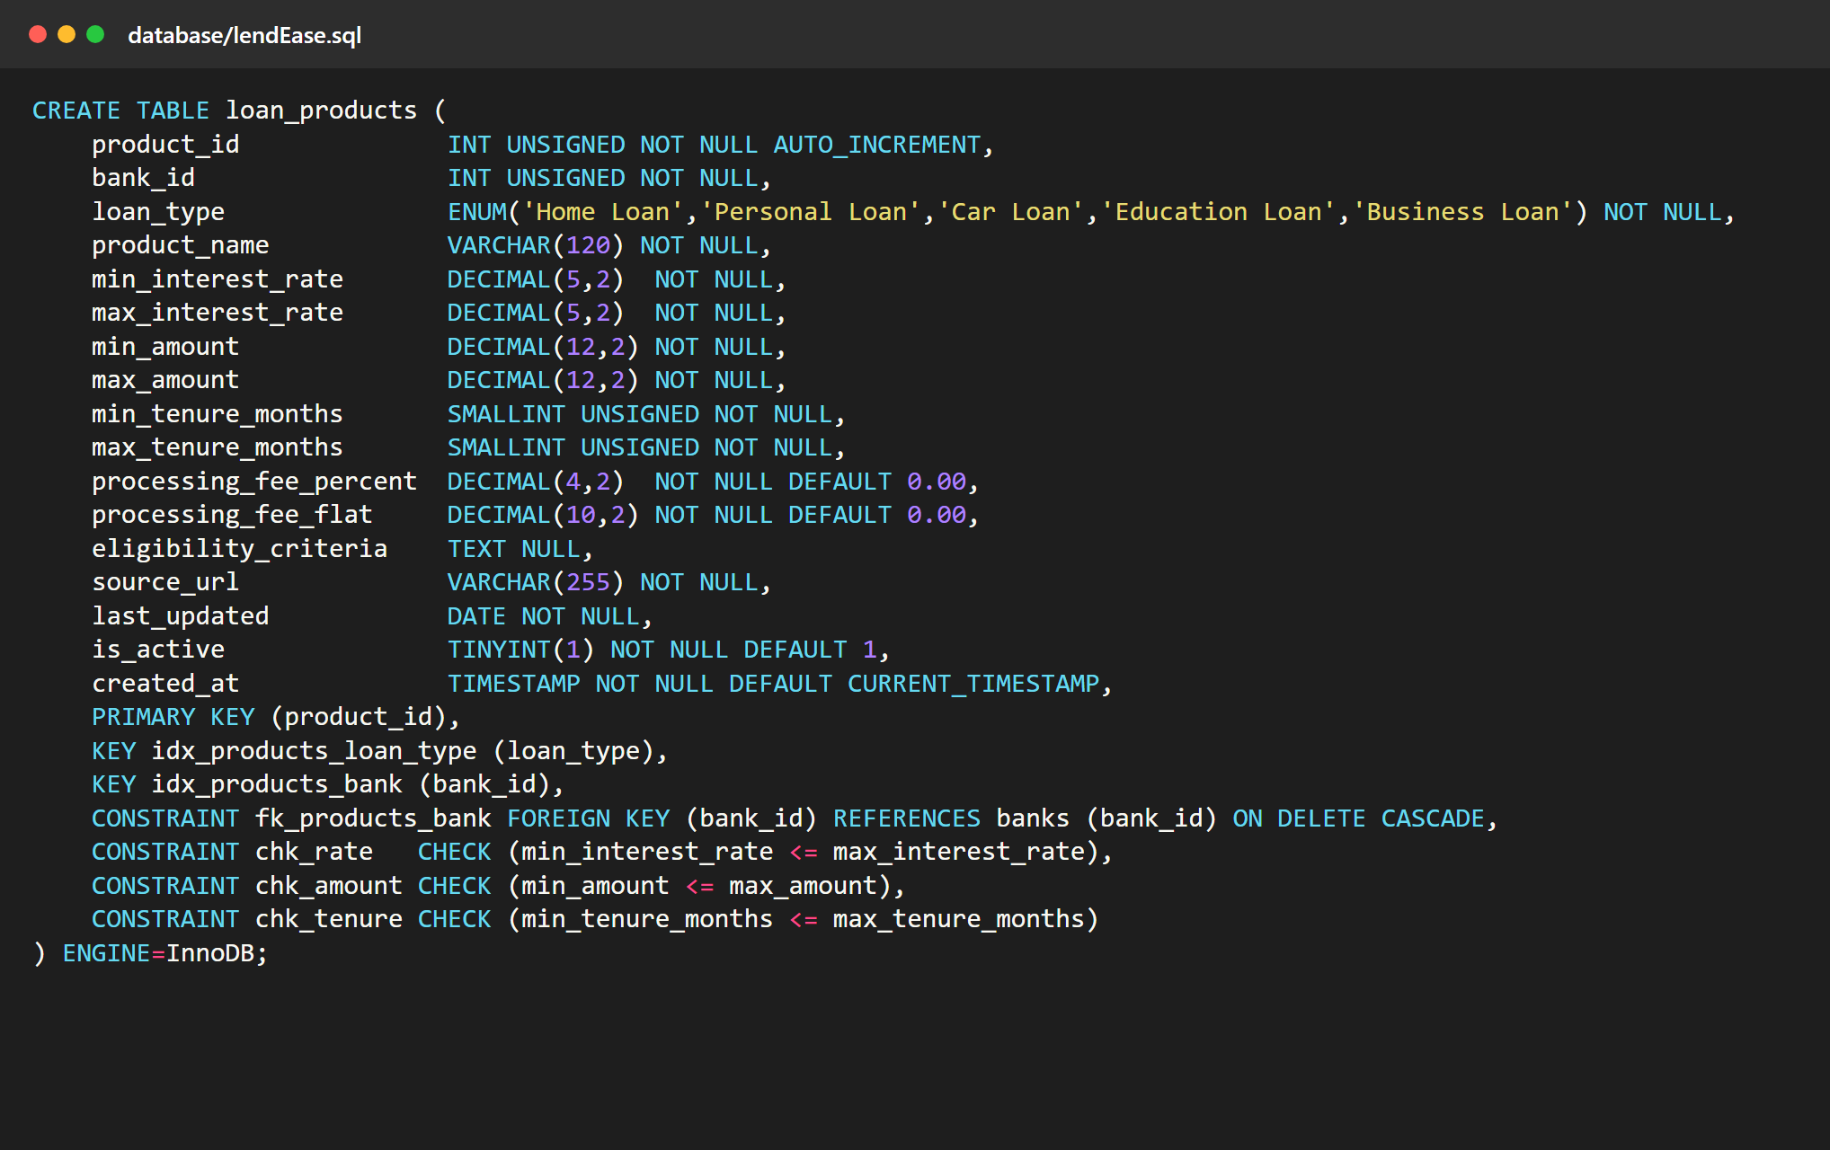
Creating the Tables
PRIMARY KEY: product_id identifies each loan product.
FOREIGN KEY: bank_id must match a bank. ON DELETE CASCADE removes a bank's products when the bank is deleted.
ENUM: loan_type can only be one of the five allowed values.
CHECK constraints: the minimum rate, amount and tenure can never be above the maximum.
Indexes: on loan_type and bank_id, the columns the comparison filters on.
DECIMAL: used for money and rates so there are no rounding errors.

Slide 11
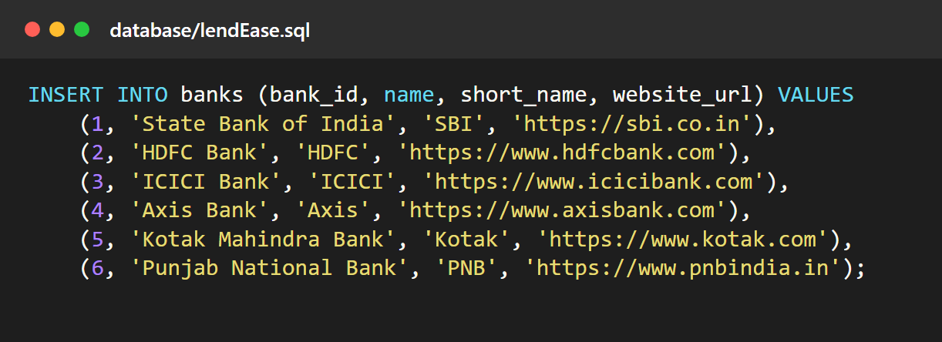
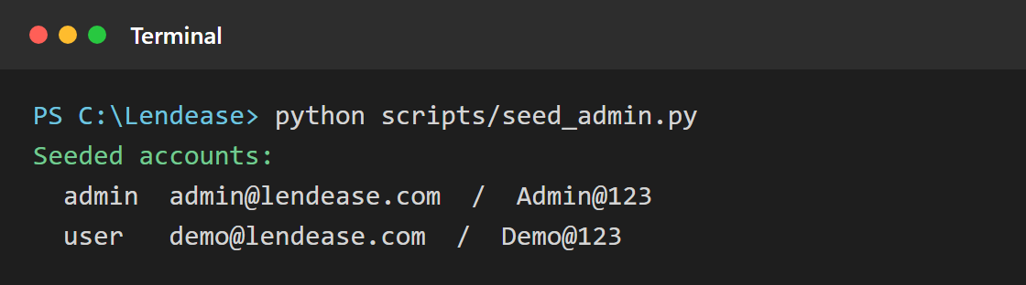
Loading the Data
1. Create the tables and insert the sample data
What gets loaded
mysql -u root -p < database/lendEase.sql
6 banks
30 loan products (6 banks x 5 loan types)
4 sample rate-history rows
2 accounts: one admin, one normal user
2. Create the demo logins
Example queries included
The same file ends with a commented query library: JOIN, GROUP BY, INSERT, UPDATE and DELETE examples that can be run in MySQL.
Passwords are hashed by the script, never typed into the SQL file.

Slide 12
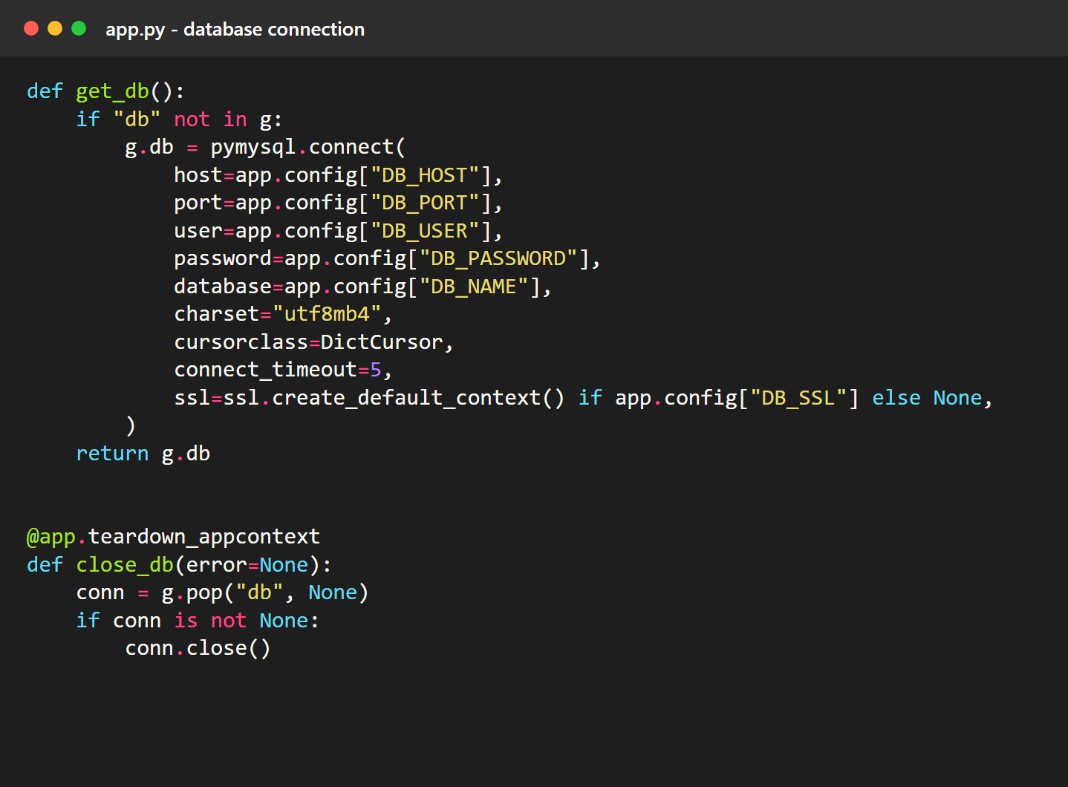
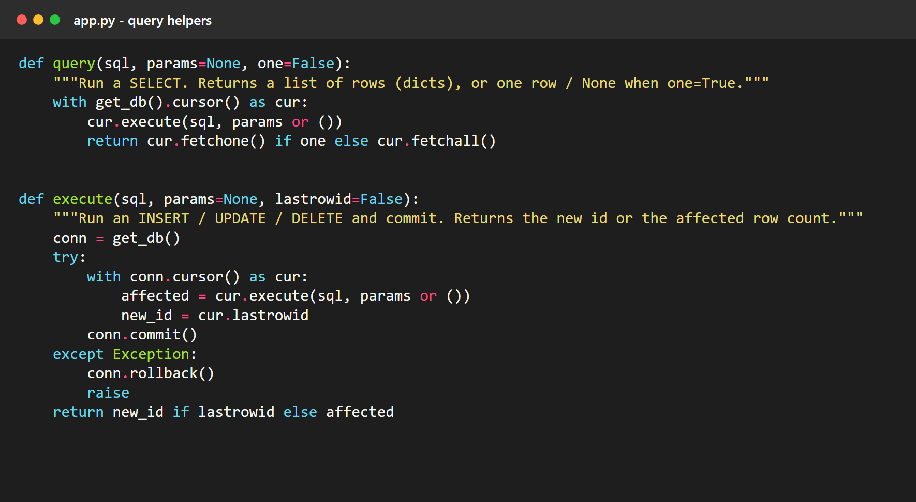
Connecting Flask to MySQL
get_db(): opens one database connection per web request and reuses it for that request.
query(): runs a SELECT and returns the rows as Python dictionaries.
execute(): runs INSERT, UPDATE or DELETE, commits on success and rolls back on error.

Slide 13
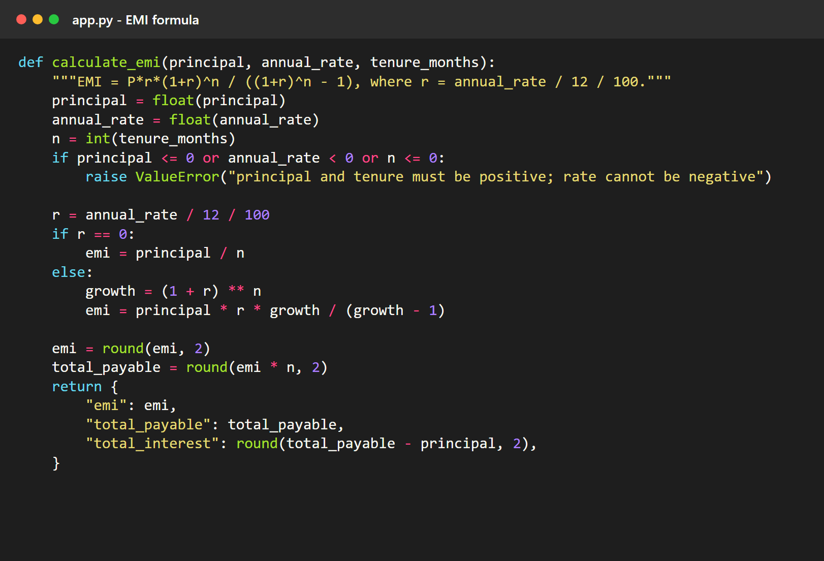
EMI Calculation
EMI = P x r x (1 + r)^n / ((1 + r)^n - 1)
P: loan amount (principal)
r: monthly interest rate = yearly rate / 12 / 100
n: number of monthly instalments
Worked example
Loan of Rs 30,00,000 at 8.5% for 20 years
r = 8.5 / 12 / 100 = 0.0070833, n = 240
EMI: Rs 26,035 a month
Total repaid: Rs 62,48,328
Total interest: Rs 32,48,328

Slide 14
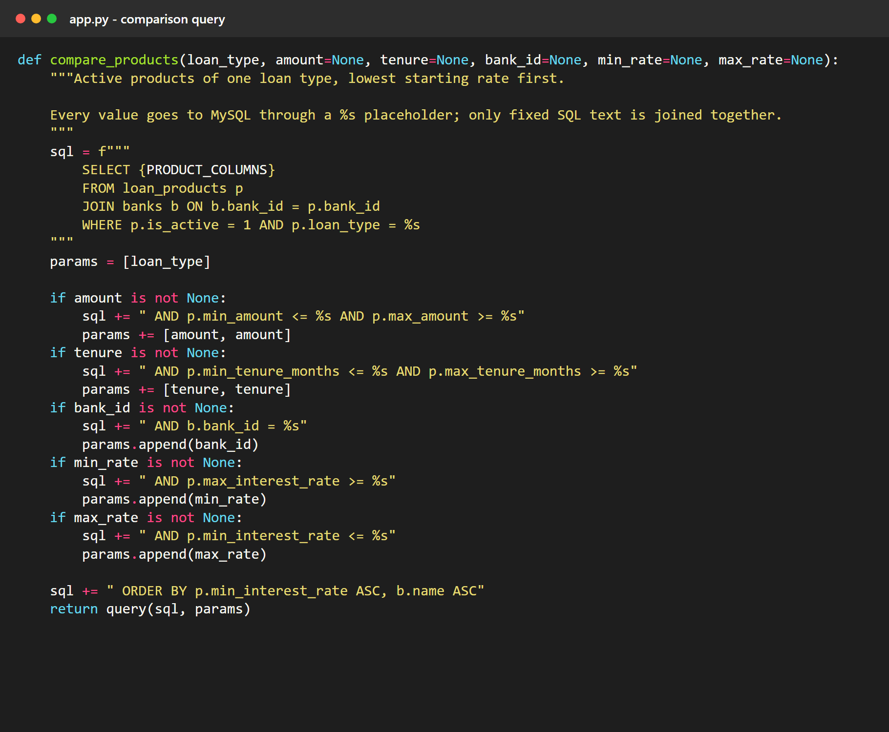
Loan Comparison Query
JOIN: loan_products is joined with banks to get the bank name for each product.
Optional filters: amount, tenure, bank and rate conditions are added only when the user fills them in.
Parameterized SQL: every value is sent through a %s placeholder, which prevents SQL injection.
ORDER BY: the lowest starting rate comes first.
Reused: the same function serves the compare page and the JSON API.

Slide 15
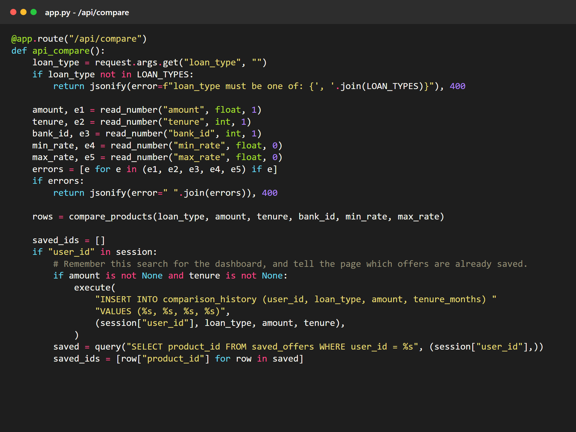
Compare API
1
Browser sends the filters to /api/compare
2
Flask checks the inputs (bad input gets a 400 error)
3
MySQL returns the matching products
4
Flask replies with JSON
5
script.js draws the result cards
For logged-in users
The search is also saved to comparison_history.

Slide 16
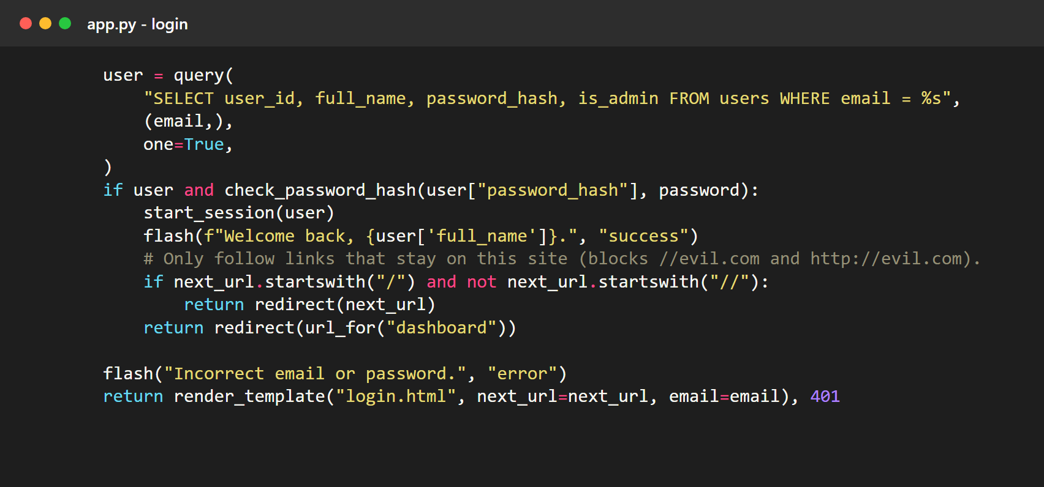
User Accounts and Passwords
Register: the password is hashed with generate_password_hash before it is stored.
Unique email: the database rejects a second account with the same email, and the page shows a clear message.
Login: check_password_hash compares the typed password with the stored hash.
Session: after login, Flask keeps the user id in a signed session cookie.
Safe redirect: after login the site only follows links that stay on LendEase.

Slide 17
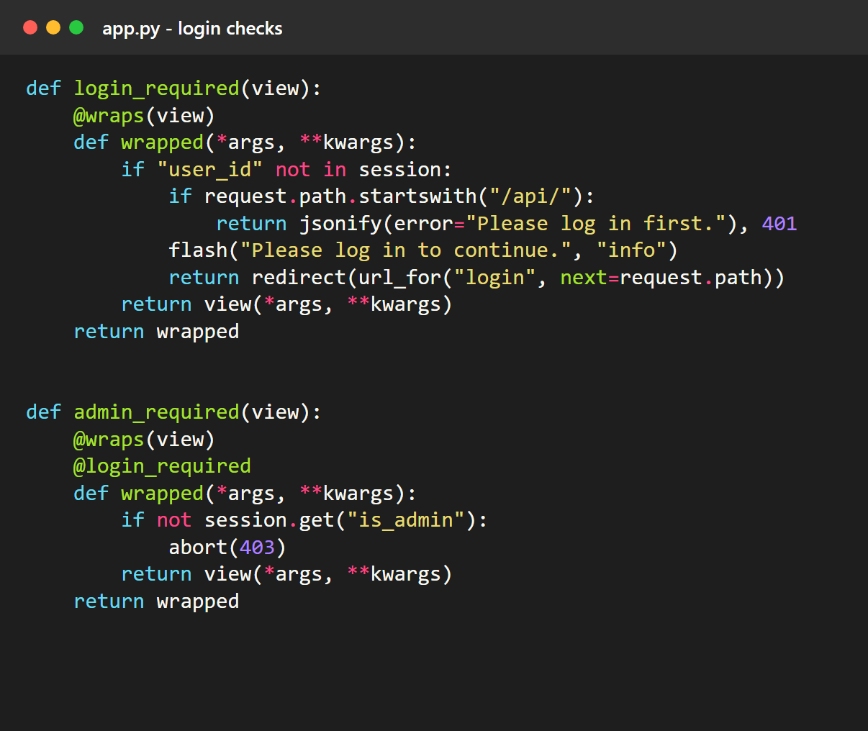
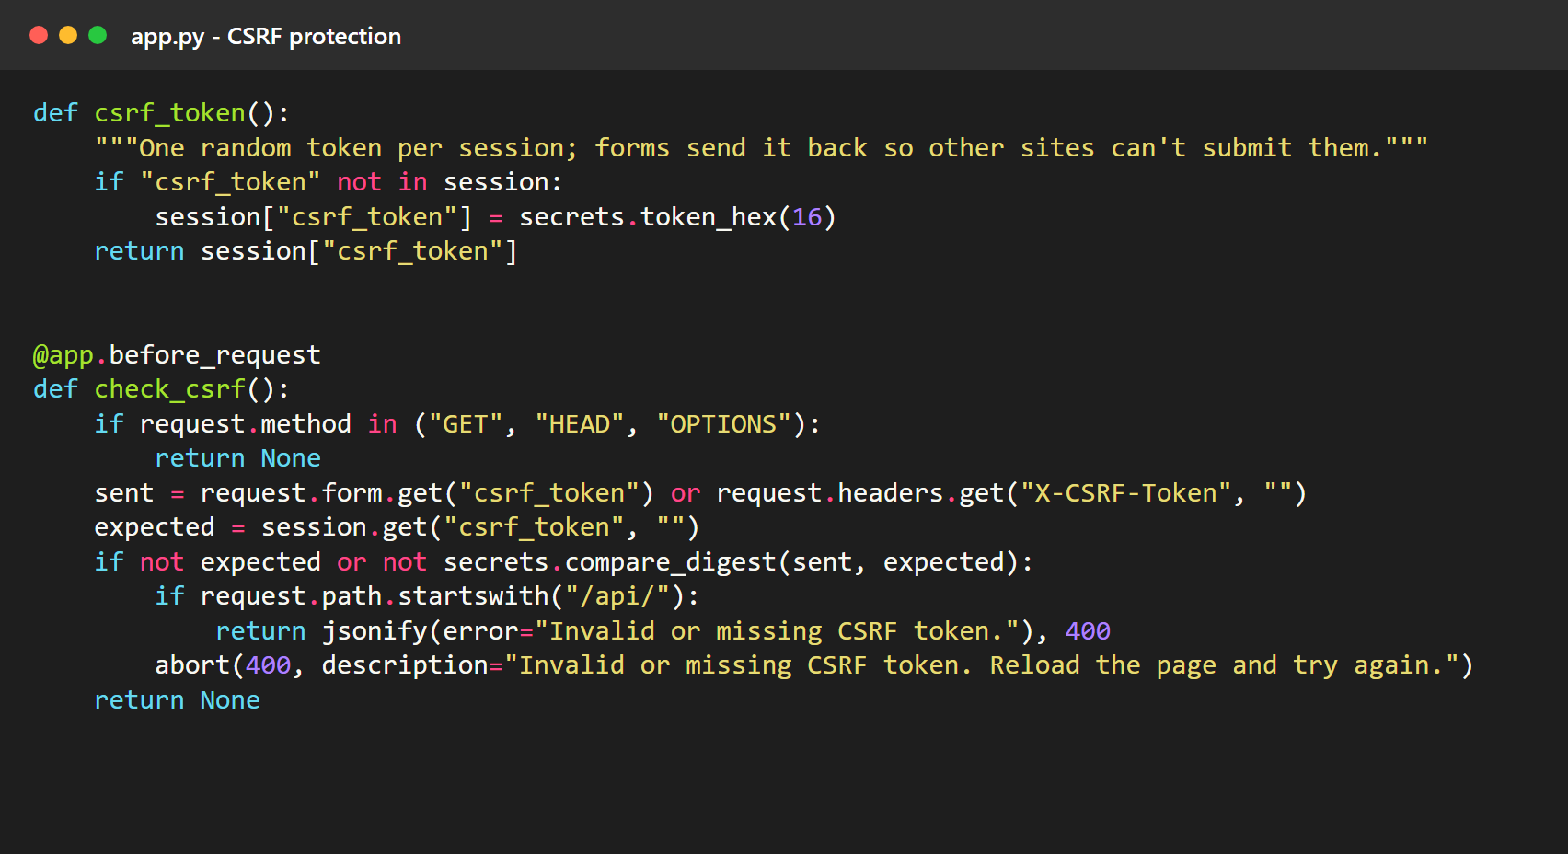
Access Control and Form Protection
login_required: pages such as the dashboard send visitors to the login page first.
admin_required: the admin panel returns 403 Access denied for normal users.
CSRF token: every form carries a secret token, so another website cannot submit forms on a user's behalf.

Slide 18
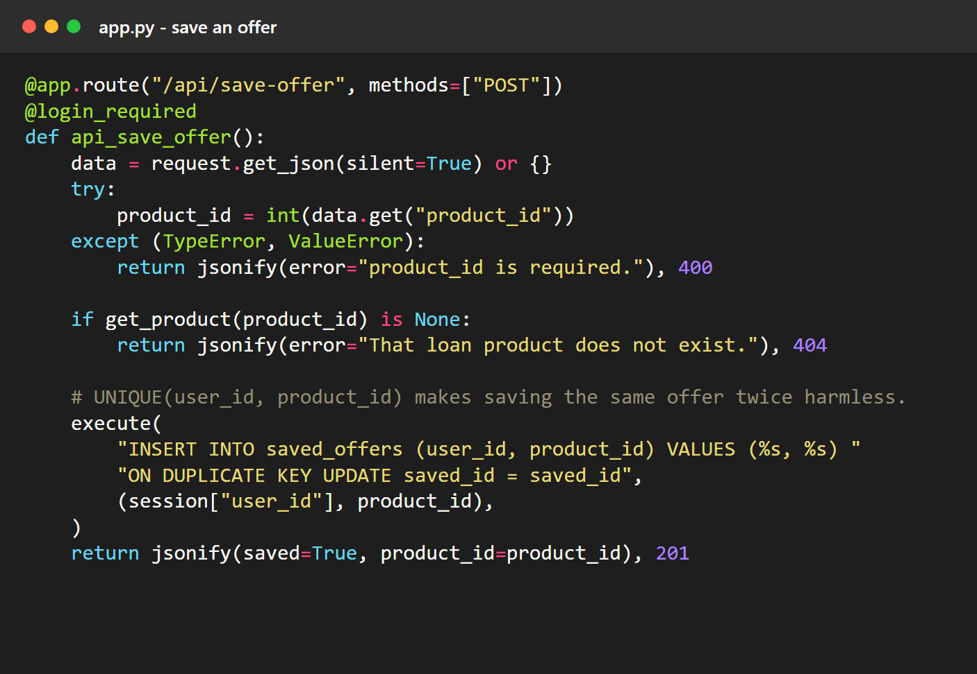
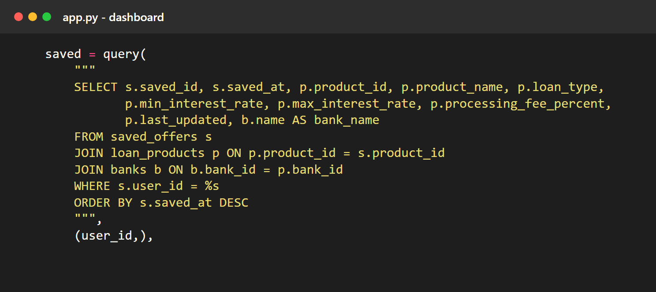
Saved Offers and Dashboard
Save: an INSERT into saved_offers. UNIQUE (user_id, product_id) makes saving the same offer twice harmless.
Dashboard: a three-table JOIN (saved_offers, loan_products, banks) lists the user's saved offers.
History: each search is stored, and Run again repeats it against the current rates.

Slide 19
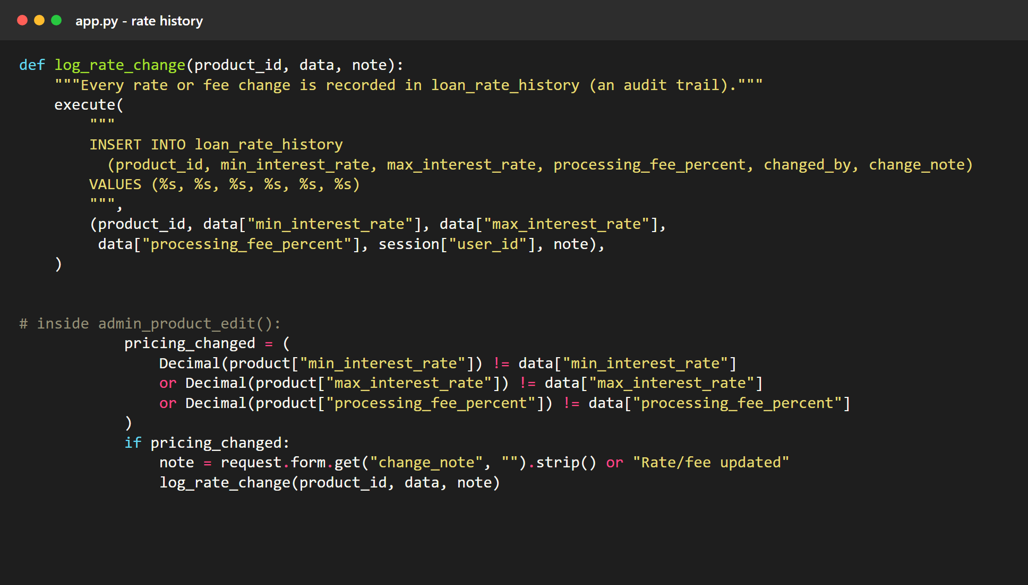
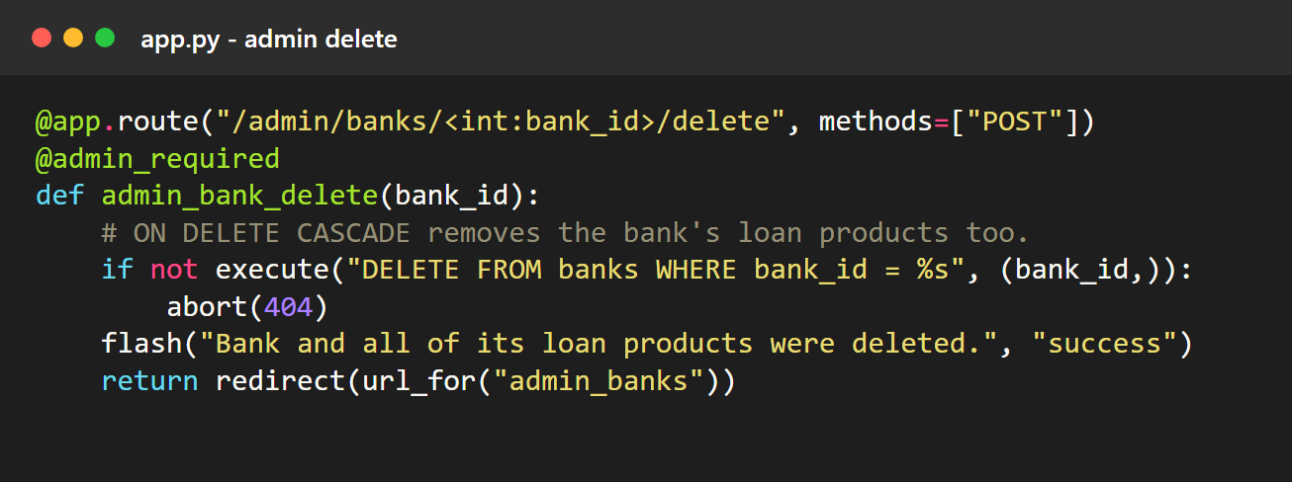
Admin Panel: CRUD and Rate History
Create, Read, Update, Delete: admins manage banks and loan products through forms.
Validation: the form rejects a minimum above the maximum and a missing source URL.
Audit trail: when a rate or fee changes, a row is added to loan_rate_history with who changed it and why.
Cascade: deleting a bank also deletes its loan products.

Slide 20
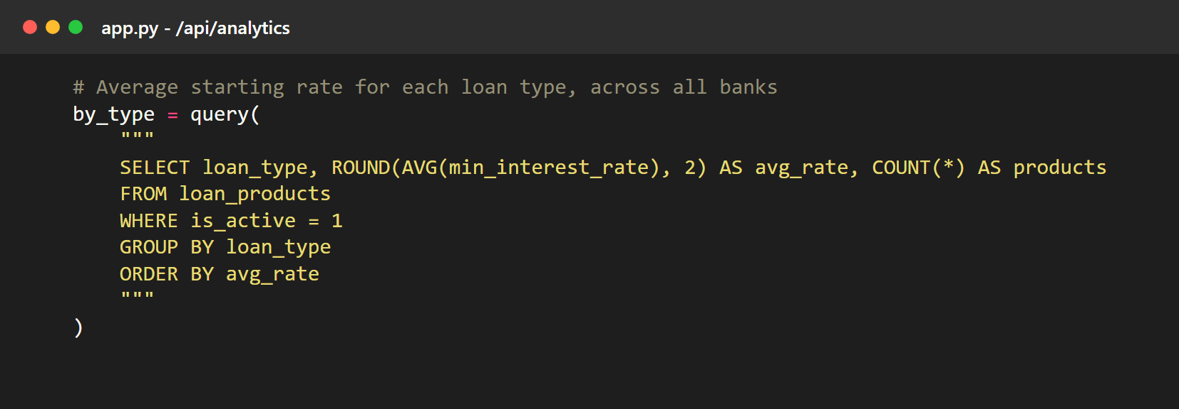
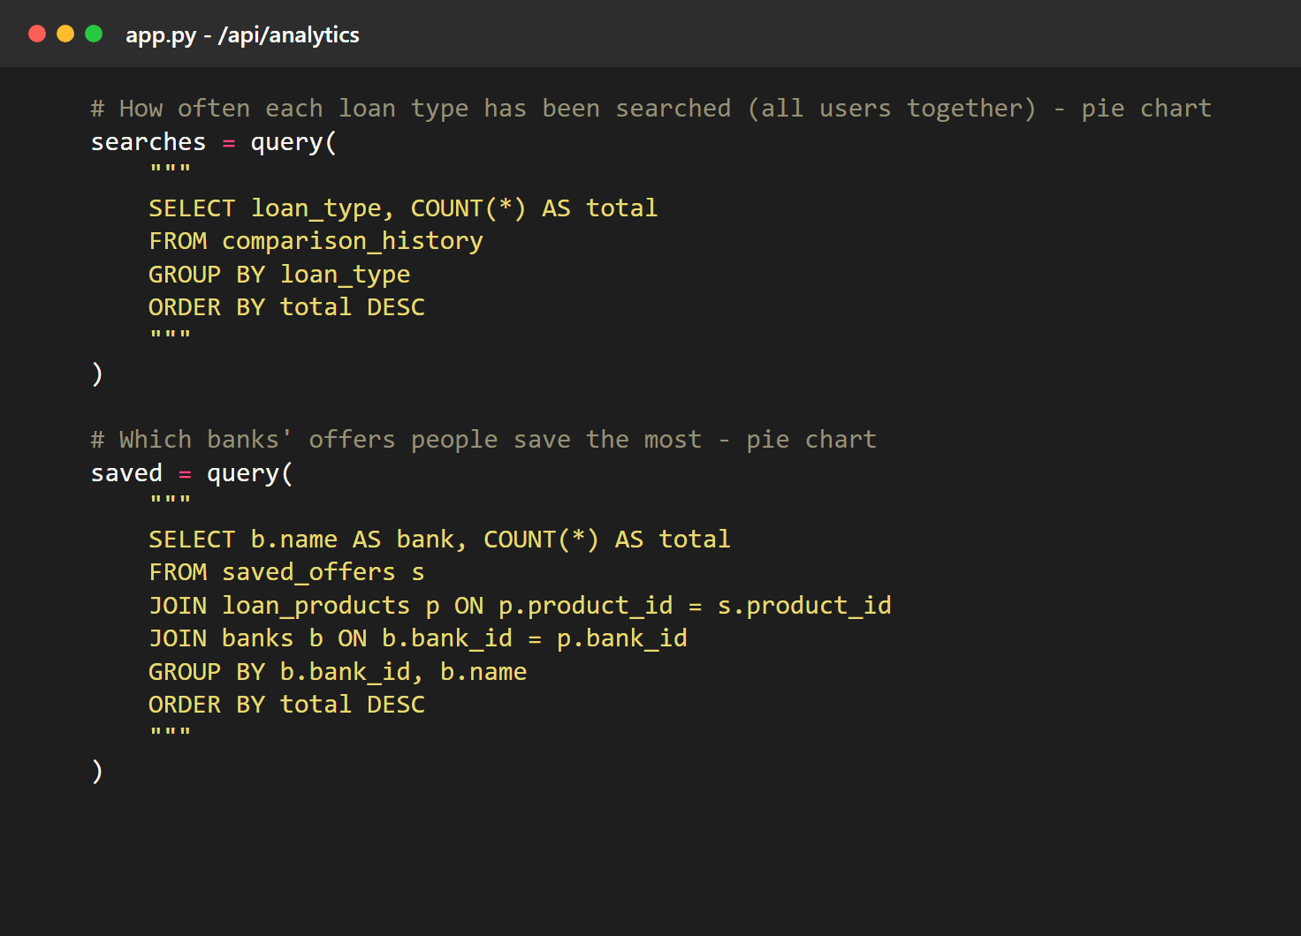
Data Analysis with SQL
The Analytics page is built on aggregate queries. GROUP BY puts rows into groups, and AVG and COUNT summarise each group.
AVG by loan type: average starting rate of each kind of loan.
COUNT by loan type: which loans users search for most.
COUNT by bank: which banks' offers users save most.

Slide 21
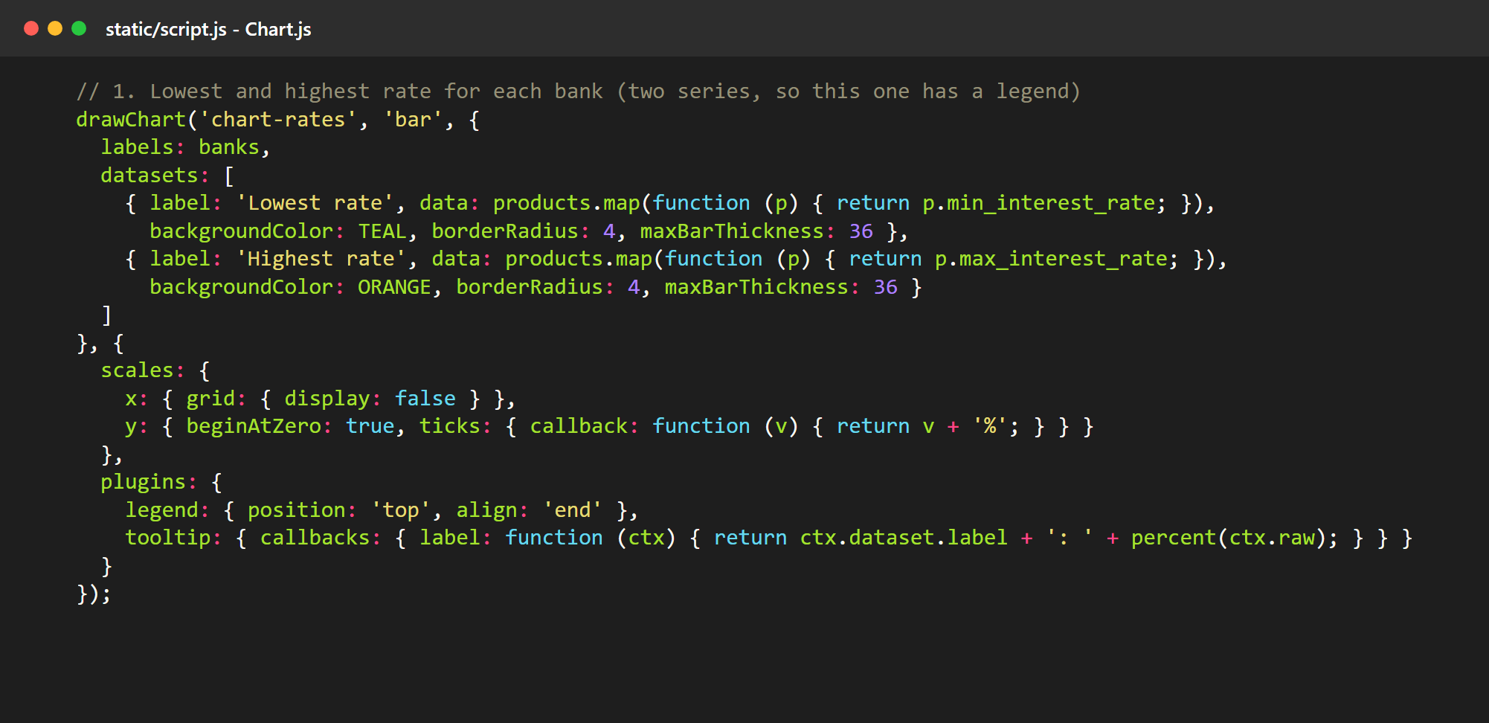
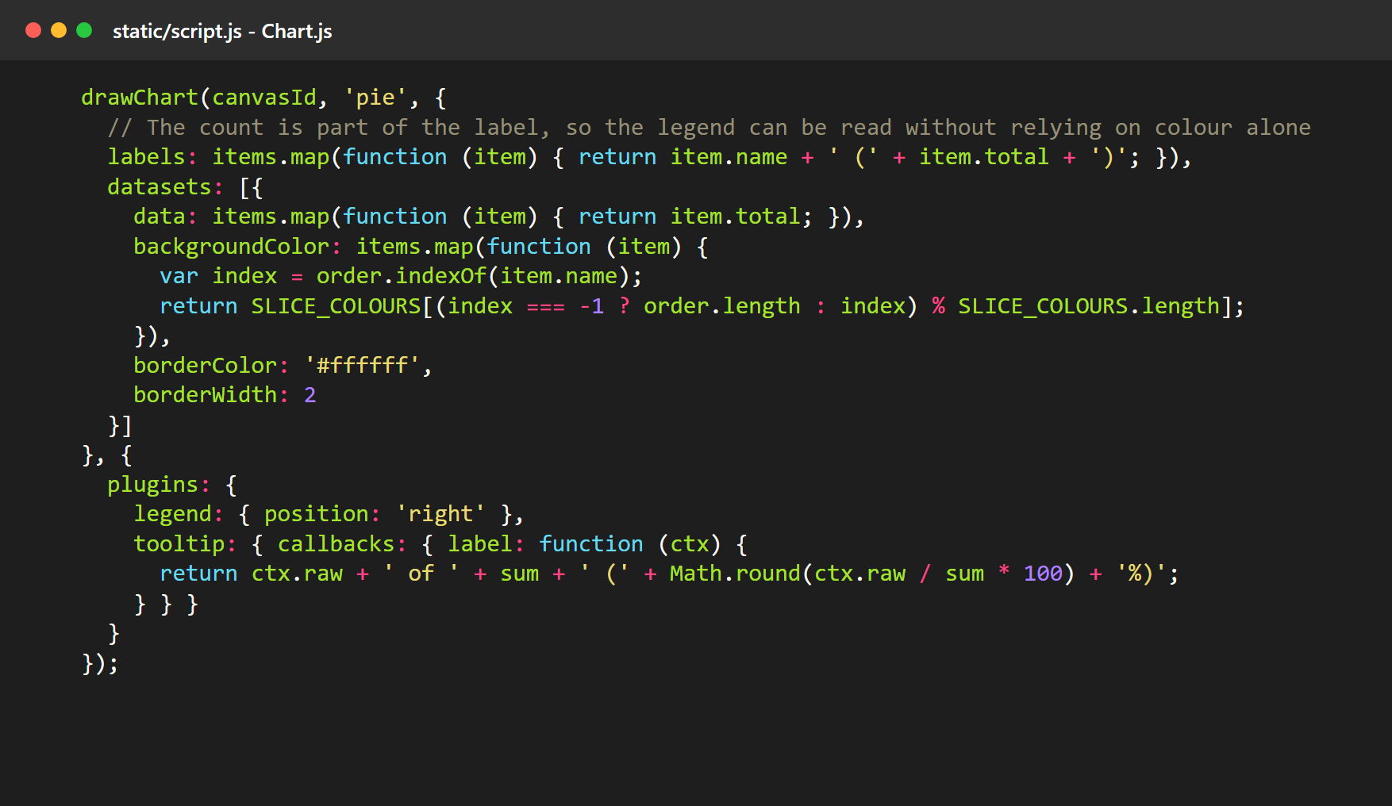
Drawing Graphs and Pie Charts
Ten charts on one page
Bar charts: rate range, monthly EMI, processing fee, average rate by loan type and by bank
Line graphs: how EMI and total interest change with tenure
Pie charts: principal against interest, most searched loan types, saved offers by bank

Slide 22
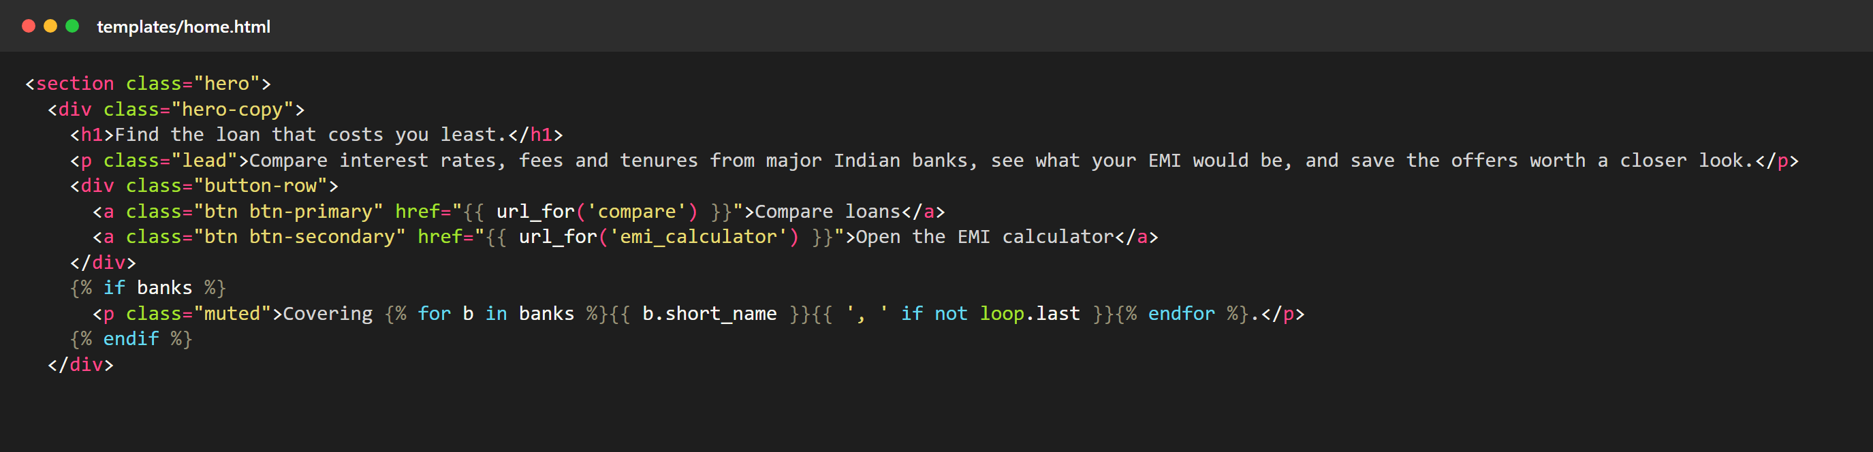
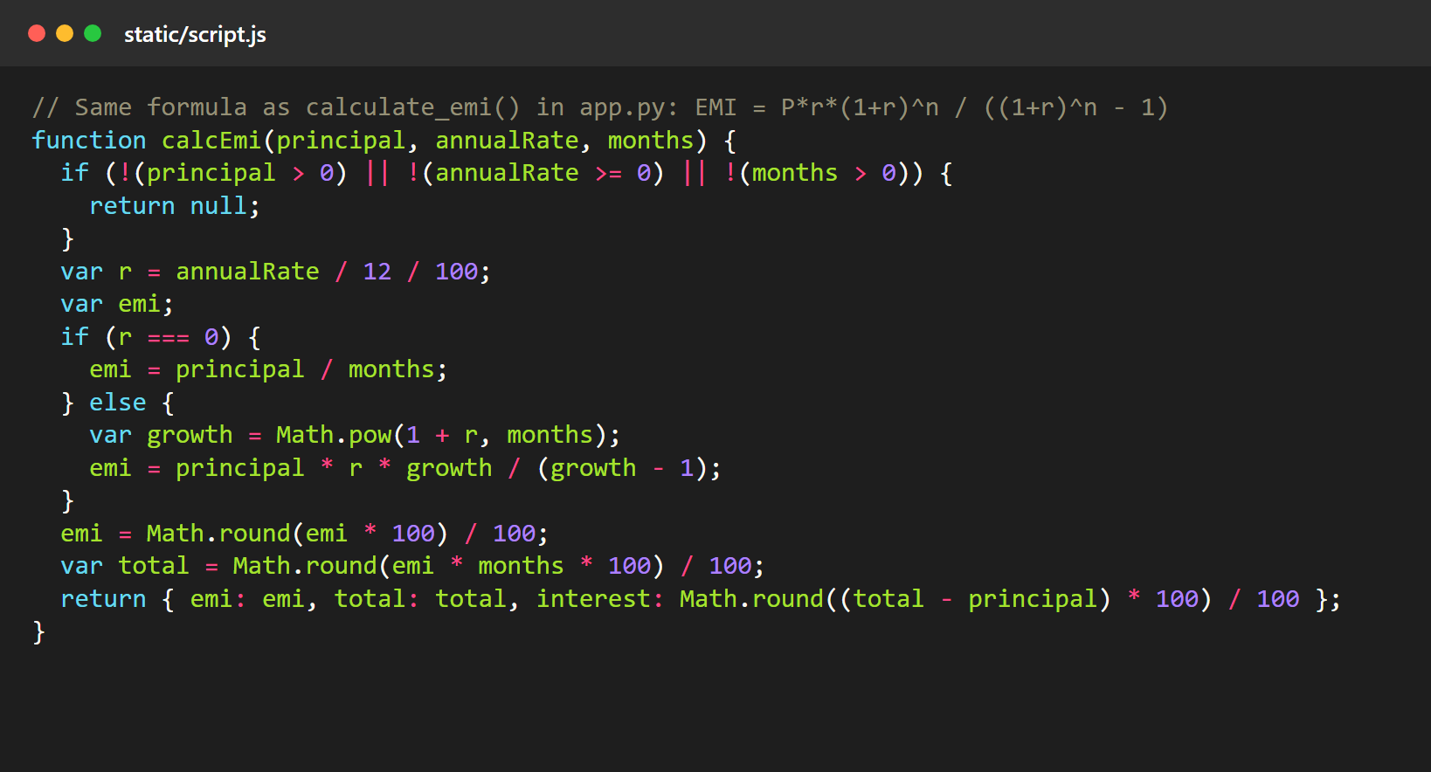
Design Using HTML, CSS and JavaScript
HTML: Jinja templates (top) fill each page with data sent by Flask.
CSS: one stylesheet, static/style.css, holds the shared colours, buttons and layouts.
JavaScript: the same EMI formula runs in the browser (left), so results update as you type.

Slide 23
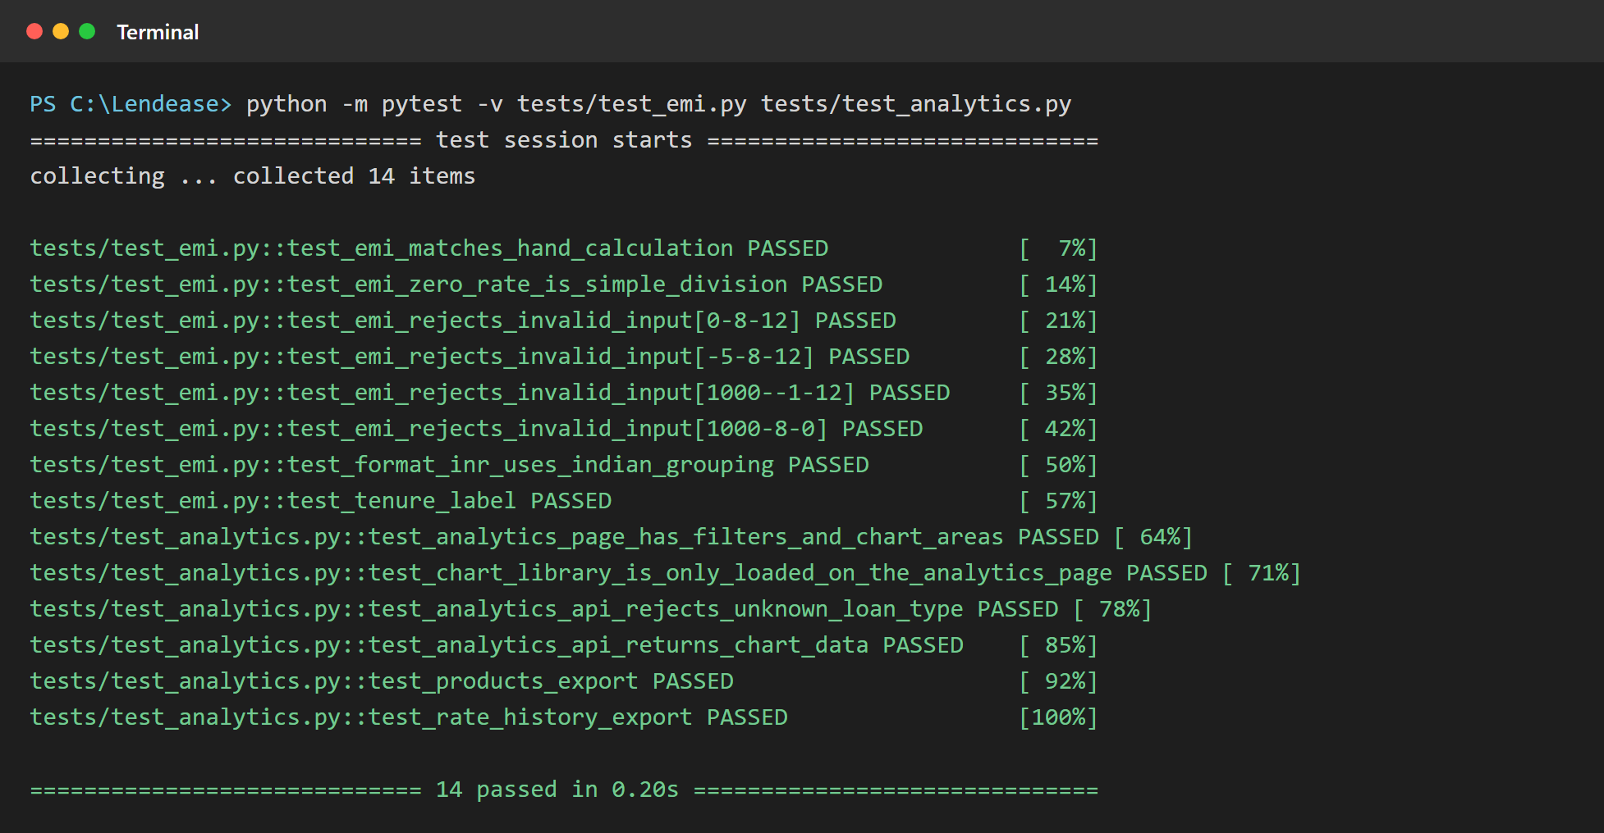
Testing
What: 48 automated tests written with pytest.
Why: they re-check the whole application in about a second after every change.
How: a fake database stands in for MySQL, so the tests run anywhere.
What is tested
EMI formula against a hand calculation
API input checks and SQL parameters
Login, wrong password, CSRF protection
Admin pages blocked for normal users
Every page opens without errors
Analytics data and CSV downloads

Slide 24
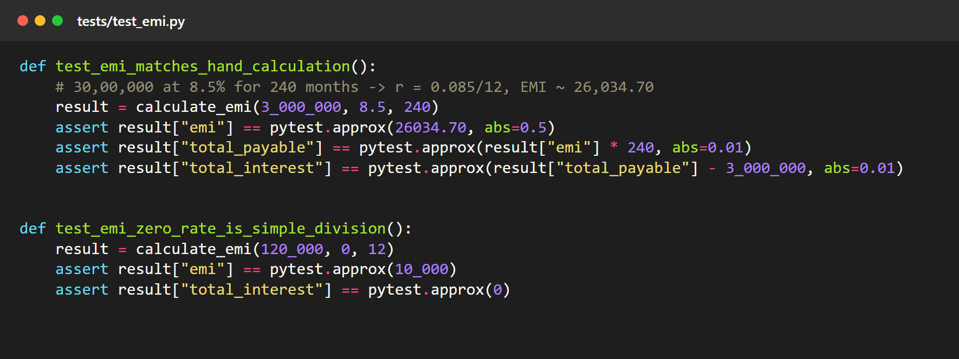
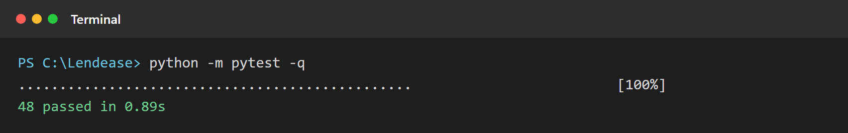
Test Results
Result
48
tests passed
0
tests failed
The first test checks the EMI formula against the value worked out by hand: Rs 26,034.70 for Rs 30 lakh at 8.5% over 240 months.

Slide 25
Deployment
User's browser
Vercel
TiDB Cloud
Opens lendease-ten.vercel.app
Runs the Flask app (app.py)
Hosted MySQL-compatible database
Hosting: Vercel finds the Flask app in app.py and serves it on a public address.
Database: Vercel does not host MySQL, so the data lives on TiDB Cloud and is reached over an encrypted (TLS) connection.
Settings: the database URL and the secret key are stored as environment variables, not in the code.
Loading the cloud database: scripts/init_db.py creates the tables, inserts the data and seeds the demo logins.

Slide 26
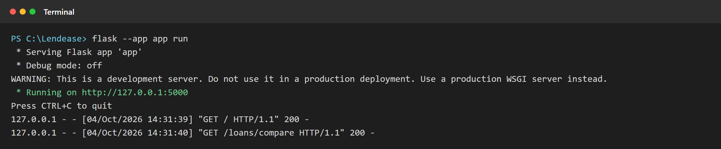
Running the Website from the Terminal
1
pip install -r requirements.txt
install Flask and PyMySQL
2
mysql -u root -p < database/lendEase.sql
create the tables and data
3
python scripts/seed_admin.py
create the demo logins
4
flask --app app run
start the website
The site then opens at http://127.0.0.1:5000. Each line at the bottom is one page request and its status code.

Slide 27
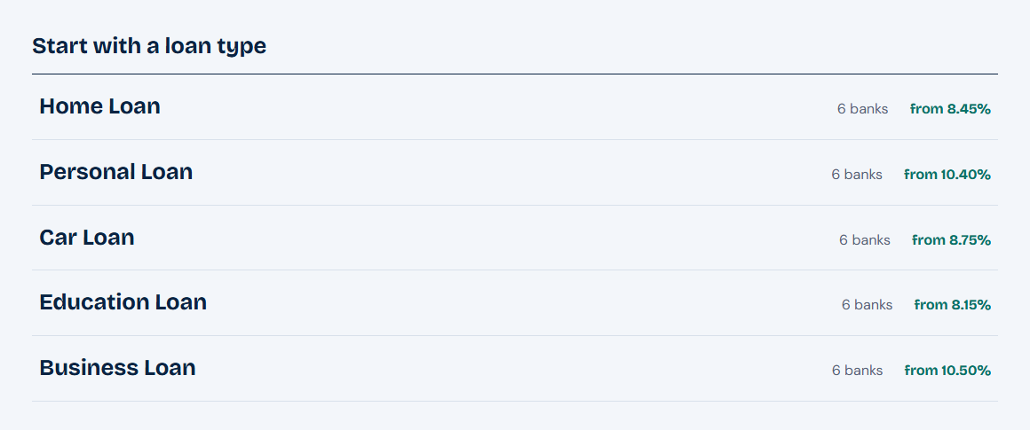
Screenshots: Home Page
On the home page
A quick EMI estimate that updates as the sliders move.
Each loan type with its lowest rate, read from the database.
Top of the home page: headline, buttons and the EMI panel.

Slide 28
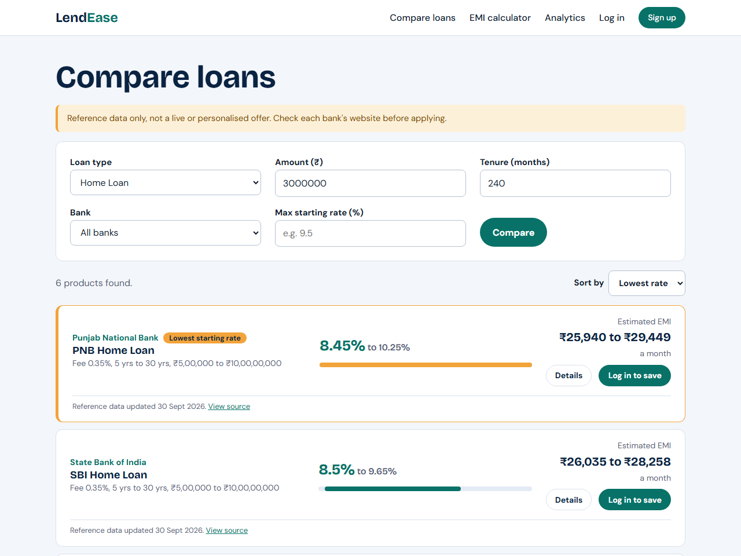
Screenshots: Compare Loans
On this page
Filters: loan type, amount, tenure, bank and maximum rate.
Results come from /api/compare without reloading the page.
Each result shows the rate range, the estimated EMI and a link to the source.
The cheapest offer is highlighted.
Results can be sorted by rate, EMI or fee.

Slide 29
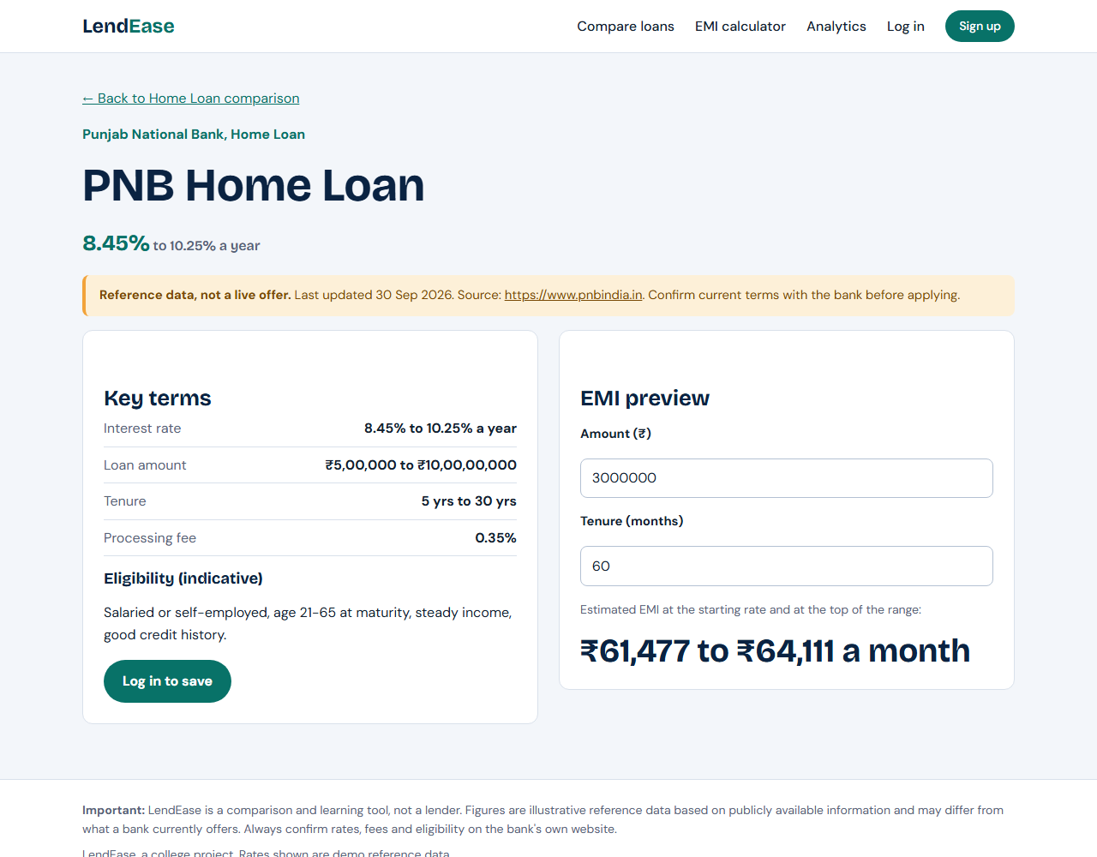
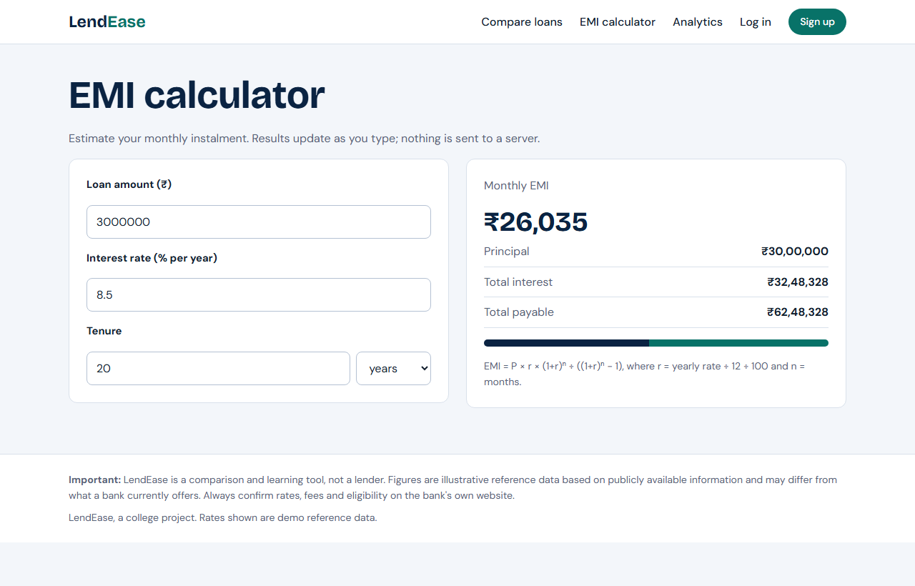
Screenshots: Loan Details and EMI Calculator
Left: one loan product with its source and last-updated date. Right: the EMI calculator page.

Slide 30
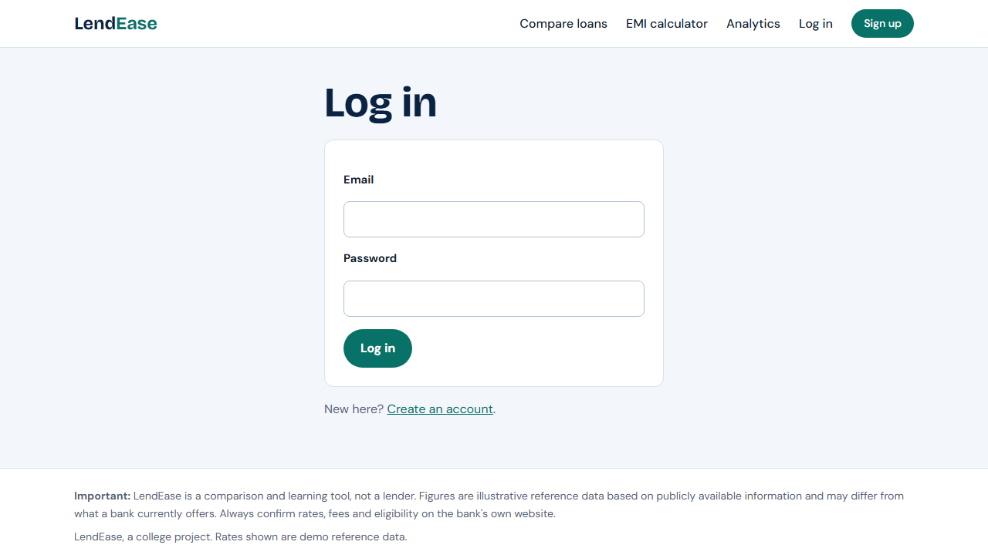
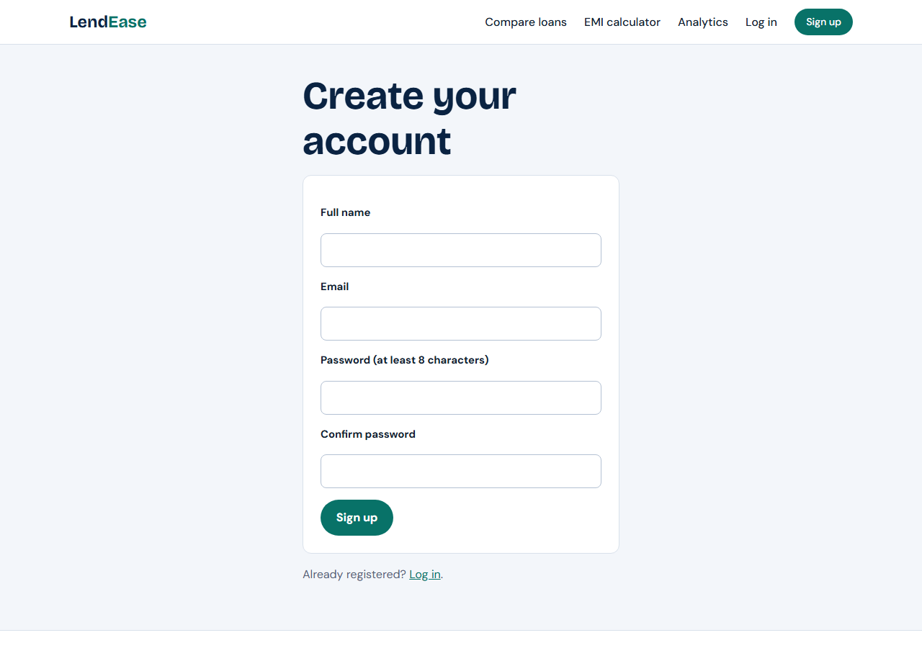
Screenshots: Login and Register
Passwords are hashed before they are stored.

Slide 31
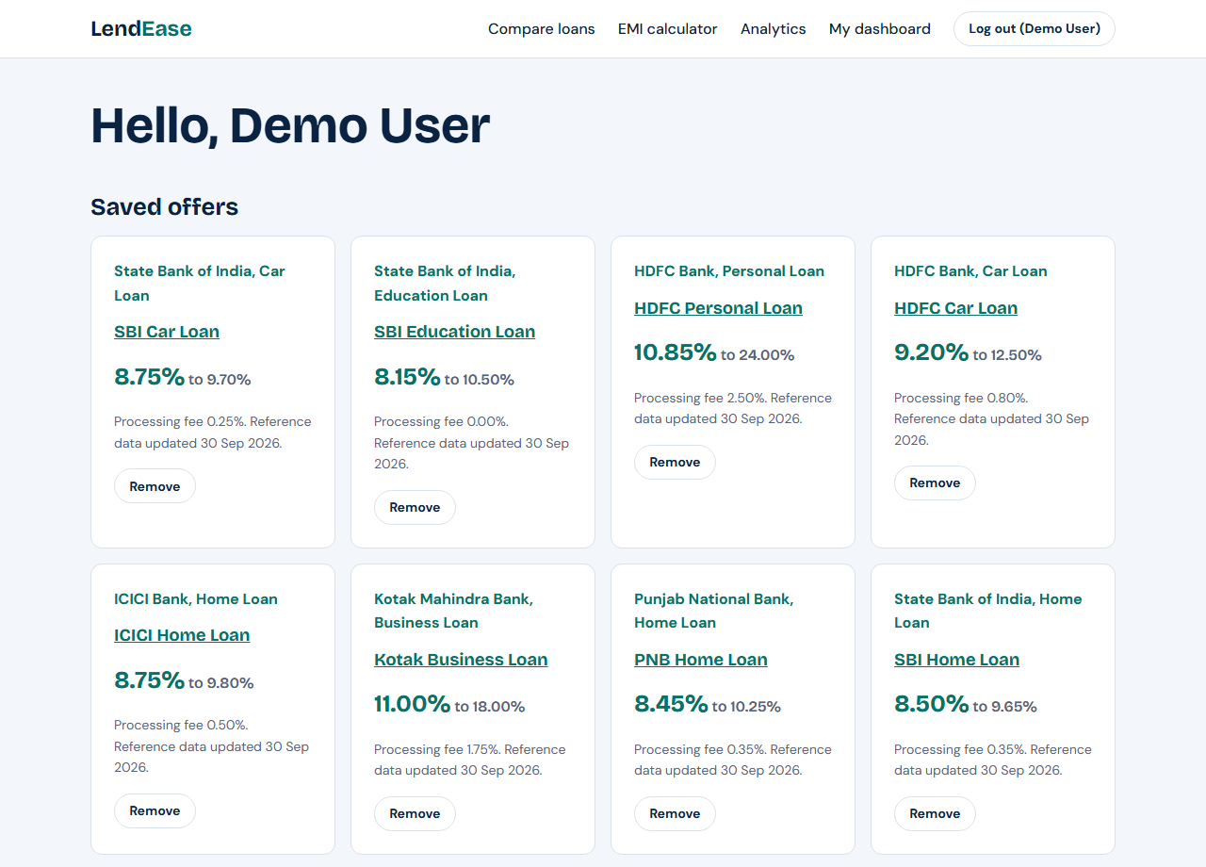
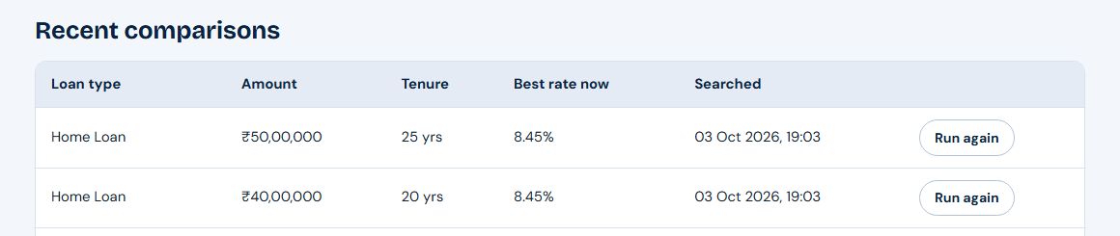
Screenshots: User Dashboard
Left: offers the user has saved. Right: recent comparisons, each with a Run again button.

Slide 32
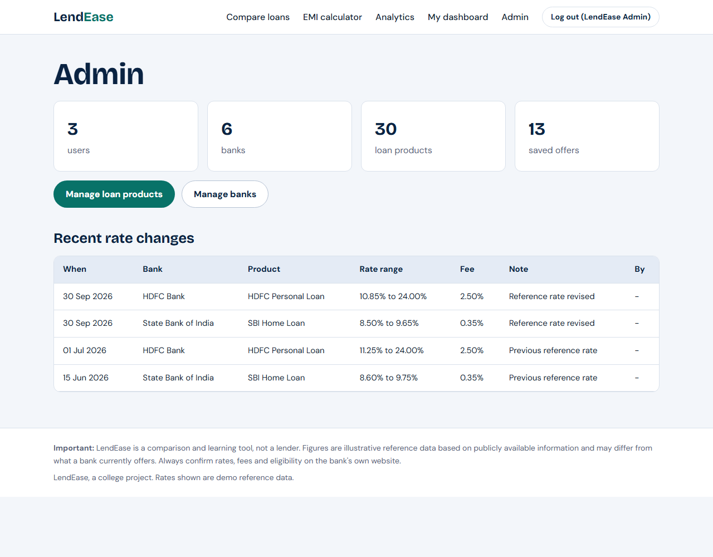
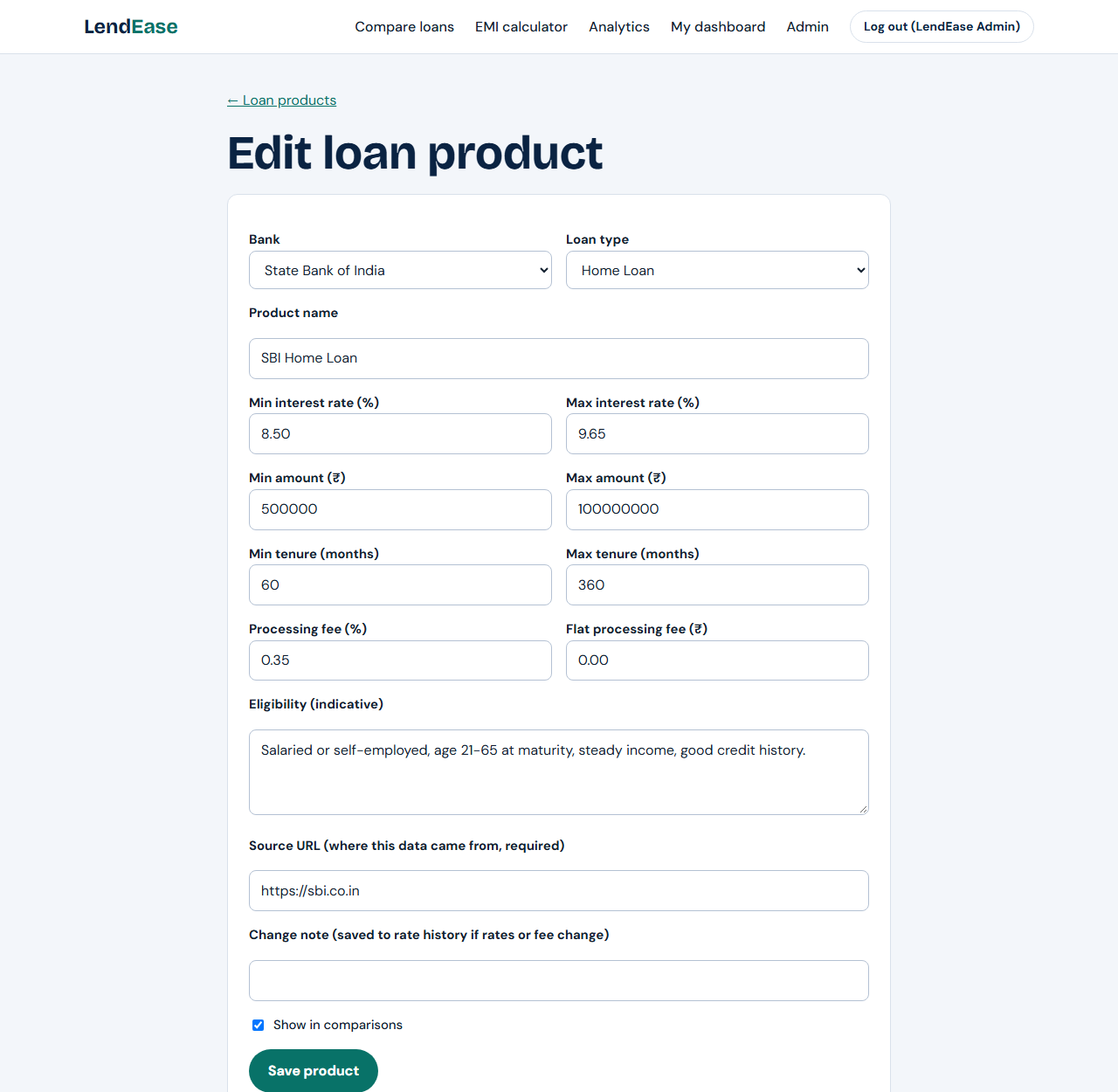
Screenshots: Admin Panel
Left: totals and the recent rate changes. Right: the form for editing a loan product.

Slide 33
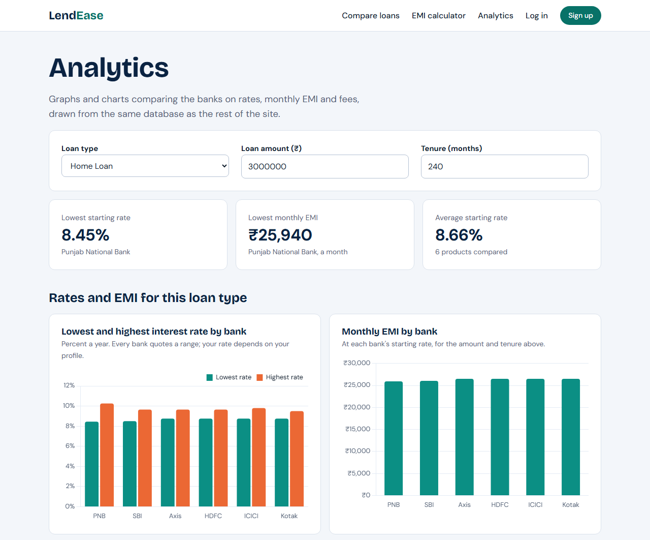
Screenshots: Analytics Page
Filters and headline numbers
Choosing a loan type, amount and tenure redraws every chart.
Three headline numbers: lowest rate, lowest EMI and average rate.
Bar chart 1: each bank's lowest and highest rate.
Bar chart 2: monthly EMI at each bank's starting rate.

Slide 34
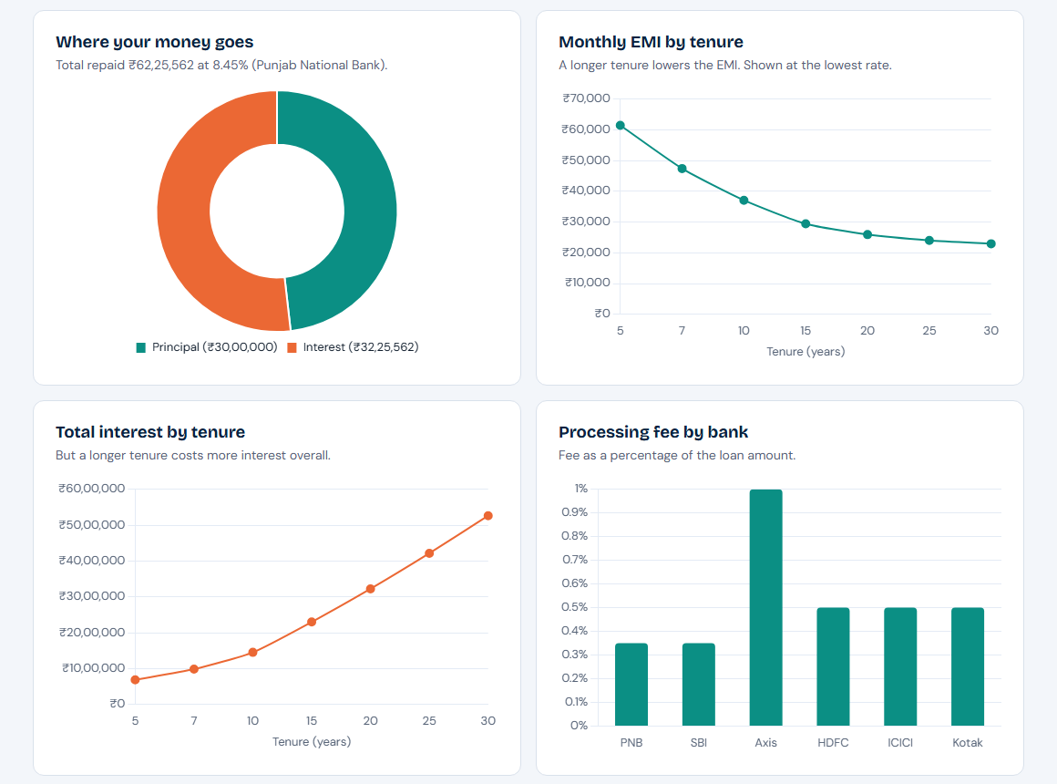
Screenshots: Analytics Graphs
What the graphs show
Pie: how the total repayment splits into principal and interest.
Line graph: a longer tenure lowers the monthly EMI.
Line graph: but a longer tenure increases the total interest paid.
Bar chart: processing fee charged by each bank.

Slide 35
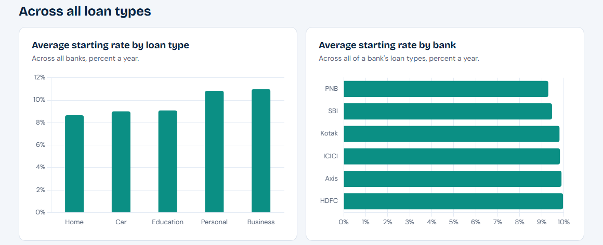
Screenshots: Analytics Average Rates
Average starting rates by loan type and by bank, each from a GROUP BY query. Home loans are the cheapest and business loans the most expensive.

Slide 36
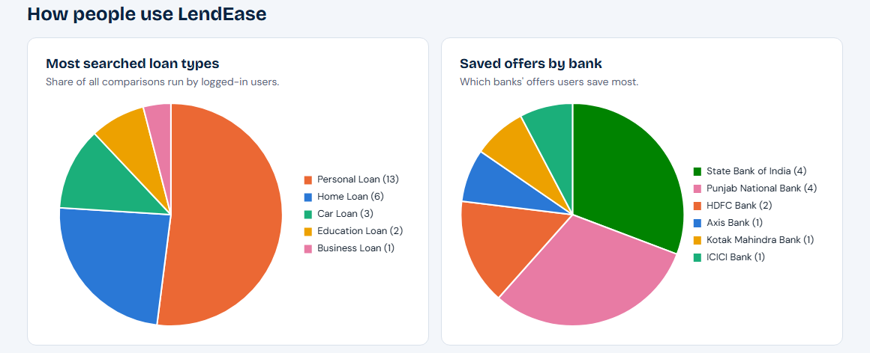
Screenshots: Analytics Pie Charts
Left: share of searches for each loan type. Right: share of saved offers for each bank. Both count rows with GROUP BY.

Slide 37
Running Website: Comparing Home Loans
1. Entering Home Loan, Rs 30,00,000 and 240 months, then clicking Compare
Result
6 products found, lowest starting rate first.
Lowest rate: Punjab National Bank, 8.45% to 10.25%
Estimated EMI: Rs 25,940 to Rs 29,449 a month
The cheapest offer is highlighted and labelled Lowest starting rate.

Slide 38
Running Website: EMI Calculator
2. Entering Rs 30,00,000 at 8.5% for 20 years in the EMI calculator
Result
Monthly EMI: Rs 26,035
Total interest: Rs 32,48,328
Total payable: Rs 62,48,328
The same figures as the hand calculation, so the formula on the website is correct.

Slide 39
Summary
6
30
10
48
database tables
loan products
graphs and pie charts
tests passed
Built: a full website with loan comparison, EMI calculator, accounts, saved offers, an admin panel and analytics.
Database: MySQL with keys, constraints, JOINs and GROUP BY, using raw parameterized SQL.
Live: hosted on Vercel with a cloud database at lendease-ten.vercel.app.
Future scope: live rates from bank APIs, an eligibility checker and email alerts when a rate changes.

Slide 40
THANK YOU
LendEase: Loan Comparison & Financial Analytics Platform

