Slide 1
Lunar Ice Watch
South Pole Candidate Ice Site Screening Dashboard
Full Stack Development Course - Mid Semester Evaluation

Slide 2
Overview
Problem: Water ice near the Moon's south pole is hard to confirm directly -
permanently shadowed regions get no sunlight, so scientists rely on indirect
signals (radar, temperature, terrain) that can each be misleading alone.
Objective: A dashboard that screens candidate sites by combining those
signals into one clear, explainable verdict per site.
Features: login, site dashboard, upload/run analysis, per-site evidence
breakdown, hazard map, and a dedicated rover traverse simulation.
Tech stack: HTML5 / CSS3 / vanilla JavaScript frontend, Node.js 'http'
static file server, client-side JSON dataset, HTML5 Canvas for map + rover.

Slide 3
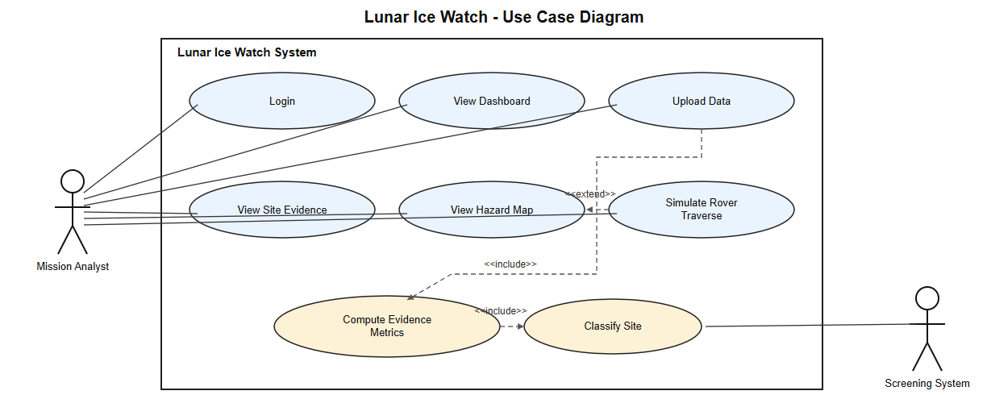
Use Case Diagram

Slide 4
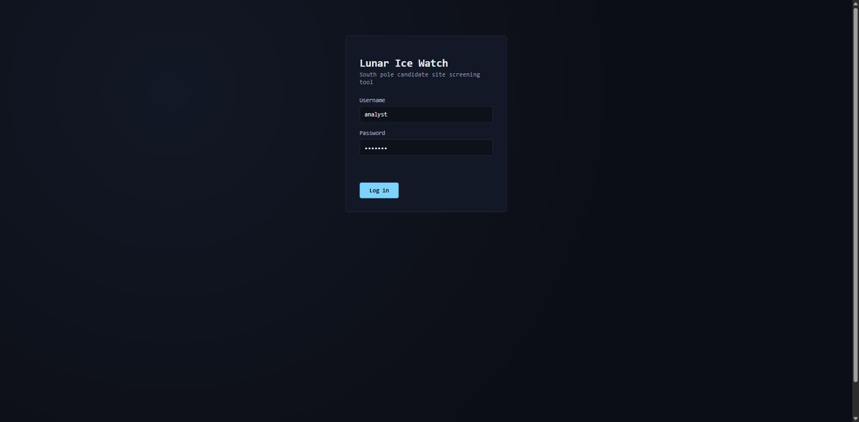
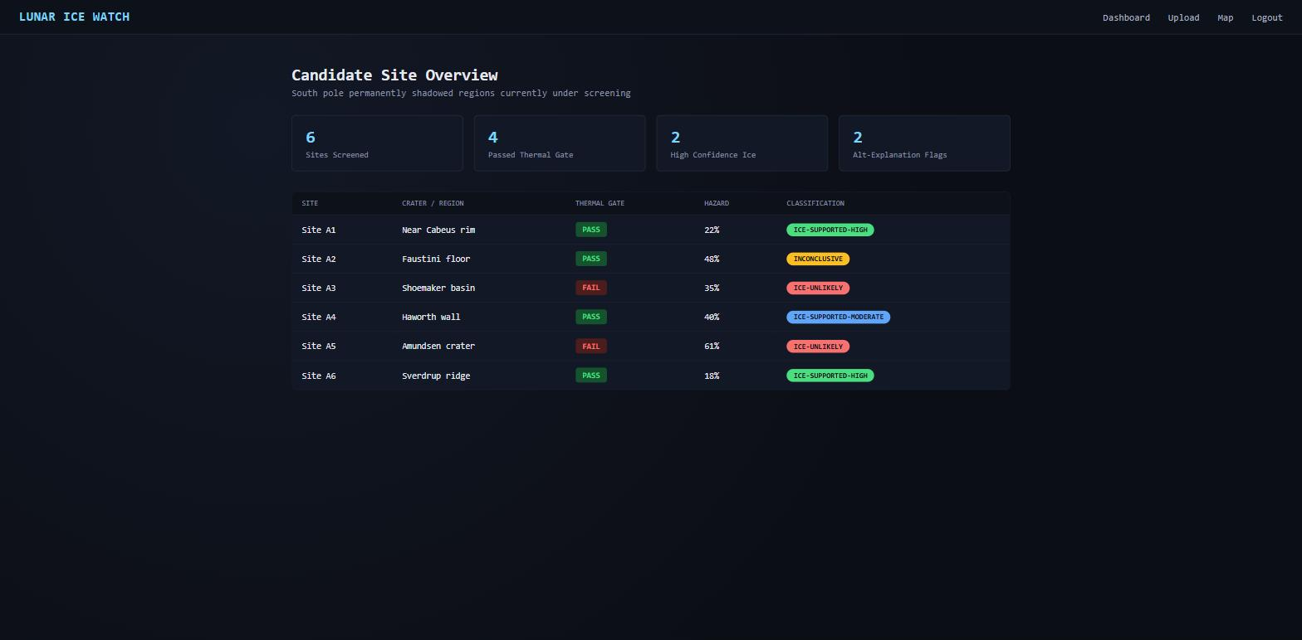
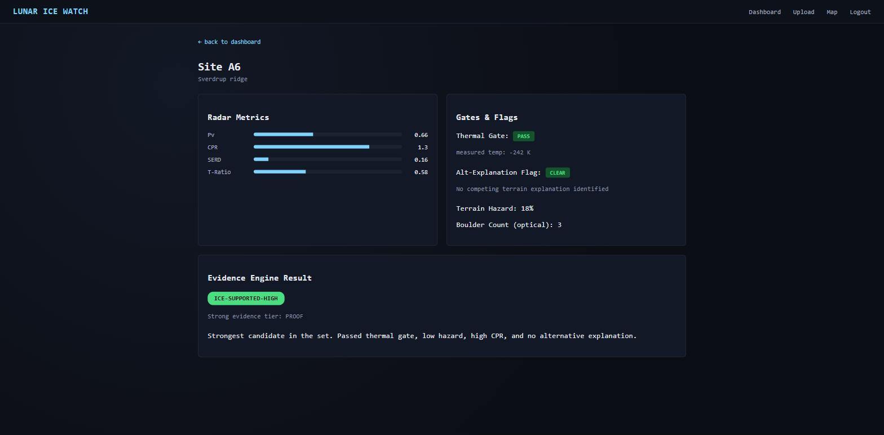
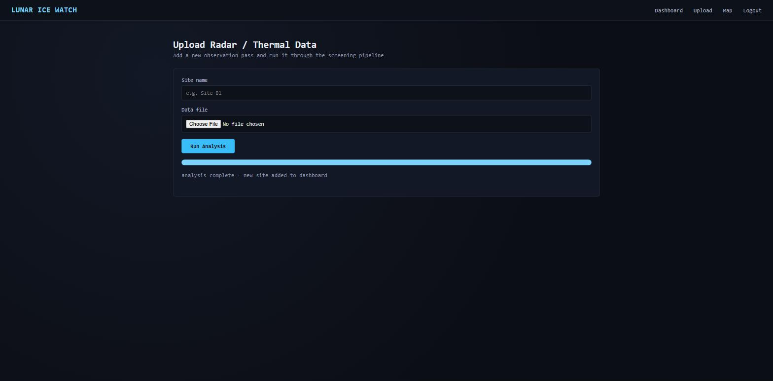
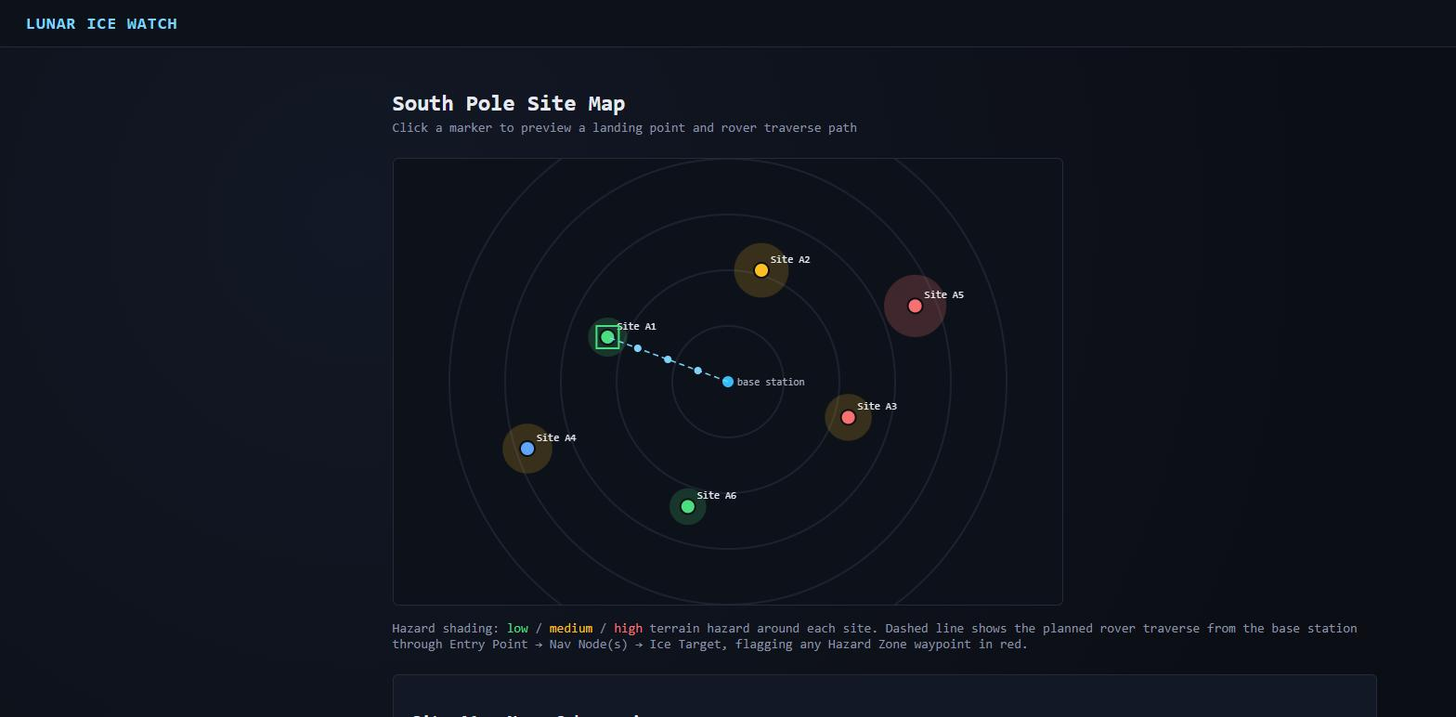
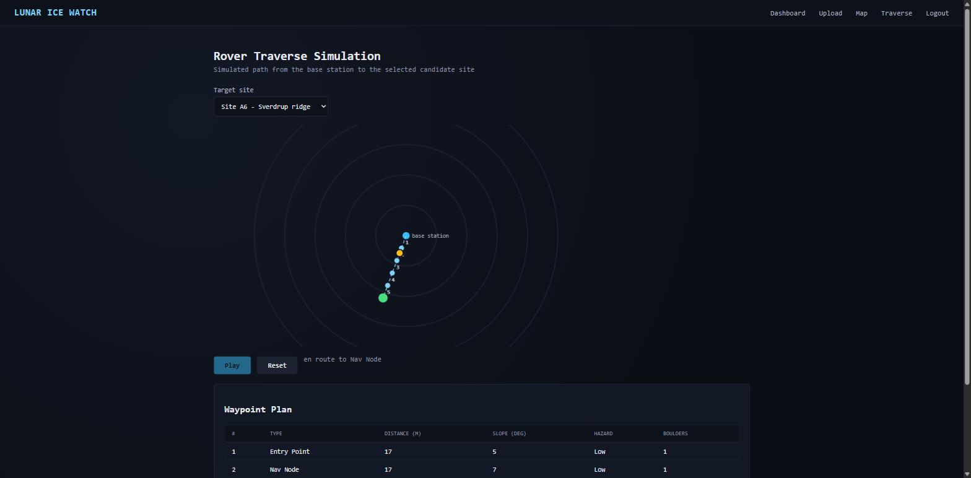
Screens
Login
Dashboard
Site Evidence
Upload / Run Analysis
Hazard Map
Rover Traverse

Slide 5
Future Scope
- Replace the mock dataset with a real backend database
- Add real user authentication and role-based access
- Persist uploaded data files and pipeline results
- Connect the evidence engine to actual scoring logic
- Add 3D terrain visualization for the hazard map
Thank You - Questions?

