Slide 1
RX Level analysis
Voltage gain 5-99dB (RF0-32dB; BB 0-62dB)
P1dB=-37dBm @RFATT0dB
100ohm impedance
Noise floor ca. -109dBm-48dB=-157dBm
1V fullscale
Wimax TRX
MAX2837
DAC/ADC
MAX5864
For Highpass 0.3-3.3 Ghz
(measured frequency=2.6-6 GHz)
For Lowpass 2,3-0,3 Ghz
(measured frequency=0-2.4 GHz)
2.3-2.7 GHz
2.3-2.7 GHz
Pmin=-89dBm for fullscale
Pmax=5 dBm for fullscale
0.02-2.6 GHz
0.001-6 GHz
2.3-2.7 GHz
0.02-6 GHz
Lowpass
LP0603A
1880ANTR
RFSwitch
SKY13317
-373LF
RFSwitch
SKY13317
-373LF
Mixer
LTC5510
RFSwitch
SKY13317
-373LF
RFSwitch
SKY13317
-373LF
2.4-6 GHz
1.5 dB conversion gain
DEA16
2400HT
-8004B1
Pmin=-109.1dBm for fullscale
Pmax=-15.1 dBm for fullscale
18.6 dB
0.02-6 GHz
LNA
MAX2616
0.02-6 GHz
Pmin=-90.5dBm for fullscale
Pmax=3.5 dBm for fullscale
Bypass 2.3-2.7 Ghz
(measured frequency=2.3-2.7 GHz)
RFSwitch
SKY13317
-373LF
0.02-6 GHz
0.02-6 GHz
RFSwitch
SKY13317
-373LF
0.02-6 GHz
0.02-6 GHz
LNA
MAX2616
0.02-6 GHz
0.02-6 GHz

Slide 2
Current consumtion
mA V
Mixer 105 3.3/5
LNA 2x81 3-5.5
Tranceiver RX110 TX170 2.7-3.6
ADC 14 1.8-3.3
LPC4300 100 3.3
Switch - 3.3/5
SUMRX 410mA
SUMTX 470mA

Slide 3
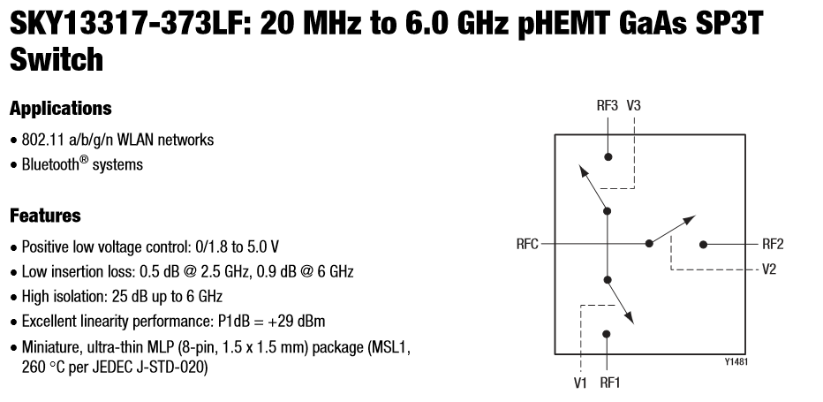
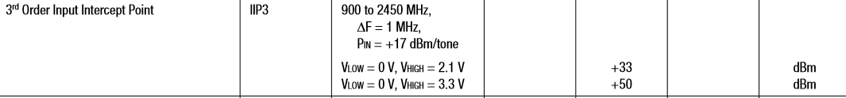
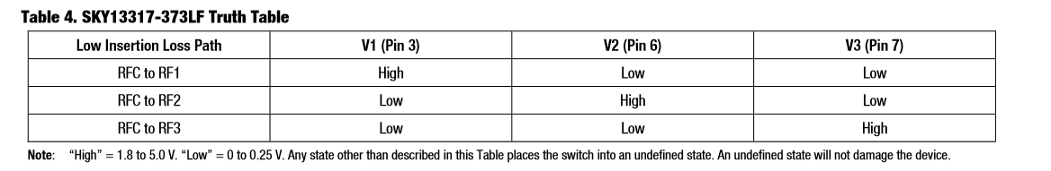

Slide 4
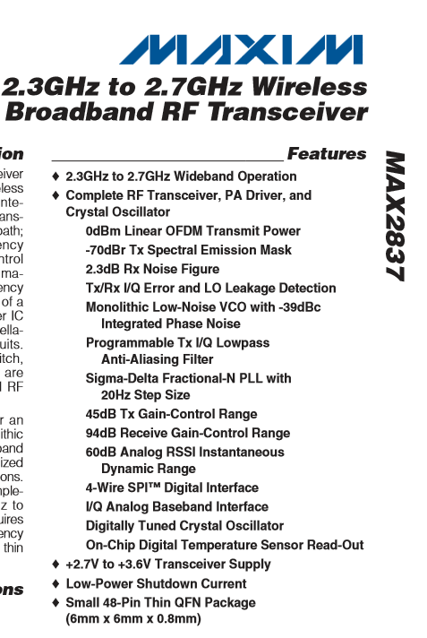

Slide 5
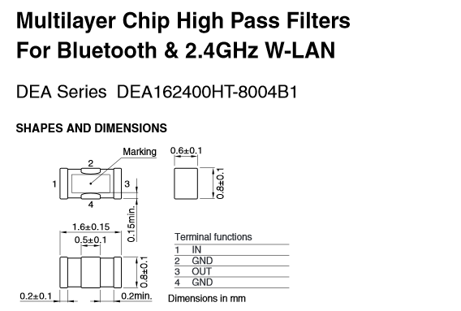
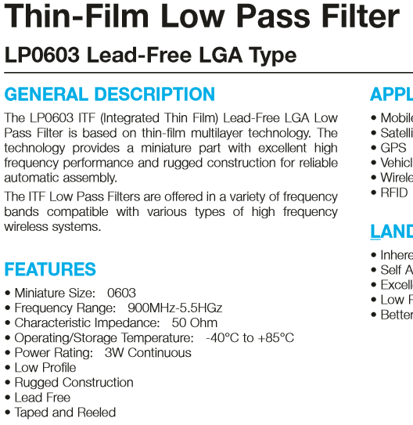
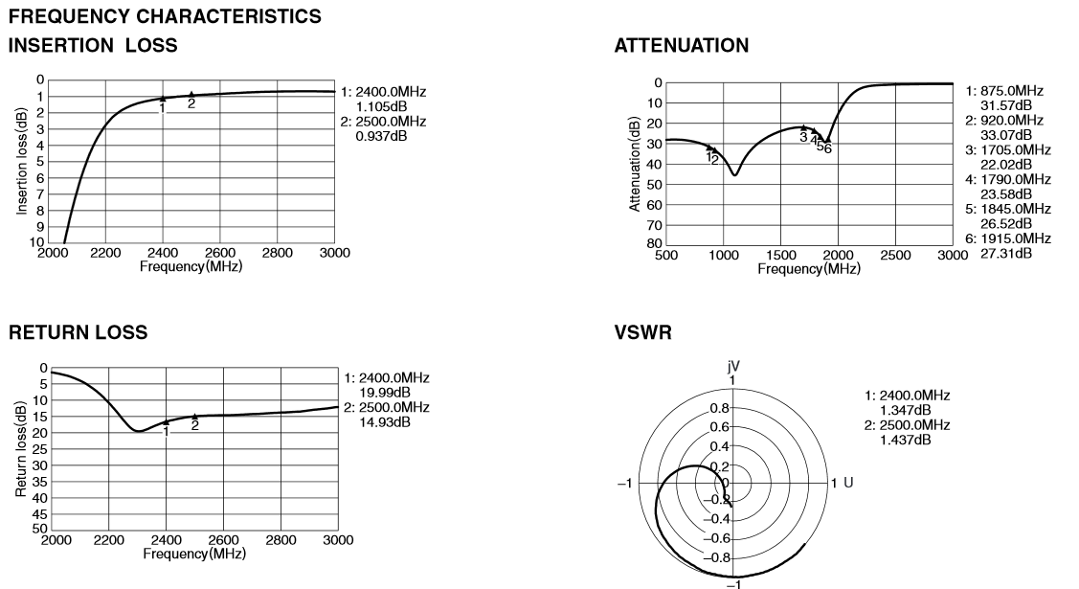
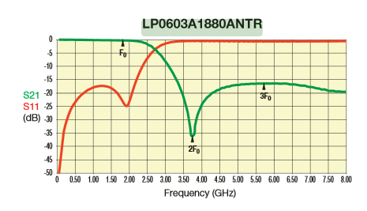
Lowpass
Highpass

Slide 6

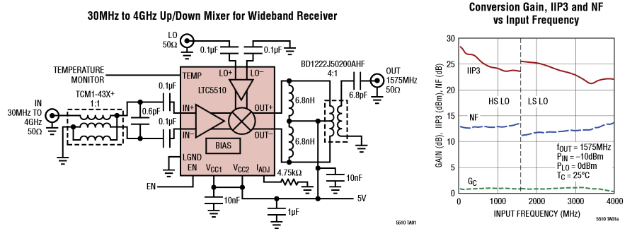
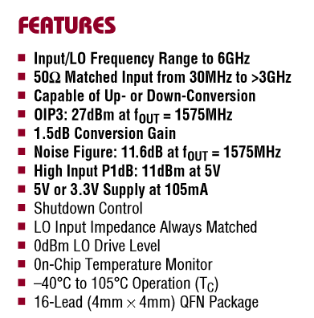
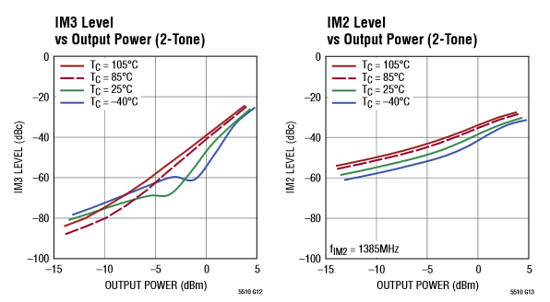
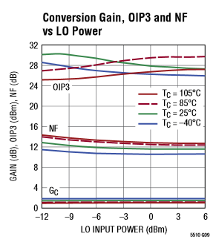
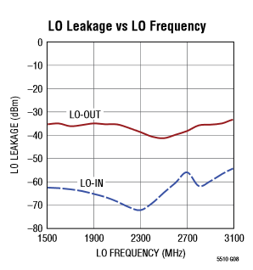

Slide 7
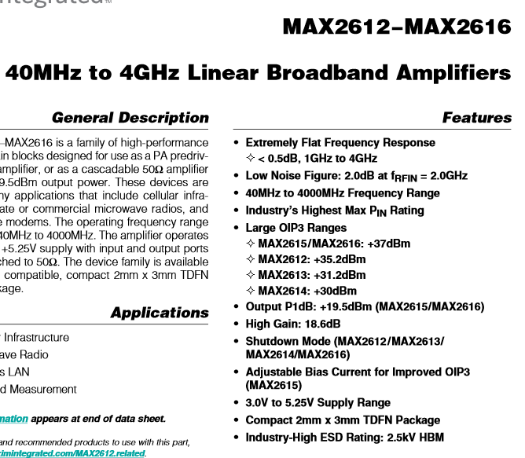
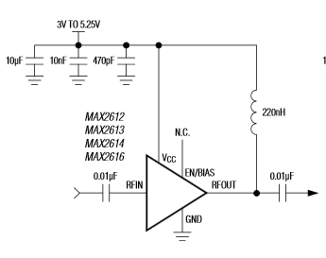
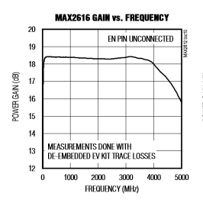
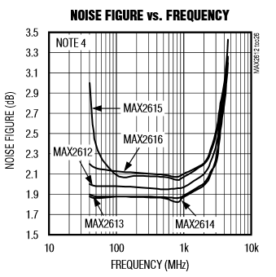
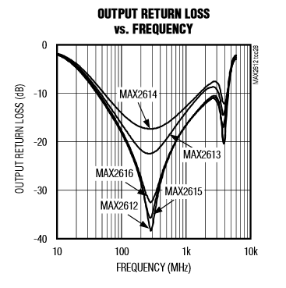
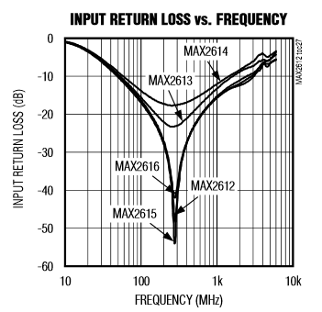
Current 80.6 mA

Slide 8
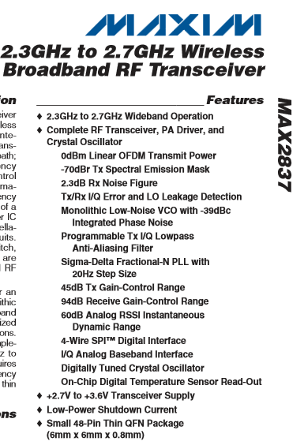
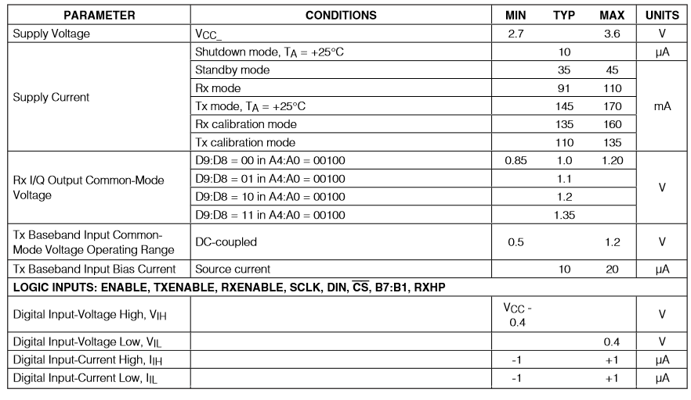
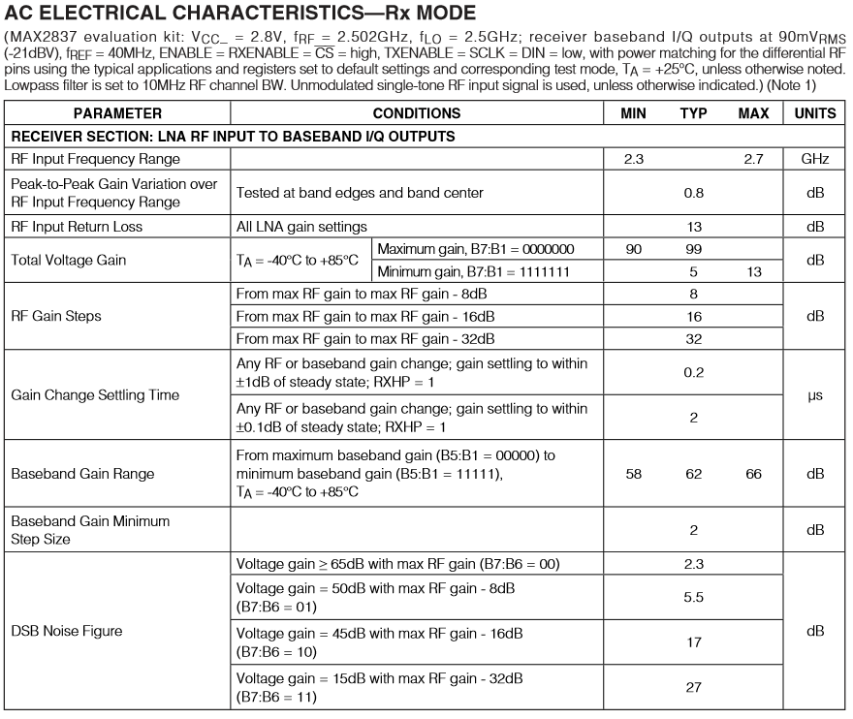
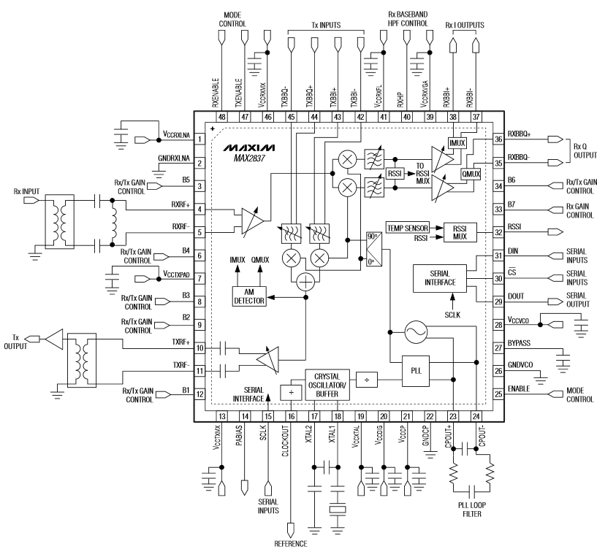

Slide 9
