Slide 1
Voltage gain 5-99dB (RF0-32dB; BB 0-62dB)
P1dB=-37dBm @RFATT0dB
100ohm impedance
RX level analysis
Noise floor ca. -109dBm-48dB=-157+att dBm
TX level analyis
dynamic ca. |-157dBm+15.1dB|=141.9-att dB
1V fullscale
RFSwitch
BGS12SL6
DAC/ADC
MAX5864
Wimax TRX
MAX2837
2.3-2.7 GHz
2.3-2.7 GHz
0.02-6 GHz
RFSwitch
BGS12SL6
Pmin=-89dBm for fullscale
Pmax=5 dBm for fullscale
2.3-2.7 GHz
0.02-6 GHz
Fullscale 0.4 V
@ 100ohm impedance =-1 dBm
Mixer
LTC5510
1.5 dB conversion gain
RFSwitch
BGS12SL6
RFSwitch
BGS12SL6
0.001-6 GHz
0.02-6 GHz
RFSwitch
BGS12SL6
For Lowpass 2,3-0,3 Ghz
(measured frequency=0-2.4 GHz)
0.02-6 GHz
2.3-2.7 GHz
2.3-2.7 GHz
For Highpass 0.3-3.3 Ghz
(measured frequency=2.6-6 GHz)
RFSwitch
BGS12SL6
2.3-2.7 GHz
Bypass 2.3-2.7 Ghz
(measured frequency=2.3-2.7 GHz)
2.3-2.7 GHz
Gain 18.6 dB
RFSwitch
BGS12SL6
0.02-2.6 GHz
0.02-6 GHz
Attenuation switch
att=9x0.25dB=2.5dB @1GHz
att=5x0.35dB=1.8dB @2.5GHz
att=9x1.5dB=13.5dB @6GHz
Lowpass
LP0603A
1880ANTR
Pmin=-109.1+attdBm for fullscale
Pmax=-15.1+att dBm for fullscale
LNA
MAX2616
0.02-6 GHz
2x
RFSwitch
BGS12SL6
2x
RFSwitch
BGS12SL6
RFSwitch
BGS12SL6
RFSwitch
BGS12SL6
0.02-2.6 GHz
0.02-6 GHz
2.4-6 GHz
LNA
MAX2616
DEA16
2400HT
-8004B1
0.02-6 GHz
Pmin=-90.5dBm for fullscale
Pmax=3.5 dBm for fullscale
Pmax=21.1 dBm for fullscale
!!! LNA in compression
0.02-6 GHz
Pmax=2.5 dBm
2.4-6 GHz

Slide 2
SPI Flash
W25Q80BW
Ethernet Pinheader
SMA
GPIO Pinheader
0.001-6 GHz
RF-part
JTAG
USB
Joystick
NXP
LPC4320
FDB144
Cortex M4
DAC/ADC
MAX5864
Wimax TRX
MAX2837
Display
VCO/PLL
MAX2871
0.001-6 GHz

Slide 3
Low pass Filter active 0-2.4 GHz
Wimax TRX receiving frequency 2.3 GHz- 2.7 GHz
LO Frequency
Input Frequency
and LO-Frequency
1
2
3
4
5
6
Output Frequency
measured Frequency:
0 GHz- 0.4 GHz
@ LO=2.3 GHz
0 GHz
1
2
3
4
5
6
Output Frequency
measured Frequency:
2 GHz- 2.4 GHz
@ LO=0.3 GHz
2.4 GHz
1
2
3
4
5
6

Slide 4
Low pass Filter active 0-2.4 GHz
(second possibility)
Wimax TRX receiving frequency 2.3 GHz- 2.7 GHz
LO Frequency
Kehrlage!!!
Input Frequency
and LO-Frequency
1
2
3
4
5
6
Output Frequency
measured Frequency:
0 GHz- 0.4 GHz
@ LO=2.7 GHz
0 GHz
1
2
3
4
5
6
Output Frequency
measured Frequency:
2 GHz- 2.4 GHz
@ LO=0.3 GHz
2.6 GHz
1
2
3
4
5
6

Slide 5
Byepass active 2.3-2.7 GHz
Wimax TRX receiving frequency 2.3 GHz- 2.7 GHz
LO Frequency
Input Frequency
and LO-Frequency
1
2
3
4
5
6
2.3 GHz
Output Frequency
measured Frequency:
2.3 GHz- 2.7GHz
1
2
3
4
5
6
2.7 GHz
1
2
3
4
5
6

Slide 6
High pass Filter active 2.6-6 GHz
Wimax TRX receiving frequency 2.3 GHz- 2.7 GHz
LO Frequency
Input Frequency
and LO-Frequency
Output Frequency
measured Frequency:
2.6 GHz- 3 GHz
@ LO=0.3 GHz
1
2
3
4
5
6
2.6 GHz
1
2
3
4
5
6
Output Frequency
measured Frequency:
5.6 GHz- 6 GHz
@ LO=3.3 GHz
6 GHz
1
2
3
4
5
6

Slide 7
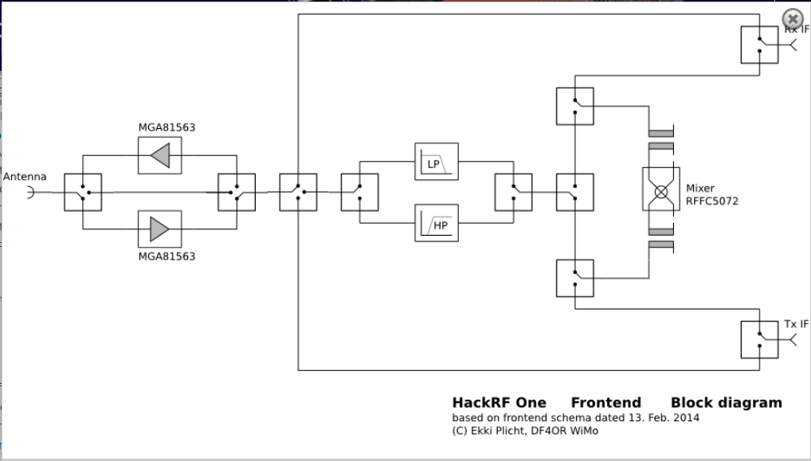

Slide 8
Current consumtion
mA V
Mixer 105 3.3/5
LNA 2x81 3-5.5
Tranceiver RX110 TX170 2.7-3.6
ADC 14 1.8-3.3
LPC4300 100 3.3
Switch - 3.3/5
SUMRX 410mA
SUMTX 470mA

Slide 9
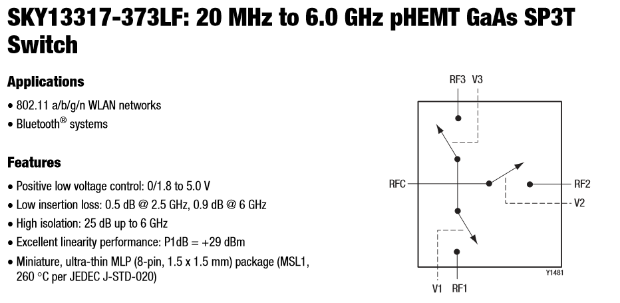
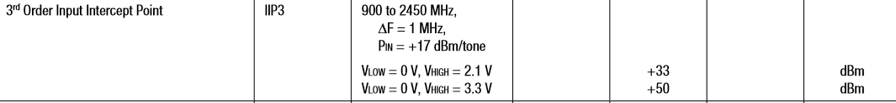
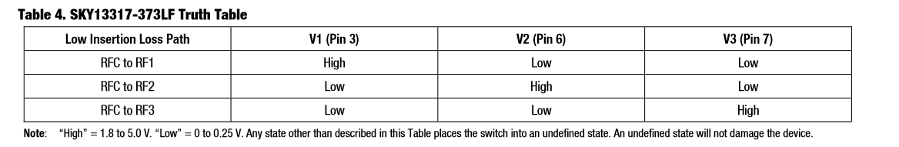

Slide 10
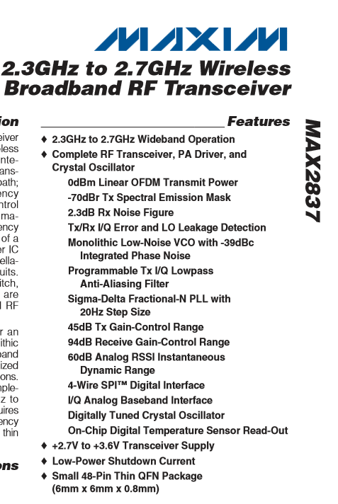

Slide 11
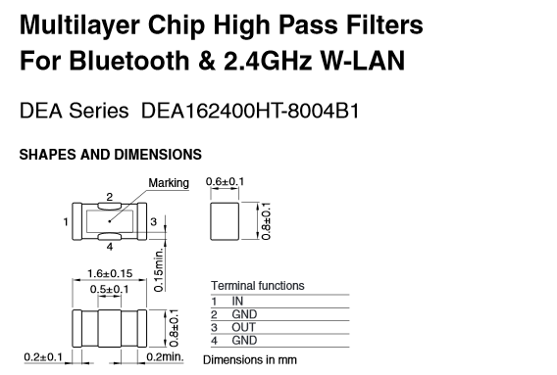
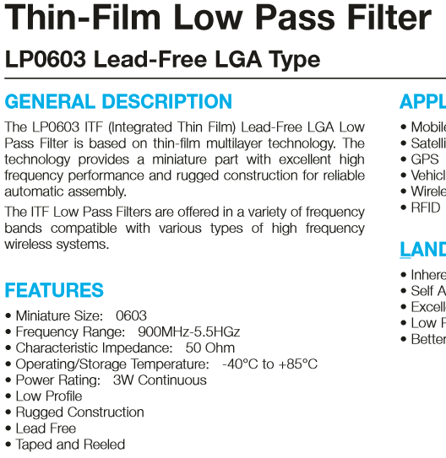
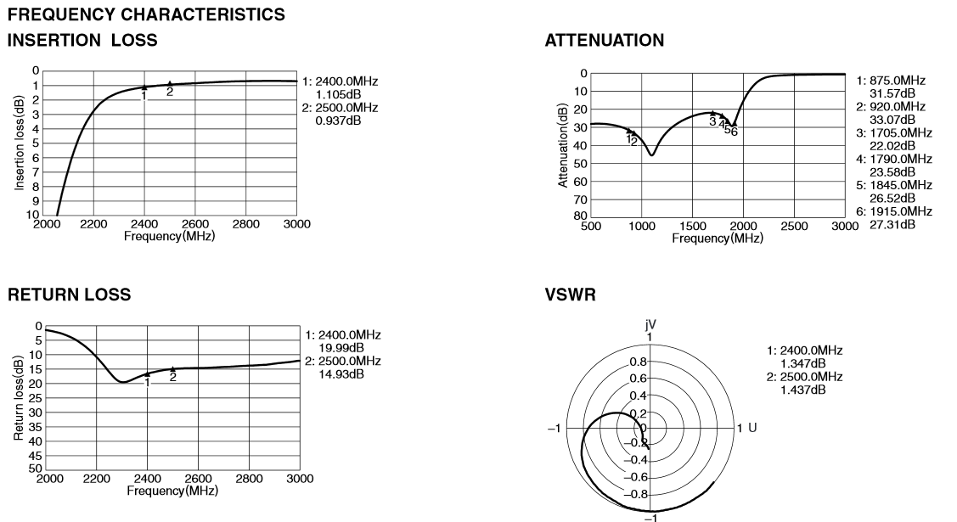
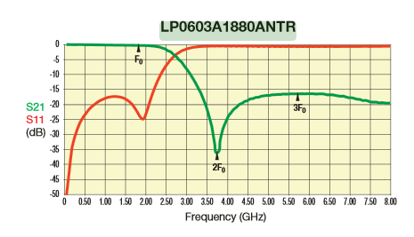
Lowpass
Highpass

Slide 12

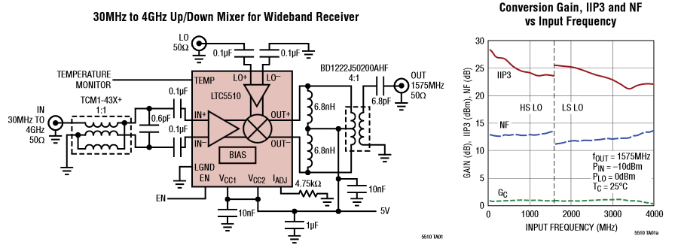
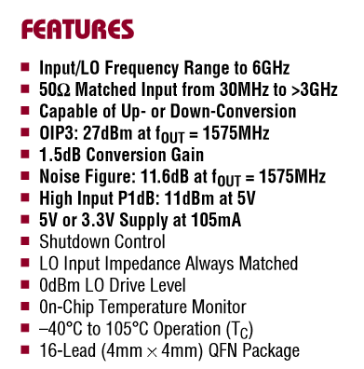
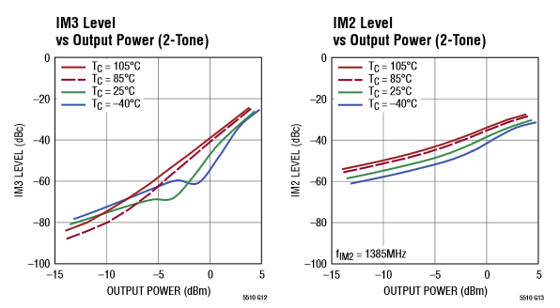
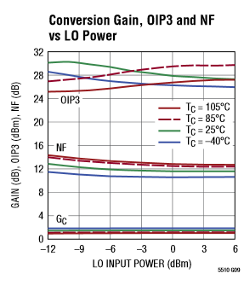
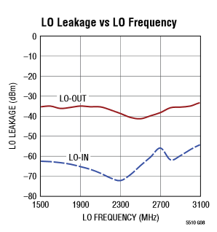

Slide 13
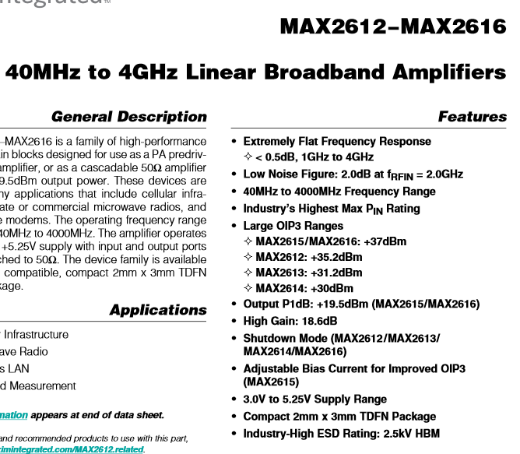
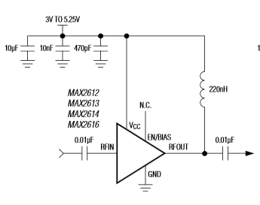
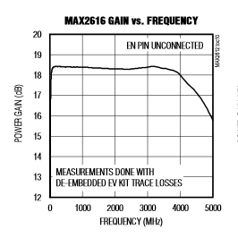
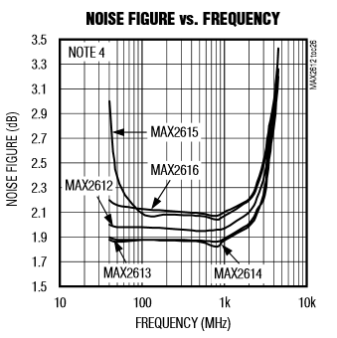
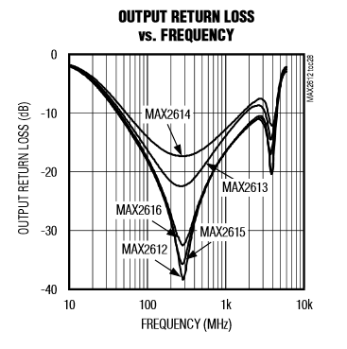
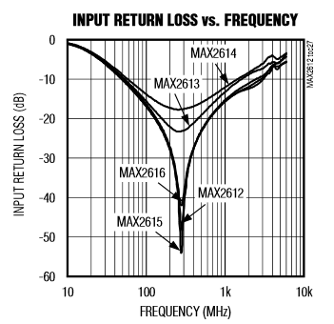
Current 80.6 mA

Slide 14
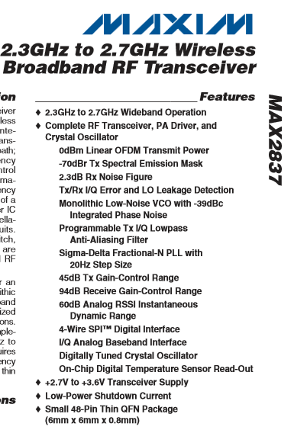
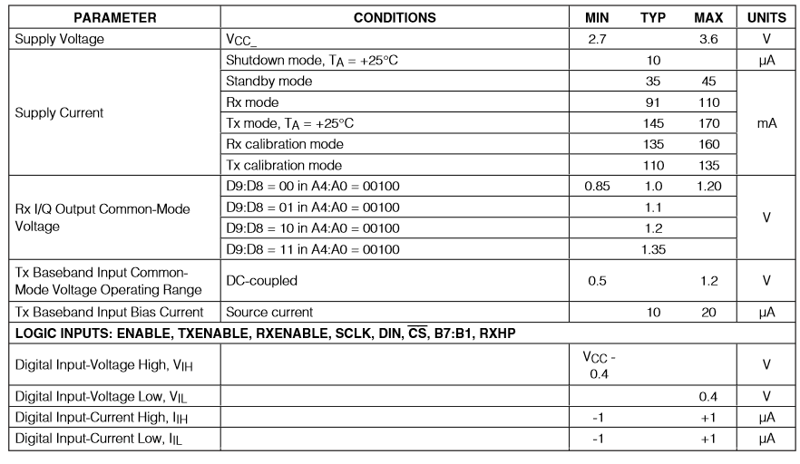
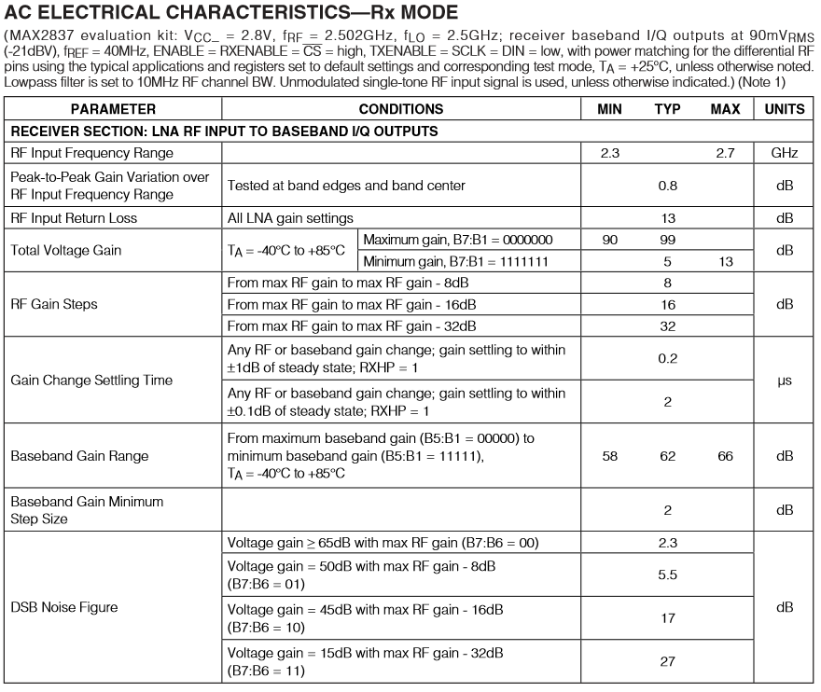
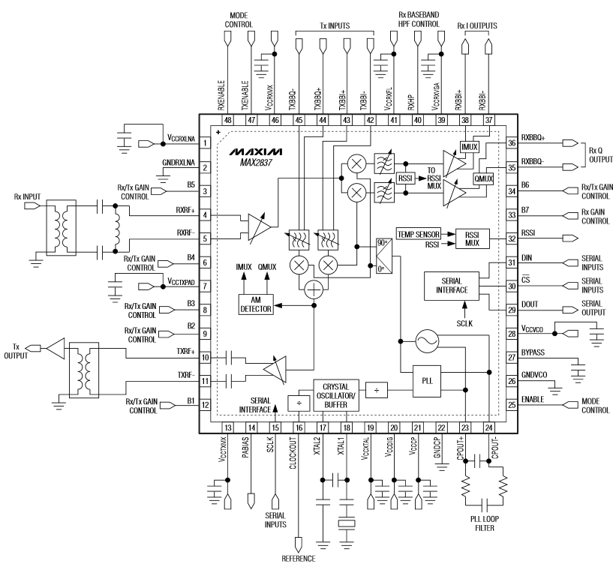

Slide 15
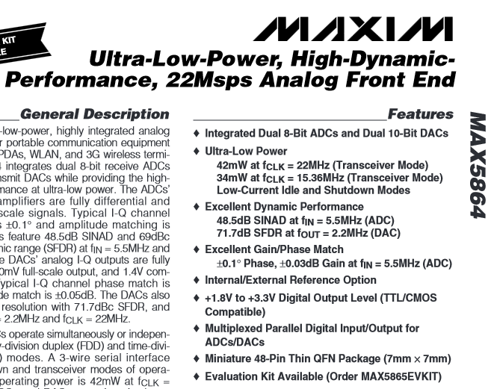
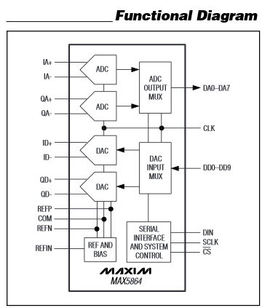
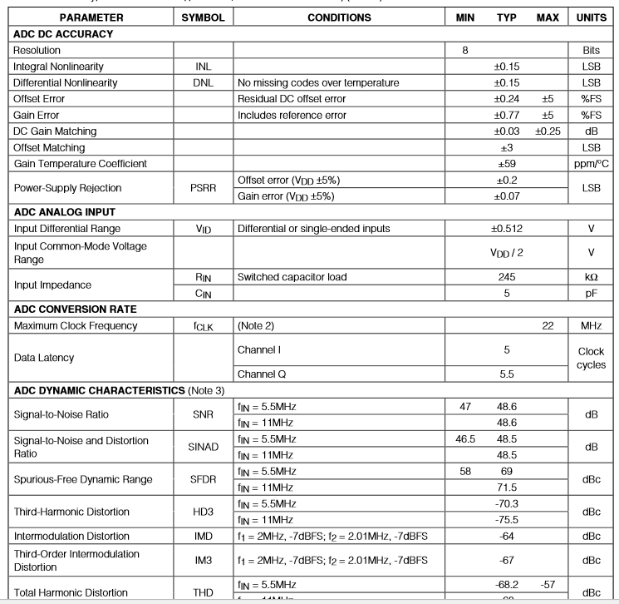
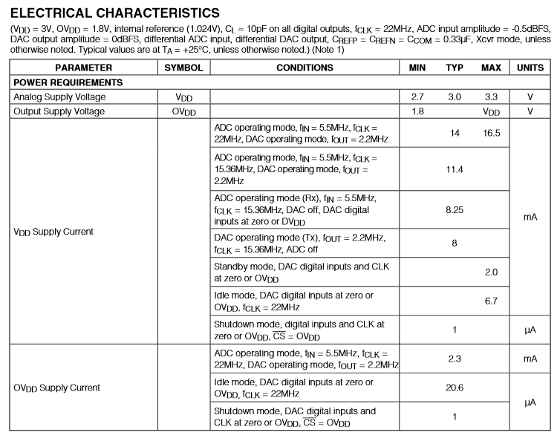
Bit-Dynamik 20*log(2^8)=48dB

