Slide 1
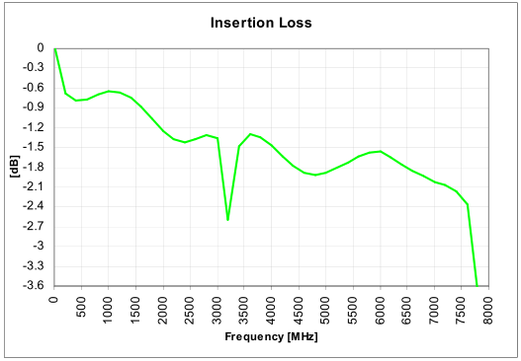
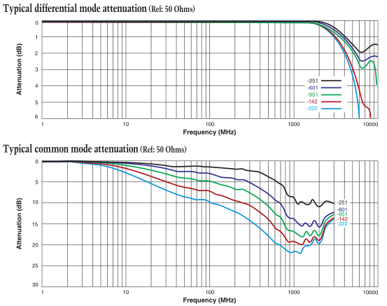
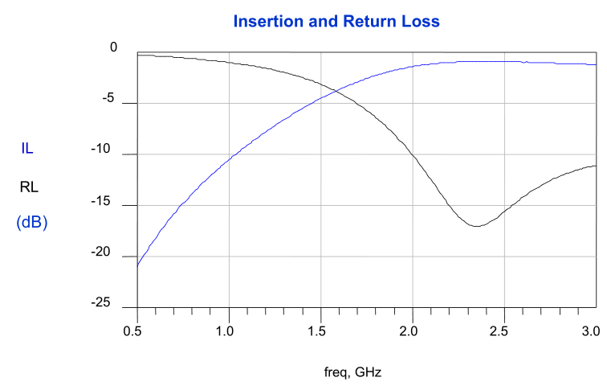
Balun selection
S21
-0.6 dB
@2.7 GHz
B0310J50100AHF
-1.3 dB
@2.7 GHz
-1.5 dB
@6 GHz
-2.8 dB
@6 GHz
USB 3.0 Common Mode Choke 0603
-1 dB
@2.7 GHz
2500BL14M100

Slide 2
S11
Passive Component
abs(S11)=sqrt( 1- abs(S11)^2)
Return loss is the best
by a low insertion loss
USB-Balun is best till approx 4.5 GHz
From 4.5 GHz till 6 GHz the
B0310J50100AHF is better by 1.3 dB
maximal

Slide 3
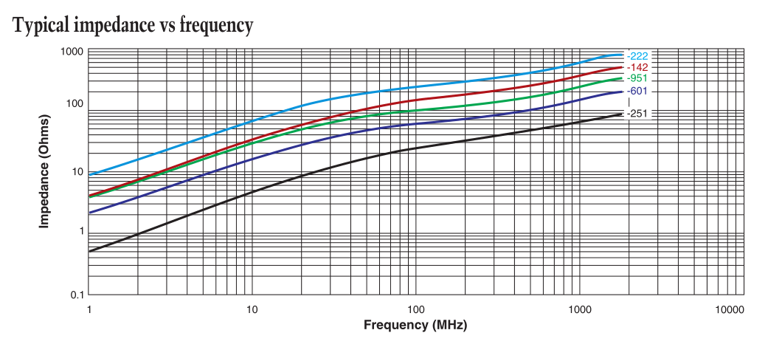
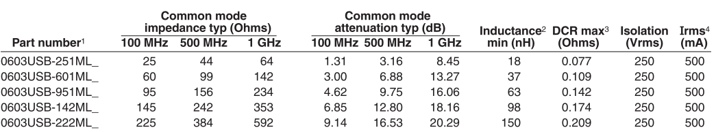
This is the impedance of the inductor in common mode!
Not the differential mode
USB 3.0 Common Mode Choke 0603
63e-9*2*pi*1e9=400 Ohm

