Slide 1

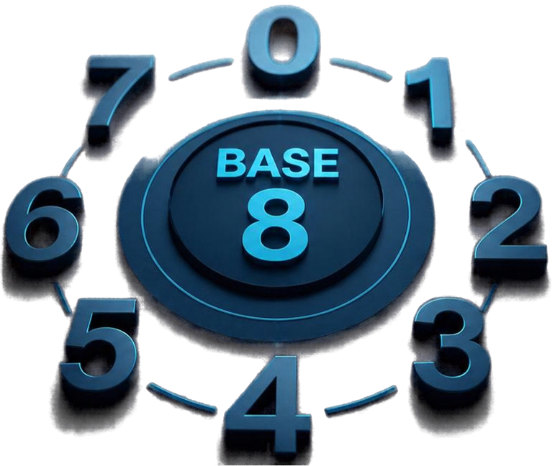

Decimal
Octal
Division-Remainder Method
Learn how to convert decimal numbers into octal using repeated division by 8.

Slide 2

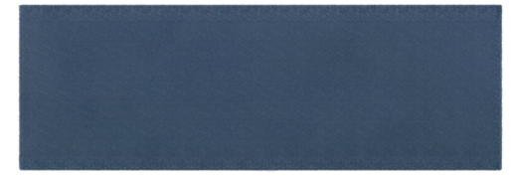

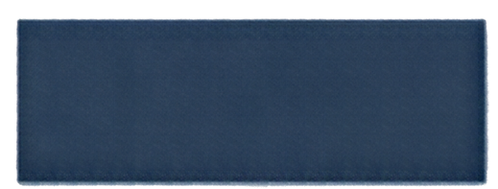

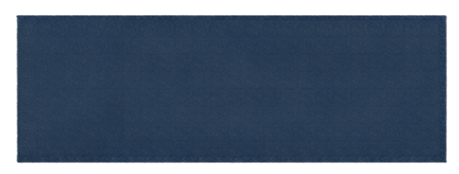

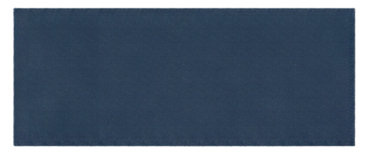
1
Divide
How to Convert
Decimal to Octal
Divide the decimal
number by 8.
2
Record
Divide the decimal number by 8.
Record
the remainder.
Record the remainder.
3
Repeat
Repeat with the quotient until it reaches zero.
Repeat with the quotient until it reaches zero.
Read the remainders from bottom to top to get the octal number.
4
Read
Read the remainders from bottom to top
to get the octal number.

Slide 3
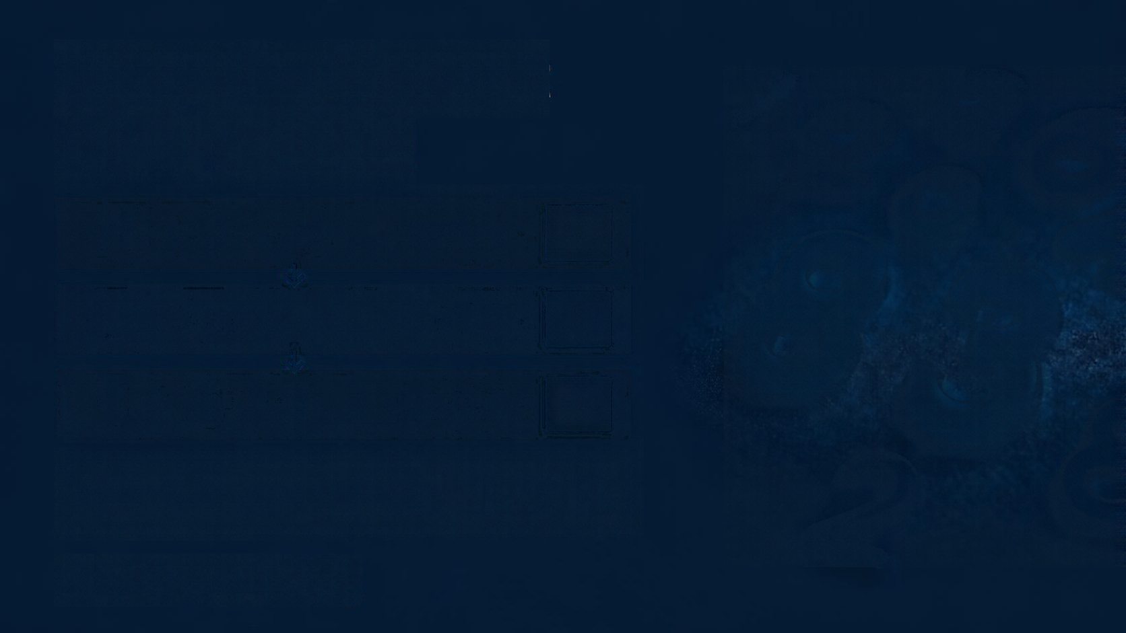
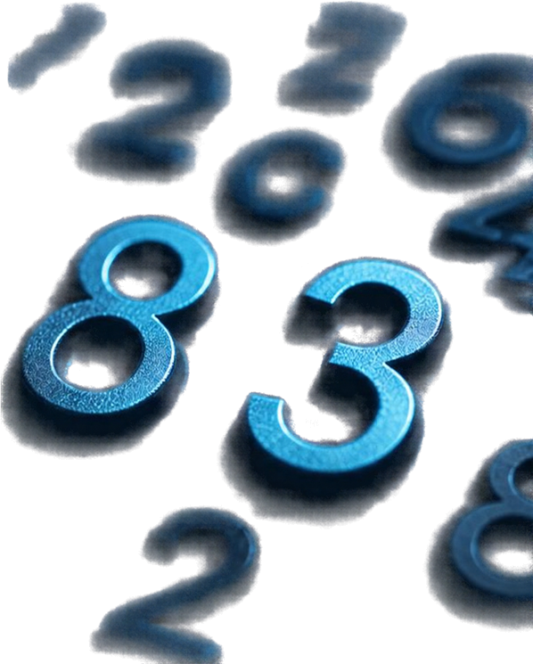
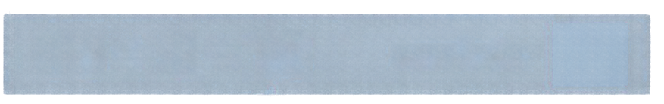


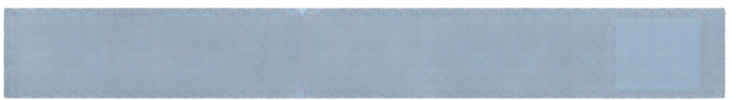


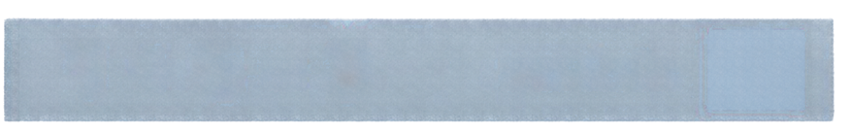

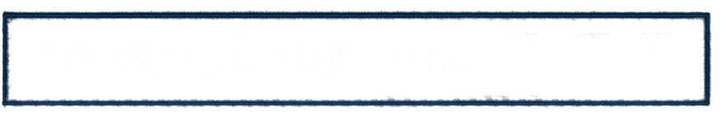
Example: Convert
83 to Octal
83 ÷ 8 = 10
remainder
3
10 ÷ 8 = 1
remainder
2
1 ÷ 8 = 0
remainder
1
Read remainders bottom → top:
1 2 3
So, 8310 = 1238

Slide 4

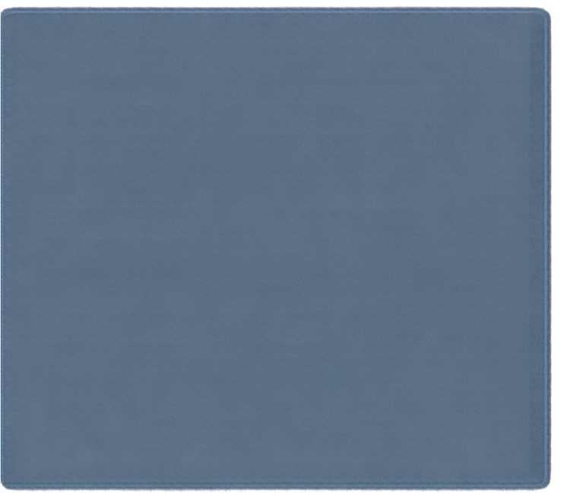
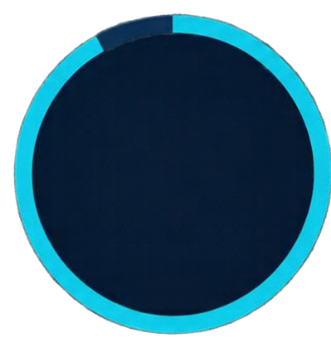

Your Turn!
Convert 5010 to Octal
Try it yourself! You have 20 seconds.
Solution:
50 ÷ 8 = 6
remainder 2
20
6 ÷ 8 = 0
remainder 6
Read bottom → top: 6 2
SECONDS
5010
628

Slide 5
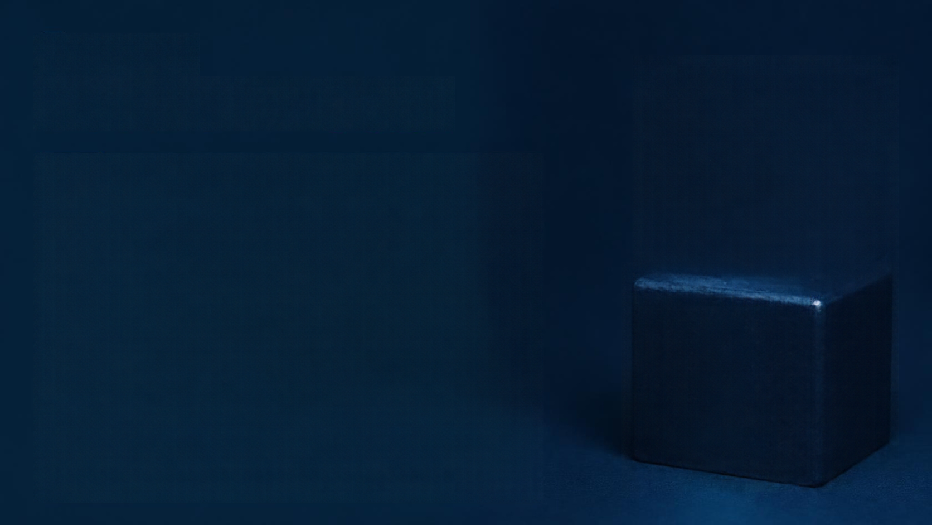
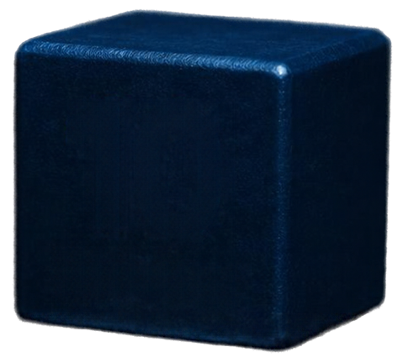
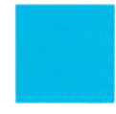
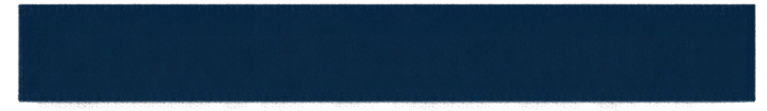
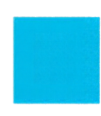
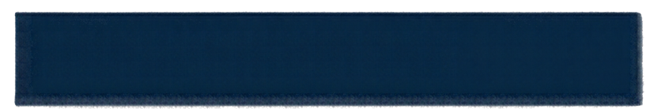
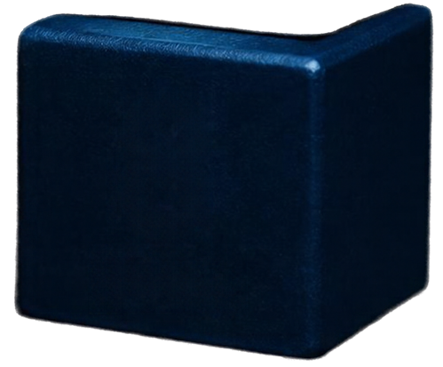
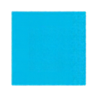
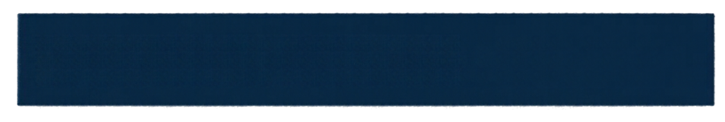
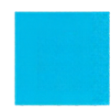
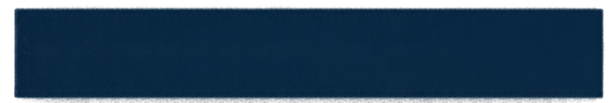
Recap:
Decimal → Octal
10
1
Divide decimal number by 8 repeatedly.
2
Record remainders each time.
DECIMAL
3
Stop when quotient is zero.
8
4
Read remainders from bottom to top for octal result.
OCTAL

