Slide 1

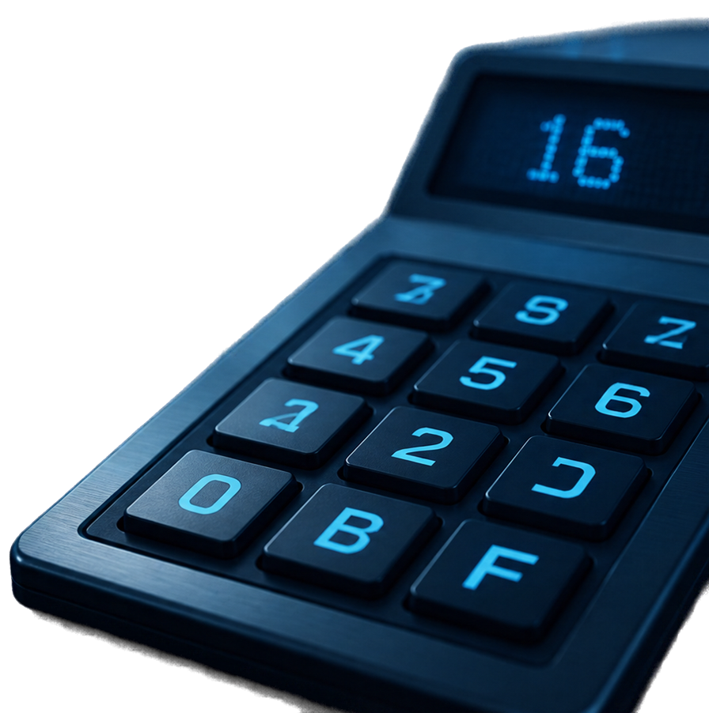

INTRODUCTION TO
DECIMAL
HEXADECIMAL
Hexadecimal is base 16.
Convert by repeatedly dividing by 16.
Remainders can be 0-9 or letters A-F.
Letters A-F represent remainders 10-15.

Slide 2



















HEXADECIMAL
10
A
VALUES
11
B
FOR
12
C
10
15
13
D
TO
14
E
These are the hexadecimal digit equivalents for decimal 10 to 15.
15
F

Slide 3










WORKED EXAMPLE
Convert 254₁₀ to Hexadecimal
FE
remainder
254 ÷ 16 = 15
14
14 → E
remainder
15 ÷ 16 = 0
15
15 → F
Therefore,
254
=
FE
Read remainders bottom to top
10
16

Slide 4




PRACTICE EXAMPLE
SOLUTION
26 ÷ 16 = 1 remainder 10
(10 → A)
YOUR TURN!
Convert 26₁₀---> ?16
20
1 ÷ 16 = 0 remainder 1
Read bottom to top: 1A
SECONDS
Therefore, 2610 = 1A16

Slide 5






RECAP AND
NEXT LESSON
01
NEXT LESSON:
Divide decimal number by 16 repeatedly.
HEXADECIMAL TO DECIMAL
02
Record the remainders.
03
Convert remainders 10–15 into letters A–F.
We’ll convert hexadecimal back to decimal.
04
Read the remainders from bottom to top.

