Slide 1




VIDEO 9:
HEXADECIMAL
DECIMAL USING
THE POSITIONAL METHOD
Number System Made Easy Series

Slide 2









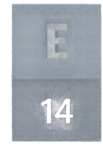

UNDERSTANDING POWERS OF 16
POWERS OF 16
16°
1
16
16
Hexadecimal is base 16.
16²
256
Each position represents a power of 16 starting from the right.
Multiply each digit by its positional power of 16.
HEX DIGIT VALUES
A
B
C
D
E
F
10
11
12
13
14
15

Slide 3







WORKED EXAMPLE 1
01
1
×
16¹
=
16
1A
16
02
10
×
16⁰
=
10
+
A = 10
03
16
+
10
=
26
1A
=
26
THEREFORE
16
10

Slide 4







WORKED EXAMPLE 2
2
× 16¹
32
2F
15
× 16⁰
15
16
+
=
47
32
15
F represents 15.
=
2F
47
16
10

Slide 5


PRACTICE QUESTION
20
Your turn!
Convert 3B₁₆ to decimal.
SECONDS
Try it in your head before we reveal the answer.

Slide 6




PRACTICE QUESTION
20
Your turn!
Convert 3B₁₆ to decimal.
SECONDS
Try it in your head before we reveal the answer.
LET’S CHECK
B = 11
3 × 16 = 48
11 × 1 = 11
48 + 11 = 59
Answer:
59
10

Slide 7

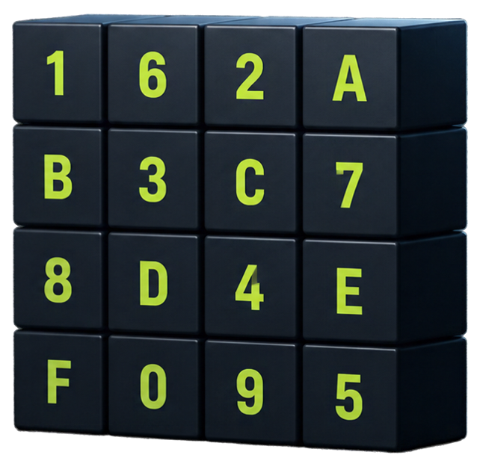


RECAP
6
2
A
Convert hexadecimal to decimal using powers of 16
Remember hex digits A=10 to F=15
Multiply each digit by its positional value
Add all products for final decimal value
B
C
7
8
D
4
E
NEXT UP
Next video:
Octal and Hexadecimal Conversion
F
0
9
THANKS FOR WATCHING!

