Slide 1
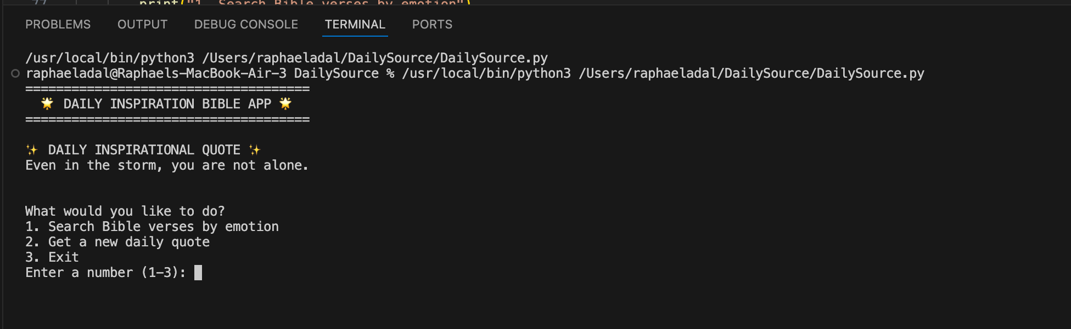
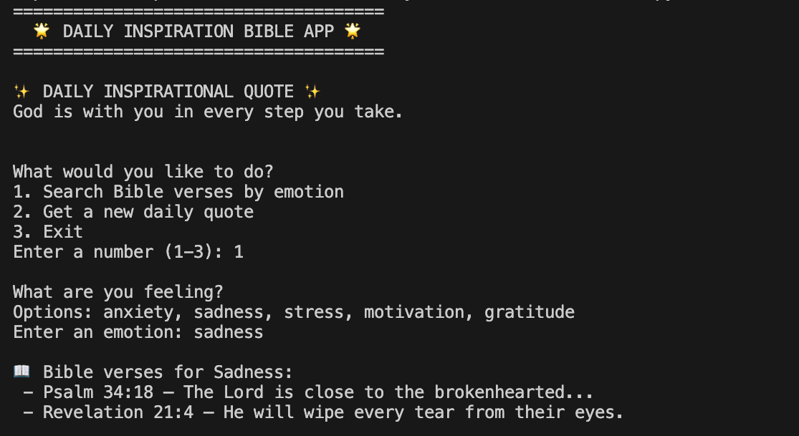
DailyVerse
Project by: Raphael Adal
Objectives:
• Deliver daily scripture by emotion
• Search verses by feeling or topic
• Provide short reflections/mini-devotions
“Scripture that meets you where you are.”
Repo: https://github.com/radal25/DailySource.git

