Slide 1

Circuit Simulator

Slide 2
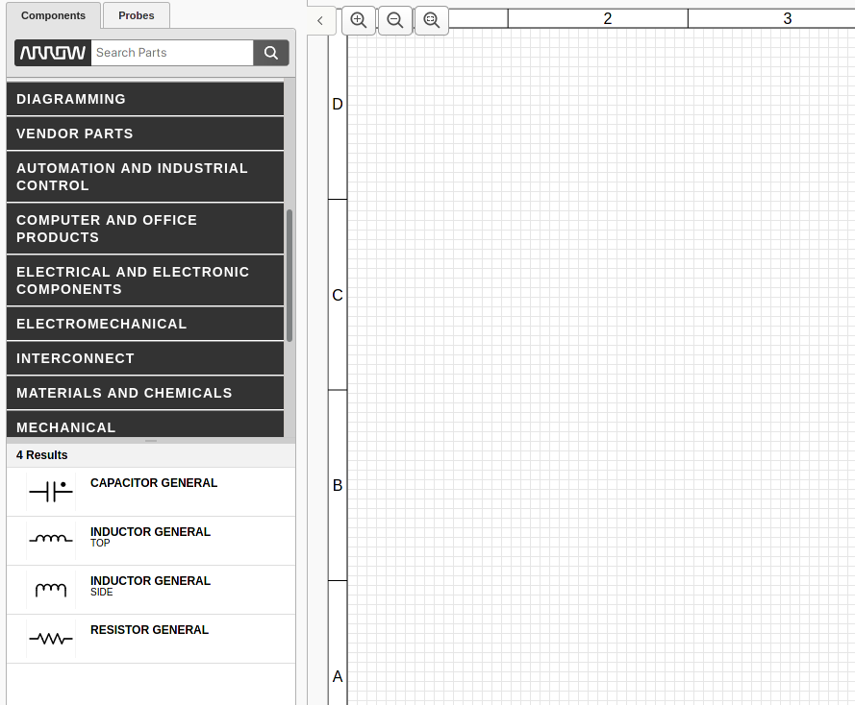
Existing Solutions - PartSim
Too many components
Hard to understand
Designed for businesses

Slide 3
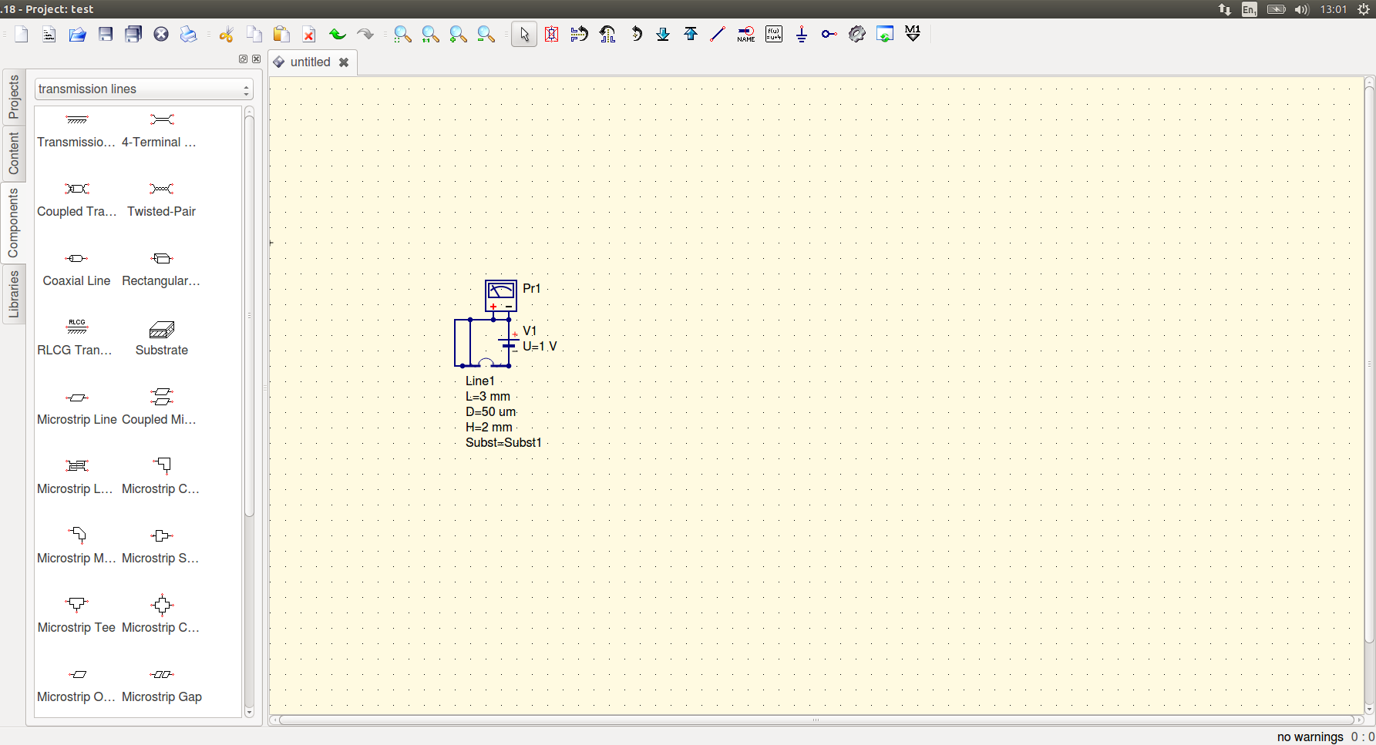
Existing Solutions - QUCS
Marginally simpler
Designed for hobbyists
Dated
Too many useless parts

Slide 4
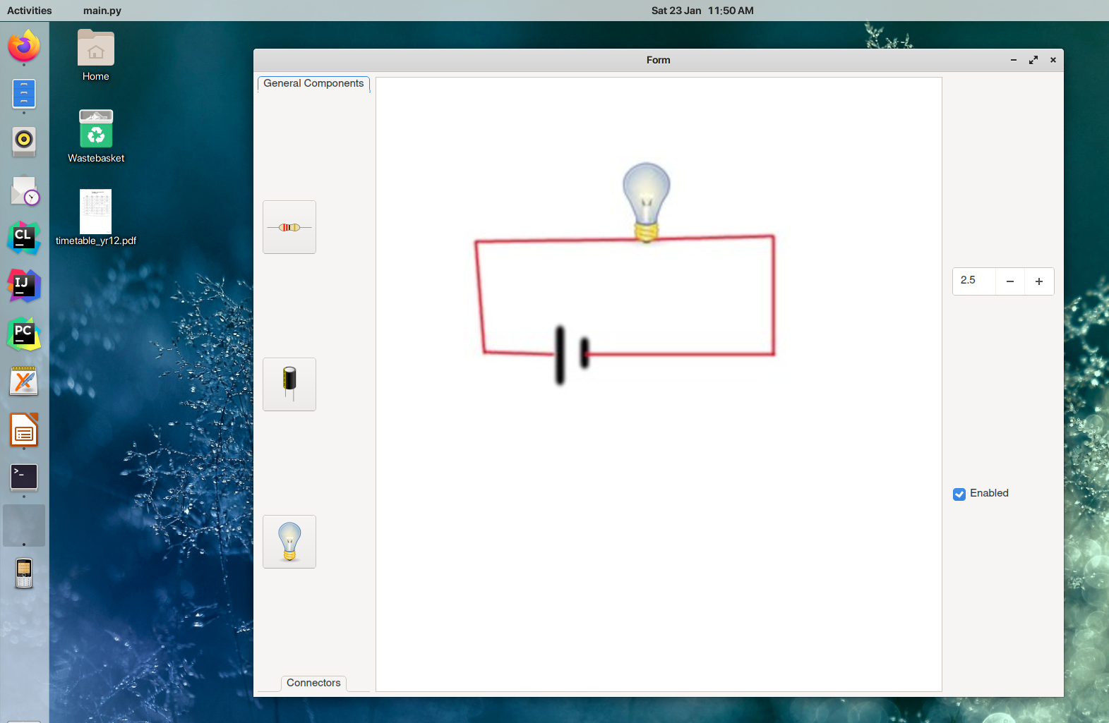
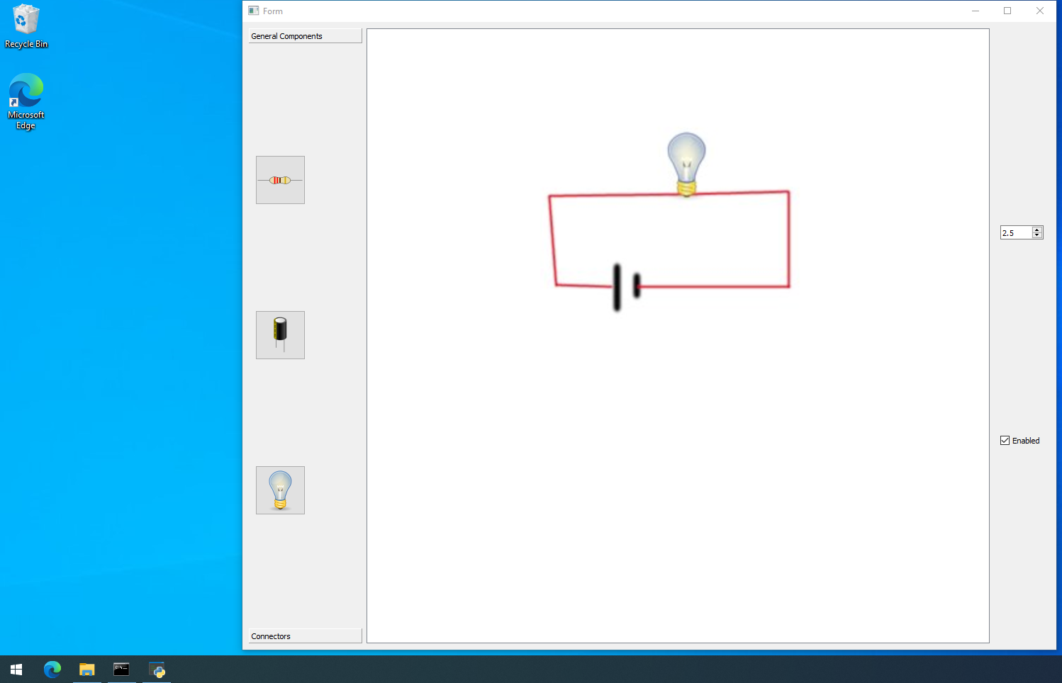
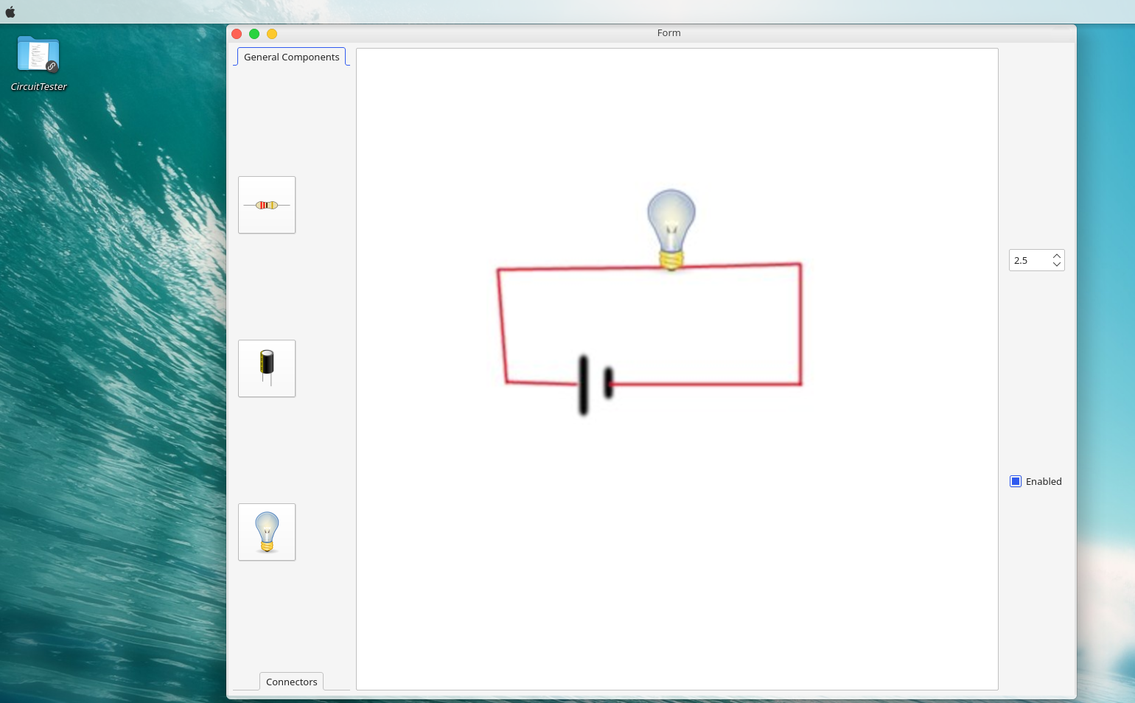
My Interface
Simple buttons
Colour to show state
Easy to understand
No unnecessary components
Cross platform design – looks good anywhere

Slide 5
Classes – Component (Abstract)
getOutput
getName
getImage
getConnected
Parent class of each component

Slide 6
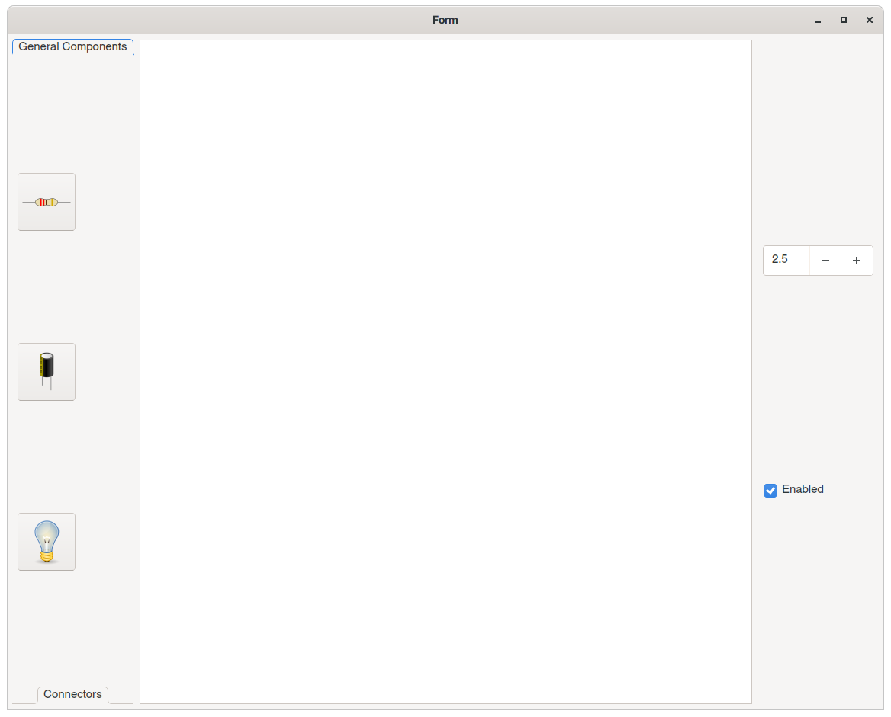
Classes – MainWindow
initialiser

Slide 7
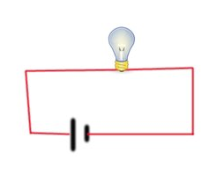
Classes - GraphicsArea
addComponent
removeComponent
moveComponent
componentDragged
connectComponents

Slide 8
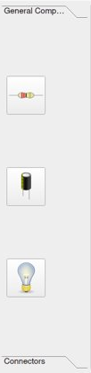
Classes - Toolbar
addComponent
deleteComponent
collapse
expand

Slide 9

Classes - InfoMenu
Battery
selectComponent
collapse
expand

Slide 10
Success Criteria
Simple circuits
A few simple components
Easy to use, familiar interface

Slide 11
Skills
Physics calculations themselves
GUI design – QT framework
Circuit Flow

Slide 12
Questions

