Slide 1
A primer on DFDI, the MARVELS optical implementation, and pipeline flow
MARVELS Science Review
Brian Lee,
June 21, 2011

Slide 2
Mirror 1
B1
B2
Input light
Mirror 2
Beamsplitter
Physical path difference: B2-B1
(DFDI Refs.: Erskine & Ge (2000), Ge et al. 2001, Erskine 2003, Ge 2002, Mosser et al. 2003, Mahadevan et al. 2008, van Eyken et al. 2010)
MARVELS basic physics

Slide 3
Mirror 1
B1
B2
Input light
Mirror 2
Beamsplitter
Physical path difference:
B2-B1 = N*lambda
-> constructive interference
(DFDI Refs.: Erskine & Ge (2000), Ge et al. 2001, Erskine 2003, Ge 2002, Mosser et al. 2003, Mahadevan et al. 2008, van Eyken et al. 2010)
MARVELS basic physics

Slide 4
Mirror 1
B1
B2
Input light
Mirror 2
Beamsplitter
(0.5*lambda
of added delay)
Physical path difference:
B2-B1 = N*lambda + 0.5*lambda
-> destructive interference
(DFDI Refs.: Erskine & Ge (2000), Ge et al. 2001, Erskine 2003, Ge 2002, Mosser et al. 2003, Mahadevan et al. 2008, van Eyken et al. 2010)
MARVELS basic physics

Slide 5
Mirror 1
Y
B1
B2
Input light
Mirror 2
Beamsplitter
Tilt mirror 2 over, so path length is a function of height Y
Y
->Intensity is now a function of height Y = fringes
MARVELS basic physics

Slide 6
Mirror 1
Y
B1
B2
Input light
Mirror 2
Now consider slightly longer wavelength of input light
Beamsplitter
Y
Old lambda
New lambda
MARVELS basic physics

Slide 7
Mirror 1
Y
B1
B2
Input light
Mirror 2
Beamsplitter
So multiple wavelengths look like this:
Y
lambda
MARVELS basic physics

Slide 8
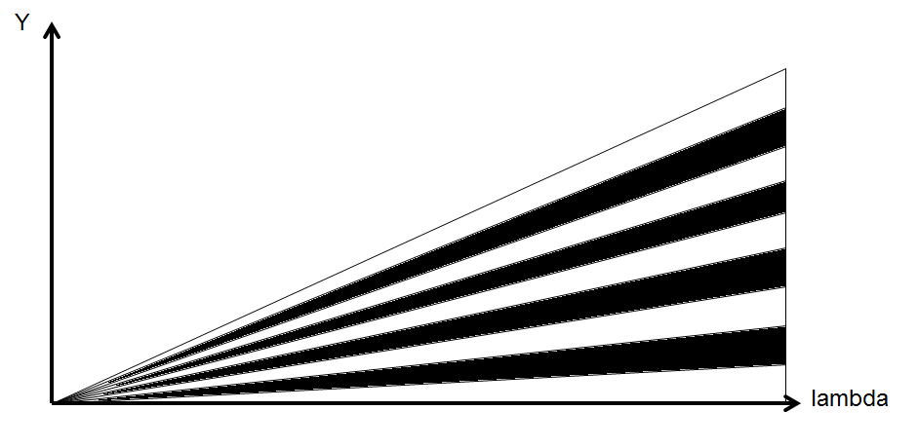
Zooming out in lambda, you’d see more strongly the dependence of periodicity of interference on wavelength. We call that the “interferometer fan”:
MARVELS basic physics

Slide 9
Orders m are evenly spaced in y…
m=4
m=3
m=2
m=1
MARVELS basic physics

Slide 10
(The MARVELS instrument can only collect a small cutout from the fan, with m~13000 and 5000A~<lambda~<5700A. We typically refer to the small cutout as, “comb.”)
this way to m=13000…
m=4
m=3
m=2
m=1
MARVELS basic physics

Slide 11
Mirror 1
Y
B1
B2
Input light
Mirror 2
Beamsplitter
(Have to add a low-resolution spectrograph so the fringes aren't all on top of each other)
Spectrograph
Y
MARVELS basic physics
lambda

Slide 12
Mirror 1
Y
B1
B2
Input light
Mirror 2
Beamsplitter
Spectrograph
Gradient in tilt of fringes across lambda is present, but fairly small.
Y
MARVELS basic physics
lambda

Slide 13
This was for a continuum light source...
Y
MARVELS basic physics
lambda

Slide 14
Now multiply in a stellar source with absorption lines instead.
Y
MARVELS basic physics
lambda

Slide 15
Now multiply in a stellar source with absorption lines instead.
Note intersections.
Y
MARVELS basic physics
lambda

Slide 16
Small x shift (e.g., from RV) of stellar lines gives larger y shift in intersections (amplification higher if slope is steeper)!
Y shift
Y
X shift
MARVELS basic physics
lambda

Slide 17
Actual intensities follow a sinusoidal model, in theory.
Y
Line depth
Continuum level
Y
Inten.
MARVELS basic physics
lambda

Slide 18
Y
Line depth
Continuum level
Okay, now what messes this up?
Y
Inten.
MARVELS basic physics
lambda

Slide 19
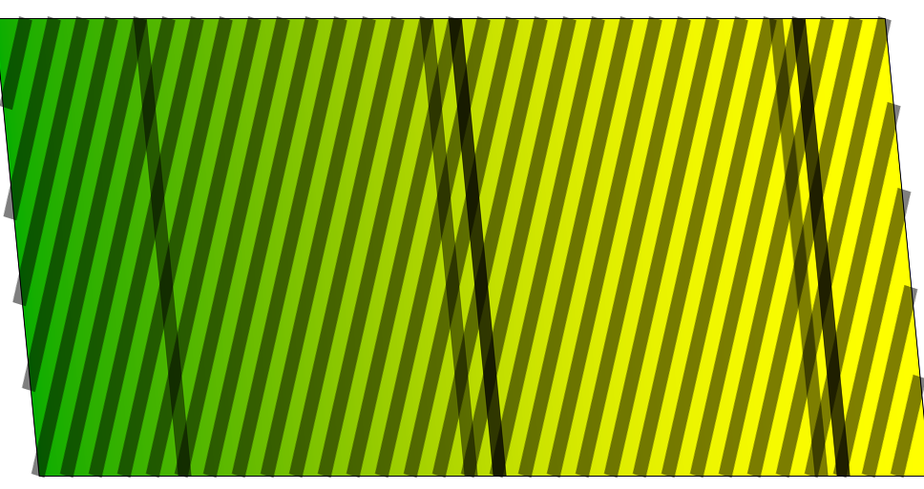
Slanted spectral lines…

Slide 20
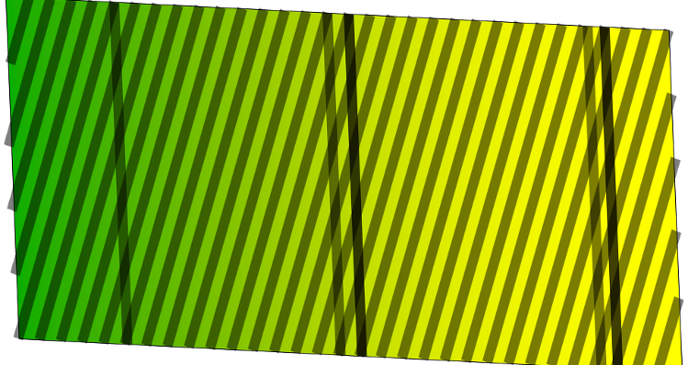
…tilted trace apertures…

Slide 21
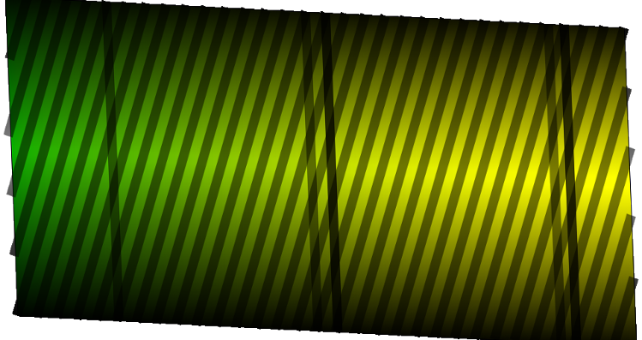
…illumination profile of the slit…

Slide 22
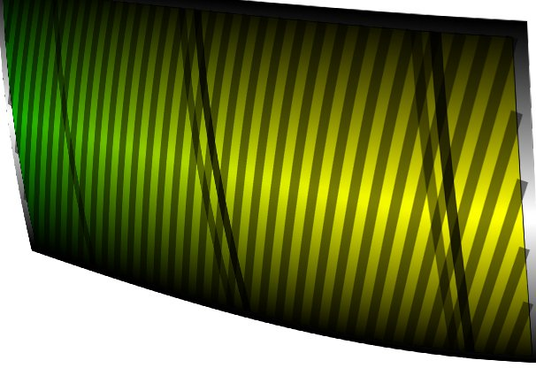
…higher order distortions (time-variable?)…

Slide 23
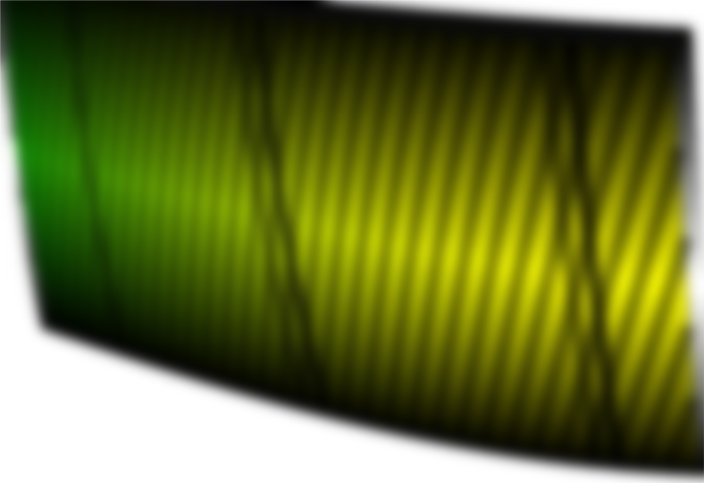
…PSF (not necessarily constant across CCD)…

Slide 24
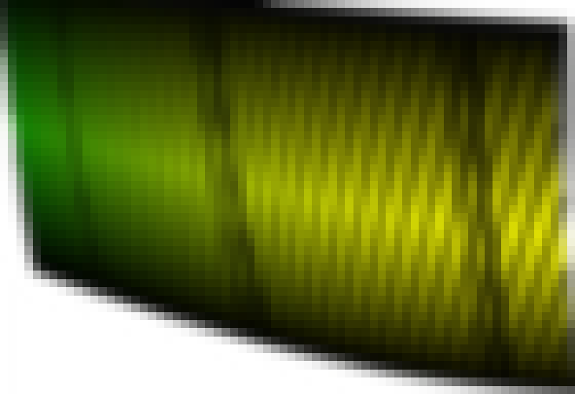
…integrated onto the CCD.
Can you still spot the intersections?

Slide 25
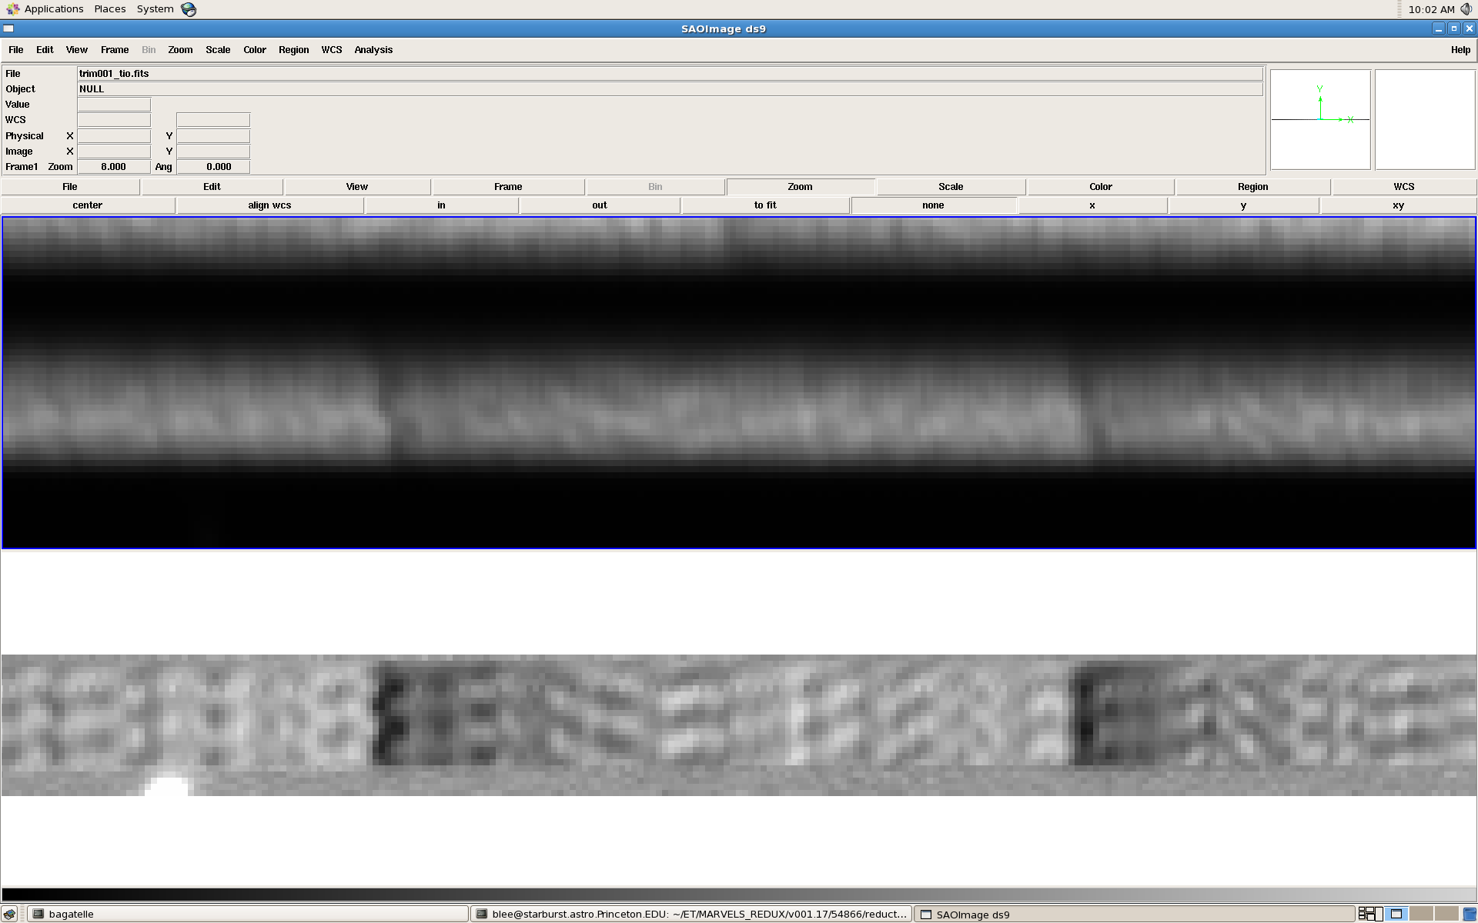
Raw data (MARVELS):
Above fringing spectrum, fully preprocessed:
Real data…

