Slide 1
A beam’s-eye tour of the optics

Slide 2
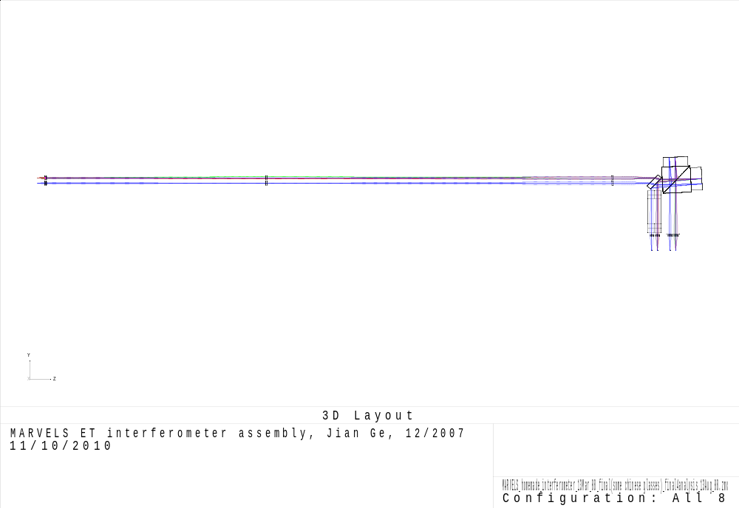
MARVELS Interferometer Optical Layout
Interferometer
Input Lenslets
Field Lenslets
Toroidal Lenslets
Reducer
Imaging Lenslets
Slits
To spectrograph

Slide 3
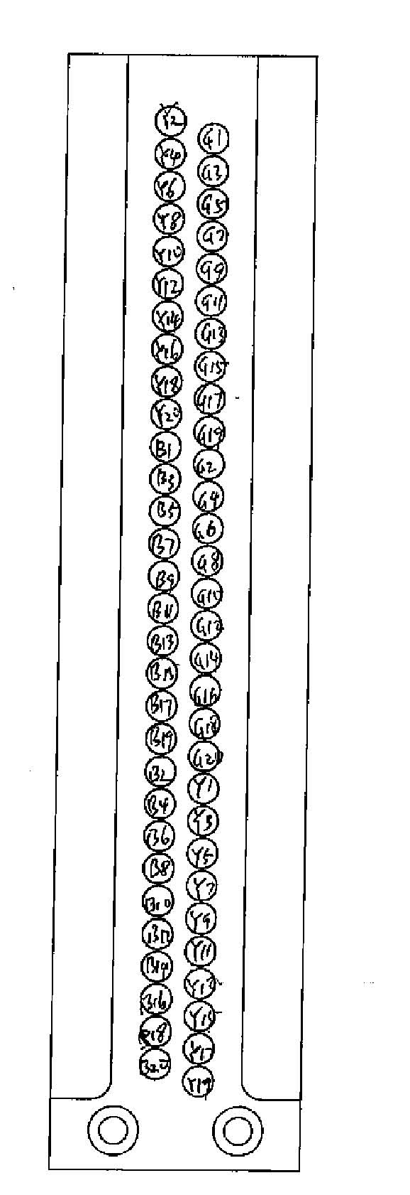
MARVELS Interferometer Optical Layout
Interferometer
Input Lenslets
Field Lenslets
Toroidal Lenslets
Reducer
Imaging Lenslets
Input Lenslets & Field Lenslets take 60 input beams from a diverging f/4 to near-collimated.
Slits
To spectrograph

Slide 4
MARVELS Interferometer Optical Layout
Interferometer
Input Lenslets
Field Lenslets
Toroidal Lenslets
Reducer
Imaging Lenslets
Toroidal Lenslets compress the beam so it will better fit through the slit.
Slits
To spectrograph

Slide 5



MARVELS Interferometer Optical Layout
Interferometer
Input Lenslets
Field Lenslets
Toroidal Lenslets
Reducer
Imaging Lenslets
Interferometer introduces the fringes and produces two output beams per input.
Slits
To spectrograph

Slide 6

MARVELS Interferometer Optical Layout
Interferometer
Input Lenslets
Field Lenslets
Toroidal Lenslets
Reducer
Imaging Lenslets
Length reducer ensures both beams will focus on the same slit plane.
Slits
To spectrograph

Slide 7
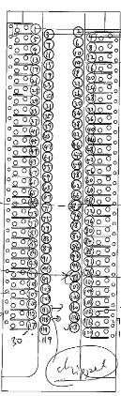


MARVELS Interferometer Optical Layout
Interferometer
Input Lenslets
Field Lenslets
Toroidal Lenslets
Reducer
Imaging lenslets focus the beams to fit through the slits (hopefully with minimal overfilling losses.)
Imaging Lenslets
Slits
To spectrograph
Object #1: slits 1, 3
Object #2: slits 2, 4

Slide 8
MARVELS Interferometer Optical Layout
Interferometer
Input Lenslets
Field Lenslets
Toroidal Lenslets
Reducer
Spectrograph sends slit image of each wavelength of fringe onto CCD.
Imaging Lenslets
Slits
To spectrograph

Slide 9
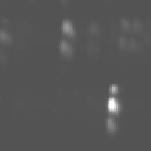
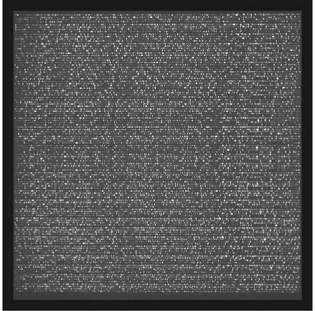
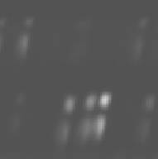
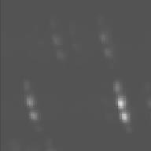
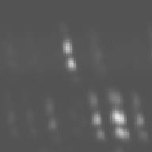
The final image: Sample full 4kx4k real data frame
(ThAr lamp calib.) (60 objects gives 120 spectra)

