Slide 1
PROJECT PRESENTATION
AVIRA / RELOADED
TraceProof
ProofShift · AI Failure-to-Test Lab
From a software failure to an evidence-backed engineering decision.
BUILT WITH AGENT-NATIVE
Rahul Ashokrao Dhapatkar · Pune, India
AVIRA RELOADED / AGENT-NATIVE HACKATHON 2026
01

Slide 2
01 / THE PROBLEM
Alerts identify symptoms. Engineers still need answers.
Why software incident investigations remain slow and difficult to reproduce.
Fragmented evidence
Request and response records sit in logs that need manual correlation.
Unclear next step
A timing alert rarely establishes the root cause or which assumption to test.
Disconnected decisions
Investigation options, trade-offs and human approvals are often documented separately.
THE OPPORTUNITY Turn evidence into a repeatable failure-to-test workflow.
AVIRA RELOADED / AGENT-NATIVE HACKATHON 2026
02

Slide 3
02 / DIFFERENTIATION
Not another alert. A guided path from evidence to experiment.
The value is the connected engineering workflow—not a claim of automatic fault repair.
01
EVIDENCE
Correlate request IDs and link every finding to event records.
02
EXPLANATION
Explain the violation, uncertainty and configured deadline.
03
CHOICE
Compare two investigation directions and their trade-offs.
04
APPROVAL
The engineer explicitly approves a synthetic what-if test.
05
EXPORT
Produce a reviewable JSON investigation report.
AVIRA RELOADED / AGENT-NATIVE HACKATHON 2026
03

Slide 4
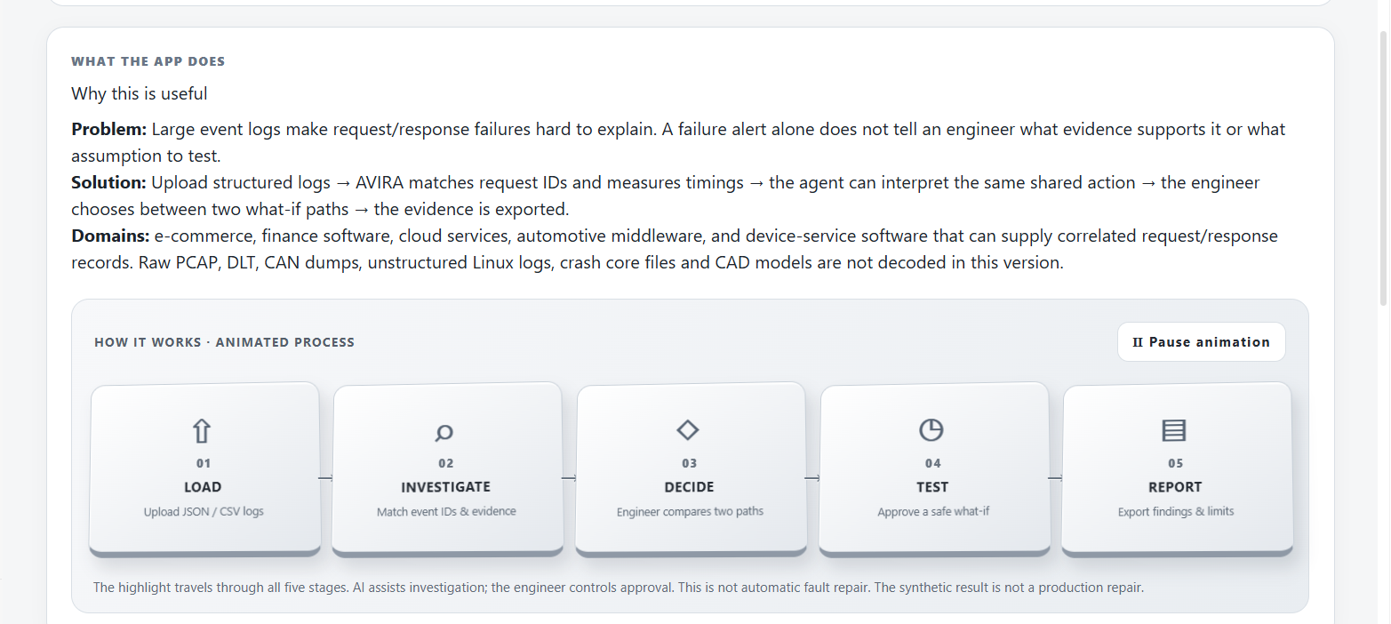
03 / END-TO-END PROCESS
Five stages. Human-controlled investigation.
The animated workflow in the actual AVIRA dashboard.
LOAD → INVESTIGATE → DECIDE → SYNTHETIC TEST → REPORT
AI can assist with interpretation; engineers control parameters and approvals.
AVIRA RELOADED / AGENT-NATIVE HACKATHON 2026
04

Slide 5
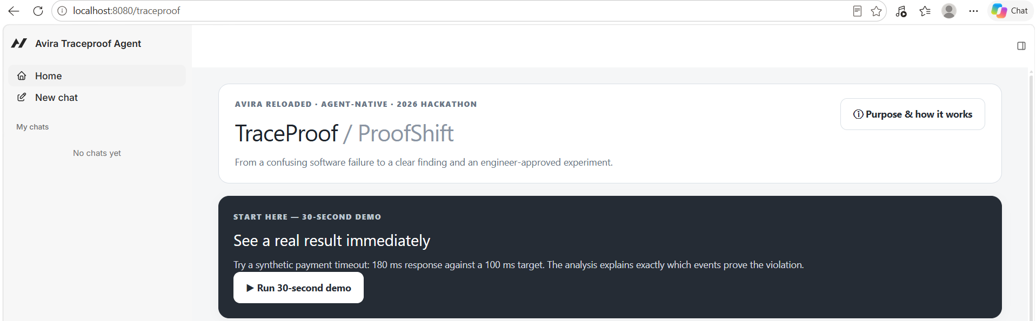
04 / WORKING APPLICATION
A clear dashboard for the first interaction.
Start with the 30-second guided demo or open Purpose & How It Works.
Actual AVIRA React interface built on the Agent-Native starter.
AVIRA RELOADED / AGENT-NATIVE HACKATHON 2026
05

Slide 6
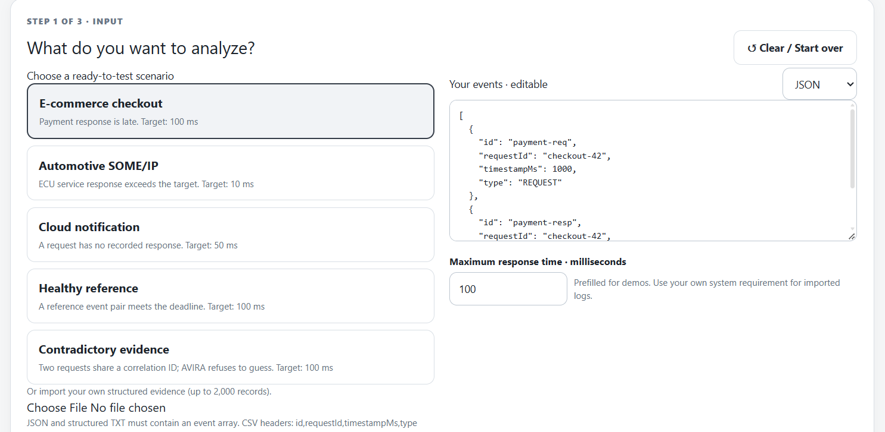
05 / EVIDENCE INPUT
Structured evidence: samples or your own logs.
Editable request/response records, correlation IDs and a configurable timing threshold.
Supports structured JSON, CSV and TXT events • Up to 2,000 records per analysis
AVIRA RELOADED / AGENT-NATIVE HACKATHON 2026
06

Slide 7
06 / EVIDENCE-LINKED FINDINGS
Automotive SOME/IP example: measurable violation.
Two correlated events in sample-automotive.txt; the result is a timing finding, not a confirmed root cause.
18 ms
10 ms
+8 ms
OBSERVED
REQUIRED LIMIT
DEADLINE EXCEEDED
CLASSIFICATION · VIOLATION
Request: ecu-7 | Evidence events: someip-req, someip-resp | 1 violating pair
Finding: the response exceeded the user-selected 10 ms deadline; this alone does not establish why.
AVIRA RELOADED / AGENT-NATIVE HACKATHON 2026
07

Slide 8
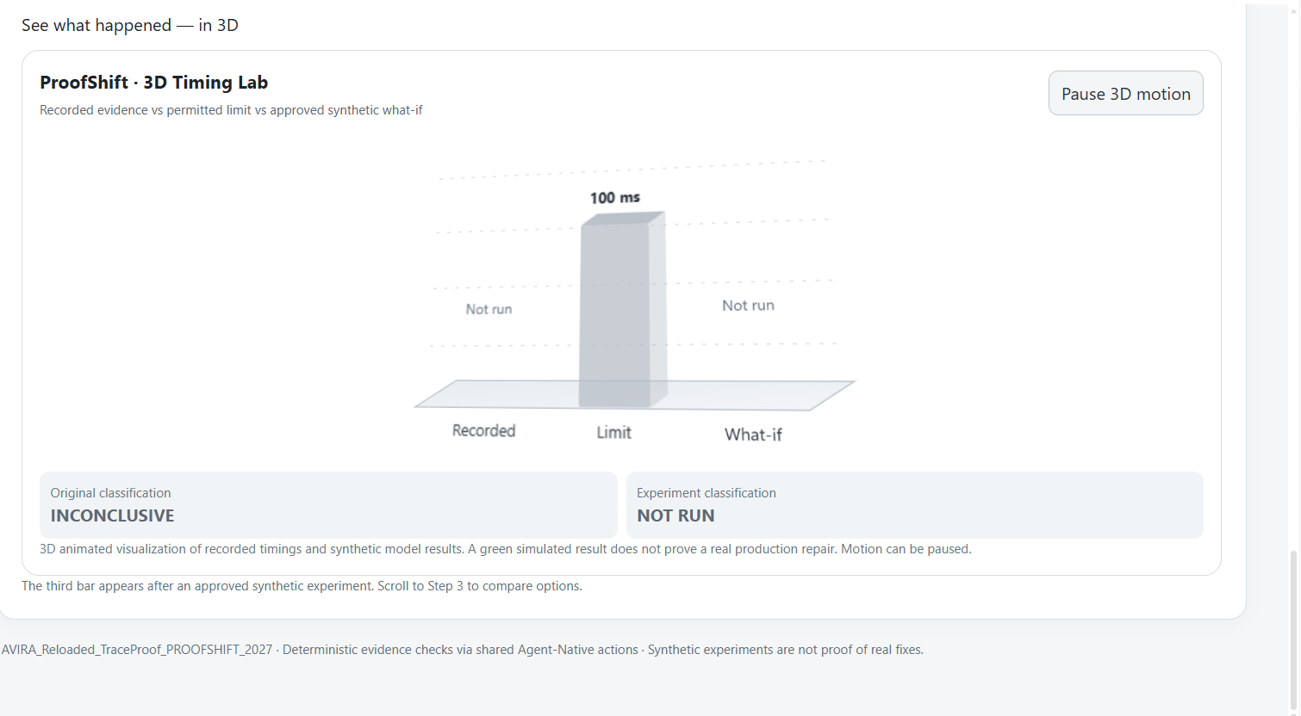
07 / EXPLAIN & EXPERIMENT
A visual lab for recorded vs permitted vs hypothetical.
The third bar is shown only after an engineer approves a synthetic experiment.
No production changes are made. “What-if” outcomes describe assumptions, not verified repairs.
AVIRA RELOADED / AGENT-NATIVE HACKATHON 2026
08

Slide 9
08 / HUMAN + AI CONTROLS
Two choices. One engineer-owned decision.
Example: investigation alternatives after detecting a deadline violation.
A · REDUCE RESPONSE DELAY
B · REVIEW THE DEADLINE
Preserves the original performance requirement.
May remove a threshold alert without changing the code.
Trade-off: implementation effort and actual latency improvement are unknown.
Trade-off: might conflict with requirements, customers or safety constraints.
HUMAN APPROVAL REQUIRED · Example hypothetical: 18 ms → 8 ms against a 10 ms limit
AVIRA RELOADED / AGENT-NATIVE HACKATHON 2026
09

Slide 10
09 / DEMO, SOURCE & CONTACT
Explore the project. Review the evidence.
AVIRA_Reloaded_TraceProof_PROOFSHIFT_2027
WATCH THE DEMO
clips.agent-native.com/r/iNdKNYZRhEbI
VIEW GITHUB
github.com/raddy23/AVIRA_Reloaded_TraceProof_PROOFSHIFT_2027
Rahul Ashokrao Dhapatkar
Pune, India | +91 77458 26084 | dhapatkar2021@gmail.com
AVIRA RELOADED / AGENT-NATIVE HACKATHON 2026
10

