Slide 1


Slide 2
Al Barrak Overview
Al Barrak formed by Master Mariner Capt. Ibrahim Barrak Al Omani in 1982 in Saudi Arabia.
In the industry more than 35 years
Providing all kind of services such as Shipping Agency, Freight Forwarding, Warehousing & Logistics & Multi Model Transportation
Representing major shipping lines in Saudi Arabia, U.A.E, and Sudan
Having presence in KSA, UAE, Sudan, Canada, Iraq, India , Singapore .

Slide 3
Al Barrak Group Net work
ABSA HQ - KSA
DAMMAM RIYADH JEDDAH
UAE INDIA SINGAPORE IRAQ SUDAN CANADA
Global Network

Slide 4
Al Barrak Group Companies
Al Barrak Shipping Agencies
Saudi Maritime Company
Expert Maritime Services
Modern Freight Logistics
Modern Maritime Logistics
Al Barrak Logistics
Al Barrak General Trading

Slide 5
Al Barrak Group Company Services
Shipping Agency
Freight Forwarding Sea & Air
Logistics & Warehouse Distribution
Chartering – Sea & Air
Project and Break Bulk handling
NVOCC operations Iso tank & Dry
Customs clearance
Port Stevedoring
Marine Survey
Transportation
General Trading Activities
P & I Club – Medical Handling
Value added service

Slide 6
Shipping Agencies Under Al Barrak Group
LOCATION – SAUDI ARABIA
CONTAINER CARRIER : Ever Green
Hyundai Merchant Marine
Australian National Line
CAR CARRIER : Glovis
Eukor
WWL
Liberty (LGL)
ARC Line
NMT
BREAK BULK CARRIER : Hyundai Merchant Marine
BBC
ETA /Al Ghurair Bulk Carrier
Tramper Carriers

Slide 7
Shipping Agencies Under Al Barrak Group
NVOCC CARRIER : ABSA Line – ISO Tank Operator
Bulk Haul – ISO Tank Operator
Perma Line – Container Operator
LNL – Container Operator
FEEDER OPERATOR : Seacon-Xpress Feeder
LOCATION – SUDAN
CONTAINER CARRIER : Ever Green
CAR CARRIER : NMT
BREAK BULK CARRIER : Tramper Carriers
FEEDER OPERATOR : Seacon-Xpress Feeder

Slide 8
Shipping Agencies Under Al Barrak Group
LOCATION – IRAQ
CAR CARRIER : NYK
BREAK BULK CARRIER : NYK / Hyundai Break Bulk and Tramper Carriers
NVOCC : ABSA Line
LOCATION – U.A.E.
BREAK BULK CARRIER : Tramper Carriers
NVOCC : ABSA Line

Slide 9
AL BARRAK GROUP – U.A.E.
AL BARRAK SHIPPING AGENCIES CO LLC was established in Dubai in 2004 and AL BARRAK LOGISTICS with the free zone warehouse facility in Jebel Ali.
Al Barrak, U.A.E. main activities include Ship Agency, Freight Forwarding Sea & Air, Logistics & Warehouse Distribution, Chartering – Sea & Air, Project and Break Bulk handling, NVOCC operations ISO tank & Dry, Customs clearance, P & I Club – Medical Handling, Transportation and All types of Value added services.
Al Barrak , UAE provides TOTAL LOGISTICS – Door to Door and expert in handling Military Cargo
AL BARRAK SHIPPING AGENCIES CO LLC was appointed by NYK Car Carrier/ Tokyo, as a General Agent for Umm Qasr, Iraq in 2009 .
NYK Bulk, formerly known as NYK Hinode – Break Bulk Carrier appointed Al Barrak Shipping Agencies Co. as their agent in Umm Qasr, Iraq
Al Barrak, Iraq office is fully controlled and monitored by Al Barrak, Dubai office for better communication and productivity.

Slide 10
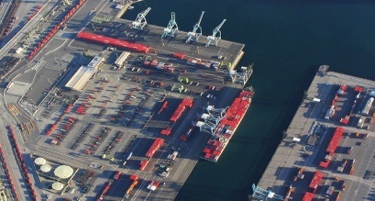
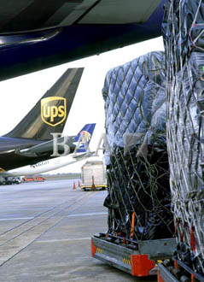
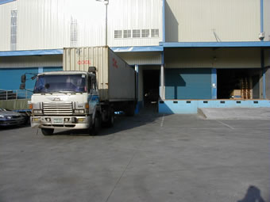
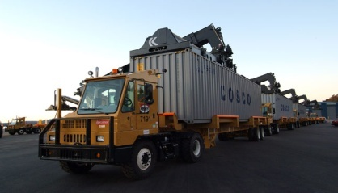
Sea Service
Port to Port & Door to Door
NVOCC
Consolidation, Bulk & Ro/Ro
Comprehensive Import & Export Handling
Warehousing & Distribution
LCL Cargo & Deconsolidation

Slide 11
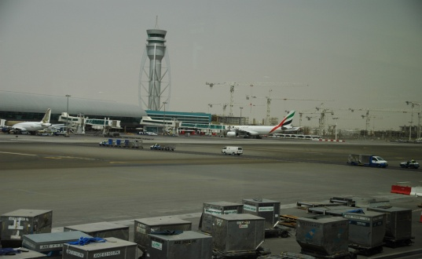
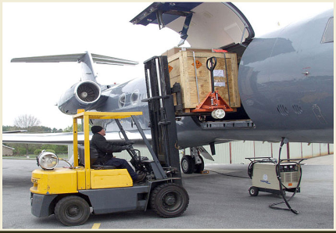

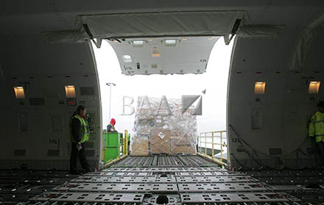
Air Service
Airport to Airport & Door to Door
Express Delivery & Regular Service
Back to Back or Consolidations
Comprehensive Import & Export Handling
Air Project Cargo Services
Warehousing & Distribution

Slide 12
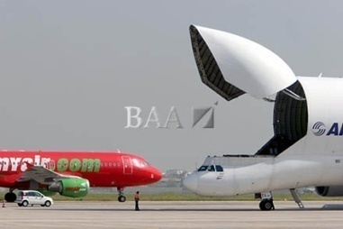
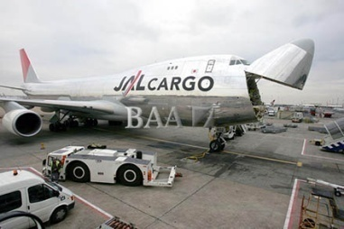
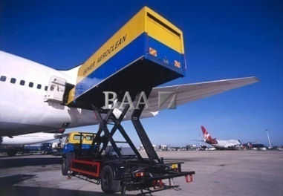

Specialized Service
D & G & Over Sized Cargo
Charter Service
Project Cargo
Personal Effects & Removals
Exhibitions

Slide 13
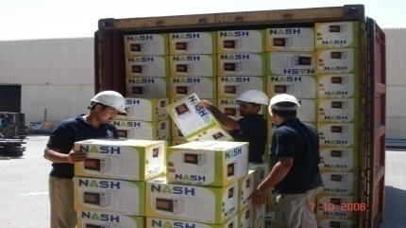
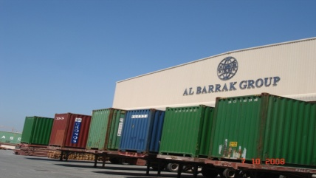
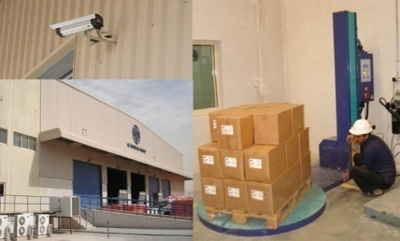
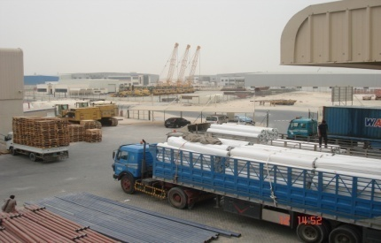
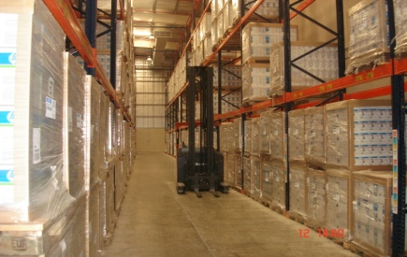
Logistics & Supply Chain Management
Vendor & Purchase Order Follow up
On-Time-Delivery & Inventory Control
Relabeling, Sorting, Pick & Pack
Distribution & Store Delivery
Reverse Logistics
Real-Time Stock & Replenishment Report
Web Access to Inventory
Fully Computerized WMS

Slide 14
Al Barrak Warehouse facilities in Jebel Ali Free Zone
Plot size of 18573 sq. mtrs.
10,619 sq. m area of covered state of the art warehouse.
1100 sq. mtrs. of office area
18 loading/unloading bays with dock levelers.
Multi Tier Heavy Duty Racking Systems with space for 14056 Standard and Euro Pallets
Cargo Storage Capacity 25,000 CBM
Large Staging area and space for Value added activities and special cargo handling (approx. 1200 sq. m)
Latest Handling Equipments :- 4 - Battery Operated Fork Lifts ,
7 - Reach struck, 8 - T 20, and 1 - 5 ton diesel fork lift.
High standards on Safety with state of the art ventilation, lighting and fire fighting systems
Insurance coverage for facility
WMS ( ATMS) for Inventory Control
Round the clock security for manning the facility with complete coverage of 80 CCTV cameras

Slide 15
Al Barrak Warehousing Solutions
Dammam Port Causeway 1 – 80,000 Sq. Meters
Dammam Port Causeway 2 – 50,000 Sq. Meters
Dammam Free Zone – Warehouse – 1600 Sq. Meters
Riyadh Warehouse – 8000 Sq. Meters
Jeddah Warehouse – 136,000 Sq. Meters
Jeddah Free Zone – Warehouse ( Tusdeer ) – 2000 Sq. Meters
Jebel Ali Free Zone ( U.A.E.) Warehouse – 25,000 Sq. Meters

Slide 16
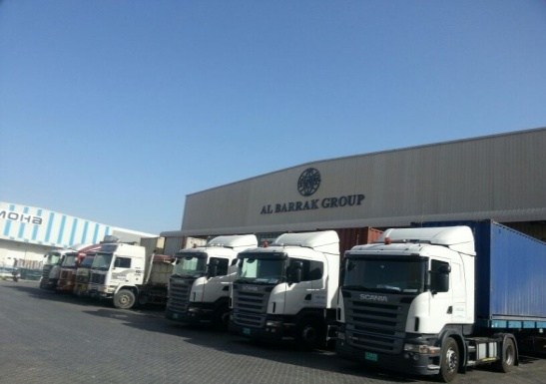
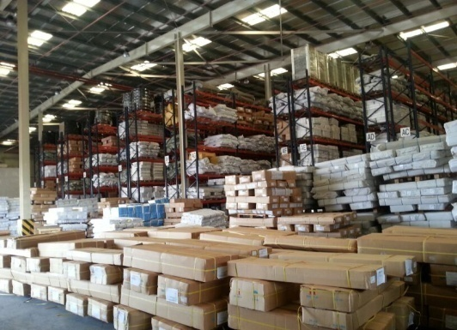
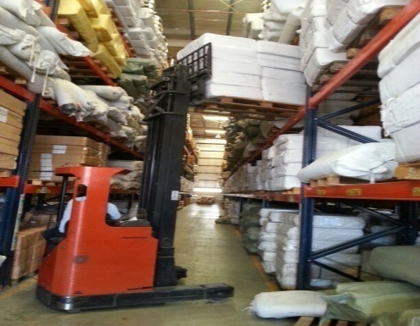
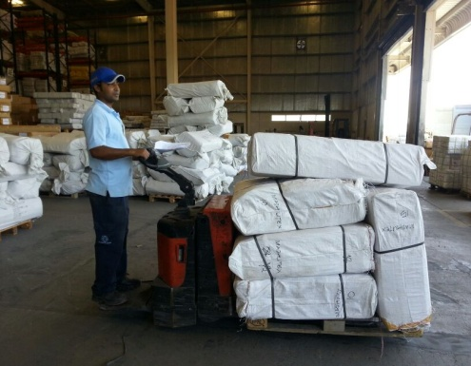
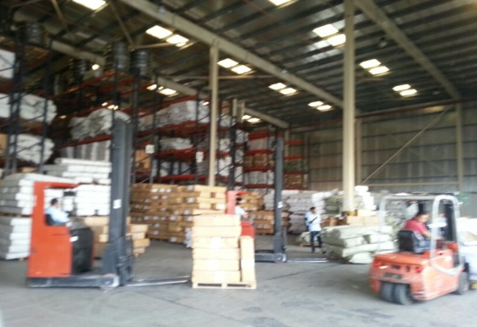
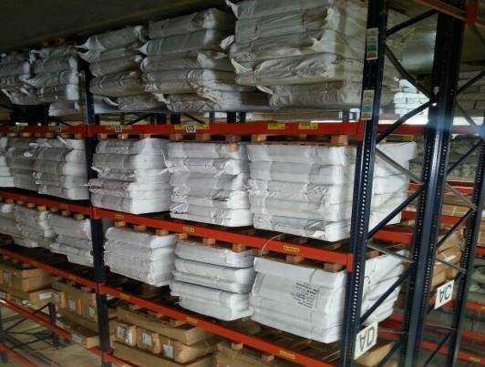
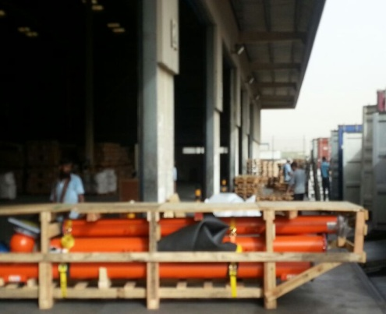
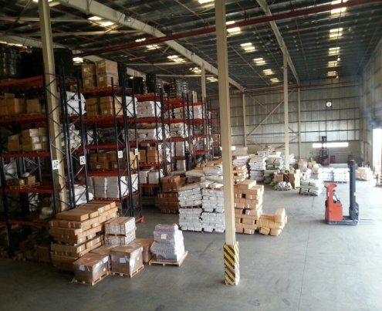
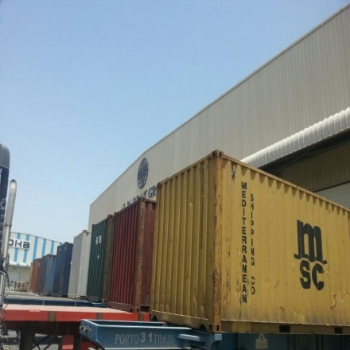
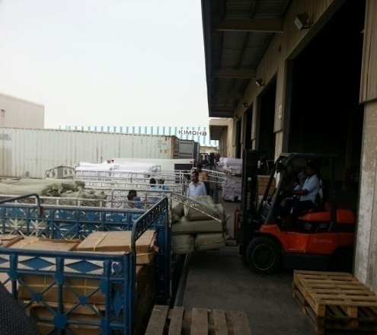
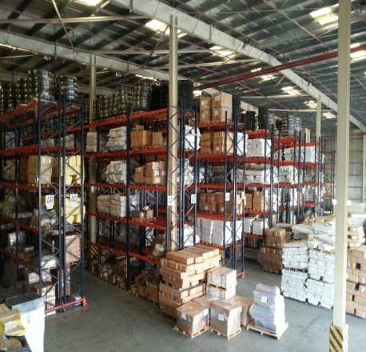
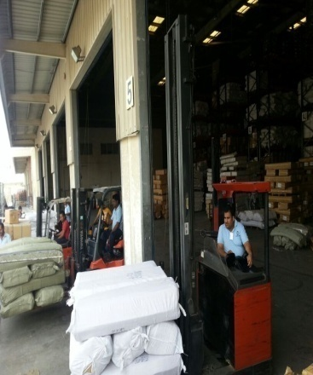
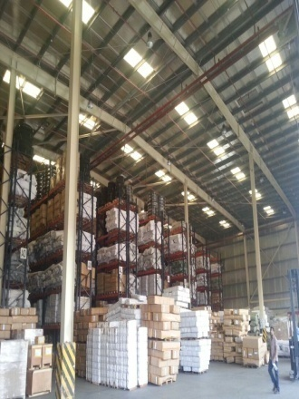
Al Barrak Warehouse facilities in Jebel Ali Free Zone

Slide 17
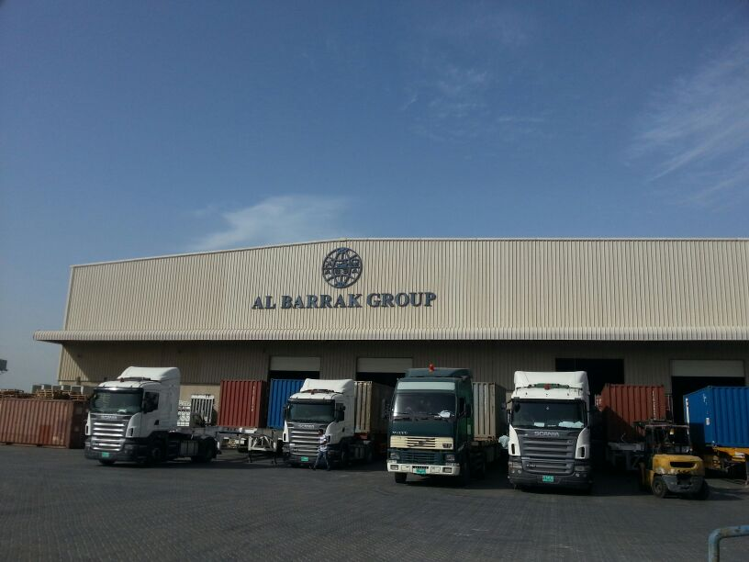
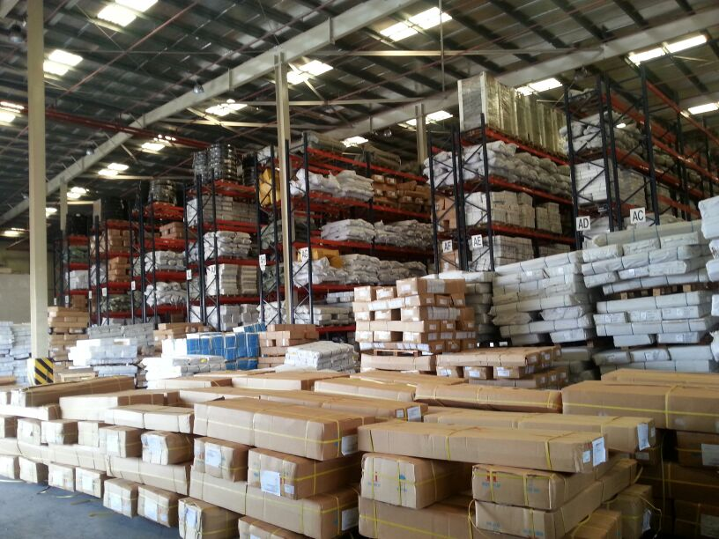



Al Barrak Warehouse facilities in Jebel Ali Free Zone

Slide 18
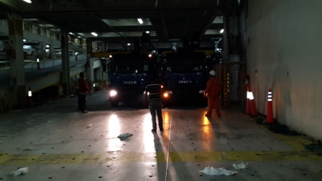
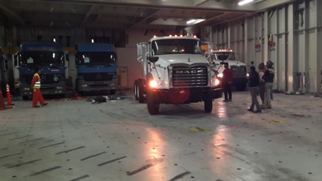
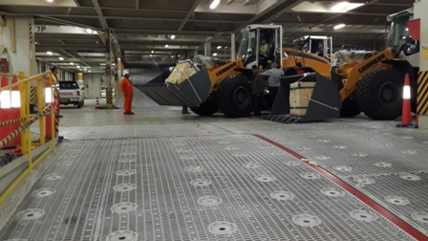
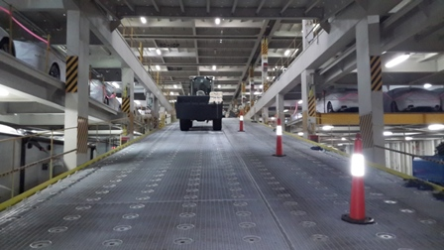
RORO Operation

Slide 19
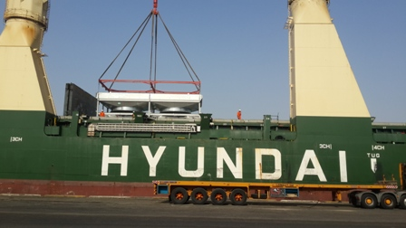
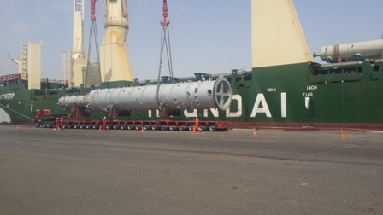
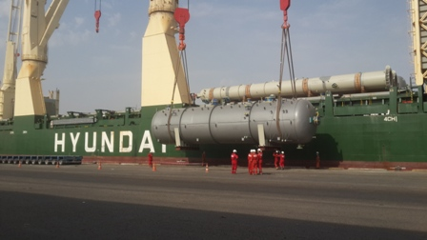
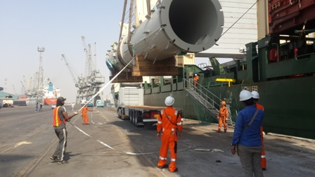
Break Bulk Operation

Slide 20
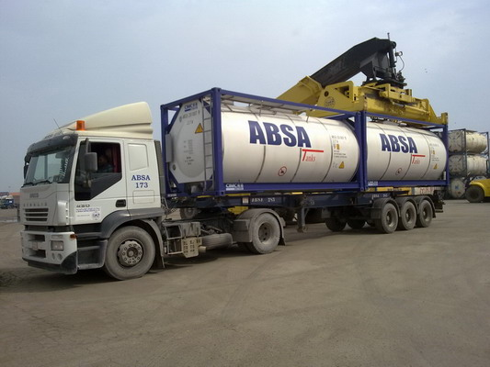
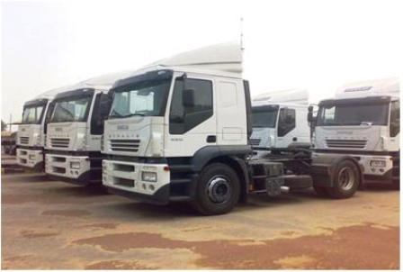
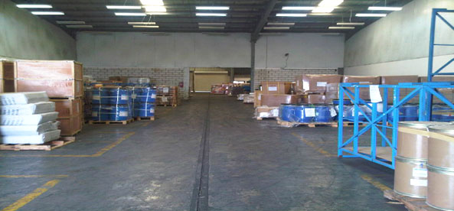
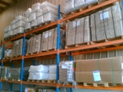
Al Barrak Group Facilities
AL BARRAK ISO-TANK
AL BARRAK - FLEETS
AL BARRAK - WAREHOUSES
AL BARRAK - WAREHOUSES

Slide 21
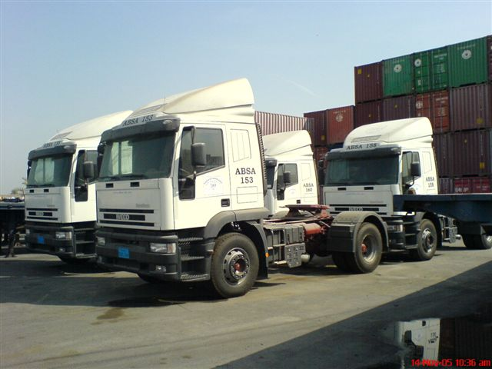
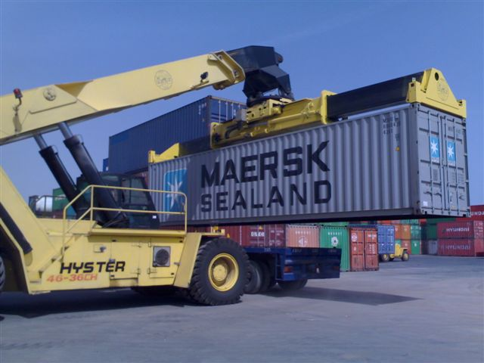
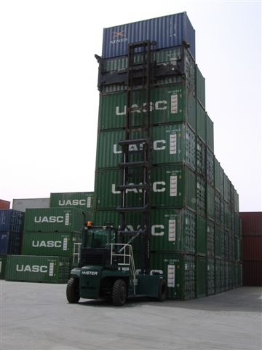
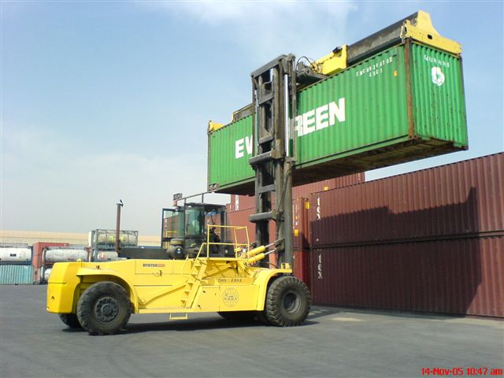
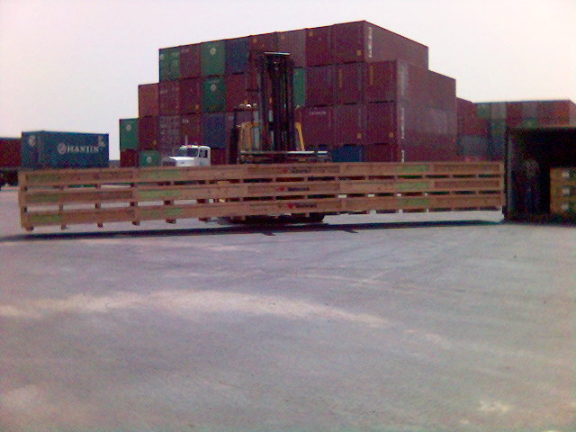
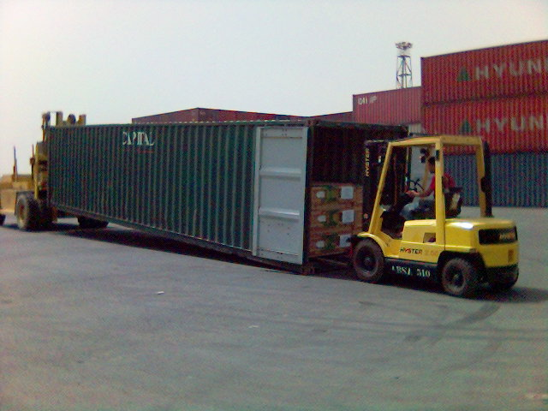
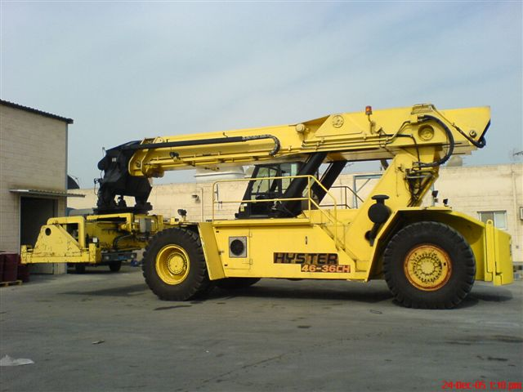
AL BARRAK - TERMINAL

Slide 22
Contact Details
Mr. Isam Al Omani - Managing Director - email : isam@absaco.com
Mr. Barrak Al Omani - Exe. Director - email : barrak@absaco.com
Mr. Emad Al Omani - Exe. Director - email : emad@absaco.com
Mr. Gerald Canute – General Manager - email : g.canute@ absaco.com
Mr. KB Kang – Group Project Development Manager email : kbkang@absaco.com
Al Barrak Shipping Agencies LLC Co.,
The Palace Tower - 16th floor , 1602
Dubai Silicon Oasis, Dubai – UAE .
Tel : +971 4 3208808
Fax : +971 4 3208809

Slide 23
THANK YOU ..

