Slide 1
L-15
Classification of Linear Partial Differential Equation of Second Order

Slide 2

Consider the Differential equation of Second order in Two independent variables x and y as
Where A,B,C are constants or continous functions of x and y.

Slide 3



Slide 4
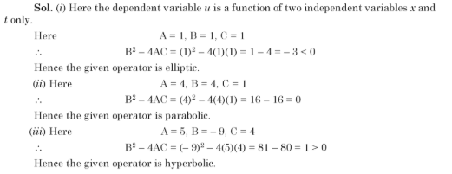
Example: Classify following operators

Slide 5



Example : Classify following PDE

Slide 6
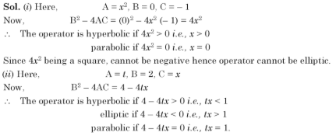
Example: Classify following operator

Slide 7
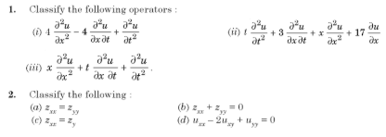
Practice Questions

Slide 8

Answers

