Slide 1
L-16
Method of Separation of Variables

Slide 2
Method of Separation of Variables
Let dependent variable is function of two independent variables.
In this method , we assume that dependent variable is product of Two functions, each of which involves only one of independent variables

Slide 3


Example: Use the Method of separation of variables

Slide 4
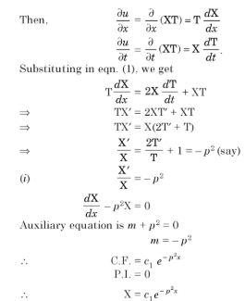

Slide 5
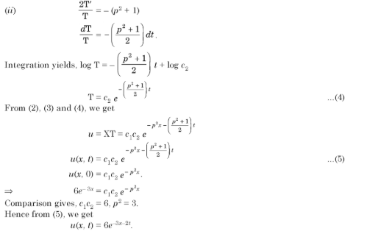

Slide 6

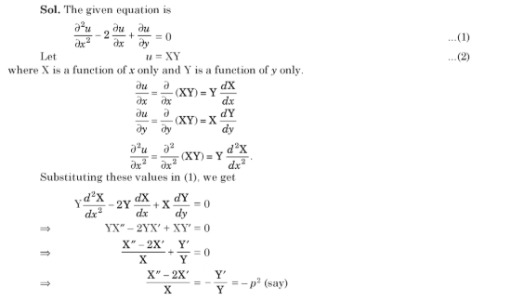
Example: Use the Method of separation of variables

Slide 7
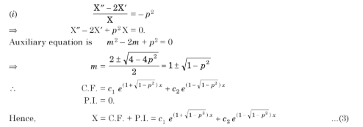

Slide 8
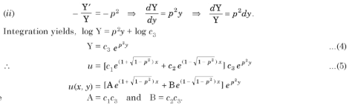

Slide 9

Practice Questions

Slide 10
Answers

