Slide 1
L-17
Method of Separation of Variables

Slide 2
Method of Separation of Variables
Let dependent variable is function of two independent variables.
In this method , we assume that dependent variable is product of Two functions, each of which involves only one of independent variables

Slide 3

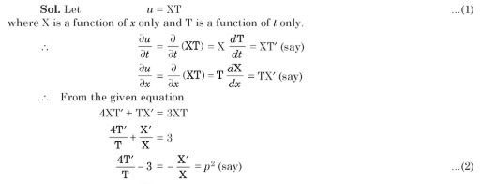
Example : Solve by separation of variable method

Slide 4
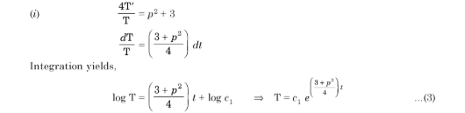
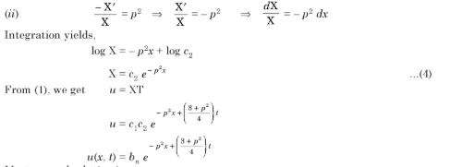

Slide 5
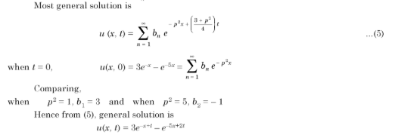

Slide 6

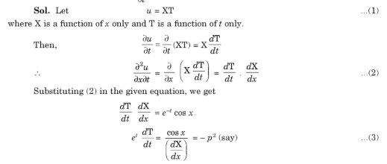
Example : Solve by separation of variable method

Slide 7
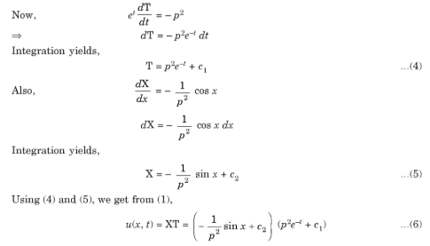

Slide 8

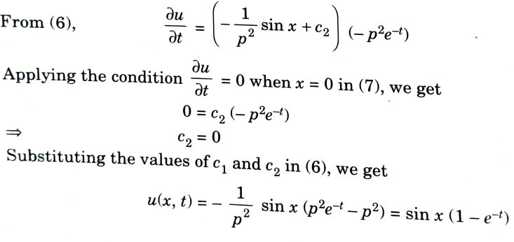

Slide 9



Practice Question
1
2
3

Slide 10
Answers
1
2
3

