Slide 1
L-18
One Dimensional Wave Equation

Slide 2
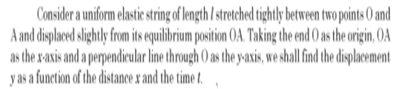
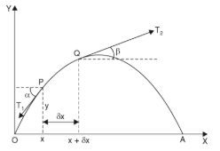

Slide 3

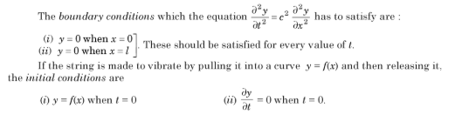
This is PDE giving the transverse vibrations of the string.
Where y(x,t) represents displacement of string.

Slide 4

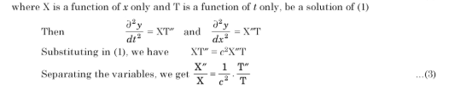
Solution of 1D –wave Equation
The wave equation is

Slide 5

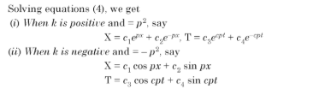


Slide 6


Since we dealing with a problem on vibrations so y must be periodic .Therefore solution must contain trigonometric terms.
Solution of 1D-wave equation will be corresponding to k is negative and $k=−p^{2}$

Slide 7



Slide 8


Solution of wave equation satisfying boundary conditions

Slide 9
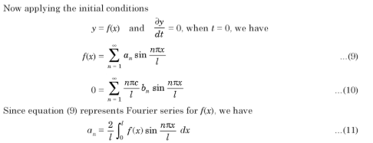


Slide 10
Practice Questions
Q1.
Find the deflection y(x,t) of the vibrating string of length l and ends are fixed ,corresponding to zero initial velocity and initial deflection is given by f(x).

Slide 11

Answer
Ans 1.

