Slide 1
Partial Differential Equations

Slide 2
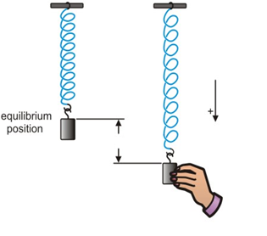

Introduction
Ordinary differential equation:
In any physical
phenomenon, if there is one independent variable upon which the dependent variable depends. It may generate an ordinary differential equation.
For example, in a mass spring System, the motion of the spring results the following differential equation
(undamped system)
which is an ordinary differential equation of second order.
y

Slide 3
Partial differential equation:
When the dependent variable depends upon two or more than two independent variables then partial differential equations may occur. Partial differential equations arise in geometry, physics, applied mathematics, life sciences, physical chemistry and engineering also.

Slide 4



Definition
An equation containing one or more partial derivatives of an unknown function of two or more than two independent variables is known as partial differential equation.
Example:
1.
2.
3.

Slide 5

Some physical examples of PDE
HEAT EQUATION:
Consider heat conduction in a homogeneous rod of length L, assume that the rod has constant density and uniform cross section A. Also assume that the lateral surface of the rod is insulated. Therefore heat flows only in one direction say x. The rod is sufficiently thin so that the temperature is same at all points of any cross sectional area of the rod. Let u(x, t) be the temperature of the cross section at the point x and at any time t. Then

Slide 6

This phenomenon can be modeled mathematically as
This is a partial differential equation and is known as heat equation.

Slide 7
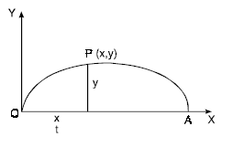
Wave equation
One – dimensional wave equation arises in the study of transverse vibration of an elastic string. Consider an elastic string, stretched to its length L with its two ends. Density of the string is constant. Let y(x, t) be the deflection of string at any point x and at any time t > 0 from the equilibrium position. When the string is distorted, then it vibrates.

Slide 8

The transverse vibrations of such a vibrating string are mathematically modeled by one dimensional wave equation as follows:
this is also a partial differential equation.

Slide 9


Order of partial differential equation
The order of the partial differential equation is defined as the order of the highest partial derivative occurring in the partial differential equation
Example: Find the order of the following PDE
1. Ans. 2
2. Ans: 1

Slide 10

Degree of the partial differential equation
The degree of a partial differential equation is the degree of the higher order partial derivative which occurs in it after the equation has been rationalised.
Example: Find the degree of the following PDE
1. Ans: 1
2. Ans: 2

Slide 11



Linear pde and non linear pde
An equation is said to be linear if dependent variable and its partial derivatives occur in first degree and are not multiplied.
If equation is not linear then it is non linear.
Example: 1. linear
2. Non linear
3. Non linear

Slide 12



Semi linear and quasi linear
If we consider the first order PDE then these concepts are also defined.
An equation of the form
P(x, y) p + Q(x, y) q = R(x, y, z) is called semi linear PDE.
Example: xy p + yx² q = x z²
An equation of the form
P(x, y, z) p + Q(x, y, z) q = R(x, y, z) is called quasi linear PDE.
Example: x² z p + yz q = xy sin z
Here p= , q = Now onwards we will also use

Slide 13




Practice questions
Find the order and degree of the following PDEs
1. Ans:2, 1
2. Ans: 1, 3
Which of the following PDEs is/are linear/ non linear
3. Ans: non linear
4. Ans: linear

