Slide 1
LECTURE-2
Formation of Partial Differential Equations
Partial differential equation can be formed in two ways- (1) eliminating arbitrary constants and (2) eliminating arbitrary functions

Slide 2
By Elimination of Arbitrary constants:
We can form partial differential equation by eliminating arbitrary constants from the given equations.
Now if the number of arbitrary constants is equal to the number of variables, in the given equation of a curve, then we get a first order partial differential equation
Consider the equation f(x, y, z, a, b) = 0 ….(1)
Where a and b are arbitrary constants. Differentiating (1) partially with respect to x and y, we get

Slide 3
….(2)
….(3)
Eliminating a and b from the equations (1), (2) and (3), we get an equation of the form
F (x, y, z, p, q) = 0
Which is the required partial differential equation of (1)
Three cases may arise :

Slide 4
Case I. When the number of arbitrary constants is less than the number of independent variables, then the elimination of arbitrary constants usually gives rise to more than one partial differential equation of order one.

Slide 5
For example, consider z = ax + y , ... (1)
where a is the only arbitrary constant and x, y are two independent variables
Differentiating (1) partially w.r.t. ‘x’, we get
Differentiating (1) partially w.r.t. ‘y’, we get
Eliminating a between (1) and (2) yields

Slide 6
Since (3) does not contain arbitrary constant, so (3) is also partial differential under consideration. Thus, we get two partial differential equations (3) and (4).

Slide 7
Case II. When the number of arbitrary constants is equal to the number of independent variables, then the elimination of arbitrary constants shall give rise to a unique partial differential equation of order one.

Slide 8
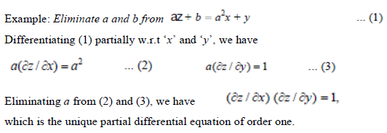

Slide 9
Case III. When the number of arbitrary constants is greater than the number of independent variables, then the elimination of arbitrary constants leads to a partial differential equation of order usually greater than one.

Slide 10
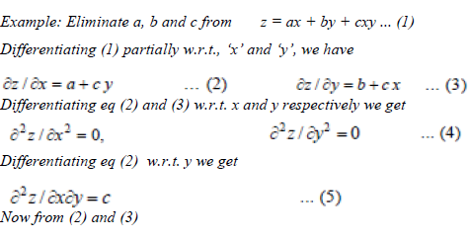

Slide 11
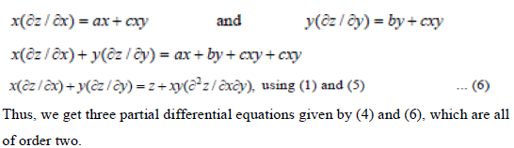

Slide 12
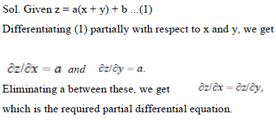
Question 1. Form partial differential equations by eliminating arbitrary constants a and b from the following relations : z = a(x + y) + b.

Slide 13
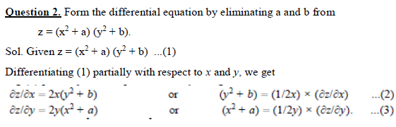


Slide 14
2. Formation of Partial Differential Equations by The Elimination of Arbitrary Function
When one Arbitrary Function is involved, in this case the resulting partial differential equation is a first order partial differential equation
Let the arbitrary function be of the form z = f(u) …(1)
where u is function of x, y, z
Differentiating (1) partially with respect to x and y, we get

Slide 15
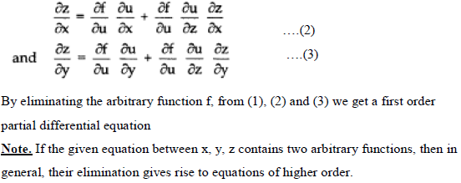

Slide 16
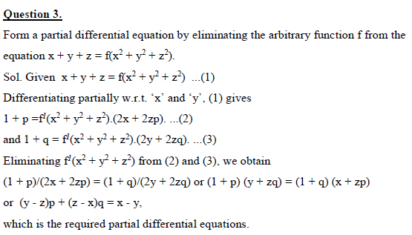

Slide 17
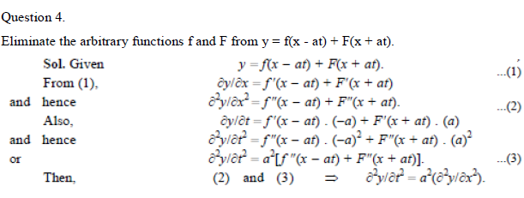

Slide 18
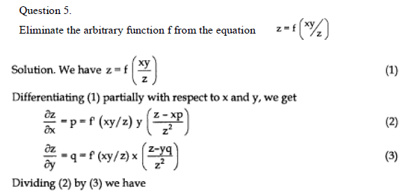

Slide 19
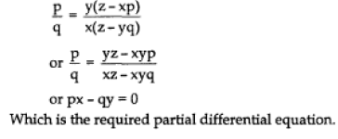

Slide 20
HOME WORK QUESTIONS
Q I. Form the differential equation by eliminating arbitrary constant in the following equation
1.
2.

Slide 21
Q II. Eliminate the arbitrary functions and hence obtain the partial differential equations:
3.
4.

