Slide 1
LECTURE N0-3
LINEAR HOMOGENOUS PARTIAL DIFFERENTIAL EQUATIONS OF nth ORDER WITH CONSTANT COEFFICIENTS

Slide 2

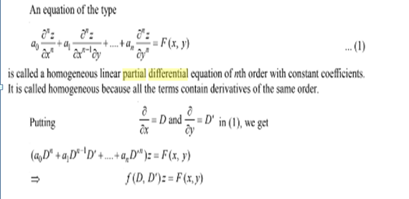

Slide 3
SOLUTION OF f(D,D’)Z=F(x,y)
Complete solution of f(D,D’)z=F(x, y) is
Z=C.F. +P.I
C.F is the Complementary function which is the general solution of f(D,D’)Z=0. It must contain arbitrary functions. The number of arbitrary functions must be equal to the order of the differential equation.
P.I is the particular solution(free from arbitrary functions) of f(D,D’)z=F(x, y)

Slide 4
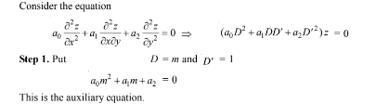
RULES FOR FINDING CF
We explain the procedure for finding CF of a differential equation of the second
order. It can be easily extended to differential equations of higher order .
Step-2 Solve the auxiliary equation.

Slide 5



Slide 6

C.F.=
The required solution Z=C.F. +P.I

Slide 7

C.F =
P.I.=0
Z=C.F. +P.I

Slide 8

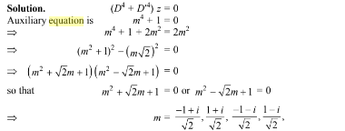
EXAMPLE-3

Slide 9


C.F=
P.I.=0
Z=C.F. +P.I

Slide 10
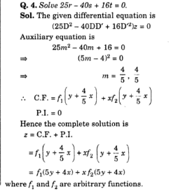

Slide 11
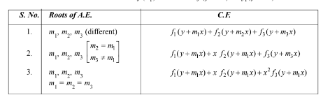
POINTS TO REMEMBER

Slide 12
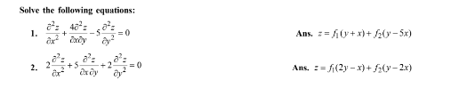
HOME WORK
4 )

