Slide 1
L - 4
Linear Homogenous Partial Differential Equation of Higher Order with Constant Coefficient:
Methods for Finding P.I.

Slide 2

Homogeneous Linear Partial Differential Equations with constant Coefficients.
A homogeneous linear partial differential equation of the nth order is of the form
homogeneous because all its terms contain derivatives of the same order.

Slide 3

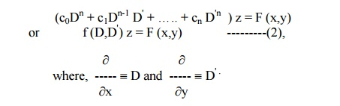
Equation (1) can be expressed as

Slide 4
As in the case of ordinary linear Differential equations with constant coefficients the complete solution consists of two parts, namely, the complementary function and the particular integral.
In similar way, solution of Eq(1) is given by
Z= C.F.+P.I

Slide 5

Finding the particular Integral

Slide 6
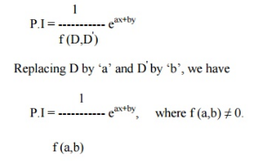
Case I : when F(x, y) = e^{ax+by}

Slide 7

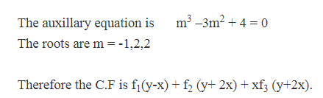
Example 1
Solution:
[Replace D-> m, D’->1, z->1 to form auxiliary equation]

Slide 8

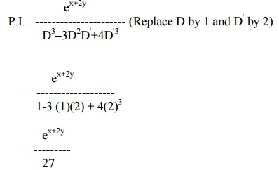

Slide 9


Slide 10


Case II : when F(x,y)=Sin(ax+by) or cos(ax+by)

Slide 11

Example :
Solution:
[ for auxiliary equation D->m, D’->1, z->1]

Slide 12


Slide 13




Slide 14


Example :
Solution:

Slide 15




Slide 16




Slide 17


Slide 18

Example:
Solution:

Slide 19





Slide 20




Slide 21

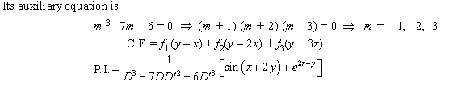
Solution:

Slide 22





Slide 23





Slide 24


Slide 25



Case III: When F(x,y)=Φ(ax+by)

Slide 26

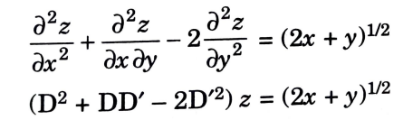


Solution:

Slide 27
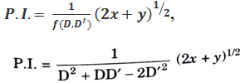



Slide 28


Slide 29



Solution:

Slide 30




Slide 31



Slide 32
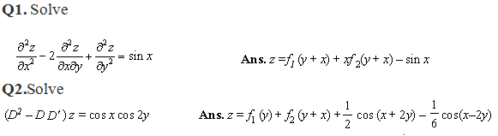
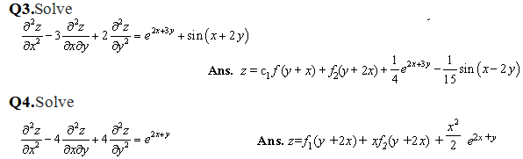
Practice Question

Slide 33
