Slide 1
Application structure

Slide 2
Agenda

Slide 3
App types
Web
Server-side
HTML, CSS, JavaScript, PHP
Hybrid
Native container (Phonegap/Cordova)
Native
Specific platform
Objective-C, Java, C#
HTML, CSS, JavaScript

Slide 4
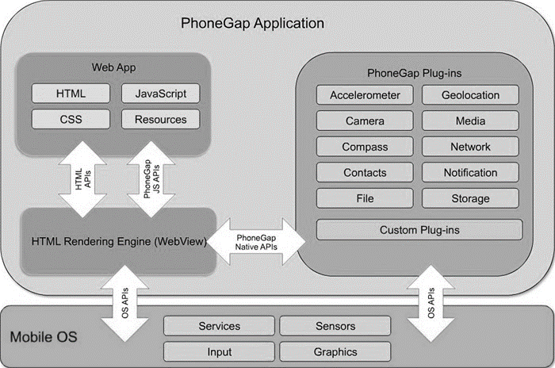
PhoneGap/Cordova architecture

Slide 5
App project structure
PROJECT
config.xml
www
merge
css
img
js
index.html
android
ios
Windows
Javascript files
App images
Css files
App project structure

Slide 6
Index.html
<!DOCTYPE html> <html> <head> <meta http-equiv="Content-type" content="text/html; charset=utf-8"> <script src="js/pgb.js"></script> <script src="cordova.js"></script> </head> <body onload="init()"> <h1>Hello World!</h1> <p id="dp"></p> <input type="button" onclick="deviceInfo()" value="Let me introduce myself!"> </body> </html>

Slide 7
Javascript file
function init() { document.addEventListener("deviceready",onDeviceReady, false); }
function onDeviceReady() { navigator.notification.beep(1); }
function deviceInfo() { info = 'Hi, I am your smartphone :-)' + '\n' + '=====' + '\n' + 'Device Name : ' + device.name + '\n' + 'Device Cordova : ' + device.cordova + '\n' + 'Device Platform: ' + device.platform + '\n' + 'Device UUID : ' + device.uuid + '\n' + 'Device Model : ' + device.model + '\n' + 'Device Version : ' + device.version + '\n'; navigator.notification.alert(info); }

Slide 8
Config.xml file
<?xml version="1.0" encoding="UTF-8" ?> <widget xmlns = http://www.w3.org/ns/widgets xmlns:gap = http://phonegap.com/ns/1.0 id = "myfirstapp" version = "1.0.0" >
<name>First app</name> <description>My first mobile app</description> <author href="http://mypersonalwebsite.com" email="johnbrown@gmail.com"> John Brown </author> <platform name="android" /> <plugin name="cordova-plugin-device" spec="~1.1.4" /> <plugin name="cordova-plugin-dialogs" spec="~1.3.1" /> </widget>
App configuring

Slide 9
Project management
Project Local repo
Remote repo Github
PhoneGap build
Mobile device

Slide 10
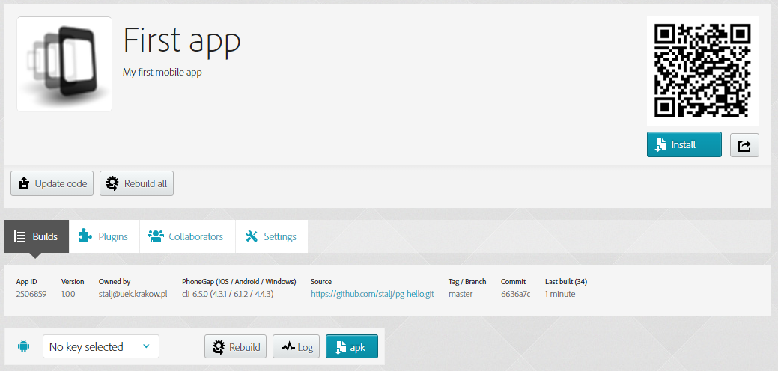
PhoneGap Build project

Slide 11
Hello World app
https://github.com/stalj/pg-hello.git

Slide 12

To do

Slide 13
Run sample app
Clone, prepare, and launch the Hello World sample app.

Slide 14
Modify sample app
Add in your sample app a button.
After clicking on the button, your personal data are to be displayed.
Launch the app on a mobile device.

Slide 15
Display your business card
Create the app ’businesscard’ to display your personal information
Name and surname
Email
Website (if you have)
Dean’s group number
Field of study
Use CSS to improve quality of your business card.
Run the app on a mobile device.

Slide 16
Make a network connection
Create the app ’network’ to display the device's cellular and wifi connection, and whether the device has an internet connection.
Use the proper core plug-in.
Take a look at the example of the plug-in usage contained at the plug-in webpage.
Launch the app on a mobile device. Try your app out by switching on/off WiFi/3G/LTE connection.

Slide 17
Detect a device movement
Create the app ’motion’ to detect a device movement.
Use the proper core plug-in.
Take a look at the example of the plug-in usage contained at the plug-in webpage.
Launch the app on a mobile device. Try to move the device and check displayed results.

Slide 18
Improve the business card app
Improve the ’businesscard’ app.
Add a splashscreen and replace a default app icon with your own one.
Use the proper core plug-in.
Launch the app on a mobile device.

Slide 19
Display contact list
Create the app ’contactlist’ to display the contact list (name and phone number) of your mobile device.
Use the proper core plug-in.
Launch the app on a mobile device.

Slide 20
Send a text message
Search for the plug-in for sending a text message (SMS) from your device.
Create the app ’sms’. Add two input fields (phone number, message) and a button ’Send’.
Send any text message to yourself and/or your friend/colleague.

