Slide 1
br

Slide 2
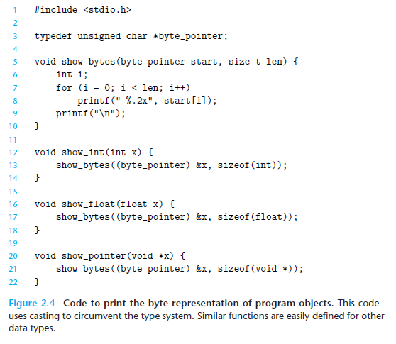
Byte representation

Slide 3
Byte representation
Hey compiler, from now on when I say byte_pointer, I actually mean unsigned char*, because I’m lazy and tired of typing.

Slide 4
Byte representation
unsigned char is the smallest addressable chunk of memory in C (1 byte).
this typedef gives it a cute little nickname: byte_pointer.

Slide 5
Byte representation
This function is the superstar.
It's the one doing all the byte-revealing magic.

Slide 6
Byte representation
It loops through each byte of memory starting at start.
It prints out each byte as a two-digit hexadecimal number (because binary would be too nerdy, even for us).

Slide 7
Byte representation
Why %.2x?
%x prints in hexadecimal.
.2 means: always print at least two digits, with a leading zero if needed.
Like formatting your exam scores to make them look cooler—“07” looks fancier than “7”.

Slide 8
Byte representation
Hey show_bytes, here’s an int.
I want you to strip it down to the byte level.

Slide 9
Byte representation
&x gets the address of x.
(byte_pointer) casts that address into a pointer to bytes.
sizeof(int) tells it how many bytes to read.

Slide 10
Byte representation
So, we’re sneaking around the type system.
It's like saying: “I don’t care what type it says it is, just give me the raw bytes!”

Slide 11
Byte representation
Same thing, but for float.
Because float and int look nothing alike when you peek into their memory.
It’s like comparing pizza and cake: both are tasty, but fundamentally different.

Slide 12
Byte representation
This one’s fun—it's for showing the actual memory address.
void * is C’s way of saying: “This pointer could point to anything. I’m not picky.”
Again, we cast it to byte_pointer and show its bytes.

