Slide 1
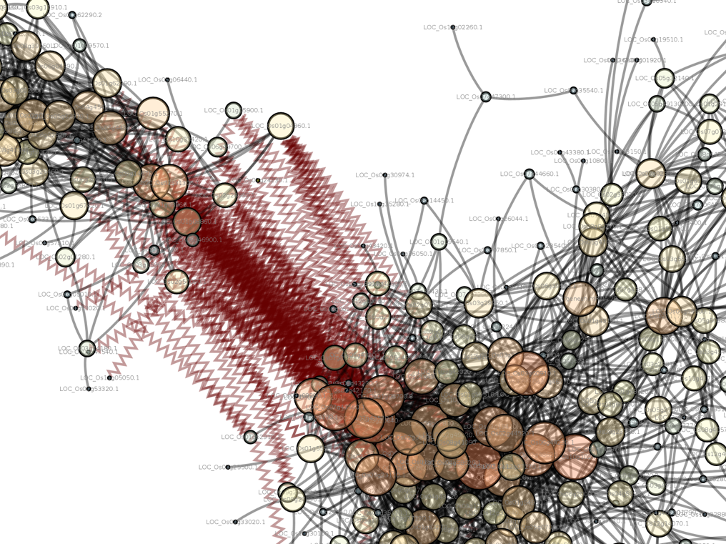
Introduction to Computing for Data Science
Day 15
02/27/2018
Hort 503-01 Spring 2018

Slide 2
Question and Answer Session
Now is the time to ask any questions you may have had concerning the first lesson and assignment.

Slide 3
Assignment #8 Review
What are the 3 rules of Tidy data?

Slide 4
Assignment #8 Review
What are the 3 rules of Tidy data?
1. Each variable forms a column.
2. Each observation forms a row.
3. Each type of observational unit forms a table.
“the layout ensures that values of different variables from the same observation are always paired.”
Why do we want to Tidy our data?

Slide 5
Assignment #8 Review
What are the 3 rules of Tidy data?
1. Each variable forms a column.
2. Each observation forms a row.
3. Each type of observational unit forms a table.
“the layout ensures that values of different variables from the same observation are always paired.”
Why do we want to Tidy our data?
Data is easier to manipulate, analyze and visualize

Slide 6
Assignment #8 Review
What makes this data untidy?
 | Treatment A | Treatment B
John Smith | - | 2
Jane Doe | 16 | 11
Mary Johnson | 3 | 1
Notes:
Table from http://www.jeannicholashould.com/tidy-data-in-python.html

Slide 7


Assignment #8 Review
What makes this data untidy?
 | Treatment A | Treatment B
John Smith | - | 2
Jane Doe | 16 | 11
Mary Johnson | 3 | 1
Values for variables are stored in the header
Name | Treatment | Result
John Smith | a | -
Jane Doe | a | 16
Mary Johnson | a | 3
John Smith | b | 2
Jane Doe | b | 11
Mary Johnson | b | 1
Notes:
Table from http://www.jeannicholashould.com/tidy-data-in-python.html

Slide 8
Assignment #8 Review
What makes this data untidy?
id | year | month | element | d1 | d2 | d3 | d4 | d5 | d6 | d7 | d8
MX17004 | 2010 | 1 | tmax | NaN | NaN | NaN | NaN | NaN | NaN | NaN | NaN
MX17004 | 2010 | 1 | tmin | NaN | NaN | NaN | NaN | NaN | NaN | NaN | NaN
MX17004 | 2010 | 2 | tmax | NaN | 27.3 | 24.1 | NaN | NaN | NaN | NaN | NaN
MX17004 | 2010 | 2 | tmin | NaN | 14.4 | 14.4 | NaN | NaN | NaN | NaN | NaN
MX17004 | 2010 | 3 | tmax | NaN | NaN | NaN | NaN | 32.1 | NaN | NaN | NaN
MX17004 | 2010 | 3 | tmin | NaN | NaN | NaN | NaN | 14.2 | NaN | NaN | NaN
MX17004 | 2010 | 4 | tmax | NaN | NaN | NaN | NaN | NaN | NaN | NaN | NaN
MX17004 | 2010 | 4 | tmin | NaN | NaN | NaN | NaN | NaN | NaN | NaN | NaN
MX17004 | 2010 | 5 | tmax | NaN | NaN | NaN | NaN | NaN | NaN | NaN | NaN
MX17004 | 2010 | 5 | tmin | NaN | NaN | NaN | NaN | NaN | NaN | NaN | NaN

Slide 9
Assignment #8 Review
Variables values are in the column names
What makes this data untidy?
id | year | month | element | d1 | d2 | d3 | d4 | d5 | d6 | d7 | d8
MX17004 | 2010 | 1 | tmax | NaN | NaN | NaN | NaN | NaN | NaN | NaN | NaN
MX17004 | 2010 | 1 | tmin | NaN | NaN | NaN | NaN | NaN | NaN | NaN | NaN
MX17004 | 2010 | 2 | tmax | NaN | 27.3 | 24.1 | NaN | NaN | NaN | NaN | NaN
MX17004 | 2010 | 2 | tmin | NaN | 14.4 | 14.4 | NaN | NaN | NaN | NaN | NaN
MX17004 | 2010 | 3 | tmax | NaN | NaN | NaN | NaN | 32.1 | NaN | NaN | NaN
MX17004 | 2010 | 3 | tmin | NaN | NaN | NaN | NaN | 14.2 | NaN | NaN | NaN
MX17004 | 2010 | 4 | tmax | NaN | NaN | NaN | NaN | NaN | NaN | NaN | NaN
MX17004 | 2010 | 4 | tmin | NaN | NaN | NaN | NaN | NaN | NaN | NaN | NaN
MX17004 | 2010 | 5 | tmax | NaN | NaN | NaN | NaN | NaN | NaN | NaN | NaN
MX17004 | 2010 | 5 | tmin | NaN | NaN | NaN | NaN | NaN | NaN | NaN | NaN
Variables are in the rows.

Slide 10
Assignment #8 Review
This line was in the Tidy Tutorial:
df['date'] = pd.to_datetime(df['date.entered']) +
pd.to_timedelta(df['week'], unit='w') –
pd.DateOffset(weeks=1)
What does it do?
year | artist.inverted | track | time | genre | date.entered | date.peaked | week | rank
2000 | Destiny's Child | Independent Women Part I | 3:38 | Rock | 2000-09-23 | 2000-11-18 | 1 | 78
2000 | Santana | Maria, Maria | 4:18 | Rock | 2000-02-12 | 2000-04-08 | 1 | 15
2000 | Savage Garden | I Knew I Loved You | 4:07 | Rock | 1999-10-23 | 2000-01-29 | 1 | 71
2000 | Madonna | Music | 3:45 | Rock | 2000-08-12 | 2000-09-16 | 1 | 41

Slide 11
Assignment #8 Review
This line was in the Tidy Tutorial:
df['date'] = pd.to_datetime(df['date.entered']) +
pd.to_timedelta(df['week'], unit='w') –
pd.DateOffset(weeks=1)
What does it do?
Dates are stored as “timestamps” (e.g. 1519720860 = 2/27/2018). The date functions make it easy to work with these numeric values.
pd.to_datetime: converts a given argument to a datetime object.
pd.to_timedelta: difference in time in specific unites (e.g. days, weeks, years, etc).
pd.DateOffset: used to add/subtract an offset from a given datetime object.
year | artist.inverted | track | time | genre | date.entered | date.peaked | week | rank
2000 | Destiny's Child | Independent Women Part I | 3:38 | Rock | 2000-09-23 | 2000-11-18 | 1 | 78
2000 | Santana | Maria, Maria | 4:18 | Rock | 2000-02-12 | 2000-04-08 | 1 | 15
2000 | Savage Garden | I Knew I Loved You | 4:07 | Rock | 1999-10-23 | 2000-01-29 | 1 | 71
2000 | Madonna | Music | 3:45 | Rock | 2000-08-12 | 2000-09-16 | 1 | 41

Slide 12
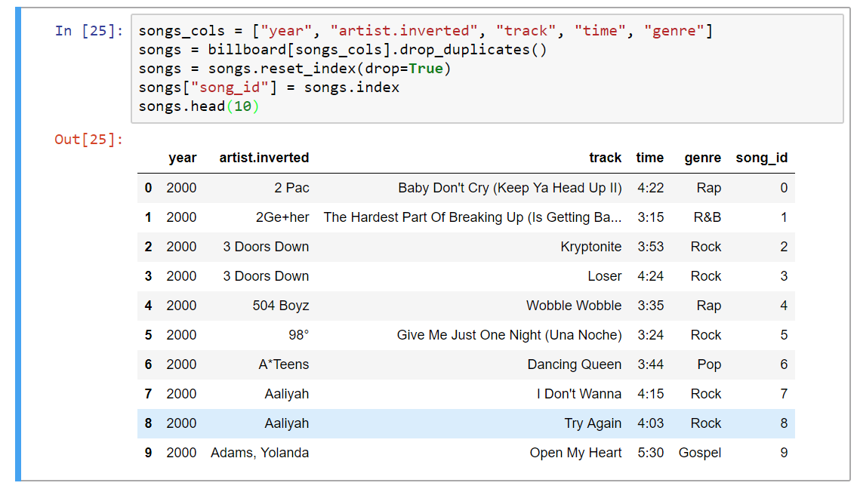
Assignment #8 Review
Why do this?

Slide 13
Assignment #8 Review
Why do this?
It adds a unique “key” for each record which is useful when “normalizing” a table.

Slide 14
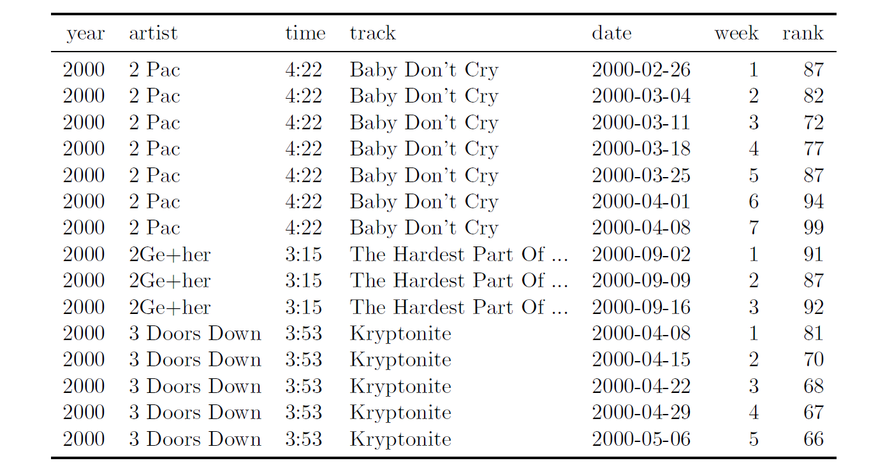
Assignment #8 Review
What is data normalization?
The dataset below meets the requirements of Tidy, expect that there is a lot of duplication.

Slide 15
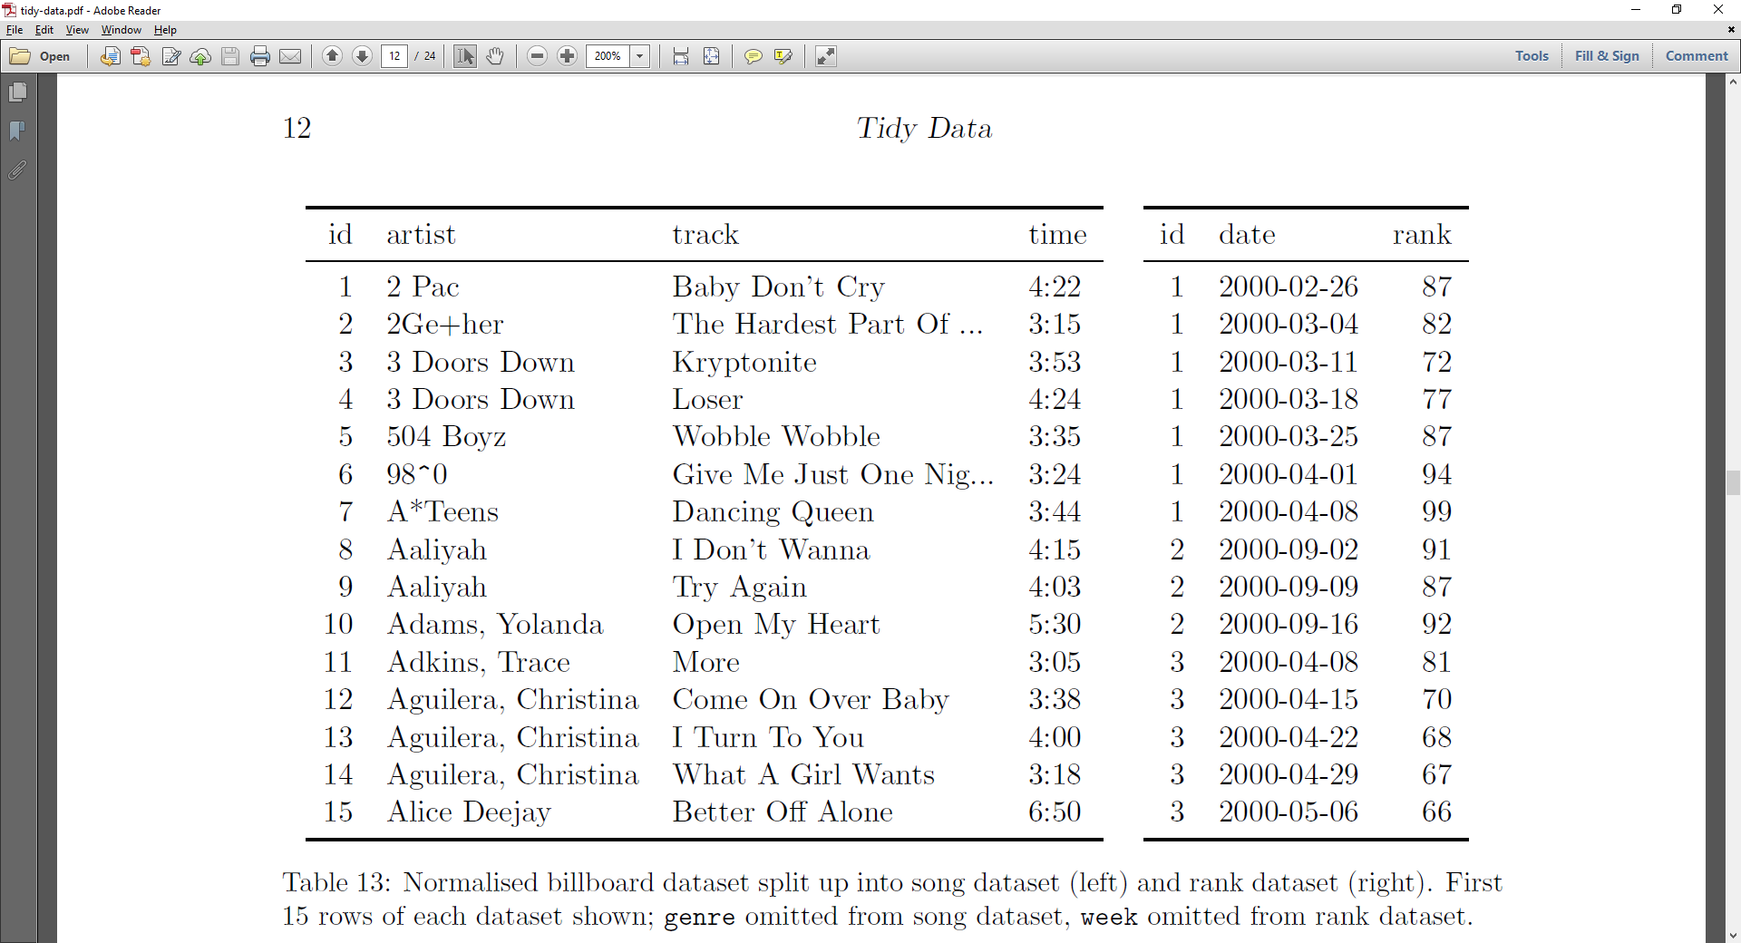
Assignment #8 Review
What is data normalization?
“breaking” into separate tables to remove duplicate data.

Slide 16
Assignment #8 Review
This line of code was used to break apart the text in the column containing sec and age in the Tuberculosis data.
tmp_df = df["sex_and_age"].str.extract("(\D)(\d+)(\d{2})", expand=False)
What does it do?

Slide 17
Assignment #8 Review
This line of code was used to break apart the text in the column containing sec and age in the Tuberculosis data.
tmp_df = df["sex_and_age"].str.extract("(\D)(\d+)(\d{2})", expand=False)
What does it do?
It uses regular expressions to break apart the string.
We will learn more about regular expressions in a few weeks!
If you didn’t understand it, that’s okay.

Slide 18
Assignment #8 Review
FYI: Mistake in Tidy Tutorial
df = df.sort(ascending=True,columns=["country", "year", "sex", "age"])
Newest updates to Pandas requires some changes.
df = df.sort_values(ascending=True,by=["country", "year", "sex", "age"])
Great figuring this out!

Slide 19
Class Exercises Data Overview
Download the PI_DataSet.txt file from this website:
https://hivdb.stanford.edu/pages/genopheno.dataset.html
Note: Choose the file labeled “10935 phenotype results from 1808 isolates”
Meaning of data columns:
SeqID: a numeric identifier for a unique HIV isolate protease sequence. Note: disruption of the protease inhibits HIV’s ability to reproduce.
First 8 columns are identifiers for unique protease inhibitor class drugs.
The values in these columns are the fold resistance over wild type (susceptible to all drugs).
Fold change is the ratio of the drug concentration needed to inhibit the isolate.
The latter columns, with P as a prefix, are the positions of the amino acids in the protease.
'-' indicates consensus.
'.' indicates no sequence.
'#' indicates an insertion.
'~' indicates a deletion;.
'*' indicates a stop codon
a letter indicates one letter Amino Acid substitution.
two and more amino acid codes indicates a mixture.
Notes:
https://www.monogrambio.com/hiv-tests/phenotype-assays/phenosense

Slide 20
Class Exercise #1: Discussion
How to Tidy this data
What are the variables?
What are the observations?
What are the values?
How many data frames are needed?
SeqID | FPV | ATV | IDV | LPV | NFV | SQV | TPV | DRV | P1 | P2 | P3 | P4 | P5 | P6 | P7 | P8 | P9 | P10 | P11
2996 | 2.5 | NaN | 16.3 | NaN | 38.6 | 16.1 | NaN | NaN | - | - | - | - | - | - | - | - | - | I | -
4387 | 0.7 | NaN | 0.8 | NaN | 0.8 | 1.1 | NaN | NaN | - | - | - | - | - | - | - | - | - | - | -
4426 | 3.0 | 32.0 | 35.0 | 32.0 | 29.0 | 164.0 | NaN | NaN | . | . | . | . | . | . | . | . | . | I | -
4432 | 1.5 | NaN | 1.0 | NaN | 2.2 | 1.1 | NaN | NaN | - | - | - | - | - | - | - | - | - | - | -
4482 | 3.9 | NaN | 20.2 | NaN | 21.6 | 9.2 | NaN | NaN | - | - | - | - | - | - | - | - | - | V | -

Slide 21
Class Exercise #1: Discussion
How to Tidy this data
What are the variables? 1) Drug, 2) Amino acid position
What are the observations? SeqID
What are the values? 1) Resistance fold-change, 2) Amino acid.
How many data frames are needed? Two: we have two types of values!
SeqID | FPV | ATV | IDV | LPV | NFV | SQV | TPV | DRV | P1 | P2 | P3 | P4 | P5 | P6 | P7 | P8 | P9 | P10 | P11
2996 | 2.5 | NaN | 16.3 | NaN | 38.6 | 16.1 | NaN | NaN | - | - | - | - | - | - | - | - | - | I | -
4387 | 0.7 | NaN | 0.8 | NaN | 0.8 | 1.1 | NaN | NaN | - | - | - | - | - | - | - | - | - | - | -
4426 | 3.0 | 32.0 | 35.0 | 32.0 | 29.0 | 164.0 | NaN | NaN | . | . | . | . | . | . | . | . | . | I | -
4432 | 1.5 | NaN | 1.0 | NaN | 2.2 | 1.1 | NaN | NaN | - | - | - | - | - | - | - | - | - | - | -
4482 | 3.9 | NaN | 20.2 | NaN | 21.6 | 9.2 | NaN | NaN | - | - | - | - | - | - | - | - | - | V | -

Slide 22
Class Exercise #2
Generate a data frame containing a Tidy’ed set of values for amino acid positions which meets the following:
Column names are ‘SeqID’, ‘AA_pos’ and ‘AA’ for the sequence ID, the amino acid position and the amino acid representation, respectively.
Order by sequence ID and then by amino acid position,
Reset the row indexes.

Slide 23
Class Exercise #2
Generate a data frame containing a Tidy’ed set of values for amino acid positions which meets the following:
Column names are ‘SeqID’, ‘AA_pos’ and ‘AA’ for the sequence ID, the amino acid position and the amino acid representation, respectively.
Order by sequence ID and then by amino acid position,
Reset the row indexes.
Solution:
aa_var = df.drop(['FPV', 'ATV', 'IDV', 'LPV', 'NFV' ,'SQV', 'TPV', 'DRV'], axis=1)
aa_var = pd.melt(aa_var, id_vars=['SeqID'],
var_name='AA_pos_raw', value_name='AA')
aa_var['AA_pos'] = aa_var['AA_pos_raw'].str.extract('(\d+)', expand=False).astype('int')
aa_var = aa_var[['SeqID', 'AA_pos', 'AA']]
aa_var = aa_var.sort_values(['SeqID', 'AA_pos'])
aa_var = aa_var.reset_index(drop=True)
aa_var.head()

Slide 24
Class Exercise #3
Generate a data frame containing a Tidy’ed set of values for drug concentration fold change
Column names are ‘SeqID’, ‘Drug’ and ‘Fold_change’ for the sequence ID, the drug name and it’s corresponding concentration fold change.
Ordered first by sequence ID and then by Drup name
Reset the row indexes

Slide 25
Class Exercise #3
Generate a data frame containing a Tidy’ed set of values for drug concentration fold change
Column names are ‘SeqID’, ‘Drug’ and ‘Fold_change’ for the sequence ID, the drug name and it’s corresponding concentration fold change.
Ordered first by sequence ID and then by Drup name
Reset the row indexes
Solution:
drug_fc = df[['SeqID', 'FPV', 'ATV', 'IDV', 'LPV', 'NFV', 'SQV' ,'TPV', 'DRV']]
drug_fc = pd.melt(drug_fc, id_vars=['SeqID'], var_name='Drug’, value_name ='Fold_change')
drug_fc = drug_fc.sort_values(['SeqID', 'Drug'])
drug_fc = drug_fc.reset_index(drop=True)
drug_fc.head()

Slide 26
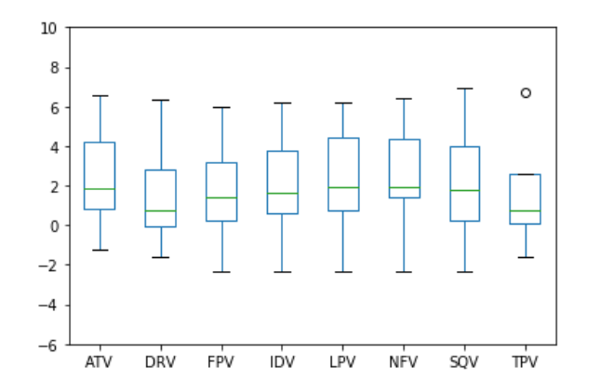
Class Exercise #4
Using the drug fold change data frame perform the following:
Log transform the fold change
Generate box plots indicating the distribution of fold changes for each drug
One box plot for each drug,
All in the same plot
Set the y limits to -6 to 10.

Slide 27
Class Exercise #4
Using the drug fold change data frame perform the following:
Log transform the fold change
Generate box plots indicating the distribution of fold changes for each drug
One box plot for each drug,
All in the same plot
Set the y limits to -6 to 10.
Solution:
drug_fc['log_fc'] = np.log(drug_fc['Fold_change'])
drug_fc_grp = drug_fc[['Drug', 'log_fc']].groupby('Drug')
drug_fc_grp.describe().transpose().plot(kind='box', ylim=(-6,10))

Slide 28
Assignment #9 Overview
Introduction to Matplotlib and Bokeh – Pandas data visualization.
Due Monday, 9am Mar 5th.

